Slide 1
Gradient Boosting: Hyperparameters and Generalization

Slide 2
Hyperparameter Tuning
The hyperparameters for gradient-boosted trees are:
Number of trees to boost
Tree depth
Learning rate
The process is repeated for different numbers of boosted trees and tree depths 1, 2, 3, etc.
The predictions from these different hyperparameters are compared to the actual observations in the validation sample.
The model that performs the best in terms of percent correct classification (PCC) is selected.

Slide 3
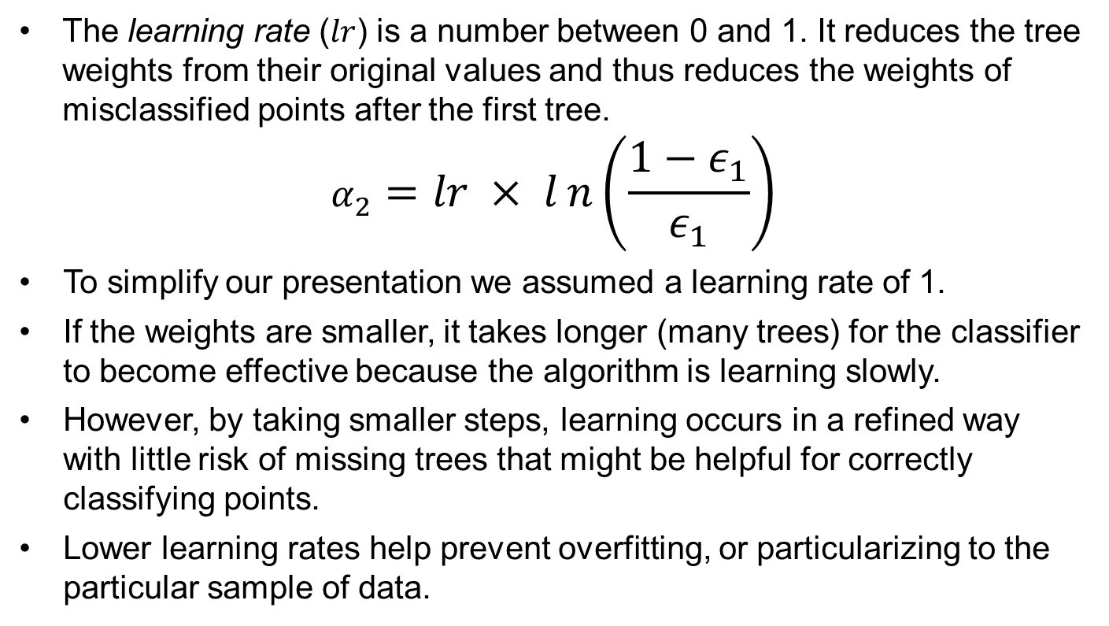
Learning Rate
The learning rate ($lr$) is a number between 0 and 1. It reduces the tree weights from their original values and thus reduces the weights of misclassified points after the first tree.
$$α_{2}=lr × ln\left(\frac{1−ε_{1}}{ε_{1}}\right)$$
To simplify our presentation we assumed a learning rate of 1.
If the weights are smaller, it takes longer (many trees) for the classifier to become effective because the algorithm is learning slowly.
However, by taking smaller steps, learning occurs in a refined way with little risk of missing trees that might be helpful for correctly classifying points.
Lower learning rates help prevent overfitting, or particularizing to the particular sample of data.

Slide 4
Stumps: Weak Learners
In our example we worked through 20 trees, but Boosted Trees of depth 1 (called stumps) often run through hundreds of trees.
These models use many trees because no individual tree is a good classifier.
By limiting each tree to a depth of 1, we are only using a fraction of the power of decision trees (compared to what we did in session 3). But using trees of greater depth risks overfitting to the sample data. Unlike random forests, boosting builds on previous models so if a tree overfits to particular data, it has no opportunity to recover.
Individually, these stumps are weak learners, but collectively they can be very powerful.

