Slide 1
Exploratory Data Analysis (EDA)

Slide 2
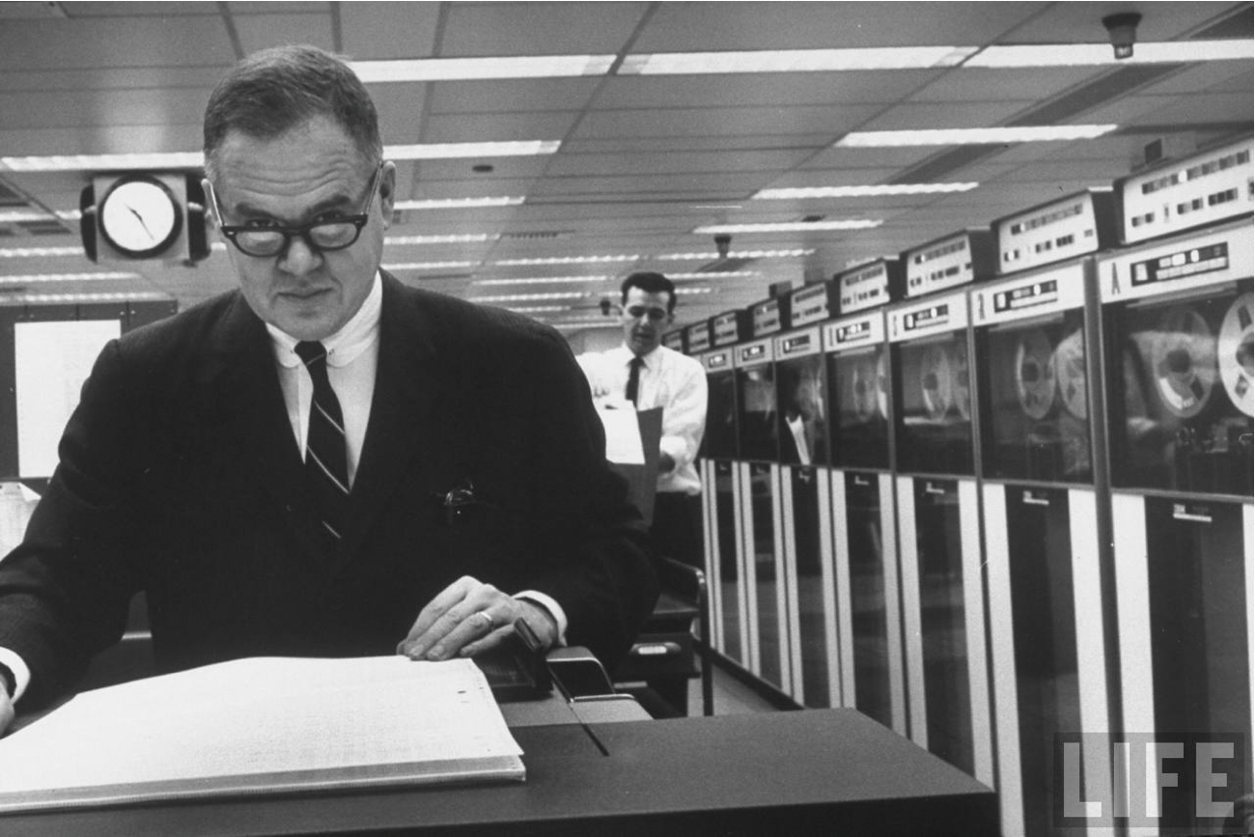
Header
Exposure, the effective laying open of the data to display the unanticipated, is to us a major portion of data analysis…
John Tukey, The Future of Data Analysis, 1962

Slide 3
What is EDA?
A philosophy for data analysis that employs a variety of techniques, mostly graphical, to:
Maximize insight into a data set
Uncover underlying structure
Extract important variables
Detect outliers and anomalies
Test underlying assumptions
http://www.itl.nist.gov/div898/handbook/eda/eda.htm

Slide 4
Exploratory Data Analysis
Ask questions
Construct visualizations to address questions
Inspect “answers” and assess new questions
Repeat…

Slide 5
Anscombe’s Quartet
Anscombe’s Quartet: Raw Data
 | I |  | II |  | III |  | IV
 | X | Y | X | Y | X | Y | X | Y
 | 10.0 | 8.04 | 10.0 | 9.14 | 10.0 | 7.46 | 8.0 | 6.58
 | 8.0 | 6.95 | 8.0 | 8.14 | 8.0 | 6.77 | 8.0 | 5.76
 | 13.0 | 7.58 | 13.0 | 8.74 | 13.0 | 12.74 | 8.0 | 7.71
 | 9.0 | 8.81 | 9.0 | 8.77 | 9.0 | 7.11 | 8.0 | 8.84
 | 11.0 | 8.33 | 11.0 | 9.26 | 11.0 | 7.81 | 8.0 | 8.47
 | 14.0 | 9.96 | 14.0 | 8.10 | 14.0 | 8.84 | 8.0 | 7.04
 | 6.0 | 7.24 | 6.0 | 6.13 | 6.0 | 6.08 | 8.0 | 5.25
 | 4.0 | 4.26 | 4.0 | 3.10 | 4.0 | 5.39 | 19.0 | 12.50
 | 12.0 | 10.84 | 12.0 | 9.13 | 12.0 | 8.15 | 8.0 | 5.56
 | 7.0 | 4.82 | 7.0 | 7.26 | 7.0 | 6.42 | 8.0 | 7.91
 | 5.0 | 5.68 | 5.0 | 4.74 | 5.0 | 5.73 | 8.0 | 6.89
mean | 9.0 | 7.5 | 9.0 | 7.5 | 9.0 | 7.5 | 9.0 | 7.5
Var. | 10.0 | 3.75 | 10.0 | 3.75 | 10.0 | 3.75 | 10.0 | 3.75
corr. | 0.816 |  | 0.816 |  | 0.816 |  | 0.816
EXERCISE
Anscombe 1973

Slide 6
Anscombe’s Quartet
12
12
10
10
y1
8
y2
8
6
6
4
4
4
6
8
10
12
14
16
18
4
6
8
10
12
14
16
18
x1
x2
12
12
10
10
y3
8
y4
8
6
6
4
4
4
6
8
10
12
14
16
18
4
6
8
10
12
14
16
18
x3
x4
Anscombe 1973

Slide 7
Same Stats, Different Graphs
Professor is referencing the following animation: Autodesk Research
Clearly different and visually distinct datasets with same statistical properties
[Matejka & Fitzmaurice 2017]
https://www.autodeskresearch.com/publications/samestats

Slide 8
Header
The greatest value of a picture is when it forces us to notice what we never expected to see.
John Tukey, Exploratory Data Analysis, 1977

