Slide 1
Introduction to Data Science
Week 1

Slide 2
Four V’s of Data
Volume Data in rest
Velocity Data in motion
Variety Data in many form
Veracity Data in doubt
Tera- to Exabytes to process
Sensor and social data
New data stores
Streaming data
(Milli) seconds to minutes to respond
Structured and unstructured data
Text, numbers and multimedia
Uncertainty due to data inconsistency and incompleteness, ambiguity, latency deception and model approximations

Slide 3
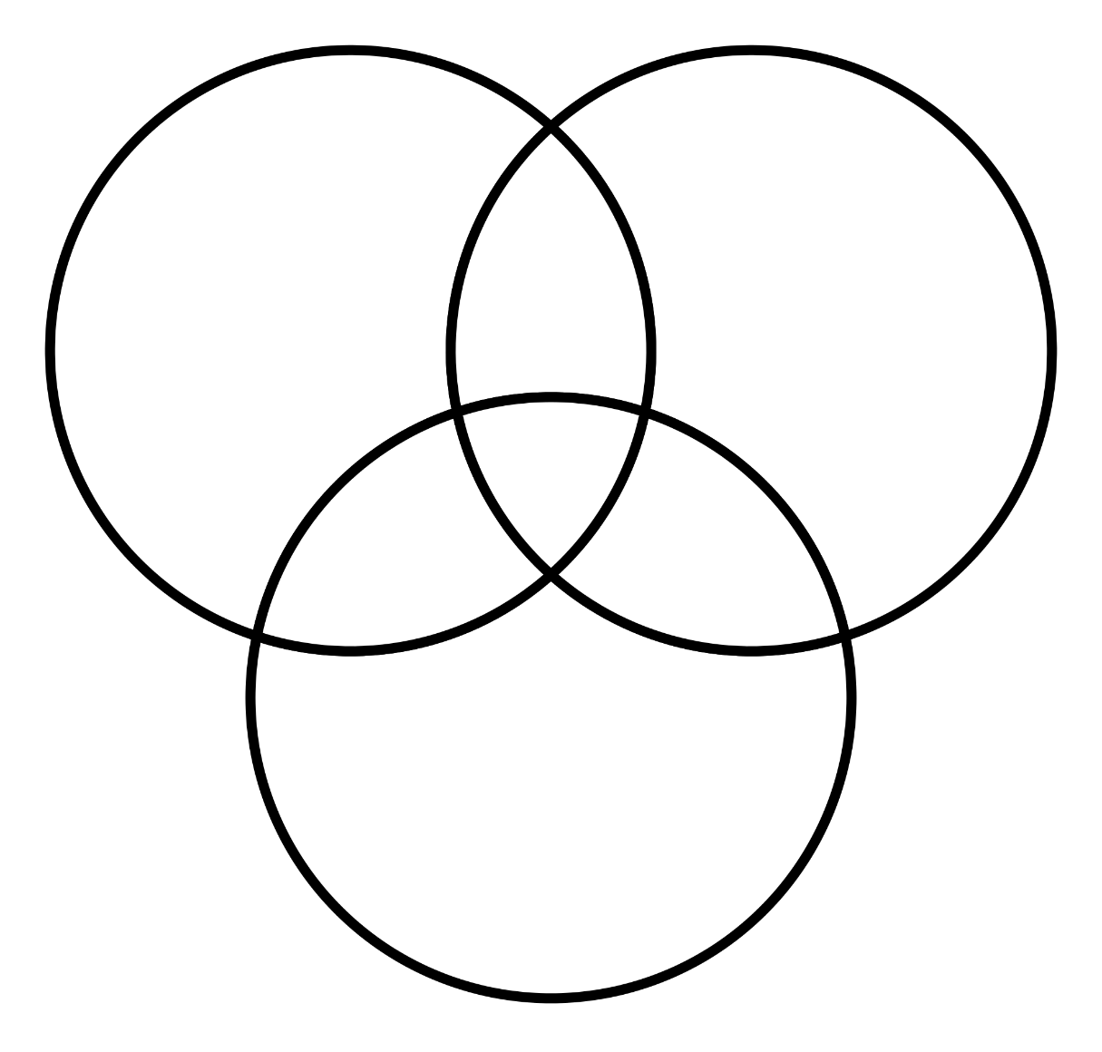
Skills Required
Math &
Stats
Knowledge,
Reasoning/
Inference
“Techniques”
Clustering
Regression
Decision trees
Sentiment analysis
On Data
Acquiring
Cleaning
Augmenting
Comp. Sci
& Data
Skills
Substantive
Expertise
Industry & Organization Knowledge
Adapted from Drew Conway’s “Data Science Venn Diagram,” http://drewconway.com/zia/2013/3/26/the-data-science-venn-diagram, accessed August, 2017.

