Slide 1
Introduction to Data Science, Part 2

Slide 2
Example 2
Commanders’ Strategy:
Put armor where the bullet holes were.
US Army Statistician Abraham Wald:
Put the armor where the bullets were not.
Wald showed that it was odds-on that those missing aircraft had holes in very different places, on average, than the surviving aircraft. Illustration of Survivorship Bias.
Image source: SKETCH BY WALD. IN “VISUAL REVELATIONS” BY HOWARD WAINER. LAWRENCE ERLBAUM AND ASSOCIATES, 1997.

Slide 3

Example 3

Slide 4
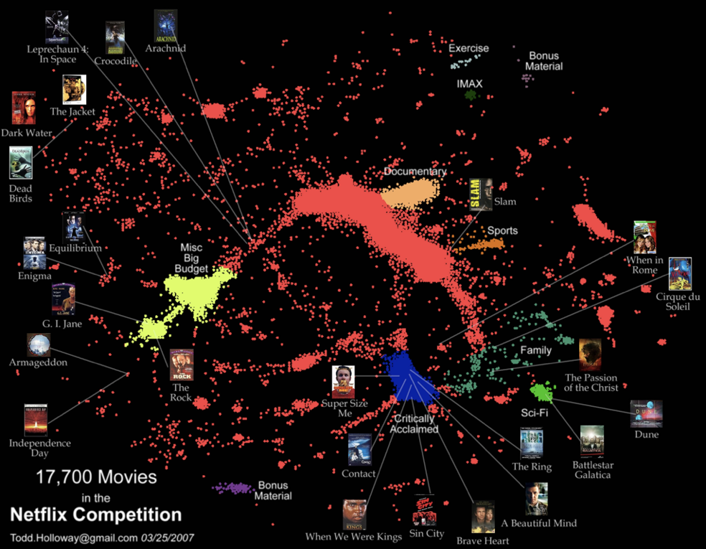

Slide 5
Netflix Prize Progress
0.95
RMS Error on
0.90
8.43%
9.44%
10.09%
0.85
Cinematch
2007 Progress prize
2008 Progress prize
2009 Grand prize
HBR, Oct 2012

Slide 6

3 Years Later…
techblog.netflix.com/2012/04/netflix-recommendations-beyond-5-stars.html

