Slide 1
Collecting Data

Slide 2
Data Sources
Internal sources
Spreadsheets
Databases
Data warehouse (sales, marketing, etc.)
External sources
Public data repositories
E.g., Data.gov, data.world, SEC.gov, Kaggle, etc.
API (Application Programming Interface)
E.g., Google Map API, Twitter API, Facebook API, etc.
RSS (Rich Site Summary)
E.g., News and blogs
Web scraping

Slide 3
Typical Data Formats
Delimited values
Comma Separated Values (CSV)
Tab Separated Values (TSV)
Markup languages
Hypertext Markup Language (HTML5 / XML)
JavaScript Object Notation (JSON)
Hierarchical Data Format (HDF5)
Ad hoc formats
Graph edge lists, voting records, fixed width files, ...

Slide 4
Why Web Scraping?
You want to collect positive and negative reviews for your product, so that customer care can respond on negative reviews. Scrape a dataset of reviews and train a model to do so.
You want to track the prices of products. Write a program that automatically scrapes prices of products every day for 2 months.

Slide 5
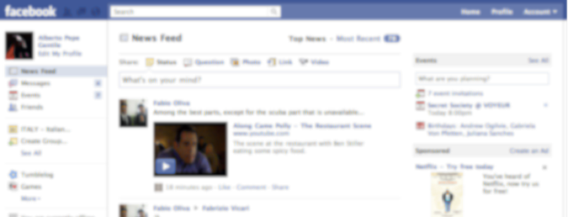
What data is OK to scrape?
Public, non-sensitive, anonymized, fully referenced information (cite sources)
Always check robots.txt first

Slide 6
Python Scraping Packages
Python 3
Python requests
http://docs.python-requests.org/en/master/
Opens web pages
Beautifulsoup 4
https://www.crummy.com/software/BeautifulSoup/bs4/doc/
Search and extract content from a web page

