Slide 1

SMART INDIA HACKATHON 2026
TITLE PAGE
Problem Statement ID – SIH26044
Problem Statement Title – Portal for Academia - Industry collaboration for Skill Mapping, Internships and Placement
Theme - Smart Automation
PS Category - Software
Team ID -
Team Name – Code Hunters

Slide 2
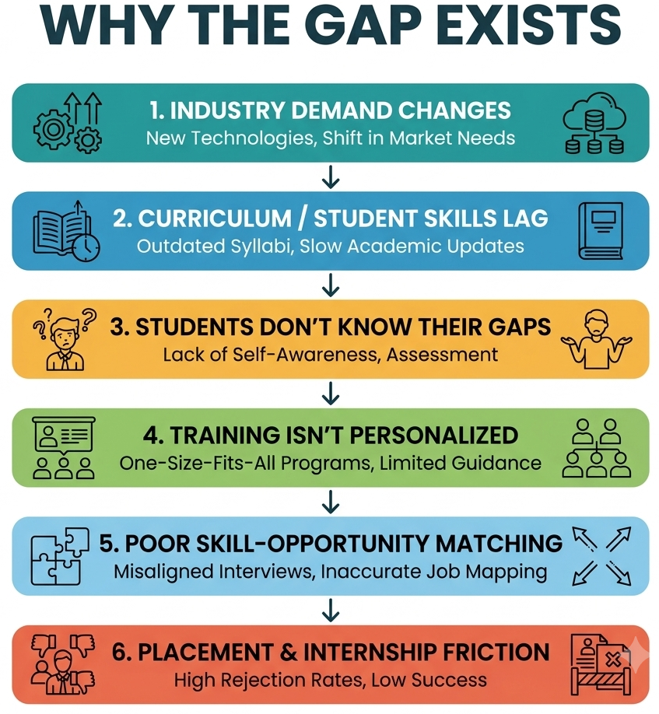
SKILLS SETU -An Intelligent Skill-Profiling and Opportunity Matching Ecosystem
Code
Hunters
OUR IDEA:
PROBLEM :
Skill Setu is an AI-driven platform that bridges the gap between student skills and evolving industry requirements. It continuously identifies skill gaps, recommends personalized learning pathways, and matches upskilled students with relevant internships and job opportunities. It also enables institutions and industries to track skill readiness, talent requirements, and placement outcomes through intelligent analytics.
Students | Academicians | Industry
Don't know which skills they lack | Limited industry visibility | Hard to find skill-fit candidates
Generic career guidance | Limited practical exposure | Skill mismatch
Scattered internships/jobs | Difficult collaboration | Inefficient screening
No verified skill identity | Limited feedback from industry | Training needs unclear
No unified system continuously maps academic talent to evolving industry skill requirements.
INNOVATION/UNIQUENESS:
PROPOSED SOLUTION:
Role-Specific Assessment – Checks skills required for the selected job.
Smart Skill-Gap Detection - Identifies exactly what the student is missing.
Personalized Learning – Recommends resources to close the skill gaps.
Learn → Reassess → Apply – Students improve and recheck their readiness.
Skill-Based Matching – Connects job-ready students with suitable opportunities.
AI-powered continuous skill-gap analysis maps student capabilities against evolving industry requirements and identifies missing competencies.
Personalized learning pathways recommend targeted courses, certifications, and projects to help students become career-ready.
Intelligent skill-based matching connects upskilled students with relevant internships and job opportunities based on compatibility and eligibility.
Unified industry–academia ecosystem enables institutions and companies to track skill readiness, collaborate on training, and build a stronger talent pipeline.

Slide 3
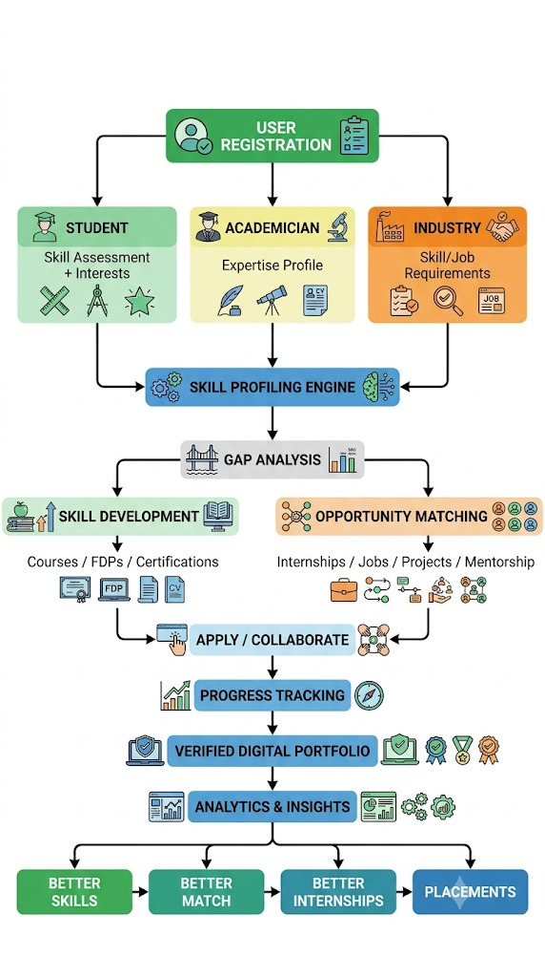

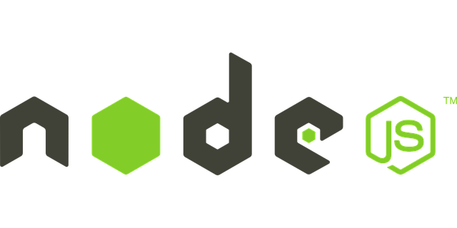


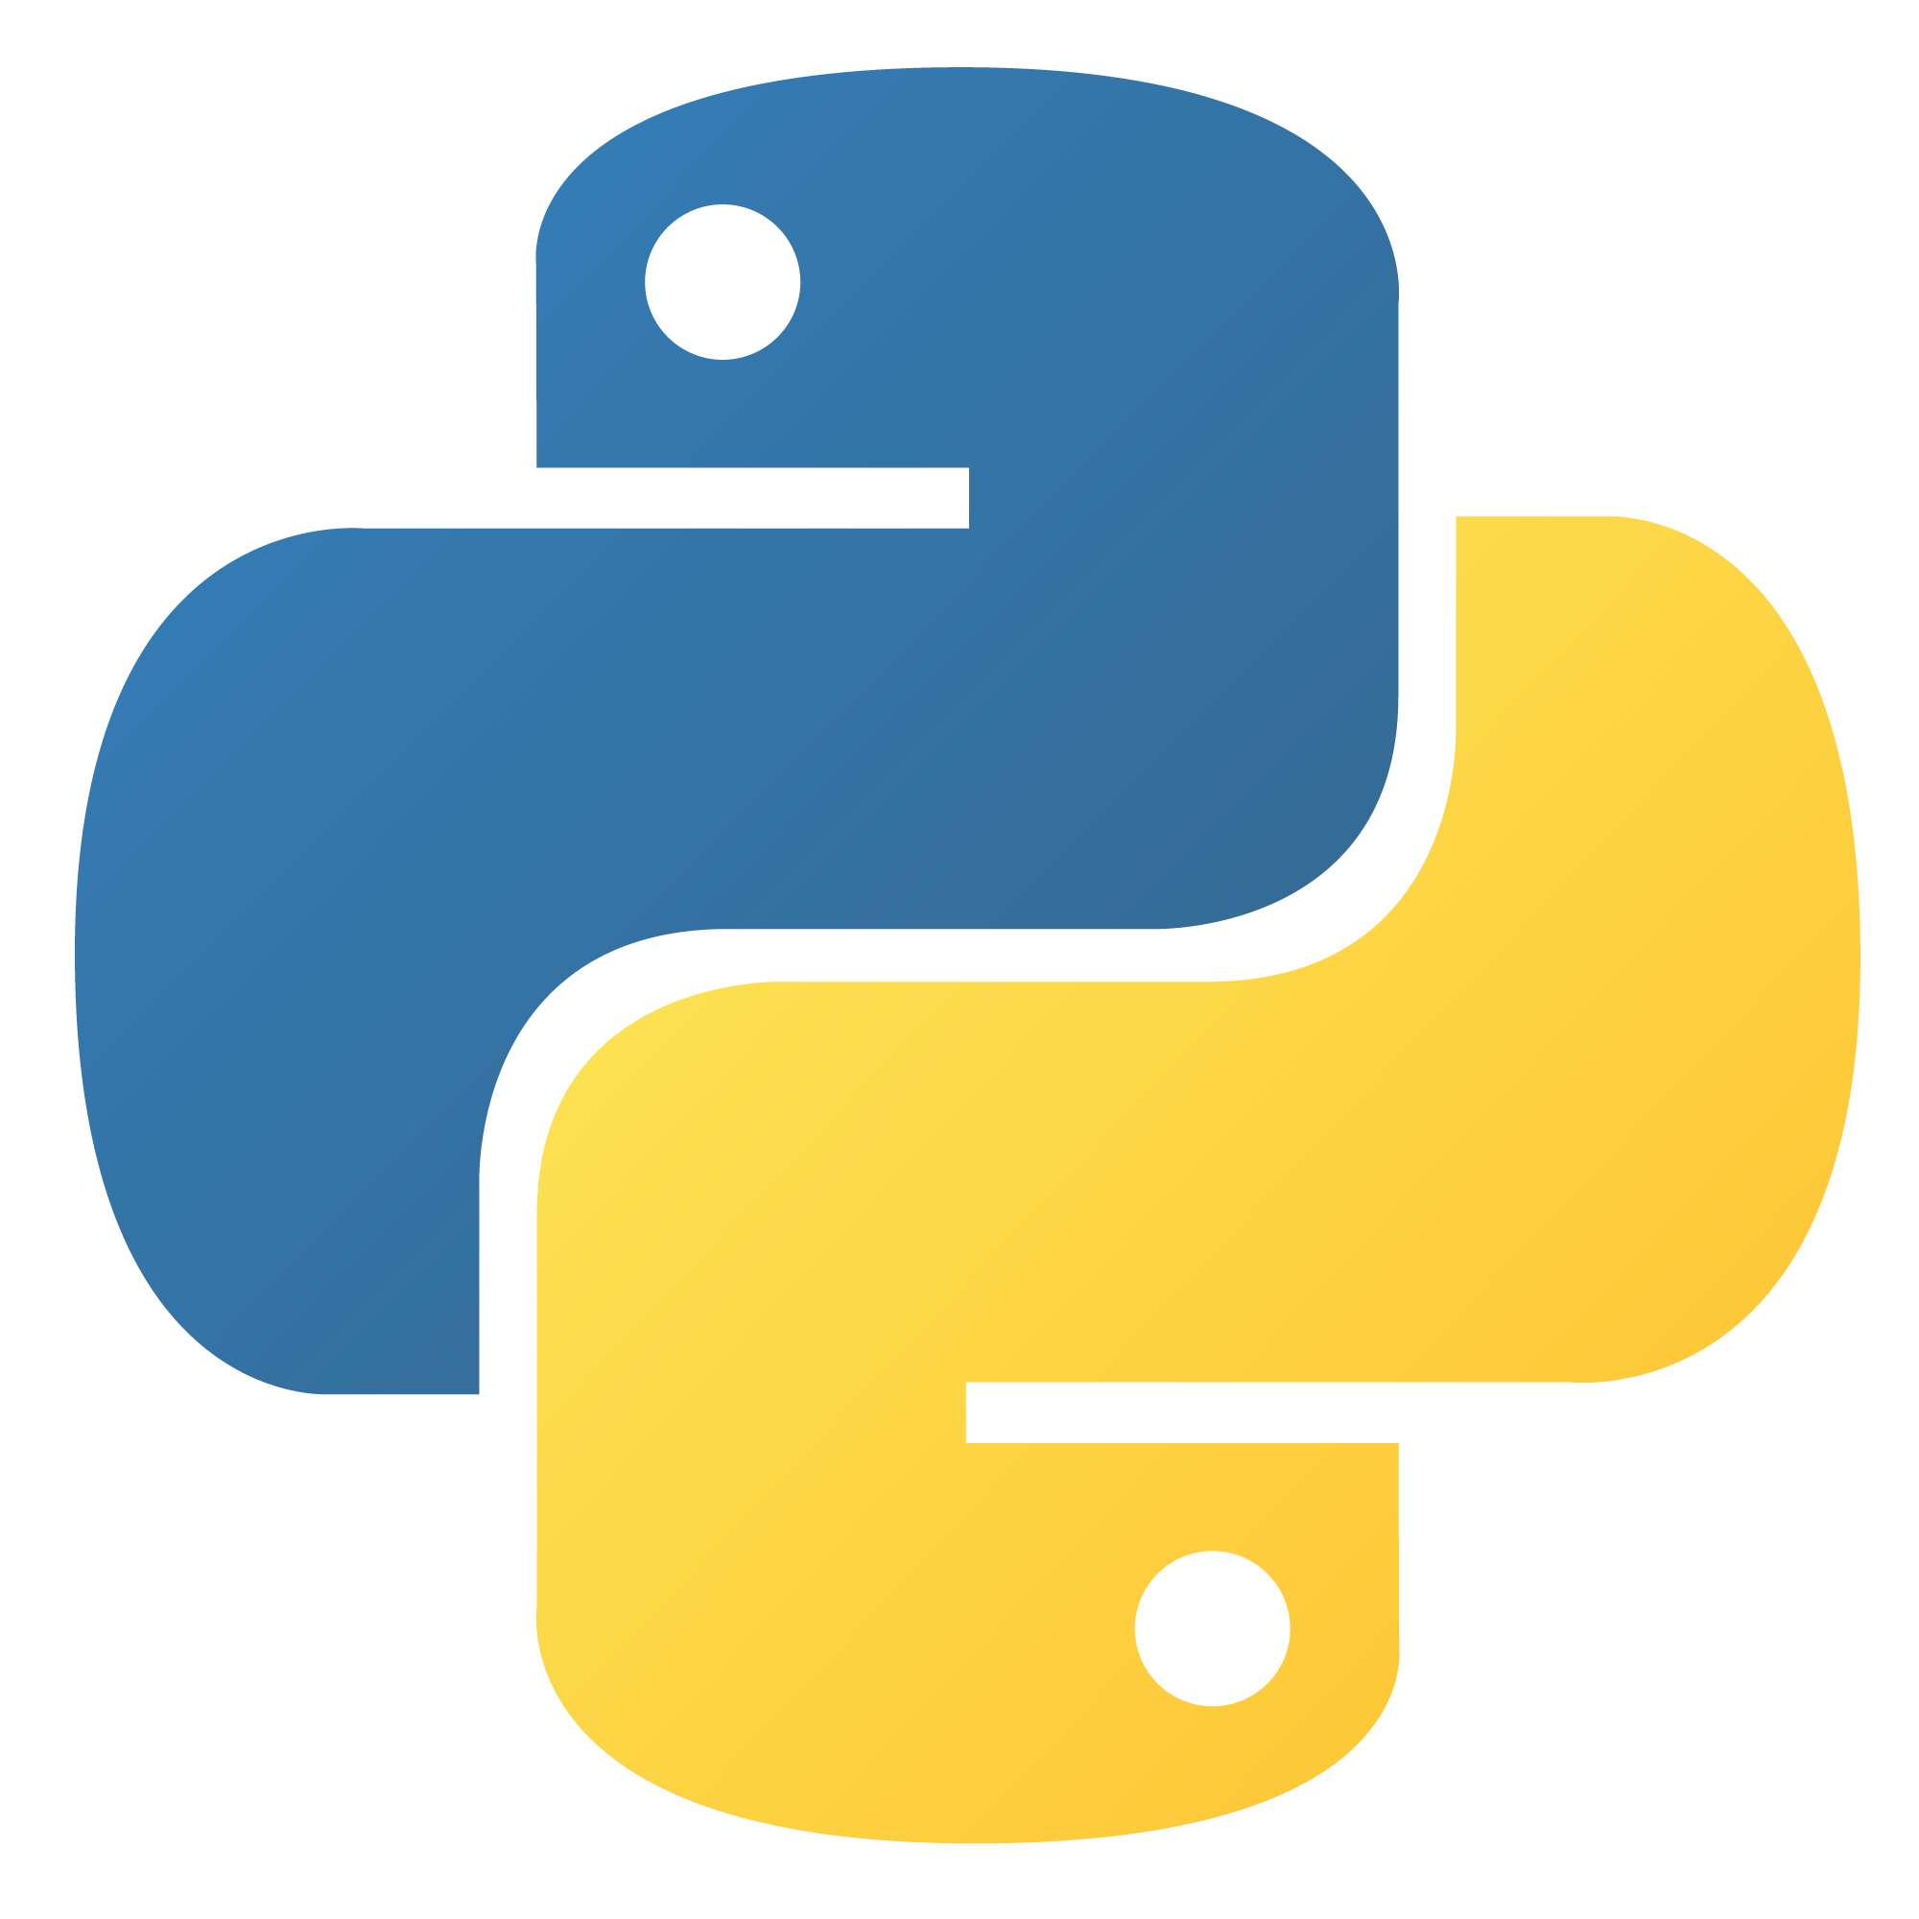

TECHNICAL APPROACH
Code
Hunters
Methodology :
WorkFlow & Process :
Onboarding & Assessment: Role-based profiling (Student, Academia, Industry) and initial skill/requirement mapping.
2. AI Gap Analysis: Benchmarking user competencies against current industry demands to identify specific skill gaps.
3. Targeted Upskilling: Recommending personalized courses, FDPs, and mentorships to bridge identified gaps.
4. Smart Matching & Collaboration: Algorithm-driven pairing for jobs, internships, and industry-academia projects.
5. Analytics & Verification: Tracking real-time progress and building verified digital portfolios to ensure placement readiness.
TECH STACK
Frontend
Backend
AI (models)
Database
Cloud
Security
React.js/ Tailwind css
Node.js/
Express
Python, NLP, Scikit-learn
MongoDB/
PostgreSQL
Azure/
GoogleCloud
JWT/ OAuth/SSO

Slide 4
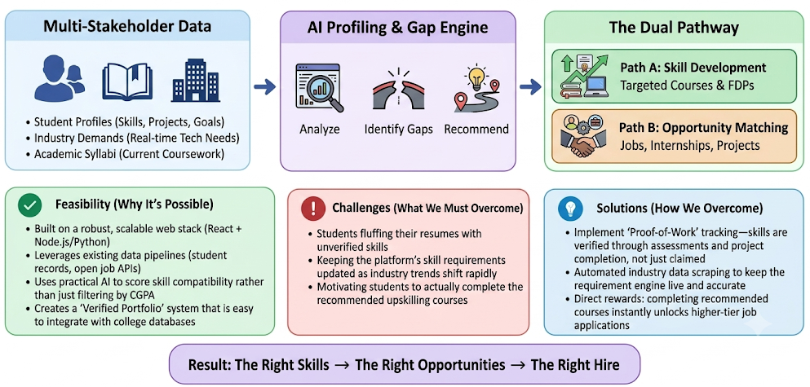
FEASIBILITY AND VIABILITY
Code
Hunters

Slide 5
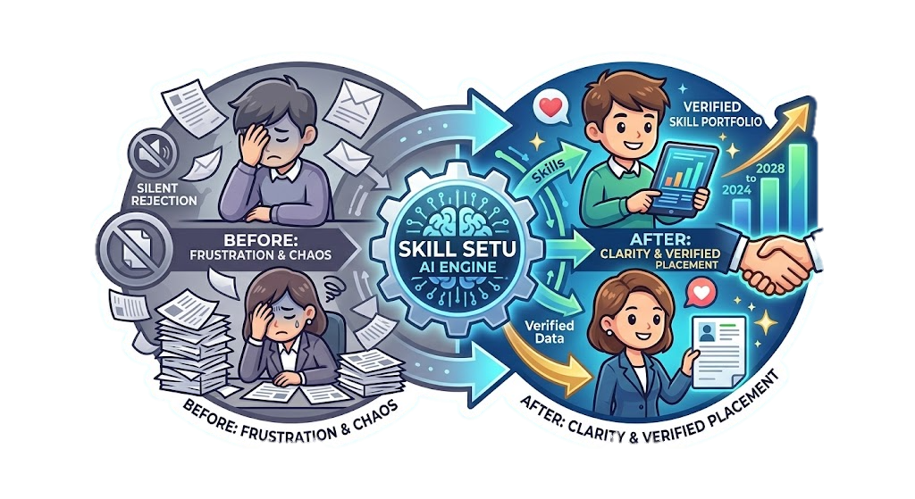
IMPACT AND BENEFITS
Code
Hunters
Intelligent Career Impact
Role-Based Intelligence: Every opportunity creates a personalized readiness analysis.
Dynamic Recommendations: Learning suggestions change according to the student's target role.
Continuous Skill Evolution: Student profiles evolve as they learn, certify, build projects, and gain experience.
Evidence-Based Profile: Skills can be supported through assessments, certifications, projects, and internships.
Direct Impact on Target Users :
Student-Level Impact
Know Before You Apply: Students see their readiness for the specific role instead of blindly applying.
Actionable Skill Gaps: Identifies exactly which required skills are missing or weak.
Personalized Upskilling: Recommends resources specifically for those gaps.
Higher Readiness: Students can learn → reassess → apply with improved confidence.
WHAT STUDENTS ACTUALLY CARE ABOUT
SKILL SETU
LinkedIn
Naukri
Coursera
Internshala
Students + faculty + institutions + industry
Who is it really for?
Mostly professionals
Mostly job seekers
Learners
Primarily students
Internships, jobs, projects, mentorship & research
Industry & Institutional Impact
Better Skill–Job Fit: Recruiters discover candidates based on role-relevant skills.
Targeted Training: Colleges can identify common skill gaps and address them before placement season.
Reduced Blind Applications: Students are guided toward opportunities aligned with their current readiness.
Stronger Academia–Industry Alignment: Industry requirements directly influence student development.
Jobs + some learning
Jobs
Courses + certificates
Internships
What can you find?
Verified by institutions + industry partners
Can I trust the profile?
User-created profiles/posts
Mostly self-posted
Verified certificates
Mixed quality
Does it connect campus + industry?
Yes — collaboration, training & projects
Limited
Indirect
Learning-focused
Limited
How smart is the matching?
AI + skill-based + role-specific
Basic/generalized
Generic job matching
General listings
Assess → Learn → Reassess → Apply
Interest-based
Is there one career journey?
No integrated journey
Learning history
No integrated profile
Built around India’s education ecosystem?
Partial profile
Yes
Not specifically
Not specifically
Not specifically
Not specifically
From “Why was I rejected?” to “Here’s exactly what I need to improve.”
Assess → Role Match → Find Gap → Learn → Reassess → Apply

Slide 6
RESEARCH AND REFERENCES
Code
Hunters
Research Papers :
Government Internship and learning portals:
World Economic Forum — Future of Jobs Report 2025 — Global evidence on changing skill requirements, employer skill gaps, and the need for upskilling. WEF Report
NITI Aayog — Reimagining Skilling for Viksit Bharat@2047 (2026) — India-focused research on skill development, employability, and future-readiness. NITI Aayog Report
Understanding and Measuring Skill Gaps in Industry 4.0 — Technology Forecasting & Social Change (2024) — Systematic review of approaches for identifying and measuring skill gaps across stakeholders. Research Paper
A Survey on Artificial Intelligence Based Job Recommendation Systems — IEEE (2023) — Research on AI-based job matching using skills, experience, preferences, machine learning, and knowledge graphs. Research Paper
NITI Aayog — Revitalizing India’s Apprenticeship Ecosystem (2026) — Supports the importance of apprenticeships and stronger connections between skills development and employment. NITI Aayog Apprenticeship Report
Global Employability Skills in the 21st Century Workplace — Heliyon (2023) — Literature review identifying commonly demanded employability skills and the mismatch between employer expectations and graduate skills. Research Paper
National Career Service (NCS) – Ministry of Labour & Employment – ncs.gov.in
AICTE National Internship Portal – Ministry of Education – internship.aicte-india.org
UGC Guidelines for Internship/Research Internship – ugc.gov.in
UGC Apprenticeship/Internship Embedded Degree Programme – ugc.gov.in
National Education Policy (NEP) 2020 – moe.gov.in
National Skills Qualification Framework (NSQF) – skillindia.gov.in
AICTE Internship Policy & Guidelines – aicte-india.org
Ministry of Skill Development & Entrepreneurship (MSDE) – skillindia.gov.in

