Slide 1
Self Service by Team 12
Authors: Zixiang Jin, Ashley Nnawugo, Thomas Murphy, Shuxiang Hu, Zihui Xu, Callum Davies

Slide 2
Our Team
Callum Davies
Thomas Murphy
Ashley Nnawugo
Zihui Xu
Shuxiang Hu
Zixiang Jin

Slide 3
User Analysis and Product analysis
User Analysis
User Profile – Employees of Browne Jacobson; professional; travel often
User Needs – Book travel; book hotels; plan routes; find parking
Product Analysis
Similar products – TripIt, Hopper, Business Travel Planner
Challenges – Cross platform development, Clean UI/UX design, Real time updates

Slide 4
Approach
Technology - Flutter(UI Toolkit), Dart (Programming language)
API's: Provided by Browne Jacobson
Prototyping: Proto.io, Adobe XD, FluidUI

Slide 5
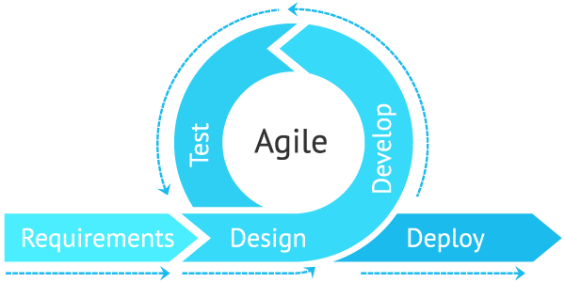
Management
Methodology: Agile Development
Project Completion Estimate: 21 - 23 weeks
Timeline
Stage One – Requirements Gathering and Skill Development (4 weeks)
Stage Two – Specification & Prototyping (4 weeks)
Stage Three – Development & Testing (10 - 12 weeks)
Stage Four – Deployment and Debugging (3 weeks)

Slide 6
Final Words...
Thank you for listening to our pitch!

