Slide 1

METBOX: Webtool for Molecular Compounds (Metabolites)
Esraa Gabal & Julie Fazekas
Purdue University, Indiana
Baylor University, Texas

Slide 2
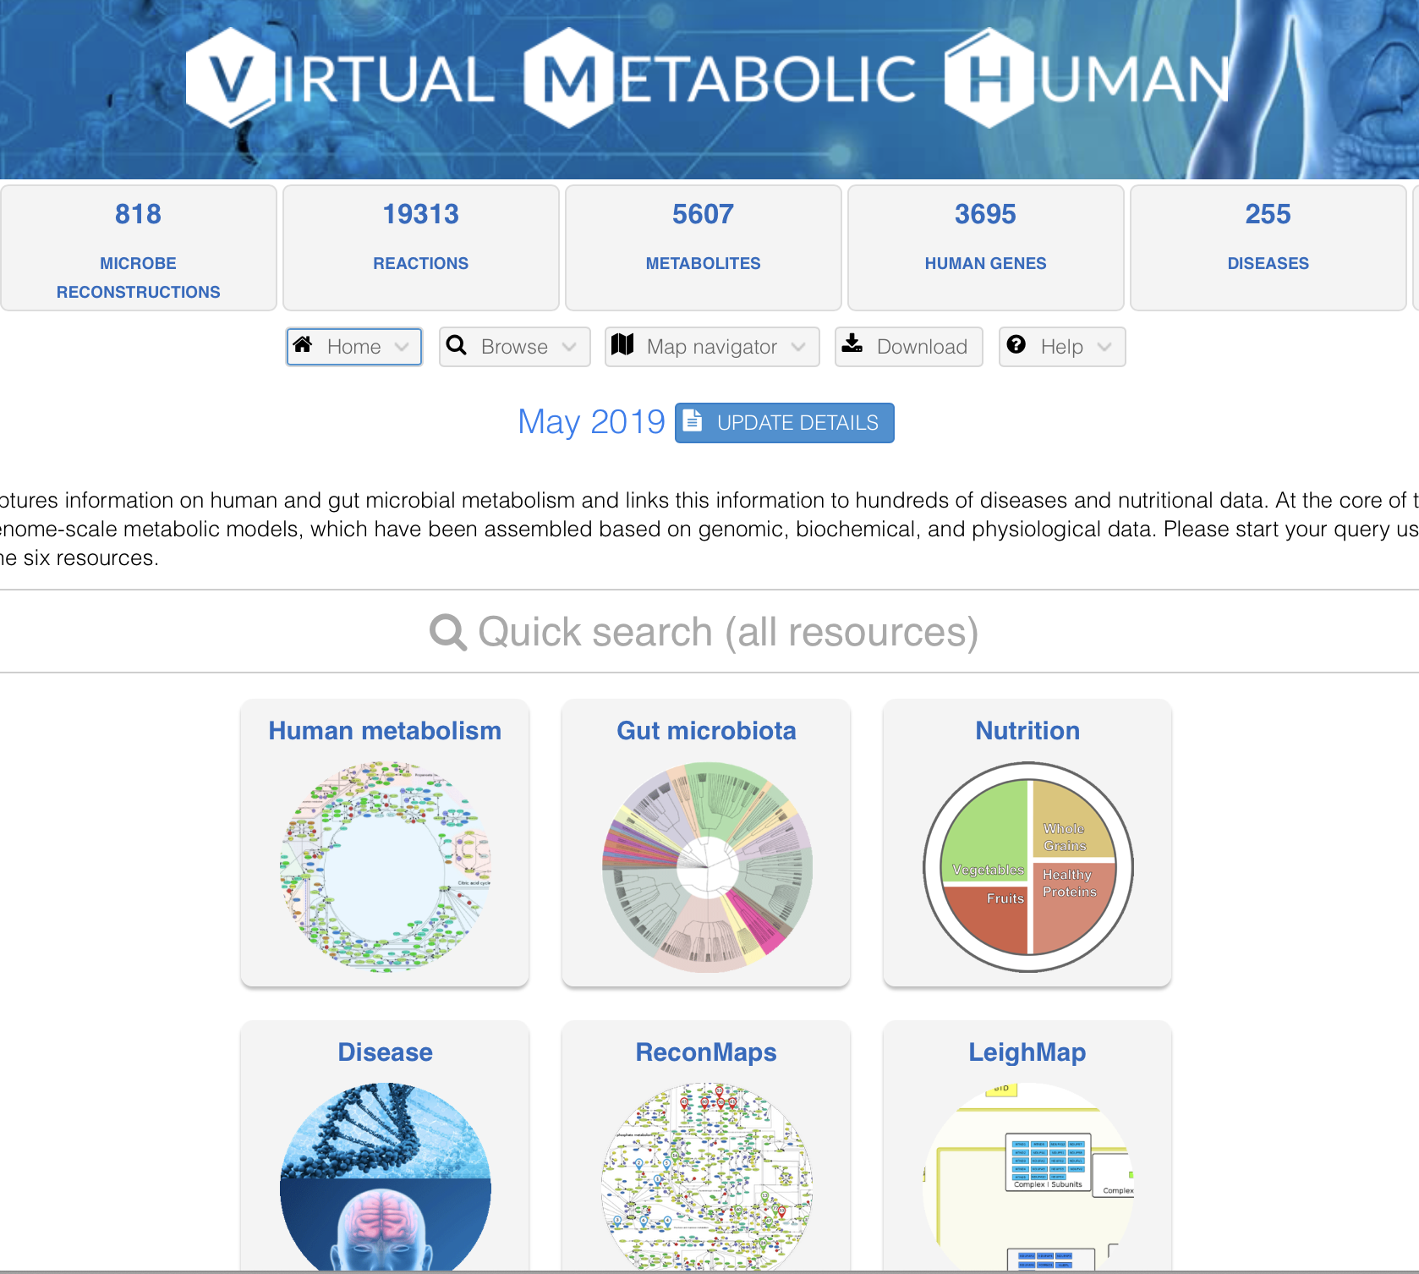
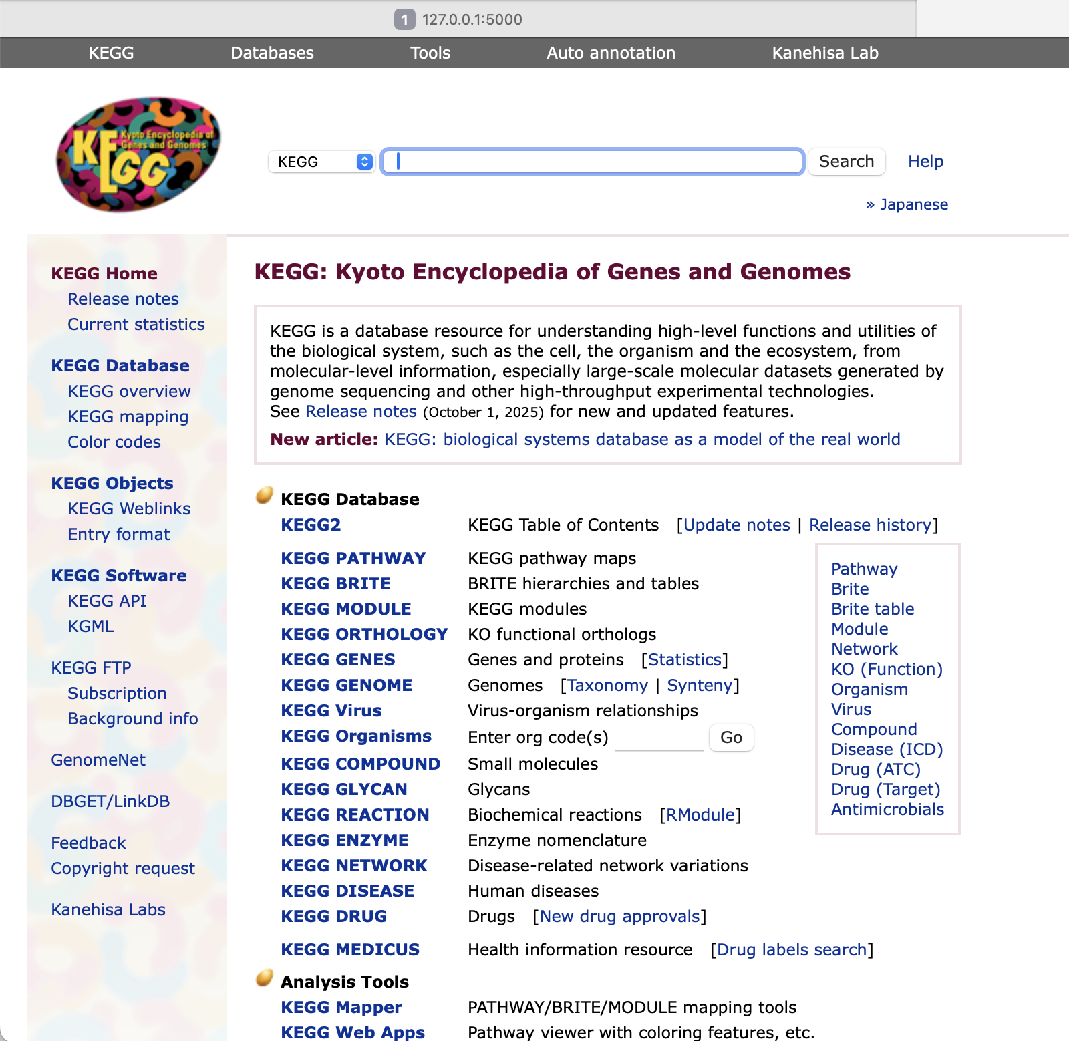
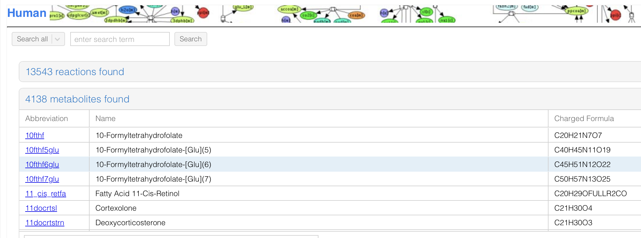

Slide 3
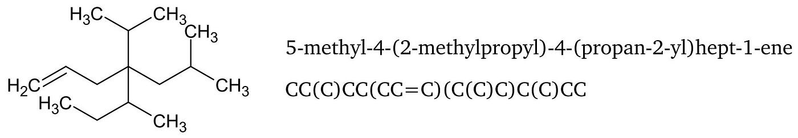
SMILE
Smile2png, GitHub
Extracting info from VMH
METBOX
KEGG
Cpd: C00004
KEGG-pull, GitHub
Biological Pathway
KEGGRESTpy, GitHub

Slide 4


Slide 5
Future Directions
Include more microbial species
Adding more metabolite information
Formatting the website to have search engine
Any further suggestions are welcome

