Slide 1
Parallel decomposition strategies in modern gpu
Sean Baxter, NVIDIA Research

Slide 2
Companion source
sbaxter@nvidia.com
Modern GPU
Text: www.moderngpu.com
CUDA source: https://github.com/NVlabs/moderngpu
GTC Talk
Companion source: https://github.com/seanbaxter/gtc_2014
Boot it up now to follow along.

Slide 3
Goal: Load balance Join
Relational join.
Accepts two sorted inputs.
Inner, left, right, outer join semantics.
Support duplicates.
Output amplification from outer product of matching keys.
Load balancing.
Don’t map fixed inputs to tile.
Outputs might not fit in on-chip memory.
Don’t map fixed outputs to tile.
Inputs might not fit in on-chip memory.
Uniform work assignment?

Slide 4

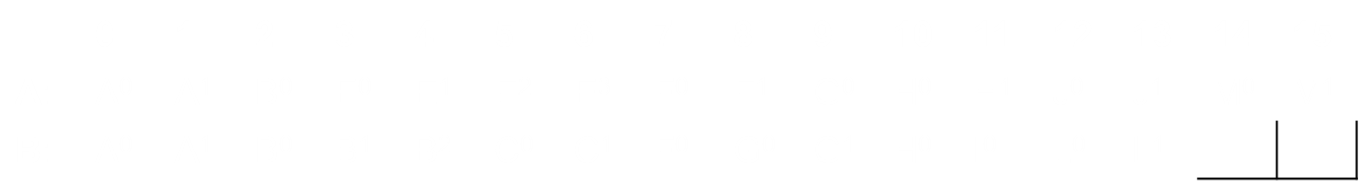
Load balancing join
Output is highly data-dependent.
Find solution that’s:
Deterministic
Vectorizable
Streaming

Slide 5
Parallel Data Decomposition
Examine 1D streaming algorithms.
Reduce, scan, merge, sort, sets, join.
Two-phase decomposition:
Parallel partitioning
Sequential logic
Limit communication to threads within CTA.
Complex tasks require multiple passes.
Keep each pass fast.
Stream through data to utilize high DRAM bandwidth.

Slide 6
Two-phase decomposition
Parallel partitioning
THE WORK ASSIGNMENT
Sequential logic
THE WORK

Slide 7
Grain-size and Decomposition
Define grain-size VT (Values per Thread) as template argument.
Increase VT:
More work per thread.
More ILP.
Decrease VT:
Less state per thread.
More CTAs.
More TLP.
Optimal tuning depends on data type, architecture, algorithm.
Don’t hardcode.
Make it odd for conflict-free transpose.

Slide 8
Grain-size and PERFORMANCE
GPU is hard because of tiny state per thread.
Static grain-size allows efficient state management.
Unroll all loops over VT iterations.
Exposes instruction-level parallelism.
High ILP important for occupancy-challenged kernels.
Static index promotes variables/arrays to register.
Fast.
More capacity.

Slide 9
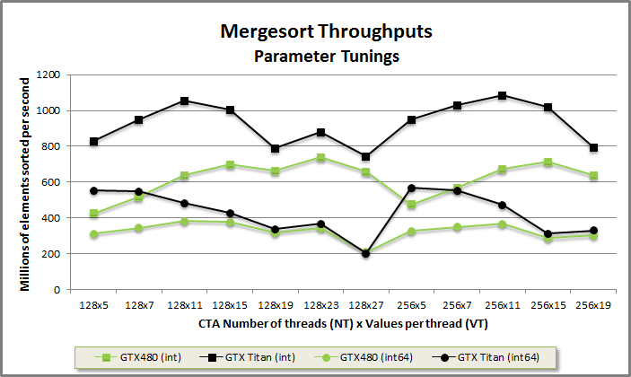

Grain-size and performance
Choose optimal tunings empirically.

Slide 10
Static decomposition
Data-independent scheduling.
Parallel reduction.
Assign VT elements in strided order.
x[i] = data_global[NT * i + tid].
Parallel scan.
Assign VT elements in thread order.
VT consecutive elements.
Load in strided order. Transpose to thread order.
x[i] = data_global[VT * tid + i].

Slide 11
Reduce.cu
// Load VT elements per thread in strided order.
// Pipelining loads from DRAM helps achieve peak bandwidth.
T x[VT];
#pragma unroll
for(int i = 0; i < VT; ++i)
x[i] = data_global[NT * i + tid];
// Reduce the elements within the thread. This requires commutativity.
T sum = x[0];
#pragma unroll
for(int i = 1; i < VT; ++i)
sum += x[i];
// Reduce the elements across the CTA.
sum = Reduce::Reduce(tid, sum, reduce_shared);

Slide 12
Scan.cu
// Load VT elements per thread in strided order.
// Pipelining loads from DRAM helps achieve peak bandwidth.
T x[VT];
#pragma unroll
for(int i = 0; i < VT; ++i)
x[i] = data_global[NT * i + tid]; // Load from DRAM in strided order.
// Move the data through shared memory to transpose from strided order to
// thread order.
#pragma unroll
for(int i = 0; i < VT; ++i)
shared.data[NT * i + tid] = x[i]; // Store to shared memory.
__syncthreads();
#pragma unroll
for(int i = 0; i < VT; ++i)
x[i] = shared.data[VT * tid + i]; // Load from shared in thread order.
__syncthreads();

Slide 13
Merge-like decomposition
Uniform work partitioning:
K’th-smallest selection on two sorted inputs in log(A + B) steps.
Solve for partitions at 0, VT, 2*VT, 3*VT, etc.
Merge.
Merge two sorted inputs into one sorted output.
Each thread emits VT contiguous (thread-order) elements.
Multiset operations.
Like std::set_intersection, set_union, etc.
Balanced Path partitioning groups key-rank pairs.

Slide 14
Merge Path search
Simultaneously search two arrays by using constraint ai + bi = diag to make problem one dimensional.
template<typename T, typename It1, typename It2, typename Comp>
int MergePath(It1 a, int aCount, It2 b, int bCount, int diag,
Comp comp) {
int begin = max(0, diag - bCount);
int end = min(diag, aCount);
while(begin < end) {
int mid = (begin + end)>> 1;
bool pred = !comp(b[diag - 1 - mid], a[mid]);
if(pred) begin = mid + 1;
else end = mid;
}
return begin;
}

Slide 15
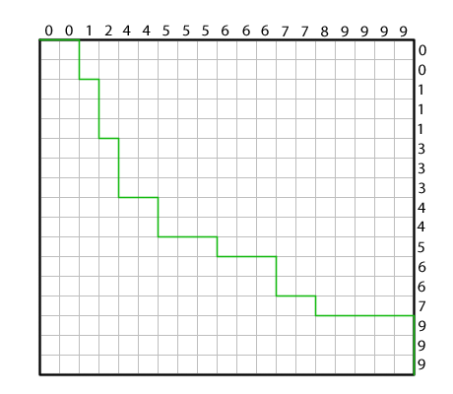
Merge Path search (2)
Geometric reasoning for k’th-smallest selection on two sorted inputs.
Draw array A along the top.
Draw array B down the right.
Merge Path curve starts at (0, 0) and advances towards the smaller element.

Slide 16
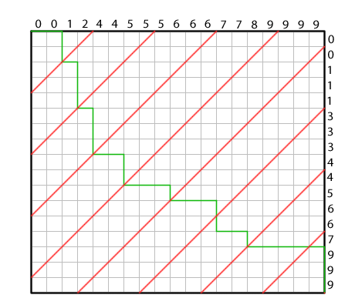
Merge Path search (2)
Search on red cross-diagonal for intersection with green Merge Path.
Bisect cross-diagonal interval and compare A element on top and B element on right.

Slide 17
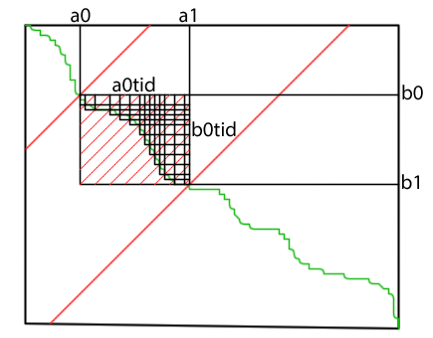
Merge Path search (3)
Search to partition CTA within global array.
Search to partition threads within CTA.

Slide 18
merge.cu
// Each thread searches for its Merge Path partition.
int diag = VT * tid;
int mp = MergePath(data_shared, aCount, data_shared + aCount, bCount,
diag, SearchBoundsLower);
// Sequentially merge into register starting from the partition.
int a = mp;
int b = aCount + diag - a;
#pragma unroll
for(int i = 0; i < VT; ++i) {
bool p;
if(b >= NV) p = true;
else if(a >= aCount) p = false;
else p = !(data_shared[b] < data_shared[a]);
x[i] = p ? data_shared[a++] : data_shared[b++];
}

Slide 19
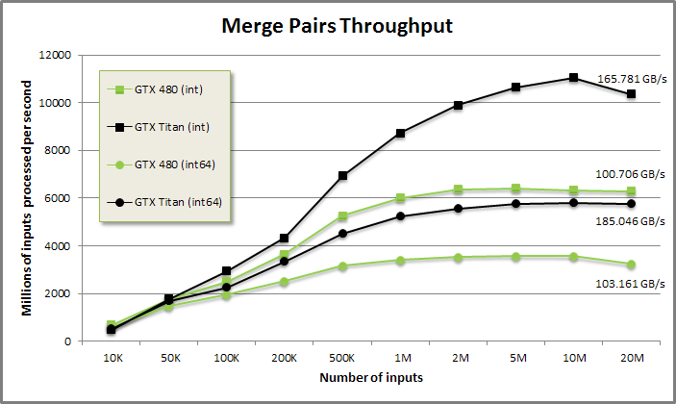
Merge performance
288 GB/s peak bandwidth GTX Titan.
177 GB/s peak bandwidth GTX 480.

Slide 20
Merge-like decomposition (2)
Vectorized sorted search.
Search from sorted needles A into sorted haystack B.
Like vectorized std::lower/upper_bound with sorted keys.
Output one index per needle.
Merge-like decomposition:
Merge Path partionining.
Linear search sequential logic.
O(A + B) complexity.
Binary search is O(A log B).

Slide 21
Sortedsearch.cu
#pragma unroll
for(int i = 0; i < VT; ++i) {
bool p;
if(b >= NV) p = true;
else if(a >= aCount) p = false;
else p = !(data_shared[b] < data_shared[a]); // Like merge
if(p) {
// aKey is smaller than bKey. Save bKey's index as the result of
// the search and advance to the next needle A.
indices[i] = b - aCount;
decisions |= 1<< i;
++a;
} else {
// bKey is smaller than aKey. Advance to the next b.
++b;
}
}
__syncthreads();

Slide 22
Merge-like decomposition (2)
Load-balancing search.
Special case of vectorized sorted search.
Enables uniform work assignment.
“Invert” a scanned array of counts.
Flatten CSR (compressed sparse row) to COO (coordinates).
Spmv
Single row may not fit in resources of thread or CTA.
LBS expands CSR to COO in on-chip memory.
Per thread: VT = num non-zeros + num rows.
Per CTA: NV = num non-zeros + num rows.

Slide 23

Load-balancing search
Work-item counts:
0: 1 2 4 0 4 4 3 3 2 4
10: 0 0 1 2 1 1 0 2 2 1
20: 1 4 2 3 2 2 1 1 3 0
30: 2 1 1 3 4 2 2 4 0 4
Exc-scan of counts (CSR):
0: 0 1 3 7 7 11 15 18 21 23
10: 27 27 27 28 30 31 32 32 34 36
20: 37 38 42 44 47 49 51 52 53 56
30: 56 58 59 60 63 67 69 71 75 75
Load-balancing search (COO):
0: 0 1 1 2 2 2 2 4 4 4
10: 4 5 5 5 5 6 6 6 7 7
20: 7 8 8 9 9 9 9 12 13 13
30: 14 15 17 17 18 18 19 20 21 21
40: 21 21 22 22 23 23 23 24 24 25
50: 25 26 27 28 28 28 30 30 31 32
60: 33 33 33 34 34 34 34 35 35 36
70: 36 37 37 37 37 39 39 39 39

Slide 24
Lbs.cu
// Each thread searches for its Merge Path partition.
int diag = VT * tid;
int begin = max(0, diag - bCount);
int end = min(diag, aCount);
// Run customized Merge Path search.
while(begin < end) {
int mid = (begin + end)>> 1;
int aKey = mid; // aKey is index. (We sample natural numbers.)
int bKey = data_shared[diag - 1 - mid]; // bKey is CSR.
bool pred = aKey < bKey;
if(pred) begin = mid + 1;
else end = mid;
}
int mp = begin;

Slide 25
Lbs.cu (2)
int a = mp;
int b = diag - a;
#pragma unroll
for(int i = 0; i < VT; ++i) {
bool p;
if(b >= bCount) p = true;
else if(a >= aCount) p = false;
else p = a < data_shared[b];
if(p)
// If a < data_shared[b], advance A and store the index b - 1.
data_shared[bCount + a++] = b - 1;
else
// Just advance b.
++b;
}
__syncthreads();

Slide 26
Join decomposition
Relational join.
Accepts two sorted inputs.
Inner, left, right, outer join semantics.
Support duplicates.
Output amplification from outer product of matching keys.
Load balancing.
Don’t map fixed inputs to tile.
Outputs might not fit in on-chip memory.
Don’t map fixed outputs to tile.
Inputs might not fit in on-chip memory.
Use load-balancing search for work assignment.

Slide 27
Join decomposition (2)
Find key matches.
Lower-bound sorted search from A into B.
Upper-bound sorted search from A into B.
Scan match counts.
Output count for element A[i] is ub[i] – lb[i].
Scan output counts.
Allocate output array from count reduction.
LBS to assign uniform work to each thread.
VT = num left keys + num outputs.

Slide 28
inner join logic
INPUT DOMAIN
0 1 2 3 4 5 6 7 8
A: A A B D F F F F G
B: A A A B C E E F F
LB: 0 0 3 5 7 7 7 7 9 Sorted search LB A->B
UB: 3 3 4 5 9 9 9 9 9 Sorted search UB A->B
COUNTS: 3 3 1 0 2 2 2 2 0 Component-wise UB - LB
SCAN: 0 3 6 7 7 9 11 13 15 (15) Exc-Scan COUNTS
8 INPUTS + 15 OUTPUTS. Launch threads for 23 items. Load-balancing search
provides scheduling
OUTPUT DOMAIN
INDICES 0 1 2 3 4 5 6 7 8 9 10 11 12 13 14
LBS: 0 0 0 1 1 1 2 4 4 5 5 6 6 7 7 aIndices
SCAN[LBS]: 0 0 0 3 3 3 6 7 7 9 9 11 11 13 13
RANK: 0 1 2 0 1 2 0 0 1 0 1 0 1 0 1 INDICES – SCAN[LBS]
LB[LBS]: 0 0 0 0 0 0 3 7 7 7 7 7 7 7 7
LB[LBS] + RANK: 0 1 2 0 1 2 3 7 8 7 8 7 8 7 8 bIndices
A-KEY: A0 A0 A0 A1 A1 A1 B0 F0 F0 F1 F1 F2 F2 F3 F3
B-KEY: A0 A1 A2 A0 A1 A2 B0 F0 F1 F0 F1 F0 F1 F0 F1

Slide 29
Inner/Left Join Kernel
int4 range = CTALoadBalance<NT, VT>(total, aCountsScan_global, aCount,
block, tid, mp_global, indices_shared, true);
int outputCount = range.y - range.x;
int inputCount = range.w - range.z;
int* output_shared = indices_shared;
int* input_shared = indices_shared + outputCount;
int aIndex[VT], rank[VT];
#pragma unroll
for(int i = 0; i < VT; ++i) {
int index = NT * i + tid;
if(index < outputCount) {
int gid = range.x + index;
aIndex[i] = output_shared[index];
rank[i] = gid - input_shared[aIndex[i] - range.z];
aIndices_global[gid] = aIndex[i];
}
}
__syncthreads();

Slide 30
Inner/Left Join Kernel (2)
// Load the lower bound of A into B for each element of A.
DeviceMemToMemLoop<NT>(inputCount, aLowerBound_global + range.z, tid,
input_shared);
// Store the lower bound of A into B back for every output.
#pragma unroll
for(int i = 0; i < VT; ++i) {
int index = NT * i + tid;
if(index < outputCount) {
int gid = range.x + index;
int lb = input_shared[aIndex[i] - range.z];
int bIndex;
if(LeftJoin)
bIndex = (0x80000000 & lb) ? ((0x7fffffff & lb) + rank[i]) : -1;
else
bIndex = lb + rank[i];
bIndices_global[gid] = bIndex;
}
}

Slide 31
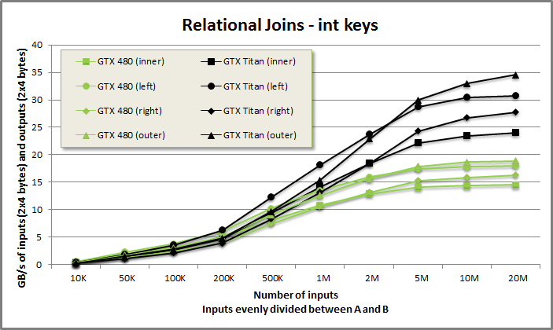
Join performance
Flexible merge-join at ~30 GB/s.
Composed from merge-like sorted searches.
Supports any keys-type with < comparator.

Slide 32
Wrap-up
Parallel partitioning for THE WORK ASSIGNMENT.
Aim for uniformity.
Make choice of grain-size (VT) static.
Partitioners may be reused.
Sequential logic does THE WORK.
Work-efficient O(n).
Clearly express algorithmic intent.
Unroll to promote state into register.

Slide 33
Questions?
sbaxter@nvidia.com
Modern GPU
Text: www.moderngpu.com
CUDA source: https://github.com/NVlabs/moderngpu
GTC Talk
Companion source: https://github.com/seanbaxter/gtc_2014

