Slide 1
Parallel decomposition strategies in modern gpu
Sean Baxter, NVIDIA Research

Slide 2
Companion source
Modern GPU
Text: http://nvlabs.github.io/moderngpu/
CUDA source: https://github.com/NVlabs/moderngpu
GTC Talk
Companion source: https://github.com/seanbaxter/gtc_2014
Boot it up now to follow along.

Slide 3
Parallel Data Decomposition
Examine 1D streaming algorithms.
Reduce, scan, merge, sort, sets, join.
Two-phase solution:
Partition problem space into uniform-length intervals.
Threads sequentially process each interval.
Limit communication to threads within CTA.
Complex tasks require multiple passes.
Keep each pass fast.
Stream through data to utilize high DRAM bandwidth.

Slide 4
Grain-size and Decomposition
Define grain-size VT (Values per Thread) as template argument.
Increase VT to improve algorithmic efficiency.
More sequential work per thread.
More instruction-level parallelism.
Decrease VT to decrease state per thread.
Schedule more threads or CTAs per SM.
More thread-level parallelism.
Optimal tuning depends on data type, architecture, algorithm.
Don’t hardcode.
Make it odd for conflict-free transpose.

Slide 5
Grain-size and decomposition
GPU is hard because of tiny state per thread.
Static grain-size allows efficient state management.
Unroll all loops over VT iterations.
Exposes instruction-level parallelism.
High ILP important for occupancy-challenged kernels.
Statically index arrays to promote to register.
Register is fast.
Register has capacity.

Slide 6
Static decomposition
Data-independent scheduling.
Parallel reduction.
Assign VT elements in strided order.
Exploit commutativity.
x[i] = data_global[NT * i + tid].
Parallel scan.
Assign VT elements in thread order.
Thread is assigned VT consecutive elements.
Load from DRAM in strided order and transpose through shared mem to thread order.
x[i] = data_global[VT * tid + i].

Slide 7
Reduce.cu
// Load VT elements per thread in strided order.
// Pipelining loads from DRAM helps achieve peak bandwidth.
T x[VT];
#pragma unroll
for(int i = 0; i < VT; ++i)
x[i] = data_global[NT * i + tid];
// Reduce the elements within the thread. This requires commutativity.
T sum = x[0];
#pragma unroll
for(int i = 1; i < VT; ++i)
sum += x[i];
// Reduce the elements across the CTA.
sum = Reduce::Reduce(tid, sum, reduce_shared);

Slide 8
Scan.cu
// Load VT elements per thread in strided order.
// Pipelining loads from DRAM helps achieve peak bandwidth.
T x[VT];
#pragma unroll
for(int i = 0; i < VT; ++i)
x[i] = data_global[NT * i + tid]; // Load from DRAM in strided order.
// Move the data through shared memory to transpose from strided order to
// thread order.
#pragma unroll
for(int i = 0; i < VT; ++i)
shared.data[NT * i + tid] = x[i]; // Store to shared memory.
__syncthreads();
#pragma unroll
for(int i = 0; i < VT; ++i)
x[i] = shared.data[VT * tid + i]; // Load from shared in thread order.
__syncthreads();

Slide 9
Merge-like decomposition
Use Merge Path binary search to assign i elements from A and VT-i elements from B.
K’th-smallest selection on two sorted inputs in log(A + B) steps.
Merge.
Merge two sorted inputs into one sorted output.
Each thread emits VT contiguous (thread-order) elements.

Slide 10
Merge-like decomposition (2)
Vectorized sorted search.
Lower- or upper-bound search of sorted needles A into sorted haystack B.
Like vectorized std::lower_bound with sorted keys.
Load-balancing search.
Invert a scanned array of counts.
Flatten CSR (compressed sparse row) to COO (coordinates).
Identical to upper-bound sorted search on natural numbers minus 1.

Slide 11
Merge Path search
Simultaneously search two arrays by using constraint ai + bi = diag to make problem one dimensional.
template<typename T, typename It1, typename It2, typename Comp>
int MergePath(It1 a, int aCount, It2 b, int bCount, int diag,
Comp comp) {
int begin = max(0, diag - bCount);
int end = min(diag, aCount);
while(begin < end) {
int mid = (begin + end)>> 1;
bool pred = !comp(b[diag - 1 - mid], a[mid]);
if(pred) begin = mid + 1;
else end = mid;
}
return begin;
}

Slide 12
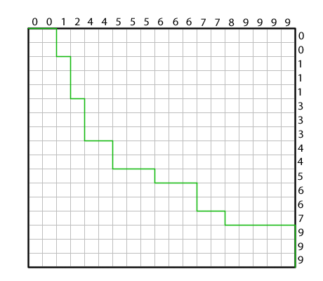
Merge Path search (2)
Geometric reasoning for k’th-smallest selection on two sorted inputs.
Draw array A along the top.
Draw array B down the right.
Merge Path curve starts at (0, 0) and advances towards the smaller element.

Slide 13
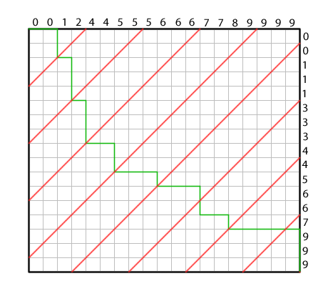
Merge Path search (2)
Search on red cross-diagonal for intersection with green Merge Path.
Bisect cross-diagonal interval and compare A element on top and B element on right.

Slide 14
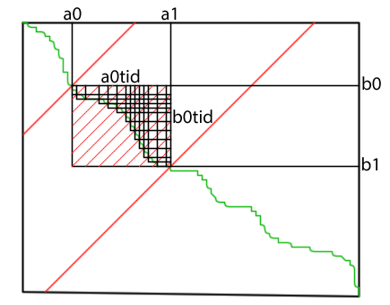
Merge Path search (3)
Search to partition CTA within global array.
Search to partition threads within CTA.

Slide 15
merge.cu
// Each thread searches for its Merge Path partition.
int diag = VT * tid;
int mp = MergePath(data_shared, aCount, data_shared + aCount, bCount,
diag, SearchBoundsLower);
// Sequentially merge into register starting from the partition.
int a = mp;
int b = aCount + diag - a;
#pragma unroll
for(int i = 0; i < VT; ++i) {
bool p;
if(b >= NV) p = true;
else if(a >= aCount) p = false;
else p = !(data_shared[b] < data_shared[a]);
x[i] = p ? data_shared[a++] : data_shared[b++];
}

Slide 16
Sortedsearch.cu
#pragma unroll
for(int i = 0; i < VT; ++i) {
bool p;
if(b >= NV) p = true;
else if(a >= aCount) p = false;
else p = !(data_shared[b] < data_shared[a]);
if(p) {
// aKey is smaller than bKey. Save bKey's index as the result of
// the search and advance to the next needle A.
indices[i] = b - aCount;
decisions |= 1<< i;
++a;
} else {
// bKey is smaller than aKey. Advance to the next b.
++b;
}
}
__syncthreads();

Slide 17
Sortedsearch.cu (2)
// Compact the indices to shared memory.
#pragma unroll
for(int i = 0; i < VT; ++i)
if((1<< i) & decisions)
data_shared[aStart++] = indices[i];
__syncthreads();
// Store all aCount indices to global memory.
for(int i = tid; i < aCount; i += NT)
indices_global[i] = data_shared[i];

Slide 18
Lbs.cu

Slide 19
Join-like decomposition

