Slide 1
Parallel decomposition strategies in modern gpu
Sean Baxter, NVIDIA Research

Slide 2
Companion source
sbaxter@nvidia.com
Modern GPU
Text: http://nvlabs.github.io/moderngpu/
CUDA source: https://github.com/NVlabs/moderngpu
GTC Talk
Companion source: https://github.com/seanbaxter/gtc_2014
Boot it up now to follow along.

Slide 3
Parallel Data Decomposition
Examine 1D streaming algorithms.
Reduce, scan, merge, sort, sets, join.
Two-phase solution:
Partition problem space into uniform-length intervals.
Threads sequentially process each interval.
Limit communication to threads within CTA.
Complex tasks require multiple passes.
Keep each pass fast.
Stream through data to utilize high DRAM bandwidth.

Slide 4
Grain-size and Decomposition
Define grain-size VT (Values per Thread) as template argument.
Increase VT to improve algorithmic efficiency.
More sequential work per thread.
More instruction-level parallelism.
Decrease VT to decrease state per thread.
Schedule more threads or CTAs per SM.
More thread-level parallelism.
Optimal tuning depends on data type, architecture, algorithm.
Don’t hardcode.
Make it odd for conflict-free transpose.

Slide 5
Grain-size and decomposition
GPU is hard because of tiny state per thread.
Static grain-size allows efficient state management.
Unroll all loops over VT iterations.
Exposes instruction-level parallelism.
High ILP important for occupancy-challenged kernels.
Statically index arrays to promote to register.
Register is fast.
Register has capacity.

Slide 6
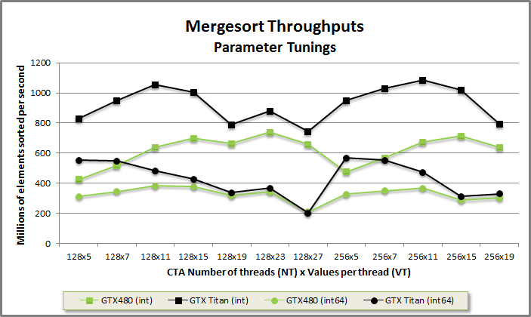

Grain-size and performance
Choose optimal tunings empirically.

Slide 7
Static decomposition
Data-independent scheduling.
Parallel reduction.
Assign VT elements in strided order.
Exploit commutativity.
x[i] = data_global[NT * i + tid].
Parallel scan.
Assign VT elements in thread order.
Thread is assigned VT consecutive elements.
Load from DRAM in strided order and transpose through shared mem to thread order.
x[i] = data_global[VT * tid + i].

Slide 8
Reduce.cu
// Load VT elements per thread in strided order.
// Pipelining loads from DRAM helps achieve peak bandwidth.
T x[VT];
#pragma unroll
for(int i = 0; i < VT; ++i)
x[i] = data_global[NT * i + tid];
// Reduce the elements within the thread. This requires commutativity.
T sum = x[0];
#pragma unroll
for(int i = 1; i < VT; ++i)
sum += x[i];
// Reduce the elements across the CTA.
sum = Reduce::Reduce(tid, sum, reduce_shared);

Slide 9
Scan.cu
// Load VT elements per thread in strided order.
// Pipelining loads from DRAM helps achieve peak bandwidth.
T x[VT];
#pragma unroll
for(int i = 0; i < VT; ++i)
x[i] = data_global[NT * i + tid]; // Load from DRAM in strided order.
// Move the data through shared memory to transpose from strided order to
// thread order.
#pragma unroll
for(int i = 0; i < VT; ++i)
shared.data[NT * i + tid] = x[i]; // Store to shared memory.
__syncthreads();
#pragma unroll
for(int i = 0; i < VT; ++i)
x[i] = shared.data[VT * tid + i]; // Load from shared in thread order.
__syncthreads();

Slide 10
Merge-like decomposition
Use Merge Path binary search to assign i elements from A and VT-i elements from B.
K’th-smallest selection on two sorted inputs in log(A + B) steps.
Merge.
Merge two sorted inputs into one sorted output.
Each thread emits VT contiguous (thread-order) elements.
Multiset operations.
Like std::set_intersection, set_union, etc.
Balanced Path partitioning groups key-rank pairs.

Slide 11
Merge Path search
Simultaneously search two arrays by using constraint ai + bi = diag to make problem one dimensional.
template<typename T, typename It1, typename It2, typename Comp>
int MergePath(It1 a, int aCount, It2 b, int bCount, int diag,
Comp comp) {
int begin = max(0, diag - bCount);
int end = min(diag, aCount);
while(begin < end) {
int mid = (begin + end)>> 1;
bool pred = !comp(b[diag - 1 - mid], a[mid]);
if(pred) begin = mid + 1;
else end = mid;
}
return begin;
}

Slide 12
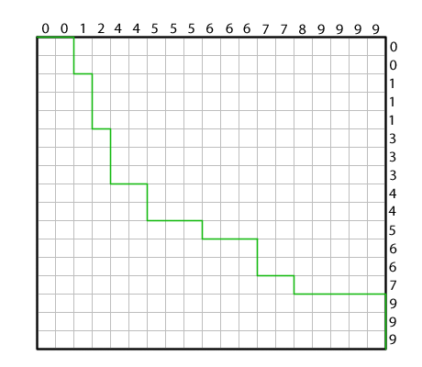
Merge Path search (2)
Geometric reasoning for k’th-smallest selection on two sorted inputs.
Draw array A along the top.
Draw array B down the right.
Merge Path curve starts at (0, 0) and advances towards the smaller element.

Slide 13
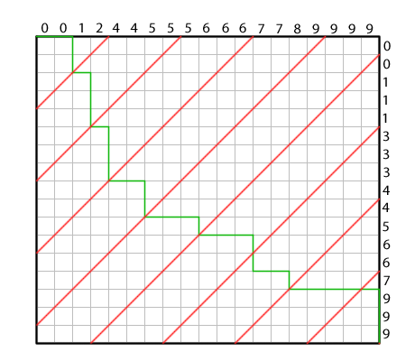
Merge Path search (2)
Search on red cross-diagonal for intersection with green Merge Path.
Bisect cross-diagonal interval and compare A element on top and B element on right.

Slide 14
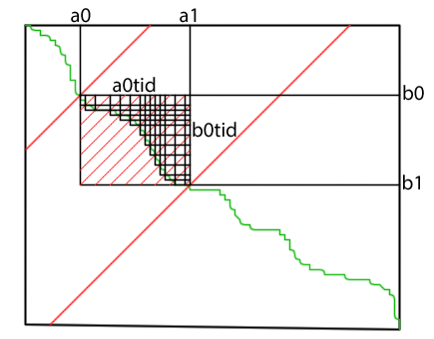
Merge Path search (3)
Search to partition CTA within global array.
Search to partition threads within CTA.

Slide 15
merge.cu
// Each thread searches for its Merge Path partition.
int diag = VT * tid;
int mp = MergePath(data_shared, aCount, data_shared + aCount, bCount,
diag, SearchBoundsLower);
// Sequentially merge into register starting from the partition.
int a = mp;
int b = aCount + diag - a;
#pragma unroll
for(int i = 0; i < VT; ++i) {
bool p;
if(b >= NV) p = true;
else if(a >= aCount) p = false;
else p = !(data_shared[b] < data_shared[a]);
x[i] = p ? data_shared[a++] : data_shared[b++];
}

Slide 16
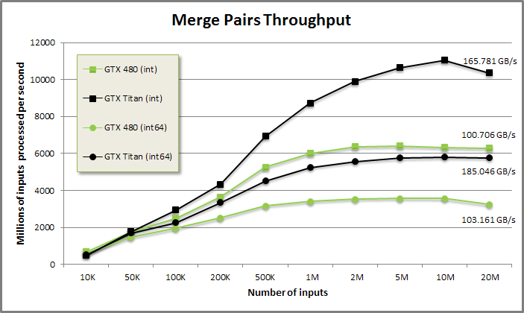
Merge performance
288 GB/s peak bandwidth GTX Titan.
177 GB/s peak bandwidth GTX 480.

Slide 17
Merge-like decomposition (2)
Vectorized sorted search.
Lower- or upper-bound search of sorted needles A into sorted haystack B.
Like vectorized std::lower_bound with sorted keys.
Same inputs and decomposition as merge.
Different sequential logic.
Output one index per needle.
Requires intra-CTA stream compaction.

Slide 18
Sortedsearch.cu
#pragma unroll
for(int i = 0; i < VT; ++i) {
bool p;
if(b >= NV) p = true;
else if(a >= aCount) p = false;
else p = !(data_shared[b] < data_shared[a]);
if(p) {
// aKey is smaller than bKey. Save bKey's index as the result of
// the search and advance to the next needle A.
indices[i] = b - aCount;
decisions |= 1<< i;
++a;
} else {
// bKey is smaller than aKey. Advance to the next b.
++b;
}
}
__syncthreads();

Slide 19
Sortedsearch.cu (2)
// Compact the indices to shared memory.
#pragma unroll
for(int i = 0; i < VT; ++i)
if((1<< i) & decisions)
data_shared[aStart++] = indices[i];
__syncthreads();
// Store all aCount indices to global memory.
for(int i = tid; i < aCount; i += NT)
indices_global[i] = data_shared[i];

Slide 20
Merge-like decomposition (2)
Load-balancing search.
Invert a scanned array of counts.
Flatten CSR (compressed sparse row) to COO (coordinates).
Identical to upper-bound sorted search on natural numbers minus 1.
Use LBS to schedule a uniform workload.
Spmv
Single row may not fit in resources of thread or CTA.
LBS expands CSR to column coordinates. Work load for CTA now bounded at NV. Work load for thread bounded at VT.

Slide 21

Load-balancing search
Work-item counts:
0: 1 2 4 0 4 4 3 3 2 4
10: 0 0 1 2 1 1 0 2 2 1
20: 1 4 2 3 2 2 1 1 3 0
30: 2 1 1 3 4 2 2 4 0 4
Exc-scan of counts (CSR):
0: 0 1 3 7 7 11 15 18 21 23
10: 27 27 27 28 30 31 32 32 34 36
20: 37 38 42 44 47 49 51 52 53 56
30: 56 58 59 60 63 67 69 71 75 75
Load-balancing search (COO):
0: 0 1 1 2 2 2 2 4 4 4
10: 4 5 5 5 5 6 6 6 7 7
20: 7 8 8 9 9 9 9 12 13 13
30: 14 15 17 17 18 18 19 20 21 21
40: 21 21 22 22 23 23 23 24 24 25
50: 25 26 27 28 28 28 30 30 31 32
60: 33 33 33 34 34 34 34 35 35 36
70: 36 37 37 37 37 39 39 39 39

Slide 22
Lbs.cu
// Each thread searches for its Merge Path partition.
int diag = VT * tid;
int begin = max(0, diag - bCount);
int end = min(diag, aCount);
// Run customized Merge Path search.
while(begin < end) {
int mid = (begin + end)>> 1;
int aKey = mid; // aKey is index. (We sample natural numbers.)
int bKey = data_shared[diag - 1 - mid]; // bKey is CSR.
bool pred = aKey < bKey;
if(pred) begin = mid + 1;
else end = mid;
}
int mp = begin;

Slide 23
Lbs.cu (2)
int a = mp;
int b = diag - a;
#pragma unroll
for(int i = 0; i < VT; ++i) {
bool p;
if(b >= bCount) p = true;
else if(a >= aCount) p = false;
else p = a < data_shared[b];
if(p)
// If a < data_shared[b], advance A and store the index b - 1.
data_shared[bCount + a++] = b - 1;
else
// Just advance b.
++b;
}
__syncthreads();

Slide 24
Join decomposition
Relational join.
Accepts two sorted inputs.
Inner, left, right, outer join semantics.
Support duplicates.
Output amplification from outer product of matching keys.
Load balancing.
Don’t map fixed inputs to tile.
Outputs might not fit in on-chip memory.
Don’t map fixed outputs to tile.
Inputs might not fit in on-chip memory.
Map fixed count of inputs + outputs to tile.
Avoids load-imbalance. Fits exactly in on-chip memory.

Slide 25
Join decomposition (2)
Use lower-bound vectorized sorted search on A and B.
Use upper-bound vectorized sorted search on A and B.
Upper - lower is amplification count for each element in A.
Scan amplification counts for streaming offsets for each output pair.
Scan of counts is like CSR vector.
Use load-balancing search to assign individual outputs to CTAs and threads.

Slide 26
Lower join logic
INPUT DOMAIN
0 1 2 3 4 5 6 7 8
A: A A B D F F F F G
B: A A A B C E E F F
LB: 0 0 3 5 7 7 7 7 9 Sorted search LB A->B
UB: 3 3 4 5 9 9 9 9 9 Sorted search UB A->B
COUNTS: 3 3 1 0 2 2 2 2 0 Component-wise UB - LB
SCAN: 0 3 6 7 7 9 11 13 15 (15) Exc-Scan COUNTS
8 INPUTS + 15 OUTPUTS. Launch threads for 23 items. Load-balancing search
provides scheduling
OUTPUT DOMAIN
INDICES 0 1 2 3 4 5 6 7 8 9 10 11 12 13 14
LBS: 0 0 0 1 1 1 2 4 4 5 5 6 6 7 7 aIndices
SCAN[LBS]: 0 0 0 3 3 3 6 7 7 9 9 11 11 13 13
RANK: 0 1 2 0 1 2 0 0 1 0 1 0 1 0 1 INDICES – SCAN[LBS]
LB[LBS]: 0 0 0 0 0 0 3 7 7 7 7 7 7 7 7
LB[LBS] + RANK: 0 1 2 0 1 2 3 7 8 7 8 7 8 7 8 bIndices
A-KEY: A0 A0 A0 A1 A1 A1 B0 F0 F0 F1 F1 F2 F2 F3 F3
B-KEY: A0 A1 A2 A0 A1 A2 B0 F0 F1 F0 F1 F0 F1 F0 F1

Slide 27
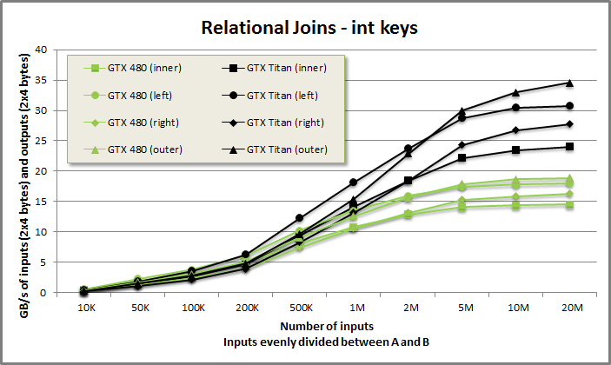
Join performance
Flexible merge-join at ~30 GB/s.
Composed from merge-like sorted searches.
Supports any keys-type with < comparator.

Slide 28
Wrap-up
Use two-phase decomposition.
Parallel partitioning to map VT work-items to each thread.
Tunable.
Data-size dependent O(n log n) but only run once per CTA or once per thread.
Sequential computation does the actual work.
Work-efficient O(n).
Clearly express algorithmic intent.
Solve harder problems (like join) with multiple streaming passes, using different parallel decompositions.

Slide 29
Questions?
sbaxter@nvidia.com
Modern GPU
Text: http://nvlabs.github.io/moderngpu/
CUDA source: https://github.com/NVlabs/moderngpu
GTC Talk
Companion source: https://github.com/seanbaxter/gtc_2014
Boot it up now to follow along.

