Slide 1
ESS 505 Term Project Presentation:
Temporal Changes in SWE on a Glacier Using InSAR
Eric Gagliano
Notes:
You will also give a (12-minute) oral presentation in the final discussion section of the course. The format should be similar to that of a talk given at the American Geophysical Union (AGU) fall meeting, Geological Society of America (GSA) annual meeting, or another international conference. The presentation should be accessible to anyone with an undergraduate degree in geology or a related field, but also present information of interest to specialists. Generally, the presenter spends 2 to 3 minutes introducing the topic, 8 minutes discussing the study and its results, and 2 to 3 minutes summarizing the study (with emphasis on the impact of the results). If there is sufficient time, a few questions are permitted. In our case, we will allow 3 to 5 minutes of questions. Tentatively, presentations are planned for the final lab section (Friday December 11th 2020).

Slide 2
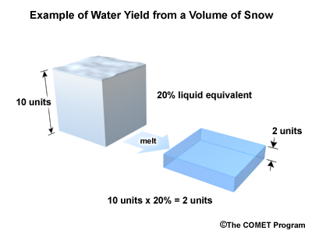
What is SWE?
Snow water equivalent (SWE) quantifies the amount of water in snowpack. (It is usually described as a depth measurement eg: 5cm of SWE)
Traditionally, SWE measured using in situ methods. This has been changing...
SWE is important to know for water resource management, flood prediction, and various surface parameters such as albedo and ground/soil insulation from temperature changes
Notes:
Snow water equivalent (SWE) quantifies the amount of water in snowpack. (It is usually described as a depth measurement like 5cm of SWE)
This would mean if we melted the snowpack, the snow volume would be equivalent to a depth of 5cm of water.
Traditionally, SWE has been measured using in situ methods.
In situ methods include things like digging snow pits and “snow pillows” which measure the weight of water
Methods of obtaining SWE have been changing with the improvement of many remote sensing methods that utilize optical & SAR imagery, altimetry data, etc
SWE is important to know for water resource management and all these other reasons

Slide 3
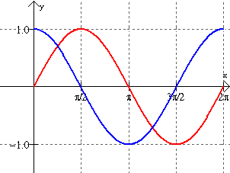
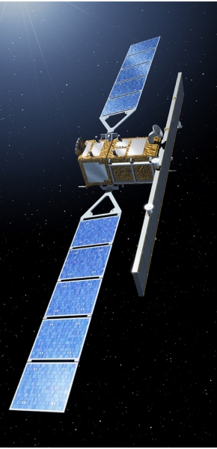
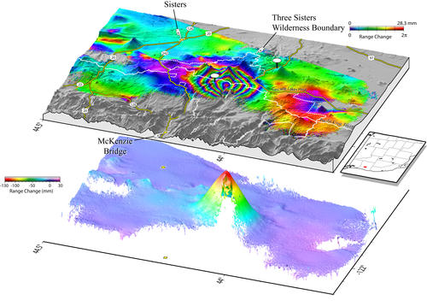
What is InSAR?
Interferometric Synthetic Aperture Radar is a remote sensing technology that measures the phase difference between two consecutive Synthetic Aperture Radar (SAR) images of a location
What can affects a SAR phase measurement?
InSAR is traditionally used to measure deformation by cancelling or minimizing all of these terms except for the change in phase due to deformation
This phase difference between SAR measurements can be represented as an interferogram
This interferogram can be converted to a displacement map after “unwrapping” the phase and relating the unwrapped phase to deformation
(Wicks, C.W. et al., 2002)
Notes:
Interferometric Synthetic Aperture Radar is a remote sensing technology that measures the phase difference between two consecutive Synthetic Aperture Radar (SAR) images of a location
So let’s take a second to understand what that means, In the top right hand corner, If we receive the red wave over our first fly over, and blue over our second, we would difference them and see that there is a pi/2 radians change in phase. So that’s what InSAR is measuring in a nutshell
So What can affects a SAR phase measurement?
CONTRIBUTIONS:
Flat: phase contribution due to look angles and projections to the ground, easily modeled and removed
Topography: phase contribution due to topography, with a digital elevation model relatively easy to remove
Deformation: phase contribution due to changes in range distance from one measurement to the next
Atmosphere: phase contributions due to the atmosphere, mainly in the form of water vapor. Relatively small, can be minimized using atmospheric models
Orbit: Usually small and negligible due to precise orbit info
Noise: every radar measurement has noise, small and hard to remove for a single InSAR pair unless you do some spatial averaging. With many inSAR pairs you can minimize this contribution
There are different types of InSAR, but for the purposes of todays talk InSAR is traditionally used to measure deformation by cancelling or minimizing all of these terms except for the change in phase due to deformation
Since the wavelengths used are usually on the order of centimeters, we can effectively get super precise deformation measurements. We talked about this in the first couple weeks of class, but If our receiver can measure phase to about 1 degree, with a wavelength of 5 centimeters that would translate to a sensitivity of about 4mm. So InSAR is crazy good at detecting very small changes from space
InSAR commonly used to detect small changes in subsidence, volcano deformations, hazards such as earthquakes and landslides, and even in glaciology--among other things--in measuring glacial motion and grounding lines.
In the bottom right corner we see an interferogram which represents the phase difference between our SAR image pair. We can then “unwrap” our interferogram and convert the phase information into displacements

Slide 4
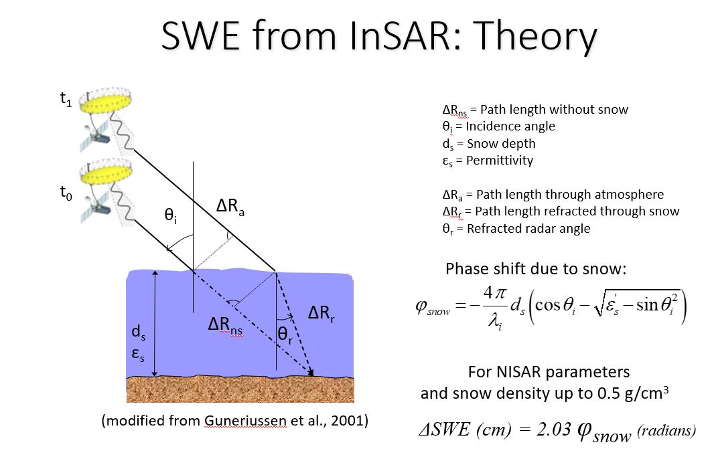
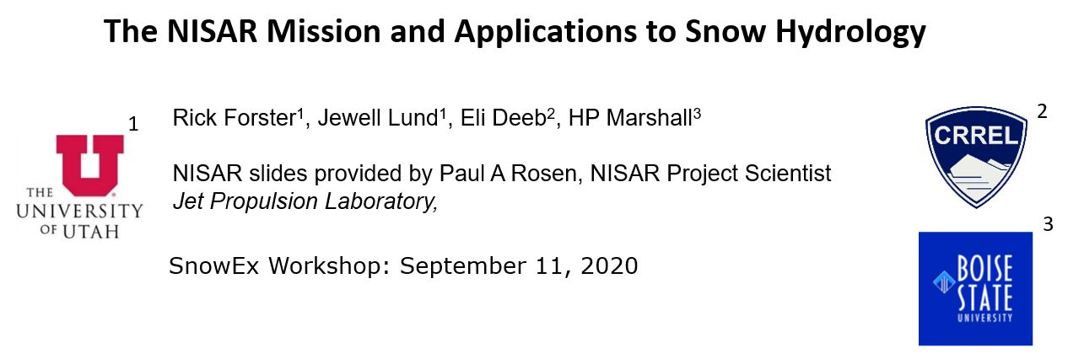
Measuring Change in SWE using InSAR
Because of the low dielectric constant of ice, dry snow is almost “invisible” to the microwave wavelengths that we use in SAR (wet snow will increase the absorption /reduce scattering of the microwave radiation)
A new term appears!
Notes:
So because of the low dielectric constant of ice, dry snow is almost “invisible” to the microwave wavelengths that we use in SAR. And that’s because wet snow has water which absorbs and reduces scattering of the incident radiation.
A bit of a fun fact I learned is that you can see this at home by throwing an ice cube and a cup of water next to each other in the microwave. Put it on for a couple of minutes and you will see that the water will boil before the ice barely melts a little. (Woodhouse 2006)
Conde 2019: “In fact, due to the dielectric contrast at air-snow interface, the radar signal is refracted when it impinges on the snow layer, resulting in a longer path when compared with the linear path”
Here we can see some trigonometry magic to get the snow depth. By knowing the average density of snow in that area we can use the change in snow depth to get change in SWE

Slide 5
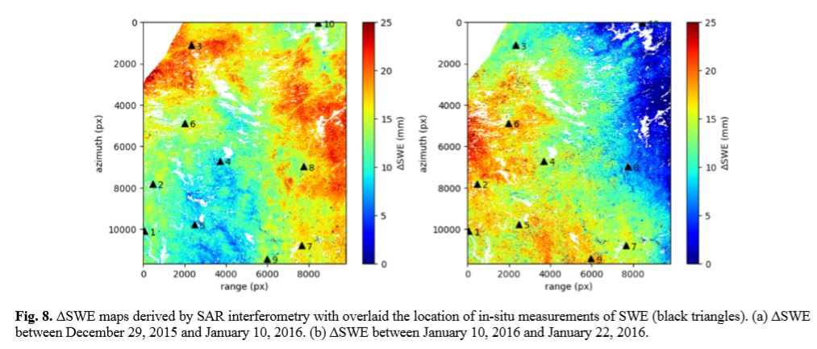
Measuring Change in SWE using InSAR
Many papers have proven the effectiveness of using InSAR to measure changes in SWE:
But these papers have only looked at areas where deformation is deemed negligible!
What if we tried looking at a more complicated area?
(Conde et al. 2019)
Notes:
Many papers have proven the effectiveness of using InSAR to measure changes in SWE:
These papers choose an area where there is negligible deformation, and they used a high quality digital elevation model and an numerical weather model, so they were able to get good estimates for change in phase due to change in swe.
But what happens if we tried looking at a more complicated area that actually had motion?
Sounds like a fun class project ;)

Slide 6
Complications on a Glacier
Glaciers move! Which means that interferometry will be more complicated because of the extra phase contributions due to glacial motion. In a single interferogram, these are all the contributions to the phase difference:
If we can remove the phase change contribution due to glacier movement, we can isolate phase change contribution from snow and then calculate change in SWE….
Minimize by choosing a good DEM and a small spatial baseline
Minimize/remove by modeling glacier motion
Negligible
Remove via atmospheric model
Negligible
What we are looking to convert to SWE!
Notes:
Glaciers move! Which means that interferometry will be more complicated because of the extra phase contributions due to glacial motion. In a single interferogram, these are all the contributions to the phase difference:
Let’s get rid of things in order of how easy they are to remove:
**CLICK through, read each**
And if we can minimize or eliminate all other terms, we can isolate the phase contribution from snow to calculate change in SWE.

Slide 7
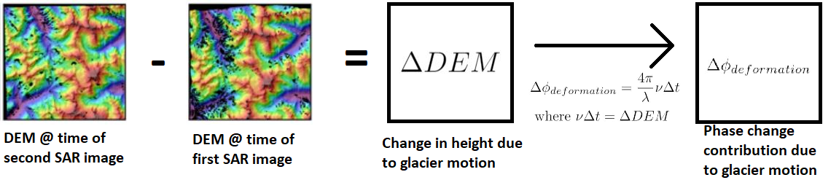
Removing the Phase Contribution due to Glacier Motion
First thought: Take two DEMs acquired at the same time as each image in the SAR image pair, difference the DEM, and convert this elevation difference to phase difference:
… but it’s hard to find DEMs that were created at the same time as the SAR pair
Second thought: Why not use velocity directly?
Settled on ITS_LIVE velocity data for prototyping
Notes:
First thought: Take two digital elevation models or (DEM)s acquired at the same time as each image in the SAR image pair, difference the DEM, and convert this elevation difference to phase difference:
… but it’s hard to find DEMs that were created at the same time as the SAR pair
Second thought: Why not use velocity directly?
Considered other methods such as SAR speckle tracking
This ITS_LIVE data isnt great since it is averaged over a year AND we only know velocity in x and velocity in y, so we also need to make the assumption that flow is parallel to the bed. This is not always true, but it is most true at the equilibrium line

Slide 8
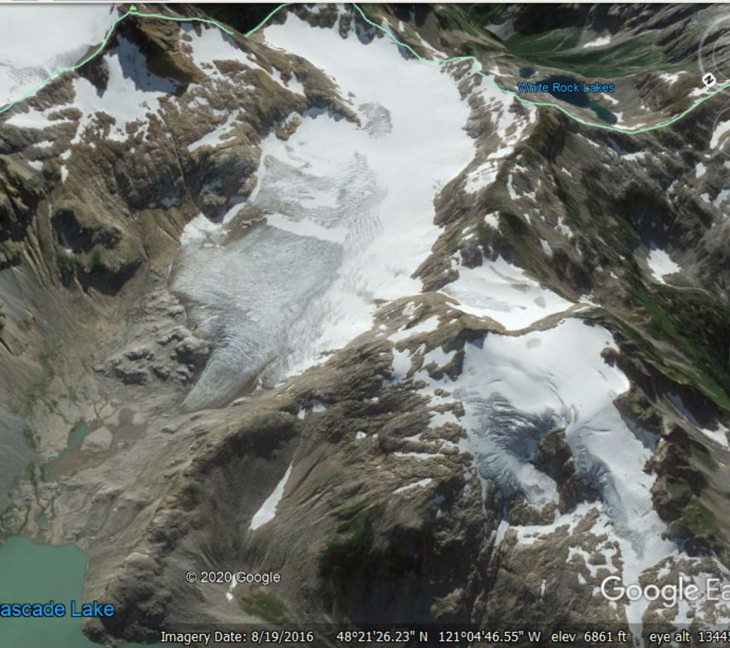
Study Area
South Cascade Glacier
Notes:
If we can produce results, compare with scg radar derived swe? When were these taken?

Slide 9
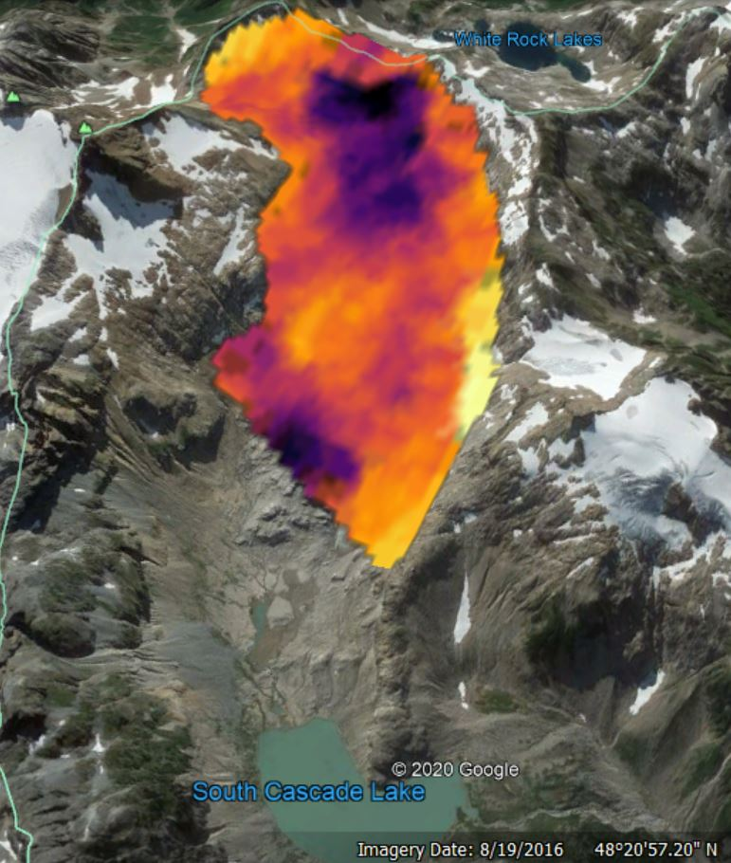
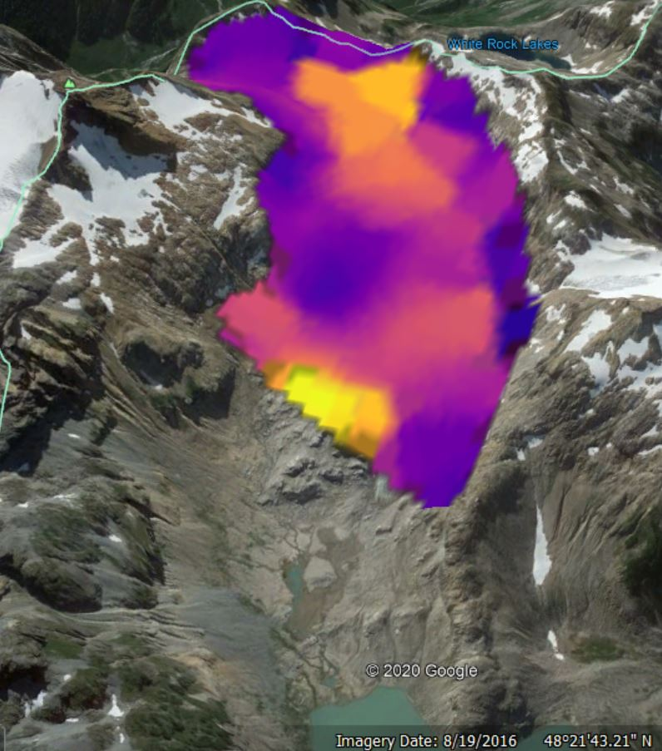
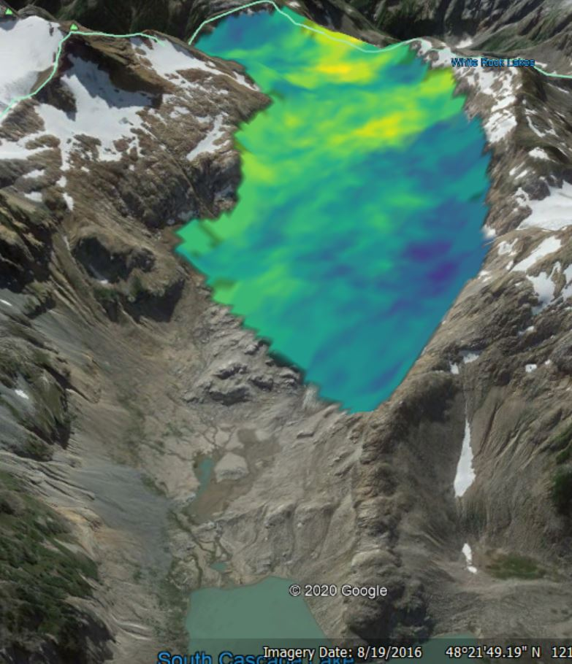
Preliminary Results
Change in SWE (m) 11/06/2014-12/24/2014
0.10
0.05
-0.03
Interferogram for 11/06/2014-12/24/2014
Velocity magnitude (m/yr)
1.6
0.8
0
ITS_LIVE velocity data averaged over a year, not accurate for our time window. For prototyping purposes only
Notes:
A lot of rough data and coarse estimation, so I wouldn’t trust these results just yet. This was more about establishing a workflow. One thing we have to keep in mind is when we pick our temporal baseline we have to balance choosing a long enough time to capture enough change, while choosing a short enough time so there isn’t too much change that our results decorrelate.
For example, this time span of a month and a half has a decently strong signal so hopefully we can pull out some SWE data, however as a result of choosing this longer timespan our coherence isn’t great. Coherence in this context can be thought of as nearby pixels behaving similarly in terms of their change in phase.
Another thing you might notice is how the velocity magnitude and change in SWE graphs look eerily similar. This could mean a bunch of things, but it looks like our calculations are very sensitive to velocity. I fed the code pretty bad yearly average velocities so maybe it’s a matter of “you put garbage in you get garbage out”. I have other theories about this if anyone is interested later: lack of coherence, interferogram signal in the winter is predominantly SWE change so using the yearly average really messes stuff up.
In terms of magnitude of change in SWE, I don’t know if these are even in the ballpark of what we should expect over 7 weeks so I’ll probably ask Knut later.

Slide 10
Summary/Next Steps
It’s unclear whether it’s possible to use InSAR to measure changes in SWE over areas with significant deformation/motion
By Project Turn-in I’m hoping to:
Process a time series of interferograms to recover changes in SWE
Compare to real SWE data/estimates
For next steps, I’d like to answer:
If this doesn’t work, why? What would need to be improved in order to make it work? Glacial motion “speed limit”? Or implausible in some way, theory wrong?
If it does work, how accurate is it? Is it useful?
Notes:
It’s unclear whether it’s possible to use InSAR to measure changes in SWE over areas with significant deformation/motion
By Project Turn-in I’m hoping to:
Process a time series of interferograms to recover changes in SWE
Compare to ral SWE data or estimates
One thing to note is that it is hard to compare to real SWE data since InSAR measures change in SWE. Wheras the SWE measurements I’ve come across so far don’t have the temporal resolution to evaluate over the small time spans of interferogram pairs, but I’ll see what I come up with
For next steps, I’d like to answer:
If this doesn’t work, why? What would need to be improved in order to make it work? Glacial motion “speed limit”? (By that I mean is there a velocity threshold where SWE isn’t recoverable anyone?) Or is this all implausible in some way, might my understanding of the theory be wrong?
If it does work, how accurate is it? Is it useful?
This whole idea seems like a bit of a low hanging fruit: if this has been done for areas with negligible motion, why hasn’t it been extended to regions with motion? Has no one tried, or is it just really hard? Considering there are so many smart people in this field, my guess is the latter. But I’m excited to explore further :)
That’s all I’ve got! Here are my references. And thanks for listening.

Slide 11
References
Conde, V., Mateus, P., Catalao, J., & Gritsevich, M. (2019). On the Estimation of Temporal Changes of Snow Water Equivalent by Spaceborne SAR Interferometry: A New Application for the Sentinel-1 Mission. Journal of Hydrology and Hydromechanics, 67, 93–100. https://doi.org/10.2478/johh-2018-0003
Deeb, Elias (2012). Estimating snow water equivalent (SWE) using interferometric synthetic aperture radar (InSAR)—ProQuest. (n.d.). Retrieved October 14, 2020, from http://www.proquest.com/docview/1268757228
Guneriussen, T., Hogda, K. A., Johnsen, H., & Lauknes, I. (2001). InSAR for estimation of changes in snow water equivalent of dry snow. IEEE Transactions on Geoscience and Remote Sensing, 39(10), 2101–2108. https://doi.org/10.1109/36.957273

Slide 12
Thanks for listening!
Questions?

Slide 13
Improved results

Slide 14
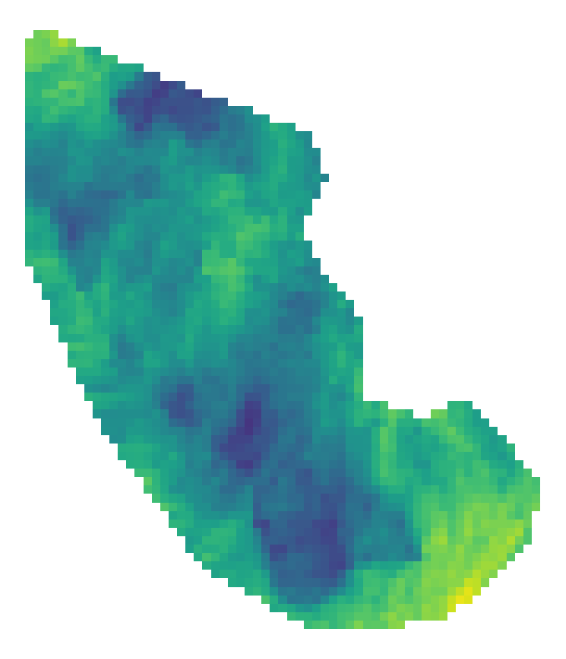
ΔSWE for South Cascade Glacier 11/16/2020 - 11/28/2020
20
16
8
ΔSWE [cm]

Slide 15
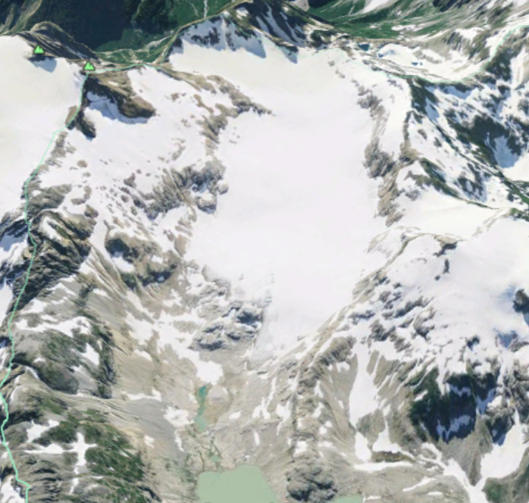
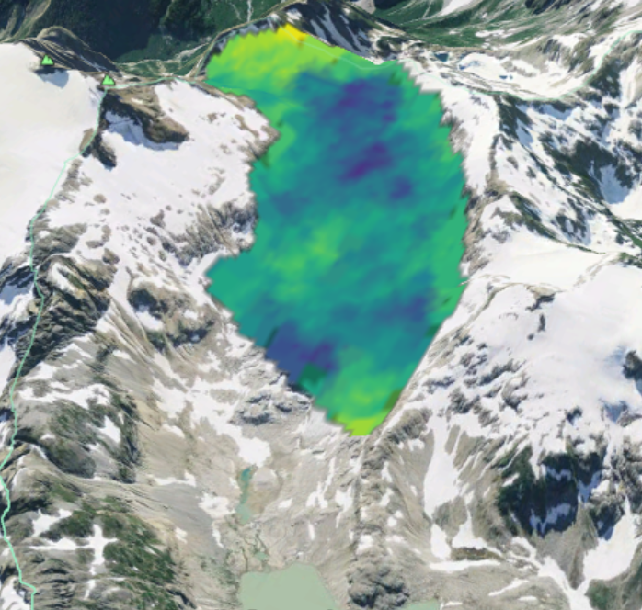
ΔSWE for South Cascade Glacier 11/16/2020 - 11/28/2020
20
16
8
ΔSWE [cm]

Slide 16
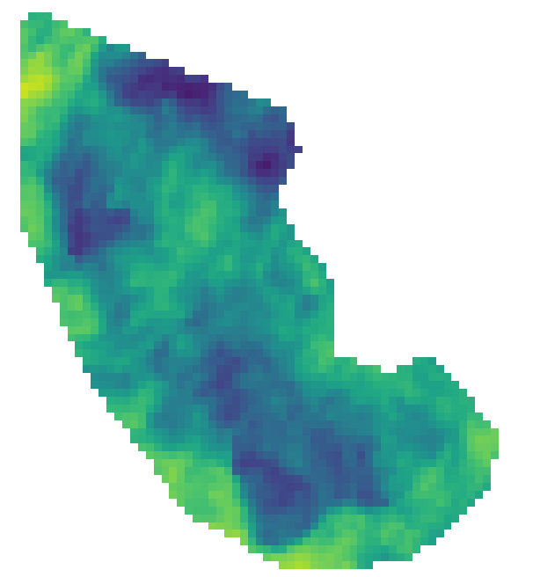
ΔSWE for South Cascade Glacier 3/2/2020 - 3/14/2020
15
10
5
ΔSWE [cm]

