Slide 1
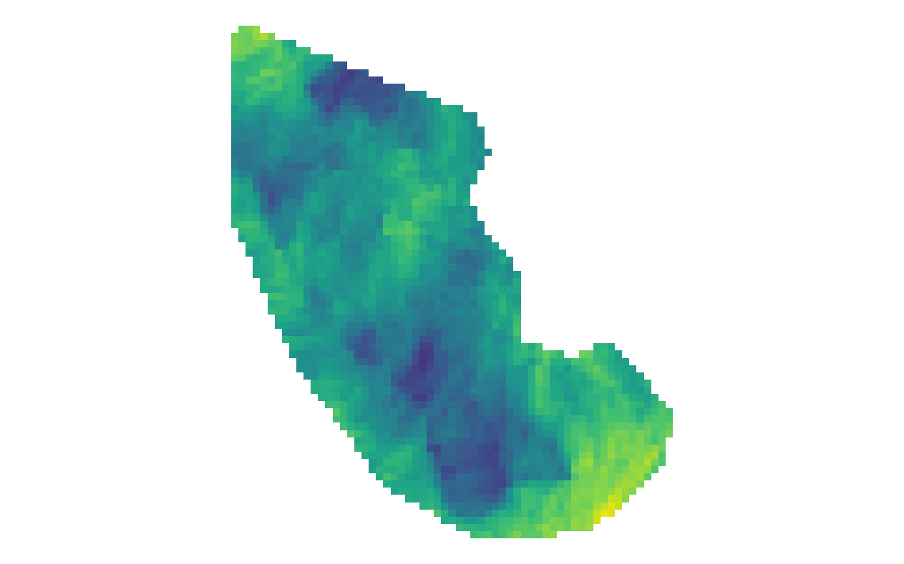


$ΔSWE$ for South Cascade Glacier
11/16/2020 – 11/28/2020
20
14
8
$$ΔSWE\left[cm\right]$$

Slide 2
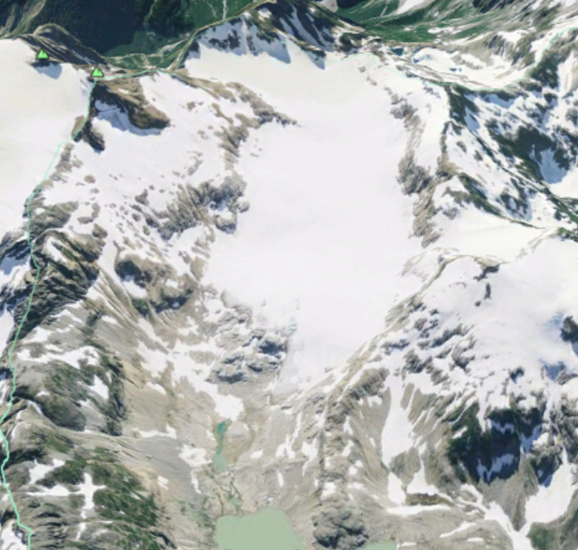
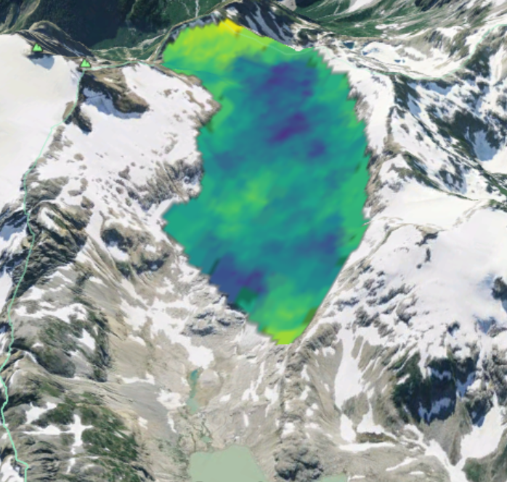


South Cascade Glacier
(for reference)
$ΔSWE$ for South Cascade Glacier
11/16/2020 – 11/28/2020
20
14
8
$$ΔSWE\left[cm\right]$$

