Slide 1
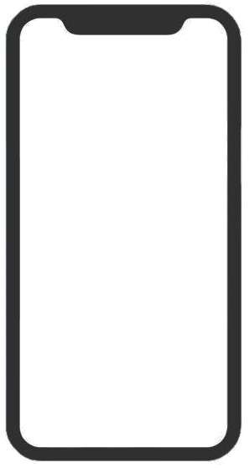
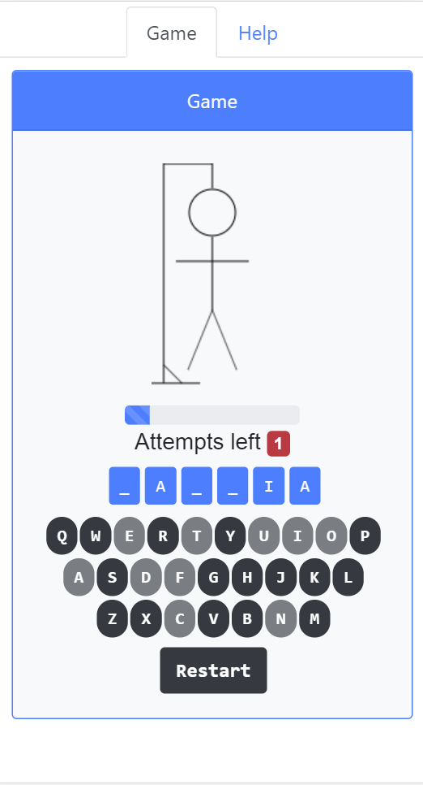
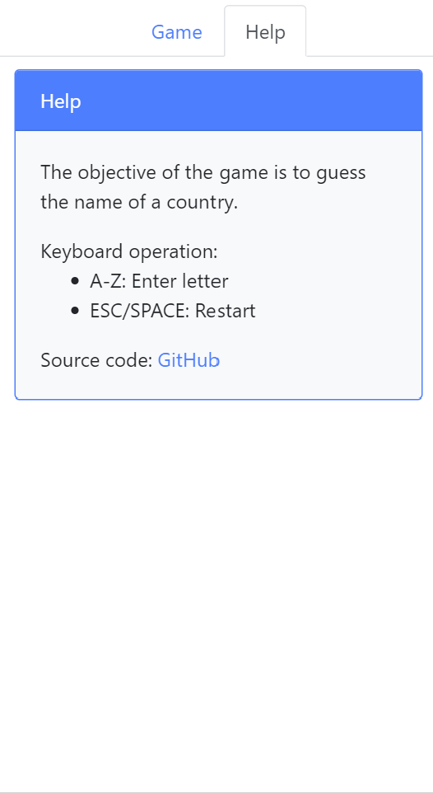
Application
App.vue Encapsulates the Game and Help views (and the switching between them)
Stickman
components/ StickMan.vue Displays the stick man and the number of attempts left
Help
views/Help.vue Provides instructions on how to operate the game with the keyboard.
Letters
components/ Letters.vue Displays the word’s letters
Game
views/Game.vue Implements the game logic, keyboard handling code and encapsulates de UI components.
Keyboard
components/ Keyboard.vue Provides on-screen keyboard

Slide 2


Window
App
Game
StickMan
fails
keyup
guessedWord
Letters
restart()
processLetter()
usedLetters
Keyboard
key = letter
restart
Help

