Slide 1

Fake vs Real News
Headline Classification
Binary classification of news headlines using three NLP approaches of increasing complexity
94.2%
92.8%
98.6%
TF-IDF + LR
SentenceTransformers + LR
DistilBERT (fine-tuned)
Sparse lexical baseline
Frozen dense embeddings
End-to-end contextual
Ironhack Data Science & ML Bootcamp

Slide 2
01 Problem Framing
THE TASK
THE REAL QUESTION
Binary: classify headlines as fake (0) or real (1)
Input is headline text only — no article body or metadata
34,152 training samples, 9,984 unlabeled test samples
Progressive complexity: sparse, dense, contextual models
Cross-validation as primary evaluation framework
Can a model distinguish fake from real based on headline alone?
Or is it learning writing style, not factual truth?
Dataset likely encodes source identity through rhetoric patterns
94%+ accuracy from bag-of-words is suspiciously high
Must separate model skill from dataset artifact

Slide 3

02 Dataset Analysis & Bias
34,152
9,984
17,572
16,580
51/49%
Train
Test
Fake (0)
Real (1)
Balance
DATASET BIAS — CRITICAL
NON-OBVIOUS OBSERVATIONS
Fake headlines: sensational, political (Trump, Obama, Clinton)
Real headlines: neutral, formal, AP/Reuters wire style
Source identity is baked into writing style — learnable shortcut
Fake samples show emotional language: 'embarrassing', 'drunk', 'joke'
Near-perfect balance means no class imbalance shortcuts
Cleaning strips punctuation — loses ALL CAPS clickbait signal
Political entity names alone may be enough to classify
Short text = limited context = model relies on lexical cues

Slide 4

03 Assumptions Made
Headline alone carries enough signal for classification
Model relies on surface-level style, not factual verification
WHY: Only headlines provided — no body, source, or metadata
Writing style is a reliable proxy for fake/real label
94%+ accuracy — but model learns source identity, not truth
WHY: Fake sources use distinct rhetoric; real sources use wire-service conventions
Train/test share identical distribution and time period
Temporal drift or new sources would break generalization
WHY: No temporal metadata; standard random split assumed
Text cleaning preserves the discriminative signal
Loses casing cues (ALL CAPS) and special characters from clickbait
WHY: Lowercase + strip punctuation reduces noise for TF-IDF

Slide 5

04 Model Architectures — Representation Trade-offs
TF-IDF + LR
SENTENCE TRANSFORMERS + LR
DISTILBERT (FINE-TUNED)
Sparse: unigrams + bigrams (50K features)
Sublinear TF: dampens frequent words
LR with C=5.0 (moderate regularization)
Lexical match only — no semantics
Fast, interpretable, debuggable
all-MiniLM-L6-v2: frozen 384-dim encoder
Pre-trained on 1B+ paraphrase pairs
Dense semantic similarity vectors
Same LR classifier on top (C=5.0)
No task-specific fine-tuning
distilbert-base-uncased (66M params)
Subword tokenizer + contextual attention
All layers updated: 3 epochs, lr=2e-5
Warmup 10%, weight decay 0.01, batch=32
Max length 64 tokens — efficient for short text

Slide 6

05 Baseline — TF-IDF + Logistic Regression
94.16%
Class | Precision | Recall | F1 | ROC-AUC
Fake | 0.95 | 0.94 | 0.94
Real | 0.93 | 0.95 | 0.94 | 0.9855
5-Fold CV Accuracy (std: 0.33%)
KEY OBSERVATIONS
0.33% std across folds — extremely stable, consistent signal in the data
Precision(fake)=0.95 > Precision(real)=0.93 — fake style is more distinctive
Bigrams capture source fingerprints: 'trump slams', 'sources say', 'breaking bombshell'
94% from bag-of-words is a red flag — if word counts suffice, the signal is lexical style, not understanding

Slide 7

06 Sentence Transformers + LR
93.05%
92.83%
0.9830
384
CV Accuracy
Val Accuracy
ROC-AUC (val)
Embedding Dim
std: 0.19%
holdout 20%
vs 50K sparse
THE SURPRISING INSIGHT
Sentence Transformers perform WORSE than TF-IDF (93.1% vs 94.2%)
Semantic similarity is NOT the signal — exact words and n-grams are
When lexical cues dominate, sparse models outperform dense embeddings
Frozen encoder misses domain-specific patterns (political rhetoric, clickbait)
This confirms the model learns style tokens, not sentence-level meaning

Slide 8
07 DistilBERT Fine-Tuning
CONFIGURATION
RESULTS
Model
distilbert-base-uncased (66M)
Accuracy (val)
98.57%
Epochs
3 (train loss: 0.079)
Precision
0.99 / 0.99 (fake/real)
Learning Rate
2e-5 + 10% warmup
Recall
0.99 / 0.98
Regularization
weight_decay=0.01
F1-Score
0.9852
Max Length
64 tokens
ROC-AUC
0.9990
Val Split
10% (same as ST: 20%)
Train Loss
0.079 (3 epochs)
CRITICAL QUESTION
98.6% accuracy — near perfect. Is this model actually detecting fake news, or memorizing style?
DistilBERT has capacity to memorize subtle token patterns (subword + attention + position)
0.9990 ROC-AUC is unnaturally high for a real-world NLP task — suggests data leakage or shortcut

Slide 9

08 Evaluation Strategy
TF-IDF + LR
SENT. TRANSFORMERS
DISTILBERT
5-Fold Stratified CV
5-Fold CV + 80/20 Holdout
90/10 Split Only
OOF predictions — each sample scored by its holdout fold
ROC-AUC, precision, recall, F1 all reported
Most rigorous and unbiased evaluation
CV on full embeddings for accuracy
Separate holdout for classification report
Consistent LR hyperparameters across models
No cross-validation — compute cost too high
Single split eval — less robust estimate
Epoch-level accuracy monitoring during training
Inconsistent evaluation across models: TF-IDF uses OOF on full train, ST uses val holdout, DistilBERT uses a different 10% split. Direct metric comparison is approximate, not exact.

Slide 10

CRITICAL INSIGHT
The Model Learns STYLE, Not TRUTH
WHY THIS HAPPENS
Fake news sourced from partisan outlets — sensational, emotional, informal
Real news from wire services (AP/Reuters) — neutral, standardized, formal
Dataset encodes source identity through writing conventions, not factual accuracy
Model learns: this style = this source = this label
THE EVIDENCE
TF-IDF (bag-of-words) already hits 94% — word frequencies alone are enough
Sentence Transformers perform WORSE — meaning doesn't help, tokens do
DistilBERT at 98.6% memorizes subtle style with subword attention patterns
0.33% fold variance means the shortcut is pervasive and consistent
WHAT THIS MEANS
These models are style detectors, not fact-checkers
Would fail on: well-written fake news or informal real reporting
Cannot generalize to unseen sources, new topics, or future time periods
Accuracy overstates actual fake-news detection capability

Slide 11

09 Model Comparison & Best Outcome
WHY DISTILBERT WINS — AND WHY IT DOESN'T MATTER
DistilBERT: highest accuracy (98.6%), F1 (0.985), ROC-AUC (0.999)
Contextual attention captures fine-grained style patterns that n-grams miss
But: all three models exploit the same shortcut — source style as label proxy
TF-IDF is the best practical choice: 100x faster, interpretable, and 94% is already near ceiling for this task

Slide 12
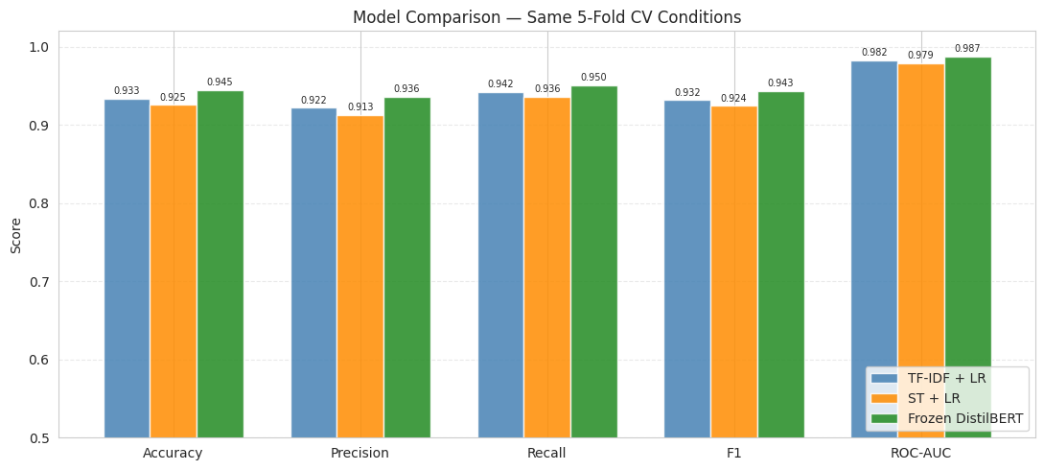
09 Model Comparison & Best Outcome
DistilBERT: best overall performance (≈94.5% accuracy, F1 ≈0.943, ROC-AUC ≈0.987)
Contextual representations capture interactions between stylistic cues that n-grams model only linearly
But: performance gain is marginal (~+1–2%) → no evidence of deeper “truth understanding”
All models converge to similar performance → task is largely linearly separable in lexical space
SentenceTransformers underperform TF-IDF → abstraction hurts when signal is surface-levelTF-IDF is the best practical choice: ~100x faster, interpretable, and within ~1% of the best model
DistilBERT adds complexity for diminishing returns → useful only if marginal gains matter
But: all three models exploit the same shortcut — source style as label proxy

Slide 13

10 Limitations
DATA
MODELING
EVALUATION
Dataset encodes source identity, not factual accuracy
No temporal metadata — can't test temporal generalization
Headlines only — no article body, images, or source features
No adversarial testing (style-swapped headlines)
No feature importance analysis beyond TF-IDF coefficients
DistilBERT not evaluated with CV — weaker comparison basis
Inconsistent eval: CV vs holdout vs single split across models
No calibration analysis — confidence estimates not validated
High metrics reflect task artifact, not real-world capability

Slide 14

11 What I Would Improve
DATA
MODELING
EVALUATION
Adversarial test set: swap styles between fake/real sources
Add temporal splits: train on past, test on future
Augment with article body, source metadata, publication date
De-bias with domain-adversarial training (remove style signal)
Ensemble TF-IDF + DistilBERT for best of both worlds
Freeze lower BERT layers — partial fine-tuning to reduce memorization
Unified 5-fold CV for all models (including DistilBERT)
Leave-one-source-out CV to test cross-source generalization
Confidence calibration + error analysis on misclassified samples

Slide 15

What I Would Do Differently & Key Takeaways
Start with an explicit dataset bias analysis before modeling
The style-as-proxy problem is visible in the data. Knowing it upfront would reshape the entire experiment.
Use consistent evaluation across all three models
Mixed eval (CV / holdout / single split) makes direct comparison approximate. Would use unified 5-fold for all.
Add a 'style-stripped' ablation experiment
Replace entity names with placeholders, normalize tone — test if accuracy drops. Would reveal how much signal is style vs content.
Frame the project as 'source style classifier' from the start
More honest framing. The model detects which kind of outlet wrote the headline, not whether it's factually true.
High accuracy does not equal real-world capability. Always ask: what is the model actually learning?

