Slide 1
Long Read
Genome Assembly
A Case Study in Python
Group D: SMRT-y pants Dylan Estep, Ethan Gaskin, Akshat Gupta, Zhen Yang

Slide 2
Background
Short-read sequencing is known for its cost-effectiveness, accuracy
However, complexities of genomes, such as repetitive regions, pose a challenge when assembling the genomes from short amplified fragments
Long reads enhance de novo assembly, overcoming amplification bias even though with higher error rates
Notes:
Now I would like to talk a little about why we chose to tackle this particular problem. Short-read sequencing is widely recognized for its cost-effectiveness and accuracy. It efficiently generates numerous short sequences, making it suitable for a wide range of applications. However, when it comes to assembling genomes, especially complex ones like those with repetitive regions, short-read data can present challenges. These repetitive regions can cause ambiguities and gaps in the assembly process, complicating the reconstruction of the complete genome. To address these challenges, researchers have turned to long-read sequencing technologies. Long reads provide significantly longer sequence fragments, which can span through repetitive regions and other complex genomic features. This enhances de novo assembly capabilities, effectively overcoming the issues of amplification bias and other artifacts associated with short-read sequencing.
It's important to note that long-read sequencing does come with
its trade-offs. While it offers improved genome assembly across challenging
regions, long reads typically have higher error rates compared to short reads.
However, advancements in sequencing technology and bioinformatics tools have
greatly mitigated these challenges, making long-read sequencing a powerful tool
in modern genomics research.

Slide 3
Problem Statement
De Novo Genome Reconstruction Problem: Reconstruct a genome from error-prone, single-molecule DNA sequencing reads (long reads) without a reference genome
Input: fastq file consisting of
N single-molecule sequencing reads
quality scores of base calls for each read
Output: Long contiguous sequences (contigs) that are highly likely to be in the genome used to produce these reads
Notes:
we’re still working on defining “highly likely” but some contributing factors include: Perhaps statistically significant based the base call confidence of the reads, the number of reads in the contig covering each position, etc.

Slide 4
Methods

Slide 5
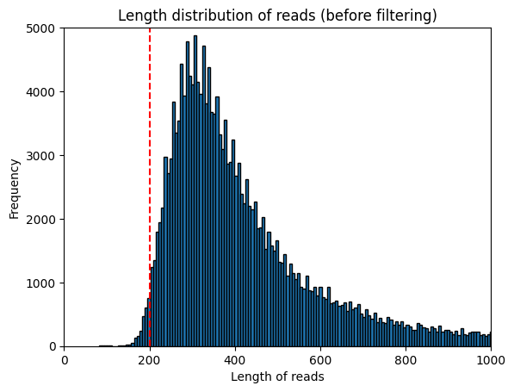
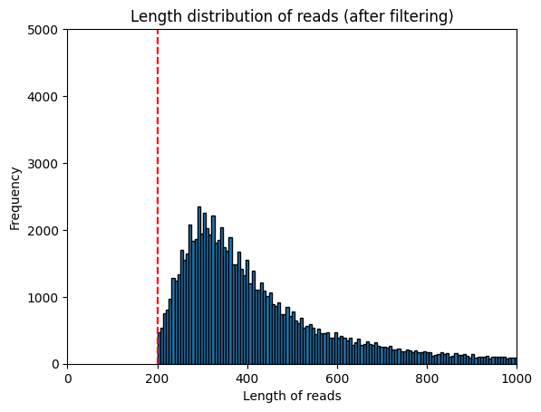
Methods Overview
Quality Control (NanoFilt -q 10 -l 200 --minGC 0.3)
Overlap-Layout-Consensus (OLC)
Overlap: Detect overlapping reads
Error Correction: FalconSense
Layout: Group overlapped reads into layouts of reads coming from same genomic region
Consensus: Overlay reads in each layout and compute consensus seq (contigs)
Whole-genome, long-read Oxford Nanopore
106,084 reads Salmonella enterica serotype Hadar
Ref. 1

Slide 6
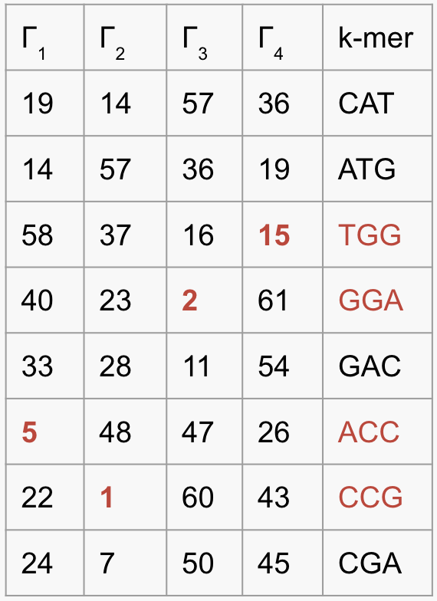
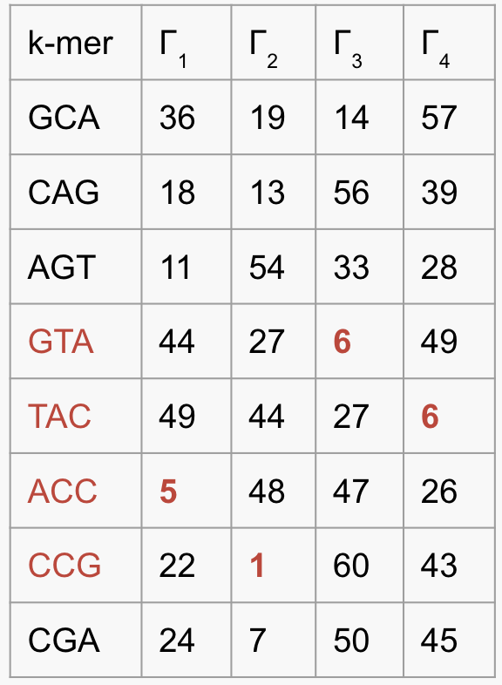
Find Overlap Using MHAP
S₁: CATGGACCGA
GCAGTACCGA :S₂
CAT GAC
GTA CGA
ATG ACC
AGT CCG
TGG CCG
CAG ACC
GGA CGA
GCA TAC
S₁: CATGGACCGA
| | | | |
S₂ GCAGTACCGA
J(S₁, S₂) ≈ 2/4 = 0.5
[5, 1, 2, 15]
min-mers
[5, 1, 6, 6]
Sketch (S₁)
Sketch (S₂)
Notes:
Zhen
In order to find overlapping reads, we adopted the methods described in MHAP (MinHash Alignment Process)
Given two reads, we first find the k-mers of the reads. In this example we use 3-mers for simplicity.
Then we generated H number of hash functions to hash the kmers into hash values that are independent, identically distributed
For each hash function, we find the minimum value called min-mers and stored them into a list called sketches.

Slide 7
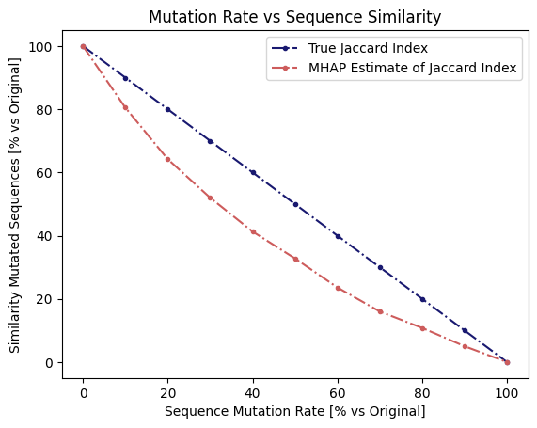
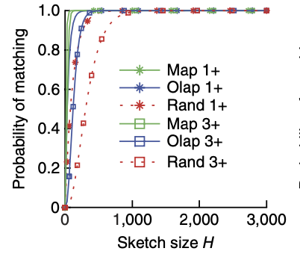
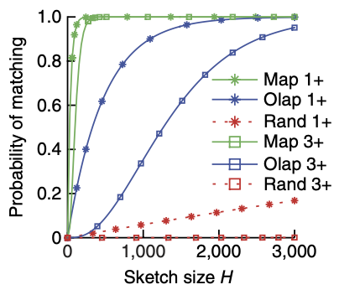
Choose Parameter k, H
k = 10
k = 16
H = 1256
Ref. 2
Notes:
Zhen
H is the number of hash functions we use, so we need to specify it ahead of time, which also determines our sketch size. The larger the H, the more computationally expensive it is. Therefore, we need to find a good H

Slide 8
Parallelization
Assume MHAP with sketch size H tells us (on average) each read has Z candidate reads to overlap with (N = 100,000, H = 1,256, Z = 1,000):
O(N*H) = 125,600,000 hashes to computed (for all N sketches)
O(N²H²) = 1,577,536,000,000,000 calcs for Jaccard mtx (N² elements)
O(N*Z) = 100,000,000 alignments will be necessary (2% of total)
Better than 100,000²/2 = 5,000,000,000 alignments!
Multiple embarrassingly parallel steps for MHAP
Pairwise Jaccard Index computations are independent & symmetric
Computing sketches for each read is independent
Future parallelization: Pairwise alignments from MHAP independent
Efficient memoization should allow us to avoid recomputation
Notes:
Ethan
Another optimization is to use a true hash table to implement MinHash rather than naive full sketch generation. see next slide

Slide 9
Overlap: Generating directed overlap graph
Error Correction by FalconSense: for each read, generate fitting alignment from all overlapping reads, then obtain consensus for each position in the read
Additionally perform overlap alignments in both directions to ascertain direction of edge that should be drawn in overlap graph, based on higher score
>
<
Notes:
Dylan

Slide 10
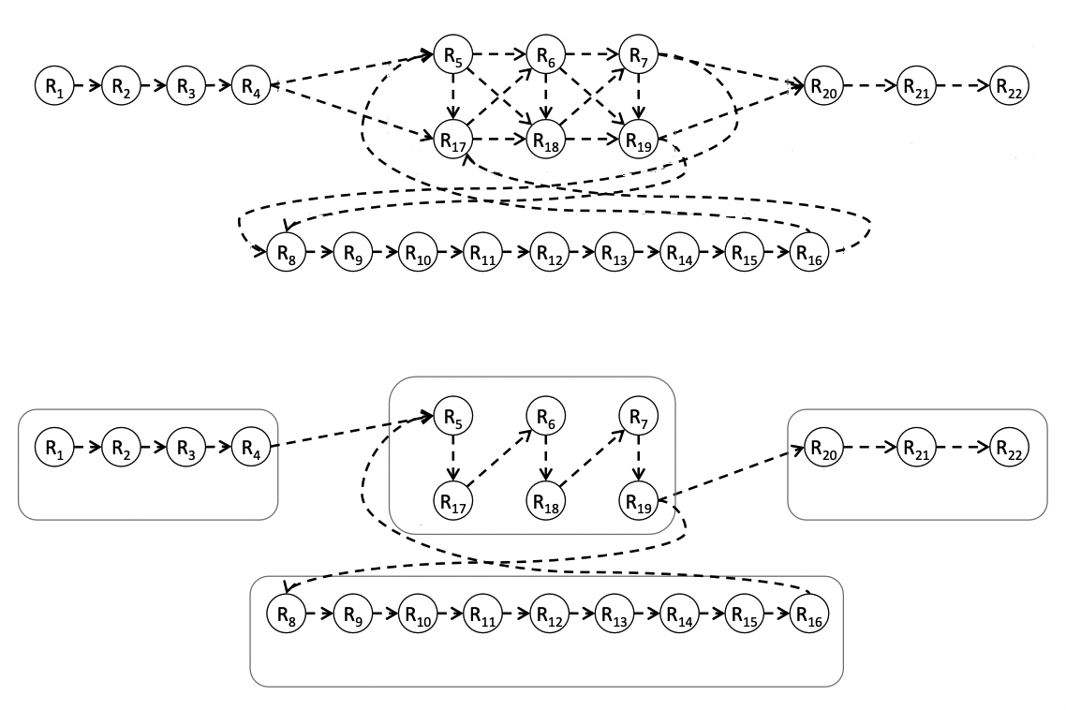
Layout
transitive
reduction
Ref. 4
maximal nonbranching paths = contigs
Notes:
Dylan

Slide 11
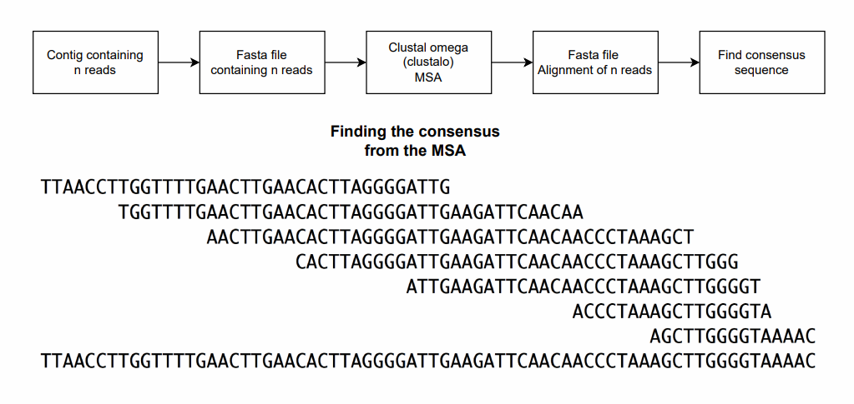
Consensus
Notes:
Dylan

Slide 12
Results
Notes:
Ethan

Slide 13
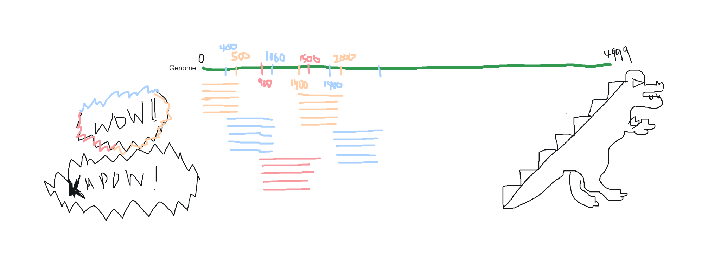
The Perfect OLC Dataset…
Notes:
Ethan
Why though? And why do we not get a single contig?

Slide 14
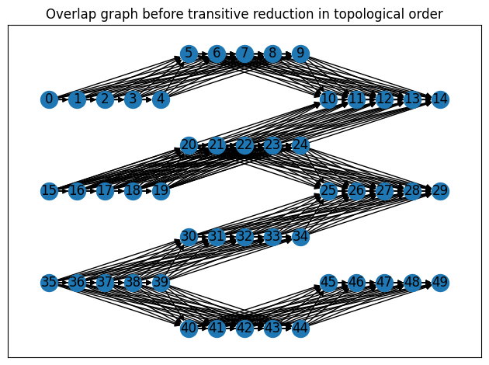
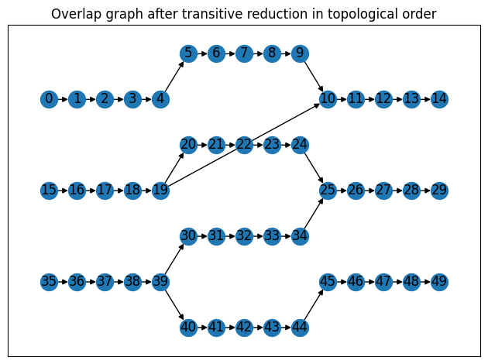
Why Transitive Reduction Matters?
Notes:
Ethan
Randomly Generated Genome of Length 5000
9 contigs, number of reads in each contig before consensus [11, 5, 5, 2, 7, 5, 5, 11, 7]
Length of consensus sequence after clustalo: [680, 600, 600, 635, 681, 600, 600, 687, 668]

Slide 15
Imperfect OLC Datasets…
Case 1
A synthetic genome is broken down into different sizes of reads (depth x1)
No sequencing errors introduced into the reads
Case 2
A synthetic genome is broken down into different sizes of reads (depth x1)
Sequencing errors (< 10%) are introduced into the reads
Our Results: (1) More contigs than reads, (2) Most contigs consists of two reads, (3) Many disjoint components (1 large connected component)
Notes:
Ethan
Why though? And why do we not get a single contig?

Slide 16
Conclusions
Optimization is an essential step to handle complex biological data.
Generating the overlap graph is the computational bottleneck of genome assembly.
The performance of our algorithm is very poor compared to Spades, even on the toy data!
Python might not be the best language to handle computationally intensive tasks.
Notes:
Zhen

Slide 17
Future Steps
Continue to run the pipeline on the real data (expensive)
Parallelize Jaccard Index Calculation and alignment step
Benchmark assembly results to existing tools
Troubleshoot the layout step for different sets of synthetic data
Characterize effects of different sequencing error rates and depths on our algorithm’s performance for the “Perfect OLC Dataset”
Notes:
Zhen
We do have jaccard index for all 100,000 reads

Slide 18
References
Amarasinghe, S. L., Su, S., Dong, X., Zappia, L., Ritchie, M. E., & Gouil, Q. (2020). Opportunities and challenges in long-read sequencing data analysis. Genome Biology, 21(1). https://doi.org/10.1186/s13059-020-1935-5
Berlin, K., Koren, S., Chin, C., Drake, J., Landolin, J. M., & Phillippy, A. M. (2015). Assembling large genomes with single-molecule sequencing and locality-sensitive hashing. Nature Biotechnology, 33(6), 623–630. https://doi.org/10.1038/nbt.3238
Chu, J., Mohamadi, H., Warren, R. L., Yang, C., & Birol, İ. (2016). Innovations and challenges in detecting long read overlaps: an evaluation of the state-of-the-art. Bioinformatics, 33(8), 1261–1270. https://doi.org/10.1093/bioinformatics/btw811
Sung, W. (2017). Algorithms for Next-Generation Sequencing. In Chapman and Hall/CRC eBooks. https://doi.org/10.1201/9781315374352
Zhang, H., Jain, C., & Aluru, S. (2020). A comprehensive evaluation of long read error correction methods. BMC Genomics, 21(S6). https://doi.org/10.1186/s12864-020-07227-0

Slide 19
k-mer | Γ₁ | Γ₂ | Γ₃ | Γ₄
GCA | 36 | 19 | 14 | 57
CAG | 18 | 13 | 56 | 39
AGT | 11 | 54 | 33 | 28
GTA | 44 | 27 | 6 | 49
TAC | 49 | 44 | 27 | 6
ACC | 5 | 48 | 47 | 26
CCG | 22 | 1 | 60 | 43
CGA | 24 | 7 | 50 | 45

