Slide 1
Budgerigar Transcriptome Annotation:
Final Slides
Team 1:
Amrit Baweja, Kevin Elaba, Rajee Ganesan & Ethan Gaskin

Slide 2
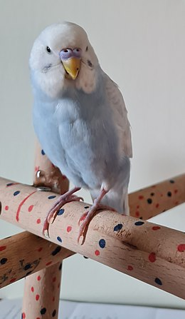
Bird.
Budgerigars (Melopsittacus undulatus) → better known as common parakeet
Sister taxons to songbirds
Thought to originate from Australia, no known transcriptome annotation available
Can we use proteins and regulatory elements to evaluate the connection to other birds in similar clades?
Notes:
reference genome to develop an annotation and search for proteins and regulatory elements, and evaluate the connection of the genomic makeup of the budgerigar to other birds in similar clades or evolutionary regions.

Slide 3
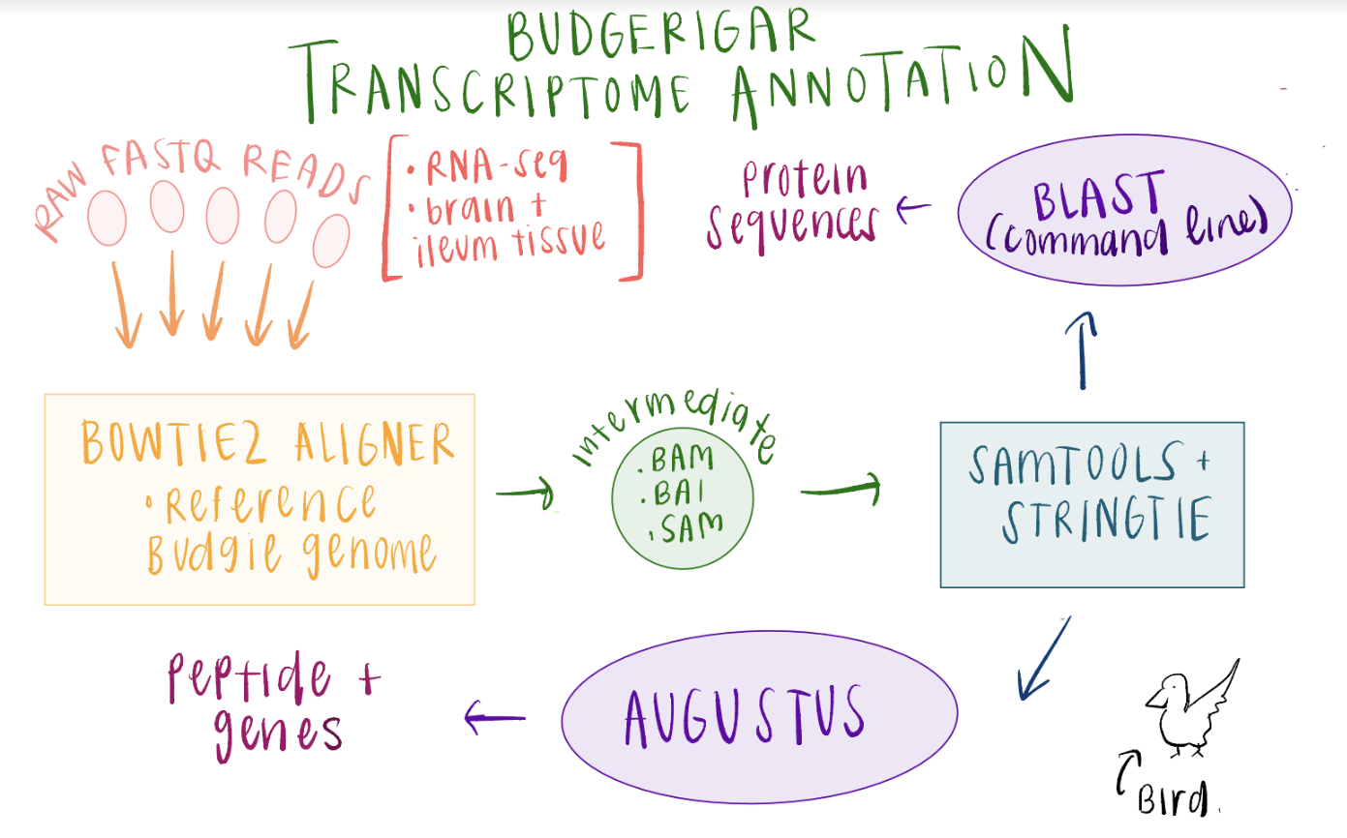

Slide 4
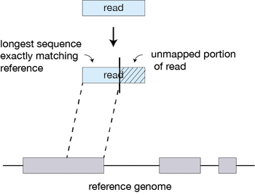
Aligning Bulk RNA-seq Reads to Reference Genome
Data acquisition
RNA-seq (ILLUMINA HiSeq 2500) with oligo-DT selection
Samples from LPS time scale experiment of parrot with brain and ileum tissues (same time point selected)
Bowtie2 alignment to reference genome
Paired-end alignment

Slide 5
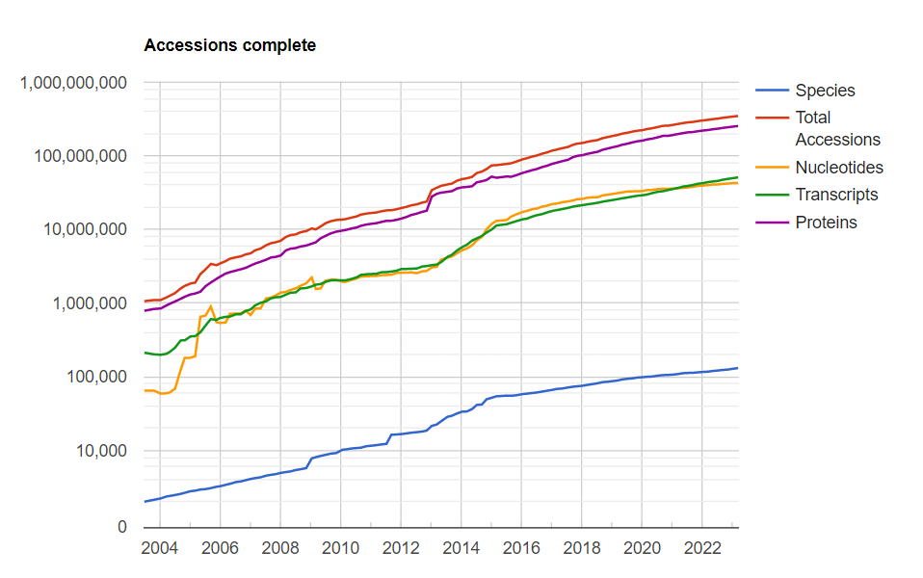
BLASTn RNA transcripts
BLAST+ installed to run BLASTn
Locally installed refseq_rna database
Parallelization allowed us to BLASTn all ~70000 transcripts vs 51,000,000 refseq_rna sequences (3.5 trillion alignments) in ~25 min
Sample ID | # of Transcript Queries | # Transcripts with Significant Matches (e-val <= 0.01) | # Transcripts with no Matches
SRR21563621 | 9565 | 8688 | 877
SRR21563622 | 17262 | 11214 | 6048
SRR21563623 | 16709 | 12680 | 4029
SRR21563624 | 13259 | 10438 | 2821
SRR21563625 | 12860 | 10641 | 2219
Examples on next slide
Notes:
https://www.ncbi.nlm.nih.gov/refseq/statistics/

Slide 6
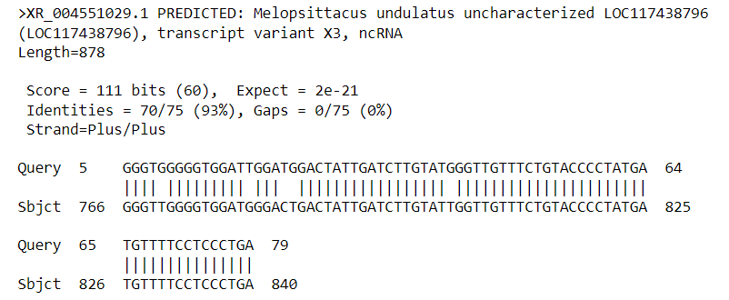
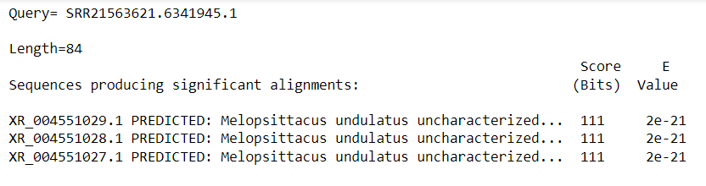
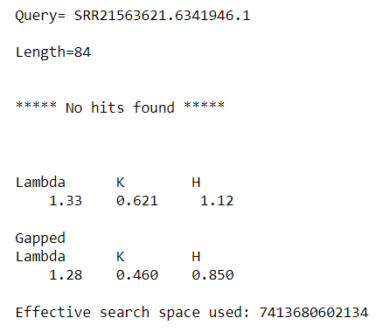
Example BLASTn outputs of some transcripts (from first sample)

Slide 7
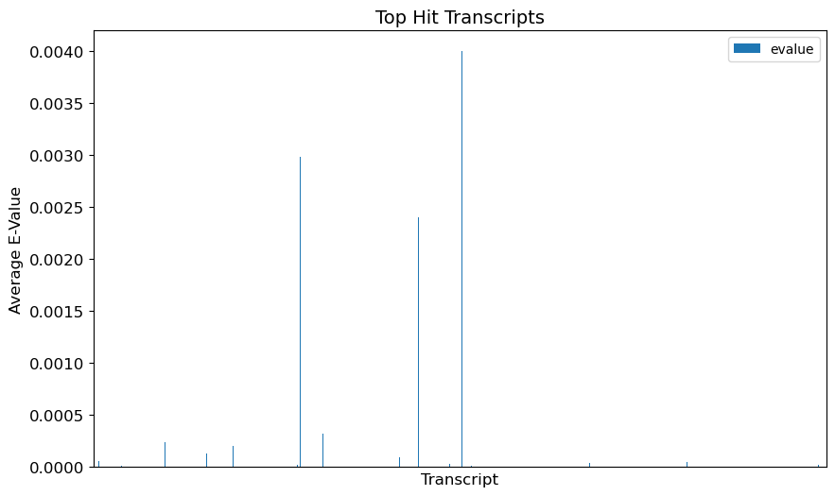

Slide 8
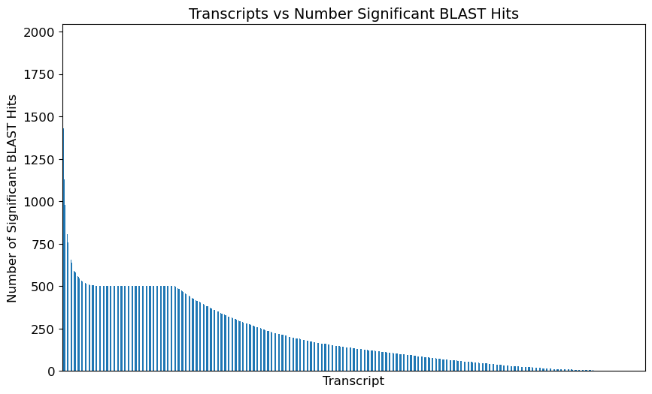

Slide 9
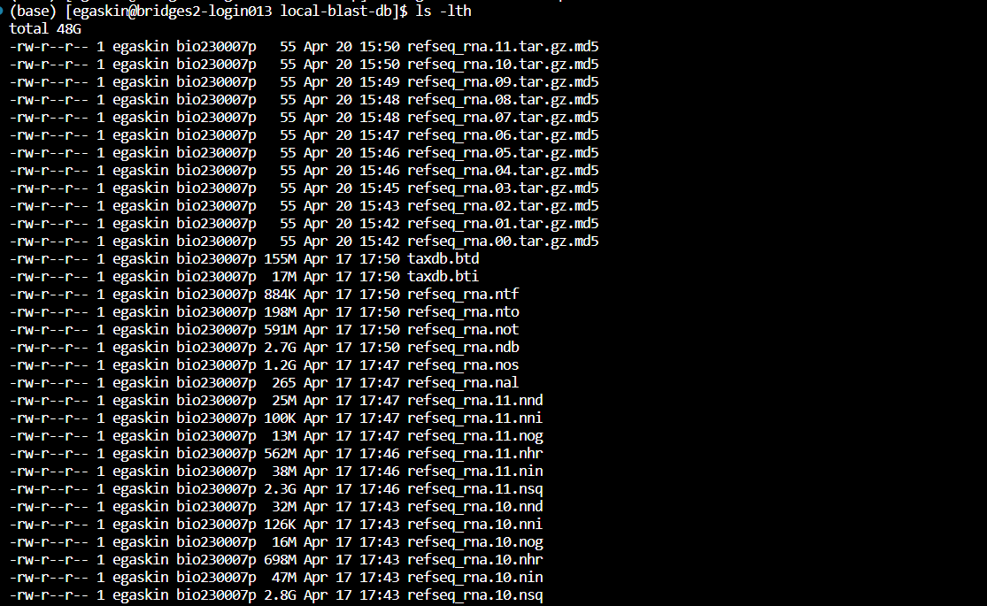
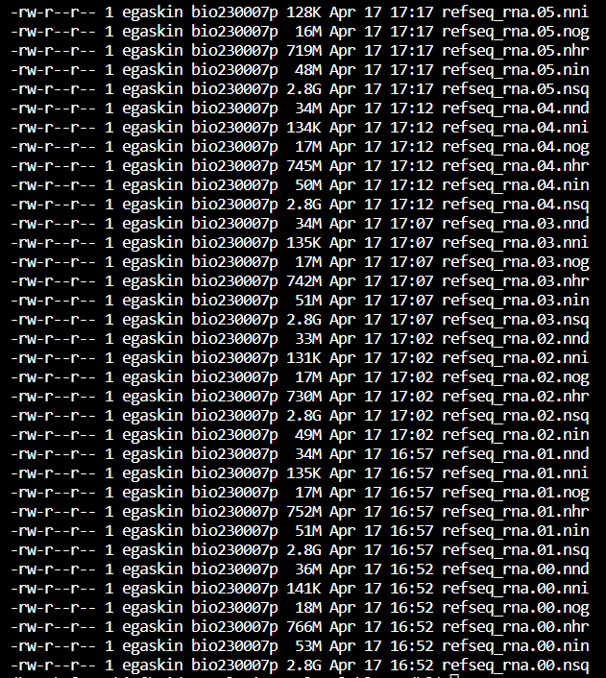
local blastn database: refseq_rna

Slide 10
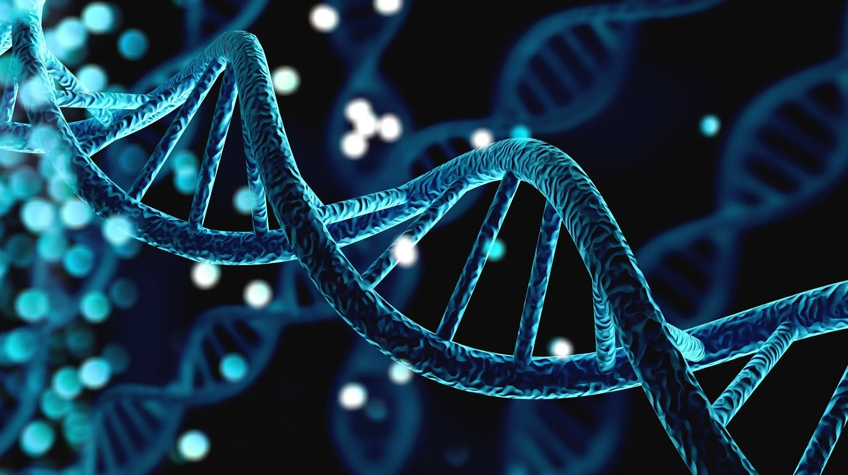
Gene Prediction using Augustus
Comparing how assembled transcripts align with predictions.
INPUT: FASTA files (bam files after alignment converted to fastq format)
OUTPUT: Predicted gene and peptide sequences

Slide 11
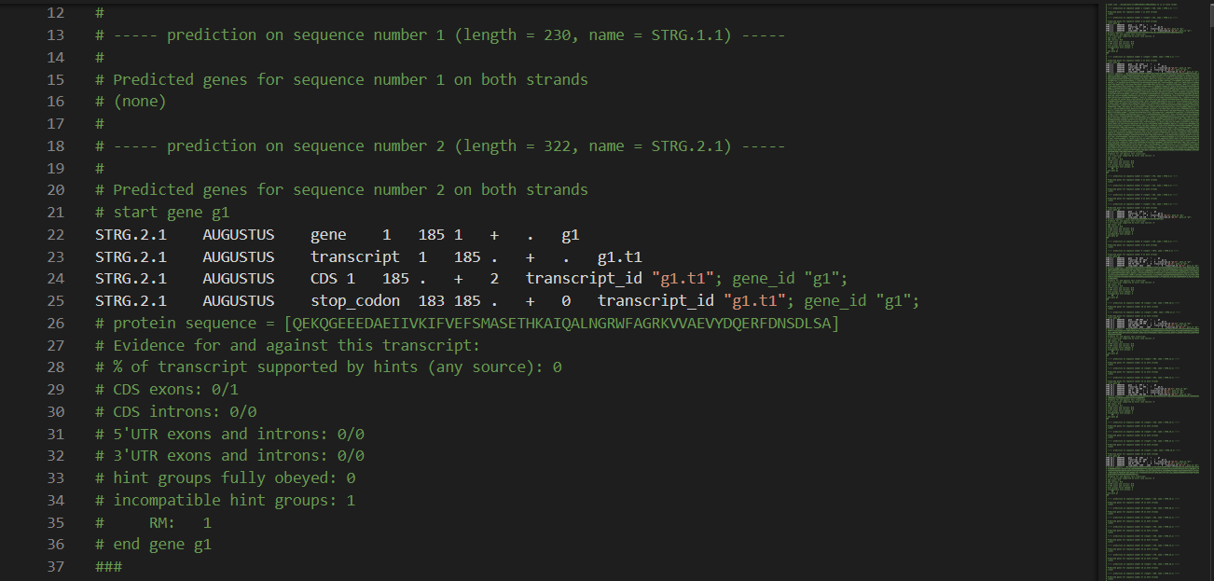
Augustus Output (first sample)

Slide 12
Wrapper script demo
Notes:
kevin.

Slide 13
Conclusions & Discussion
BLAST results
9565, 17262, 16709, 13259 and 12860 transcripts with identified protein matches and 877, 6048, 4029, 2821, and 2219 transcripts with no BLAST results, respectively.
Ran Augustus to visualize genes in Integrated Genome Viewer.
Future steps may include further analysis of the proteins and genes identified within genome browsers and viewers

