Slide 1

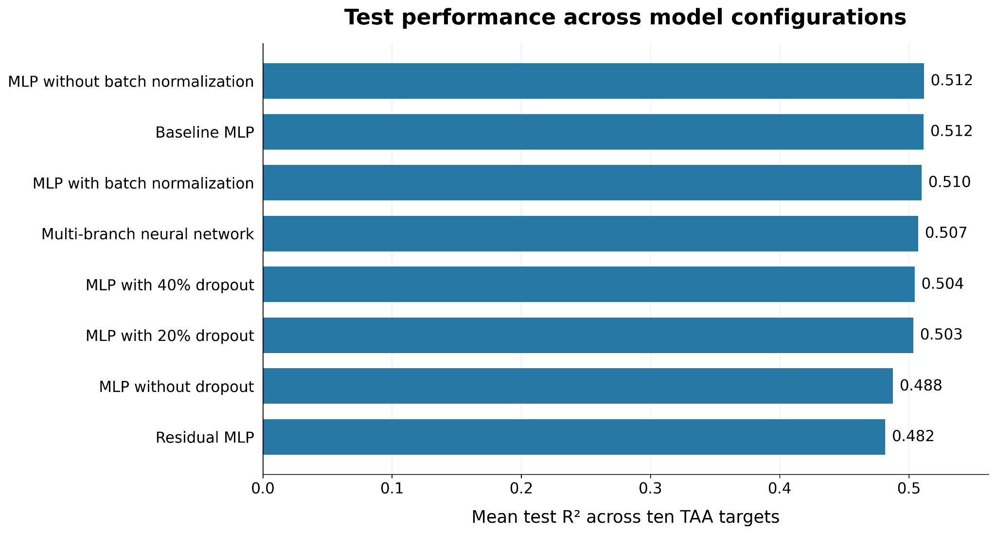
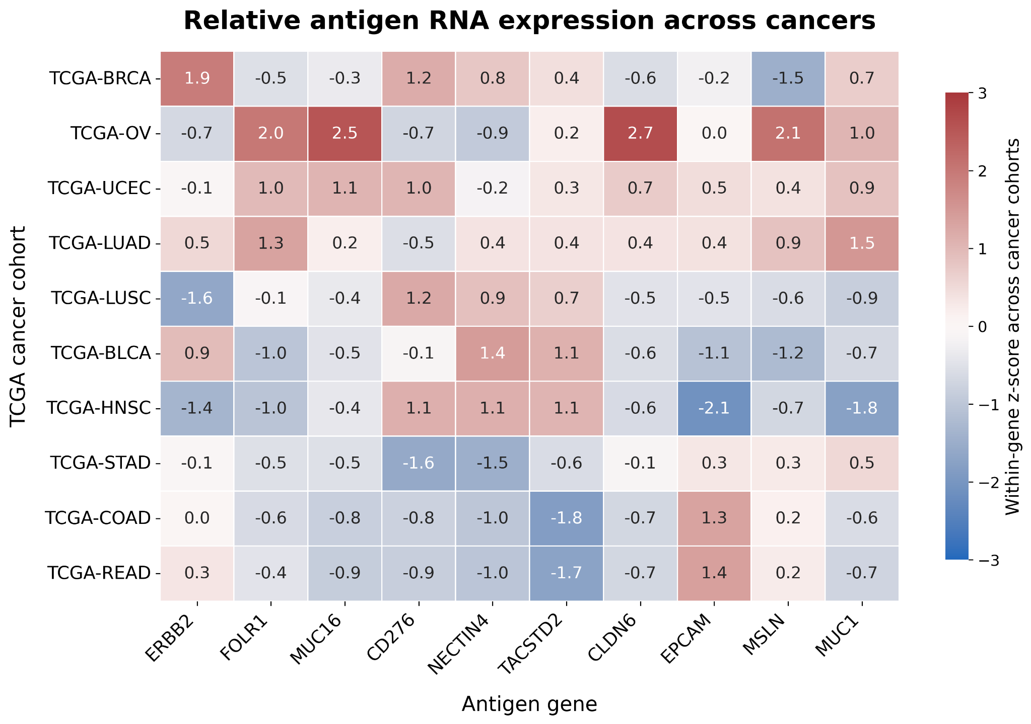
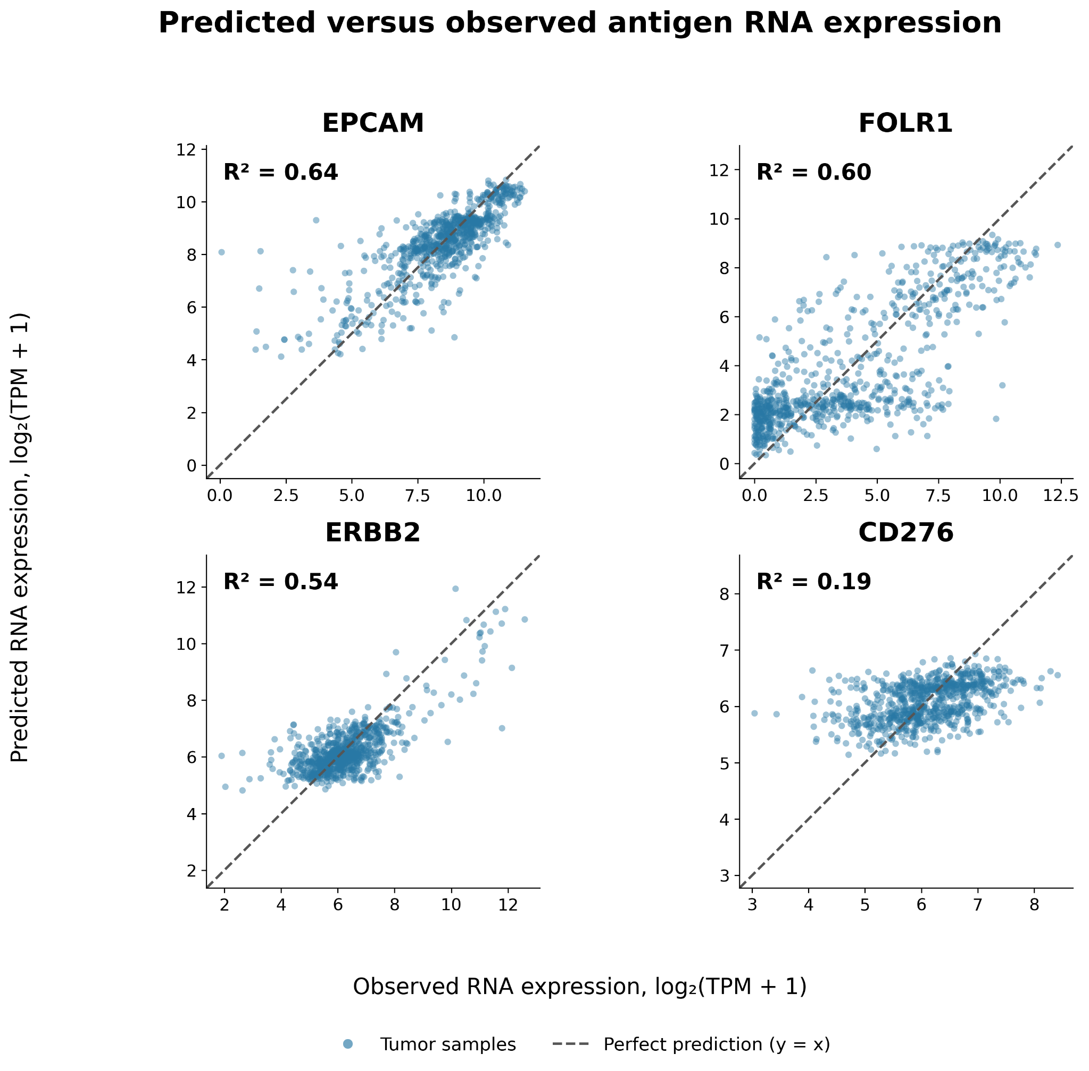
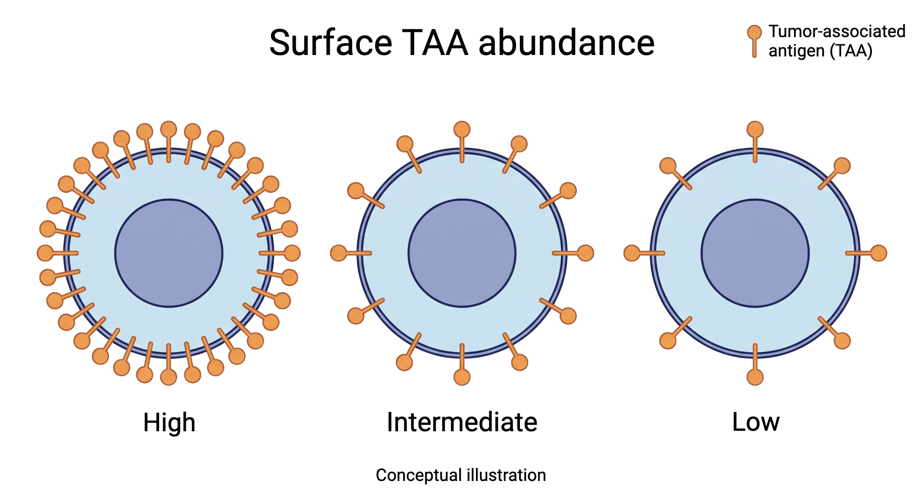
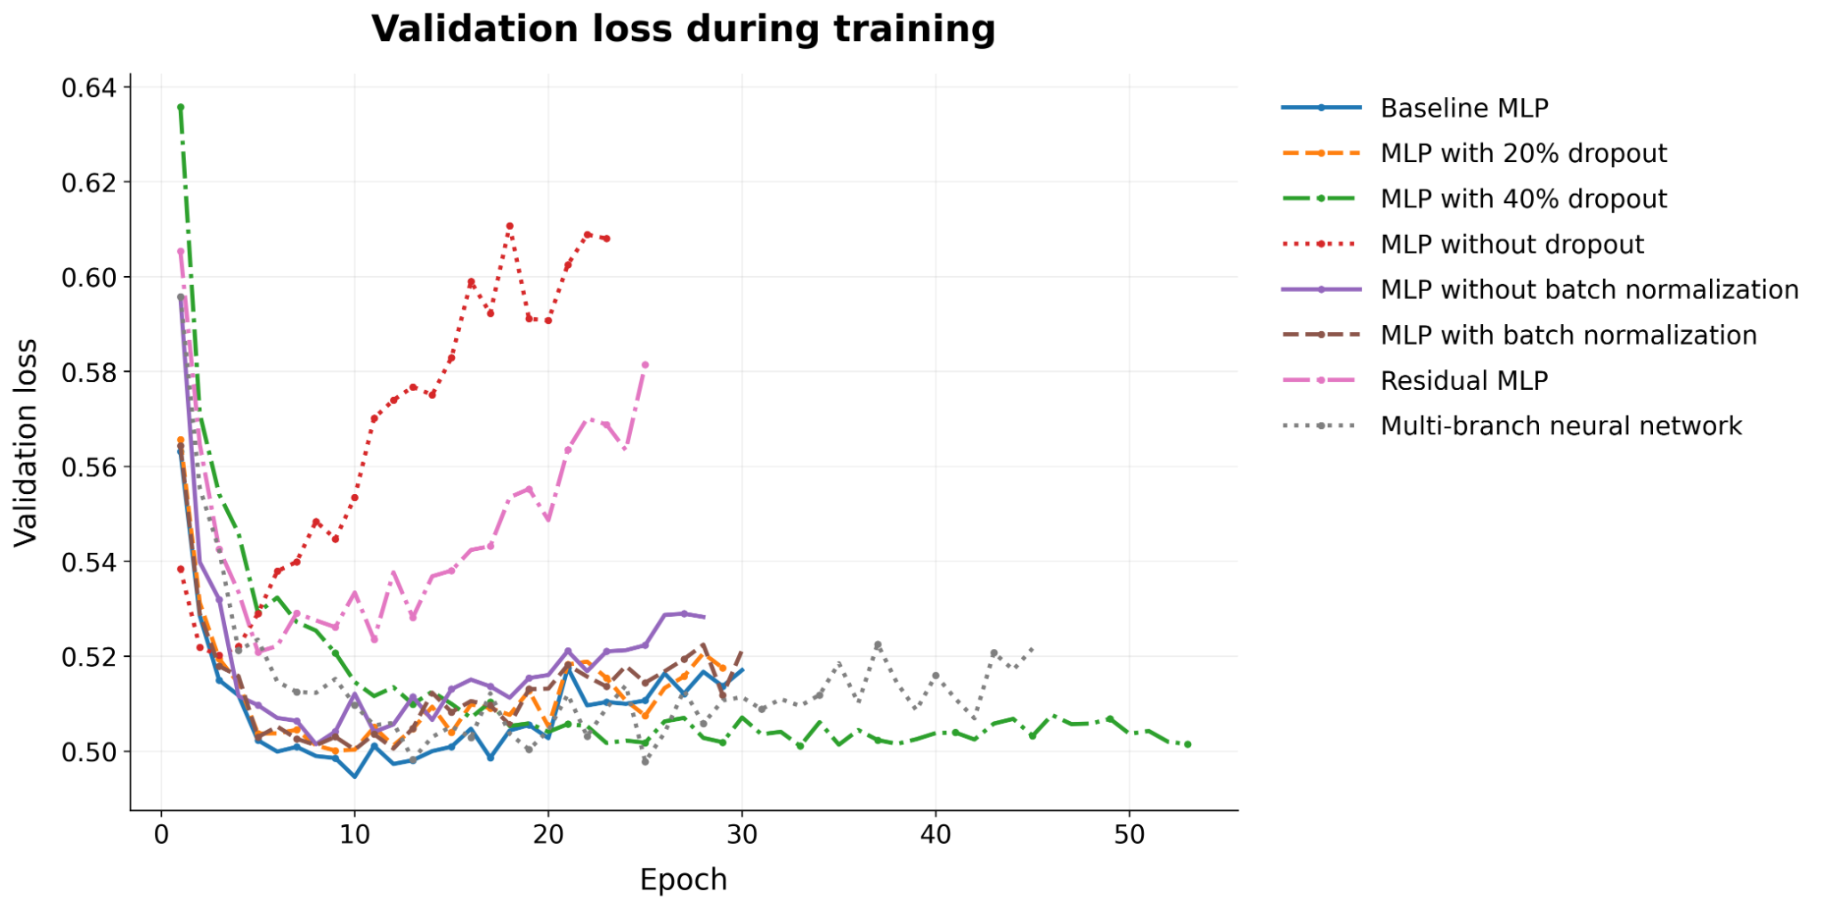
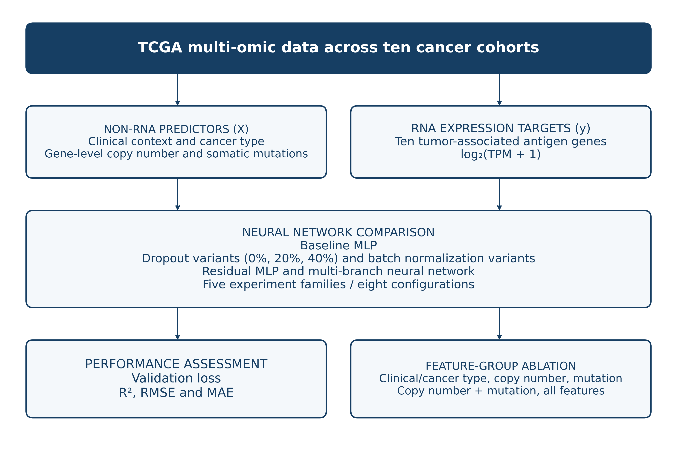
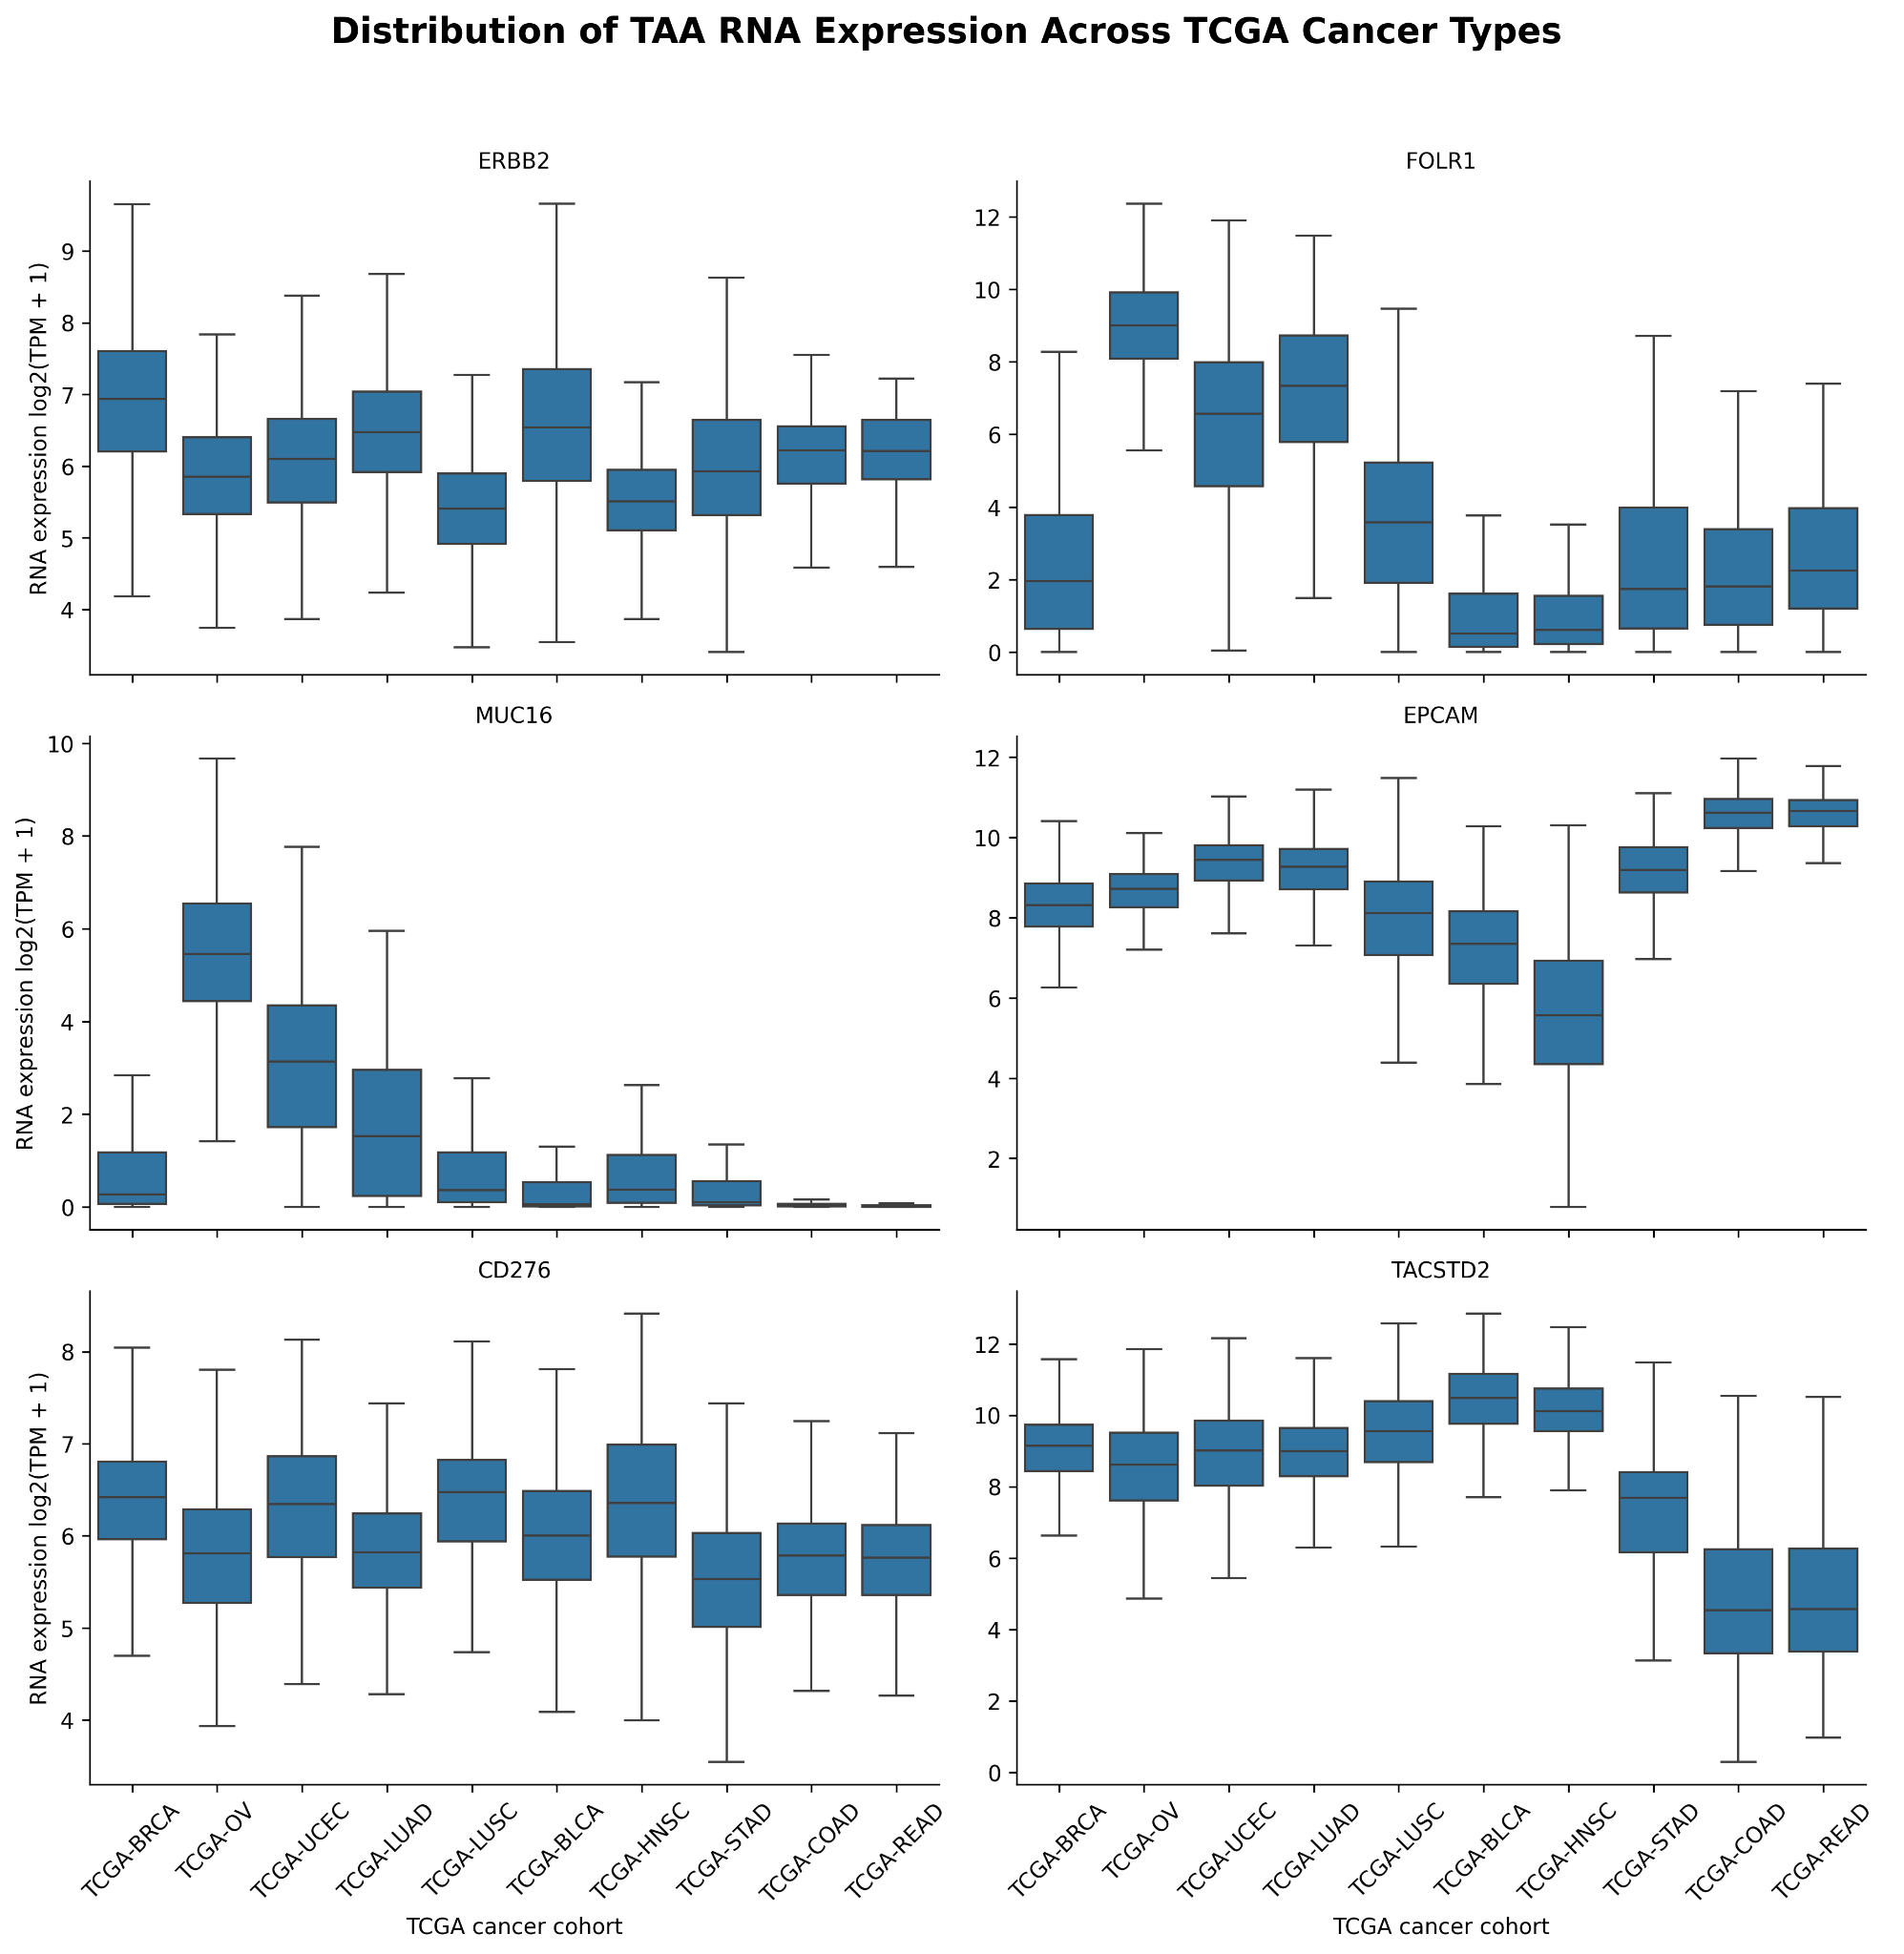
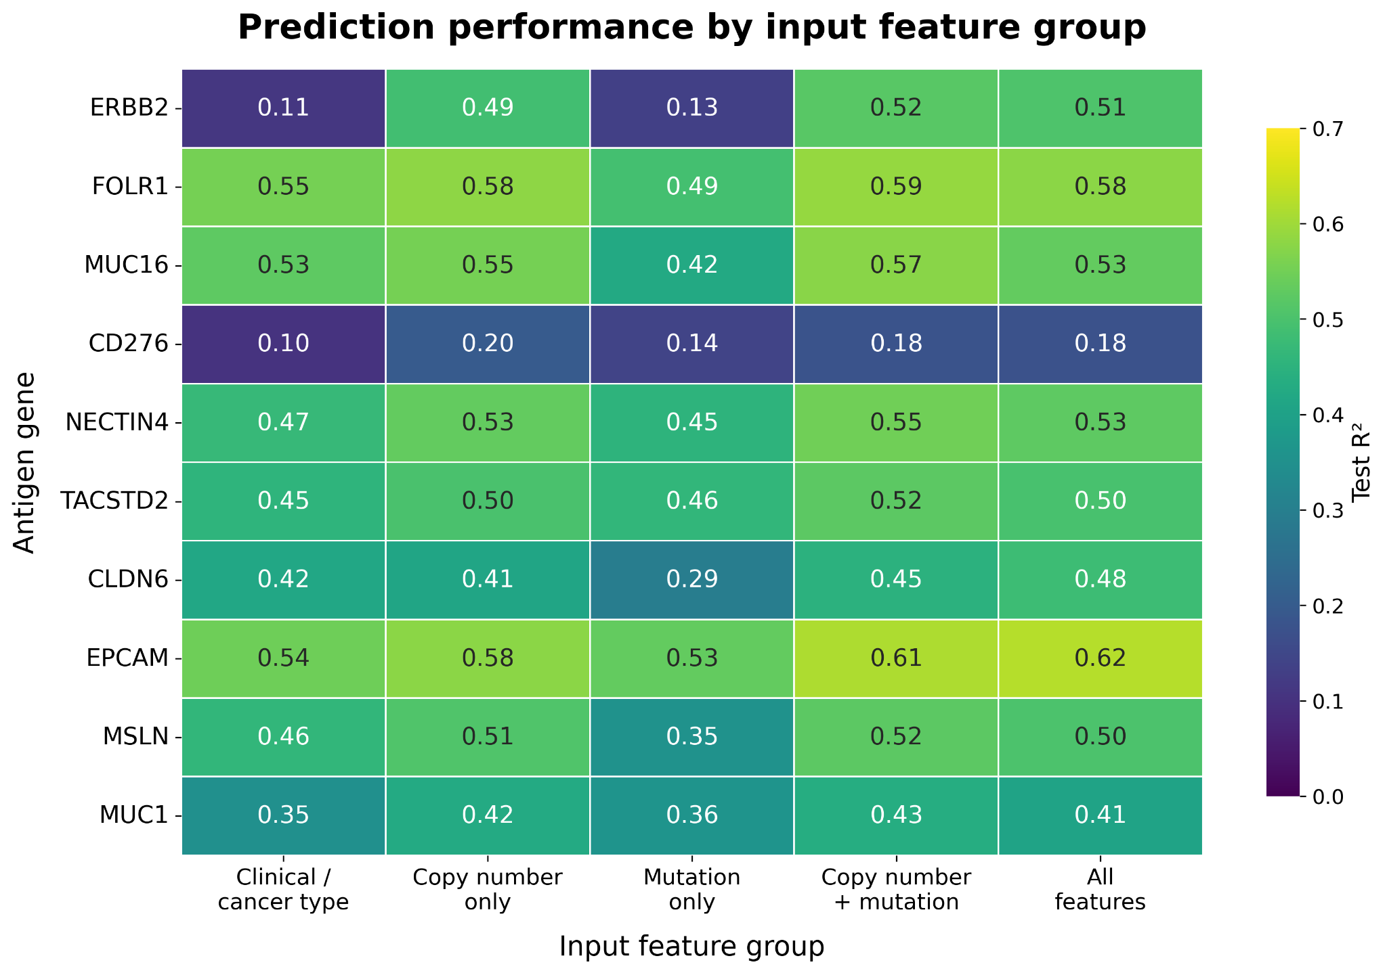
Deep Learning Prediction of Tumor-Associated Antigen
RNA Expression from Non-RNA Tumor Features
Erick Galdamez Calles | Faculty advisor: Jonathan Schlosser, PhD
The University of North Carolina at Chapel Hill
School of Data and Information Sciences · Master of Applied Data Science Program
Study design
Can non-RNA tumor features predict RNA expression for individual tumor-associated antigens (TAAs)?
10 TCGA cancer cohorts
10 TAA RNA targets
Model training and evaluation
BRCA Breast invasive carcinoma · OV Ovarian serous cystadenocarcinoma · UCEC Uterine corpus endometrial carcinoma · LUAD Lung adenocarcinoma · LUSC Lung squamous cell carcinoma · BLCA Bladder urothelial carcinoma · HNSC Head and neck squamous cell carcinoma · STAD Stomach adenocarcinoma · COAD Colon adenocarcinoma · READ Rectum adenocarcinoma
ERBB2, FOLR1, MUC16, CD276, NECTIN4, TACSTD2, CLDN6, EPCAM, MSLN, MUC1
Eight neural network configurations trained with AdamW.
Metrics: R², mean R² across targets, root mean squared error (RMSE), mean absolute error (MAE), and validation loss. Feature-group ablation compared input sets using R².
Outcome: bulk RNA expression, log₂(TPM + 1).
Inputs: cancer type and clinical features, gene-level copy number, and somatic mutation features.
Background
Model complexity adds little predictive gain
Relative expression differs across cancer types
Prediction accuracy depends on the antigen
Targeted therapies can bind tumor-associated antigens. Their expression varies across cancers and among tumors, so cohort averages can miss individual variation.
Mean test R²: 0.482–0.512 across eight configurations.
Validation loss falls early in training
Colors are within-gene z-scores of cohort mean RNA. ERBB2 is relatively high in BRCA and EPCAM in COAD and READ.
Conceptual illustration of surface protein abundance.
TAA expression varies within cancer types
Modeling workflow
Later increases in some configurations suggest overfitting.
R²: EPCAM 0.64, FOLR1 0.60, ERBB2 0.54, CD276 0.19. Some high-expression samples are underpredicted.
Copy number usually outperforms mutation alone
Reading the scatterplots
The diagonal marks perfect agreement. Points below it show underprediction. The four targets illustrate how much prediction performance varies by antigen.
Copy number alone beat mutation alone for most antigens.
Individual tumors vary in RNA expression even within the same cohort.
Key findings
Future work
Non-RNA tumor features predict TAA RNA expression with accuracy that varies across antigens.
Validate in independent cohorts and compare predicted RNA with measured protein abundance.
RNA predictions can guide follow-up studies. Cell-surface protein abundance requires direct measurement.
Acknowledgments
Jonathan Schlosser: modeling guidance. Elaine Chen: biological interpretation. Data: TCGA / Genomic Data Commons.
UNC Chapel Hill · Master of Applied Data Science Program
Notes:
Data and results: source UNC ABRCMS poster and original embedded figures. Tumor RNA is the modeled outcome. No independent validation or surface protein prediction is claimed.

