Slide 1

Territory management system
for Kings Park Filipino Congregation
http:// territory101.info

Slide 2
What is territory management system (tms) and its advantages?
This is a web application that monitors the maps released to publishers. Main objective of this system is to manage and monitor our territory maps effectively and efficiently, thus we accurately covered all our territory. Hence, we can guarantee that all maps been covered specially during campaign period.
This system solves or if not totally solve but minimize the problems encountered in the current manual releasing of maps, such as:
Not all maps are done equally in a period of time. For example, within six months, St Albans maps were done 2x or 3x but Tullamarine map wasn’t touched.
TMS implements a cycle, each map will only be released once in a cycle.
Some released maps were missing. No way of finding out whom to chase.
TMS stores to whom the map was released.
When a note we insert in our map to tag that a certain address is “Not Filipino” or “Address Not Found”, is lost, that address still remain in our map.
TMS allows the publisher to tag the status for each address in the map – Done, Not at home 1, Not at home 2, Not Filipino, Address Not Found. When an address was tagged as Not Filipino or Address Not Found, and the Territory Overseer approves it, that address won’t exists when the map is released in the next cycle.

Slide 3
cont... What is territory management system (tms) and its advantages?
Addresses in a suburb are not grouped equally. For example, One map in Caroline Spring has 20 addresses while the other map in Caroline Spring only has 6 addresses.
Kings Park Filipino Congregation territories (1238 addresses) were regrouped per suburb and suburbs with many addresses were grouped per 10 addresses as much as possible.
When no map available in a field service group, brothers and sisters do return visits instead, even though it’s their schedule to go to field service.
Anyone can approach an elder, MS or brothers who are leading field service group to ask for a map, either by calling them or sending them SMS. Brothers mentioned above have the access to assign map to a publisher. They can do anytime as long as they have internet access.
Or the brother (that is not an elder) who’s leading the group can ask the Territory Overseer a night before for maps they can do the next day.

Slide 4
How to access tms?
In your internet browser – Internet Explorer, Google Chrome, Firefox, Safari, etc. type http://territory101.info in the address bar
You can access this website in any device with internet – desktop computer, laptop, tablet or smart phone.
But keep in mind that the smaller the screen your device has, the uglier the resolution of page would look like.
Recommended internet browser is Google Chrome.

Slide 5
How to start using tms?
Give your email address to Territory Overseer.
Your email address will then be tagged with your name in the system.
After step 2 is done, you can now register by clicking “Not registered yet?” link in Login page. Then enter the password you want to use in TMS.
See next page for User Registration screenshot.
Use your email address and password to enter the website.
See next 2 page for Login page screenshot.

Slide 6
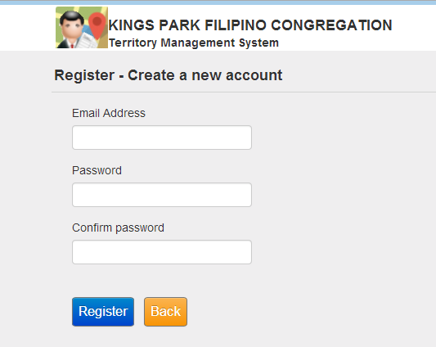
User Registration

Slide 7
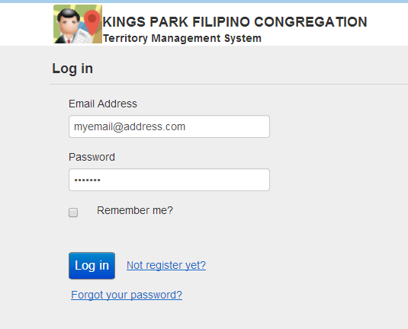
User Login

Slide 8
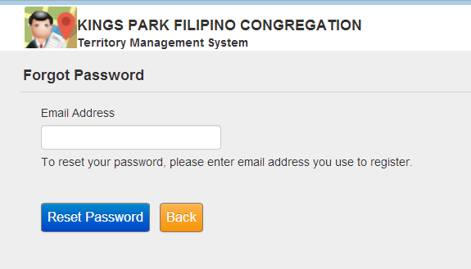
What if I forgot my password?
In Login page, click “Forgot Password?” link.
This will take you to this page to enter your email address.
Click “Reset Password” to get an email on how to reset your password.

Slide 9
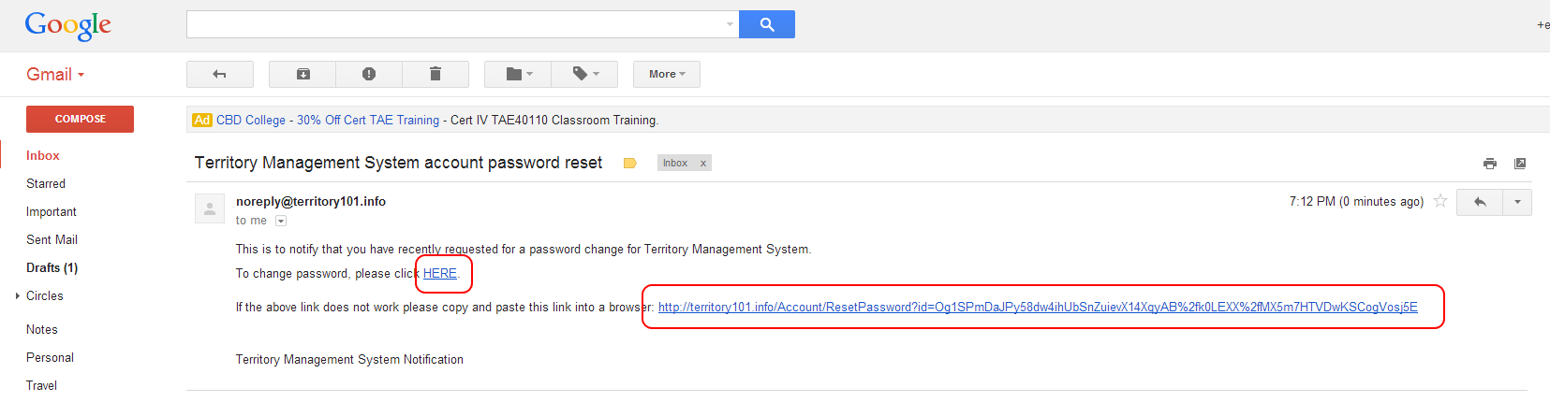
Reset Password email
Reset password email looks like this.
By clicking “HERE” or copy/paste the link in the address bar of your internet browser, will take you to page where you can enter your new password.

Slide 10
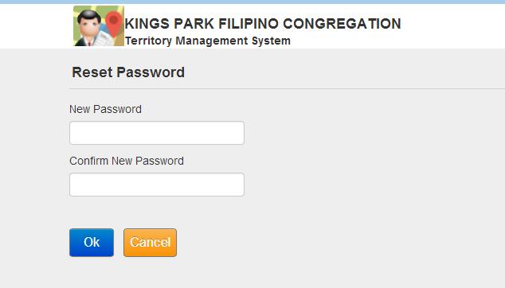
Reset Password
Enter your new password here.

Slide 11
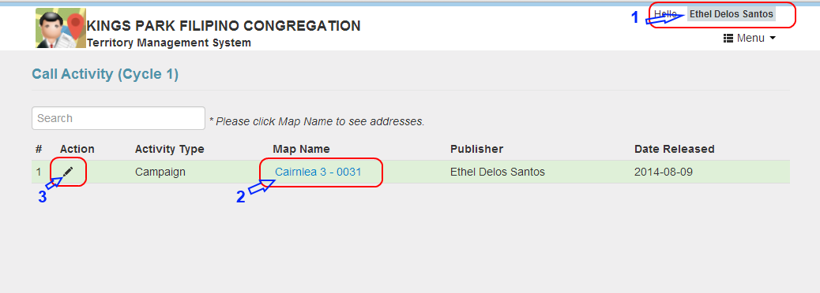
What will I do to maps I received?
When a map is released to you, you will see it in your main screen when you logged in.
Below is the screenshot how it looks like.
#1 Name of the publisher currently logged in – clicking this will log you out.
#2 Map Name – clicking this will display all the addresses in this map. See next page.
#3 Pencil Icon (Edit) – clicking this will take you to Details page where you can enter the status of each address in the map.

Slide 12
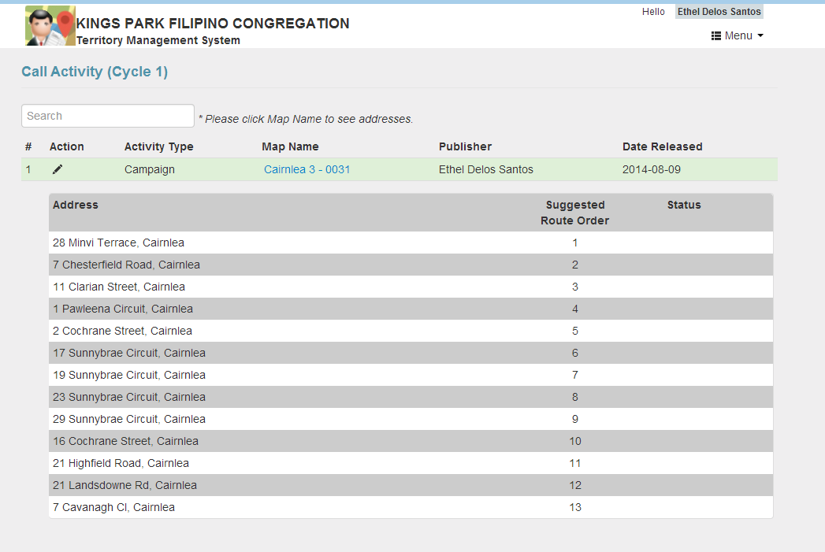
Map addresses

Slide 13
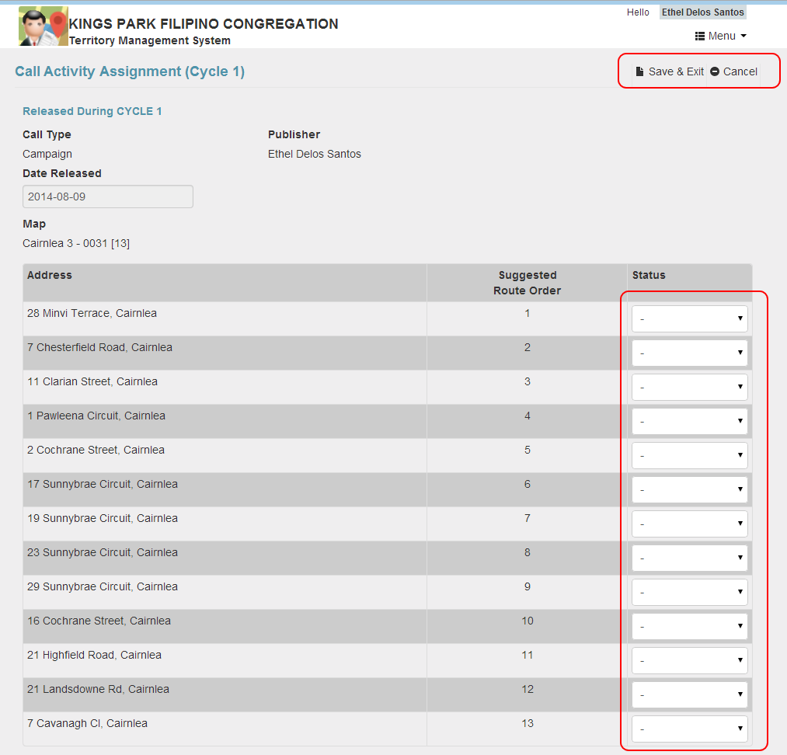
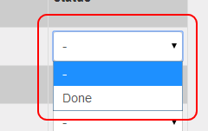
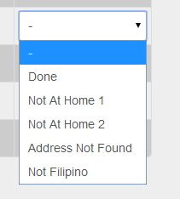
Map Details
Enter the status for each address in the map by selecting status from the dropdown list.
Campaign
Regular/Personal Territory
You can update all at once and click “Save & Exit” or just update one or few addresses and click “Save & Exit”. It will then take you to Home page.
Cancel link will disregard all your updates in the page and take you to Home page.

Slide 14
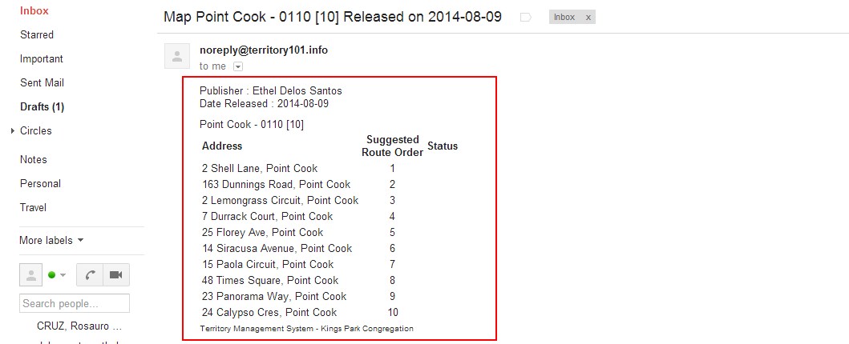
Emailed Map
You can request the map assigned to you to be emailed .
Email looks like this:

Slide 15
Frequently Asked Questions:
I don’t have internet in my mobile phone or tablet, what will I do? Can I still get map?
Yes, you can get a map. All publishers can get a map even though they don’t have mobile access or email address.
Because you can’t access the website to see the addresses you’re suppose to go, the Brother leading the group will either give you a printed copy of the map or take a screenshot from his device and send it to you as MMS or copy paste the addresses and send it to you as SMS.
You can update at home the status of the map assigned to you.
I don’t have email address or I don’t want to give my email address, can I still get map?
Yes of course. Please refer to question #1.
But because you didn’t give any email address to be entered in TMS, you can’t register as a user of the website and you can’t access it.
I can’t find an address in the map, but the only option for me to update the status is Done, what will I do? Where are the other status?
When Call Type is “Campaign”, only “Done” status is available for you. You need to inform the Territory Overseer that a certain address in a map is not valid anymore. (or the system will be changed to also show Not Filipino and Address Not Found)

