Slide 1
Fishopoly
a questionably unethical fishing game
Notes:
1-7
8-13
14-rest

Slide 2
About Us
Christiana Ramey -
C/C++, C#
RNG for Breeding
RNG for Fish images
NPC Generator
Music
Gloria Kim -
C/C++, C#
General UI Design
PC design
Environment design
World Generation
Jasmine Wicker -
C/C++, C#
Boat design
Fishing Mechanics
Currency system
Upgrade system

Slide 3
General Goals
Aim 1: Catch fish using a fishing pole.
Aim 2: Breed fish for different, never before seen fish. Bred fish are generally better fish.
Aim 3: Explore different oceans with different unique fish. Areas are explored by travelling a certain distance in the x direction.
Aim 4: Have a family tree that tells you what ancestors a fish has.
Aim 5: have a log of all fish currently discovered
Aim 6: have different baits that can attract fish
Aim 7: upgrade boat to travel further
Aim 8: upgrade fishing pole to fish deeper
Notes:
(click the fish to see the ancestors, etc.)
Goes further in x direction = different ocean
Goes further in -y direction = different fishes

Slide 4
Assigned Functions
Each member has at least three functionalities, including one “HARD (REQUIRED)” and ONE “REQUIRED”. CHRISTIANA GLORIA JASMINE 1. HARD (REQUIRED) Fish Breeding 2. HARD (REQUIRED) NPC Generator (spawn fishes in backgrounds, possibly depends on time) 3. (REQUIRED) NPC Design (fish are designed through cellular automata) 4. HARD (REQUIRED) PC - Fishing Pole (move downward in general direction towards mouse, never upward. Fishing animation. Upgrades to pull fish in faster. (needed for deeper fish)) 5. HARD (REQUIRED) Environment (design 5 different oceans + set 5 different backgrounds/world + possibly change the color of sky based on time) 6. (REQUIRED) Log and family tree (track discovered fish) 7. (REQUIRED) Currency and store (in exchange of caught fish, used to upgrade boat and fishing pole) 9. (REQUIRED) PC - penguin (move side to side and animation, travels with boat, travels up dock) 10. (REQUIRED) Boat (move leftward/rightward with PC on it. Animation) 11. (OPTIONAL) Baits (attract specific NPC, i.e., fishes) 13. (OPTIONAL) Weather

Slide 5

The World
Aim 1: Consists of a background and floor with several layers
Aim 2: All actions take place on an xy plane
Aim 3: PC is slightly affected by gravity in that the bobber must sink when thrown
Aim 4: The world is procedurally generated unto n length. This is done for all 5 oceans. Crossing oceans should be seamless
Aim 5: The camera is fixed on the bobber (PC)
Aim 6: The world is traversed on the x plane, left(2 extra oceans) or right(2 extra oceans). past a certain distance, the PC will arrive at a new ocean. The user will know this by change of environment and music along with notification in game.
Notes:
Bobber = you have a steady speed going down.
Camera follows bobber

Slide 6




Time of Day
Time of day is important for fish as they can only be caught at certain points of the day (morning, noon, twilight, midnight).
Time changes through ingame mechanic, TIME IS NOT BASED ON REAL TIME.
Sky can change according to time. Possibly animate the sun and moon.

Slide 7
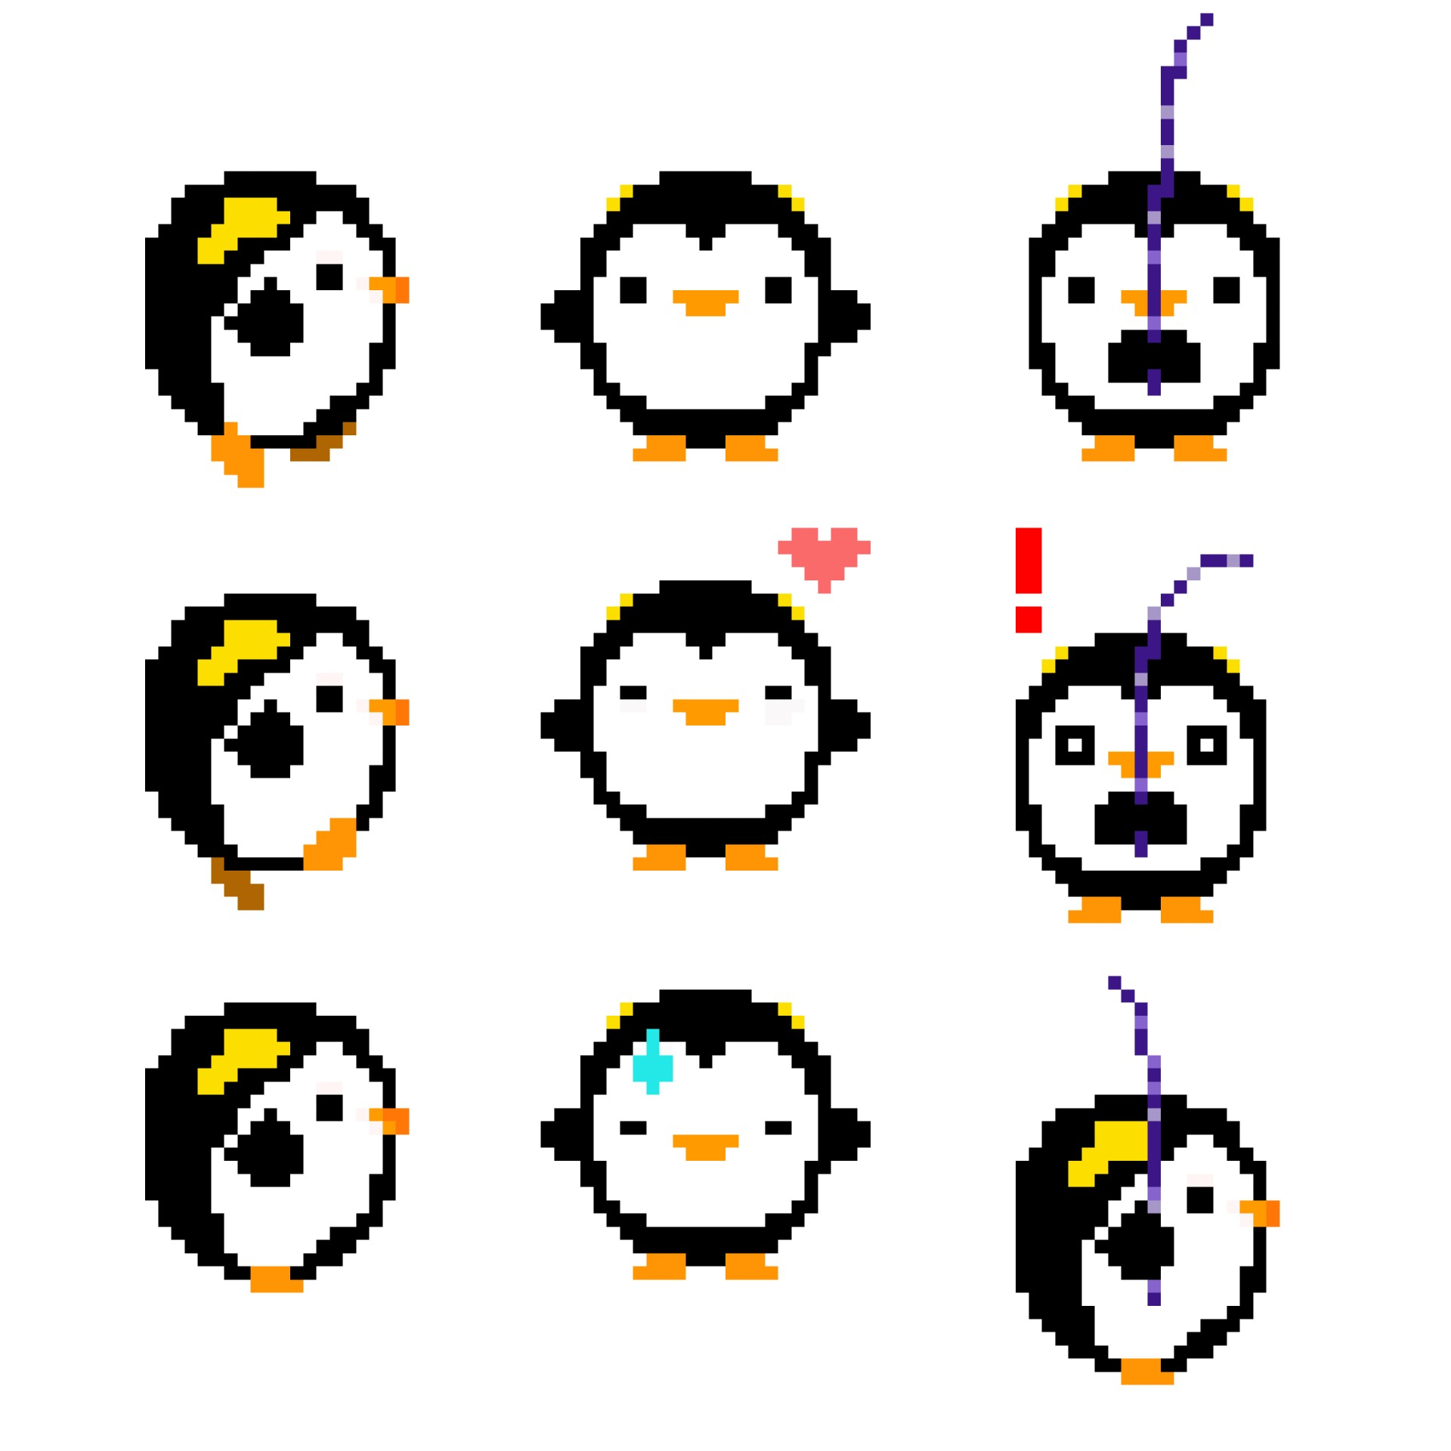
Player Character - Penguin
Moves left, right, and possibly up using the WASD format.

Slide 8
UI Mockup
Christiana Ramey

Slide 9
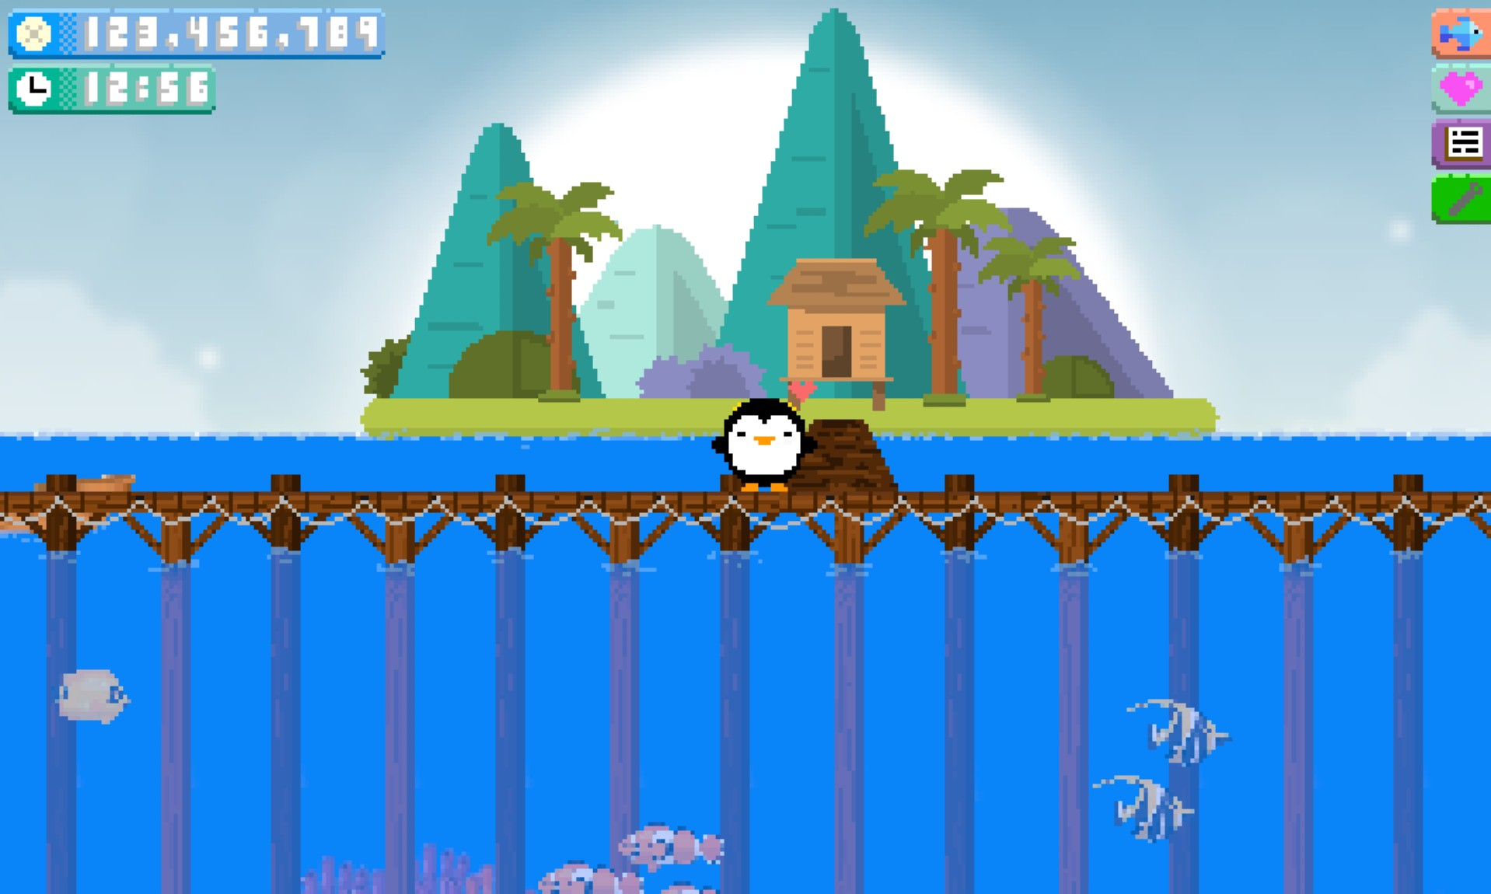
Starting point and UI
Fish Inventory:
displays each fish you have kept.
Breeding:
displays breeding fish and time left of breeding.
Fishing Log:
displays every fish the player has caught, including those released back into the ocean.
Sand dollars are earned through selling fish
(optional) Sky changes through time of day
Settings: displays credits, music volume, etc..
Fish by clicking and holding the left mouse button

Slide 10
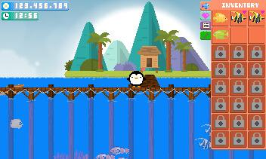
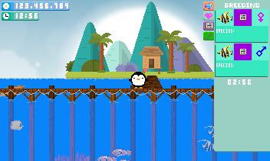
Inventory:
6 containers at start, more unlocked by purchasing with sand dollars
holds one fish; same species do not stack
Displays heart symbol when breeding
Breeding:
Displays selected breeding fish
Includes sex and species
Log symbol opens expanded log details
Breeding time displayed below fish

Slide 11
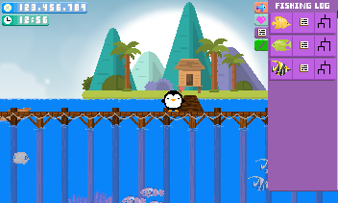
Fish Log:
Displays each fish
Log symbol opens detailed information on the fish species.
Tree symbol opens family tree for breeding ancestor details
Settings:
Contains sliders to change volume
Contains button to view credits.
Notes:
Weight, size, place caught, time caught

Slide 12
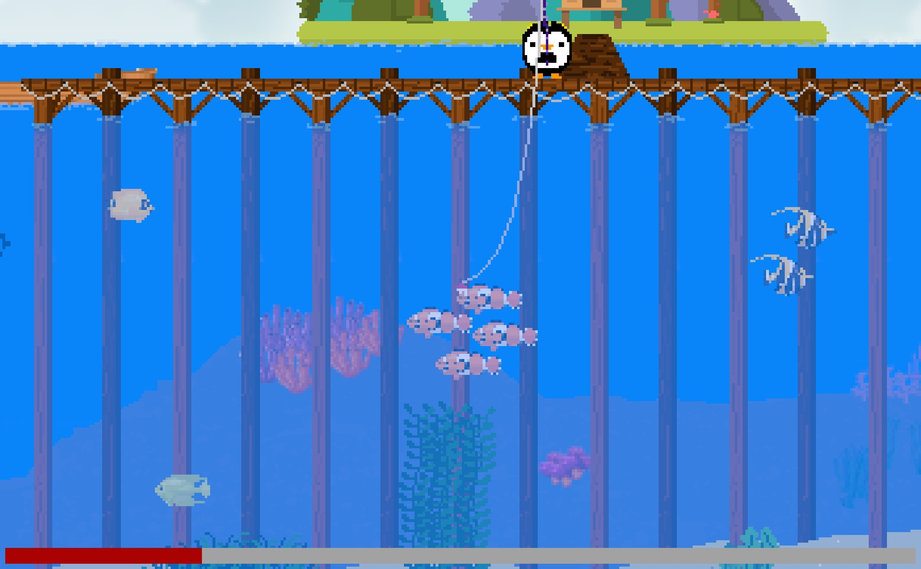
Fishing Mechanic
When a fish is caught, player must continuously click left mouse button to reel in the fishing line.
The menu icons will remain stagnant in the top right of the image. They will not reposition to remain in the screen.
Screen pans down based on red and white bobber location. The bobber moves toward cursor location.
A bar will appear at the bottom once a fish is caught. It will fill with resistance from the fish. Once filled, the line will snap. You need to click when not resisting.
This can be compared to The Legend of Zelda: Link's Awakening fishing minigame.

Slide 13

Breeding Mechanic
In the breeding portion of the UI, fish can be selected for breeding
Must have one male and one female.
Bred fish will contain an average of data between mother and father, but in certain aspects, they will follow a punnett square to determine traits (color, feeding time, etc.)
Fish images (sprites) will be generated through cellular automata. This makes the breeding more interesting as every single fish (as long as they dont have the same species of parent) will look different.
The idea is that you are to breed a super fish that can be sold at a super price.

Slide 14

Island Life - ART WIP
Travel up the dock to visit the island where you reside!
Contains shop and possibly questing cat/animal
Possibly contains a house for which you can purchase decorations
Contains boat store
Notes:
You can travel up the dock to visit the island where you reside!
The dock contains shop and possibly some ani

Slide 15
Questing (Optional)
Certain creatures can appear once an in-game day to request a fish for a higher than normal price.
The request can be for a fish of a certain size or a fish from a different ocean or a fish of a certain colour or a fish of a certain age, or any combination of the aforementioned traits.
The questing animals will reside on the island and a notification will appear to the user when they have arrived and departed.

Slide 16


How Many Fish are in the Ocean?
Each ocean has a table of fish. (Stored in a hash table)
Each chunk of the ocean (chunk is the part of the ocean that is currently loaded) has a sub table of fish that are to be visible by the PC.
Fish can breed in the ocean! Breeding uses the table of fish for the entire ocean.
Bred fish are added to the table.
Sub tables are randomized upon leaving and entering an ocean.

Slide 17
Fishing poles
Different fishing poles yield deeper fish! As you upgrade fishing poles it is possible to catch rare fish in deeper waters.
Controlled with mouse.
Fishing poles cost a currency that can be bought at a shop

Slide 18
Boats
The only way to travel to different oceans is by boat
You must upgrade your boat to increase the distance it can travel.
Boat upgrades cost currency to upgrade
Once an ocean is discovered, the PC and the boat can fast travel to a selected ocean if desired.

Slide 19
References
Most art was created by Christiana ramey. The following art was pixelated and edited by Christiana Ramey:
https://www.vecteezy.com/vector-art/614312-different-types-of-seashells-on-white-background
https://www.vecteezy.com/vector-art/86049-tropical-fish-vectors
https://www.vecteezy.com/vector-art/301812-different-types-of-coral-reef
https://www.vecteezy.com/vector-art/160348-sea-weed-vector-icon
https://www.vecteezy.com/vector-art/126452-mountain-shack-vector-illustration
https://www.vecteezy.com/vector-art/229821-vector-beautiful-landscape-illustration
https://www.vecteezy.com/vector-art/229836-vector-beautiful-summer-illustration
https://www.vecteezy.com/vector-art/225482-vector-beautiful-seascape-illustration/editor
https://www.vecteezy.com/vector-art/217221-vector-nature-landscape-illustration

Slide 20
Software
Art was created using the following programs (Pixelmash is paid for)
PixelMash- https://nevercenter.com/pixelmash/
Gimp - https://www.gimp.org/

