Slide 1

SE 2226
Software Quality Assurance
and Testing Project
Department: Software Engineering
Prepared By:
Toprak Güçlü – —
Berkay Yıldırım – —
Serdar Sabit Güngör – 2370006081
Ege Artun – —

Slide 2
CONTENT & OUTLINE
Project Overview
SauceDemo — UI Testing
01
02
Tested applications & testing stack
Selenium WebDriver · Selenium IDE · Playwright
Library DB — Unit Testing
Mutation Testing
03
04
Jest · 48 test cases · Code coverage
Stryker · 105 mutants · 60.19% score
Load Testing
Results & Conclusion
05
06
JMeter performance & stress tests
Summary of findings
1

Slide 3
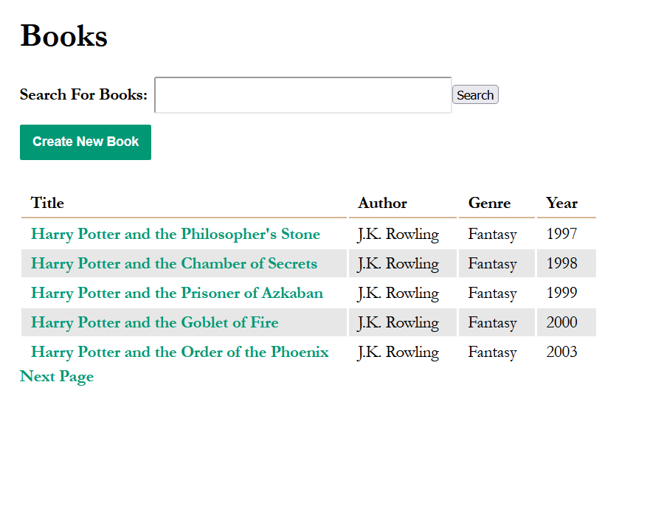
PROJECT OVERVIEW
Library DB Express
Node.js / Express / Sequelize / SQLite
Books CRUD web app with REST API.
Backend testing performed with:
• Jest (Unit + Integration)
• Stryker (Mutation Testing)
• JMeter (Load Testing)
Endpoints tested: CRUD + Search + Pagination
GET /books · POST /books/new
GET/POST /books/:id · DELETE /books/:id/delete
404 & 500 error handlers
2

Slide 4
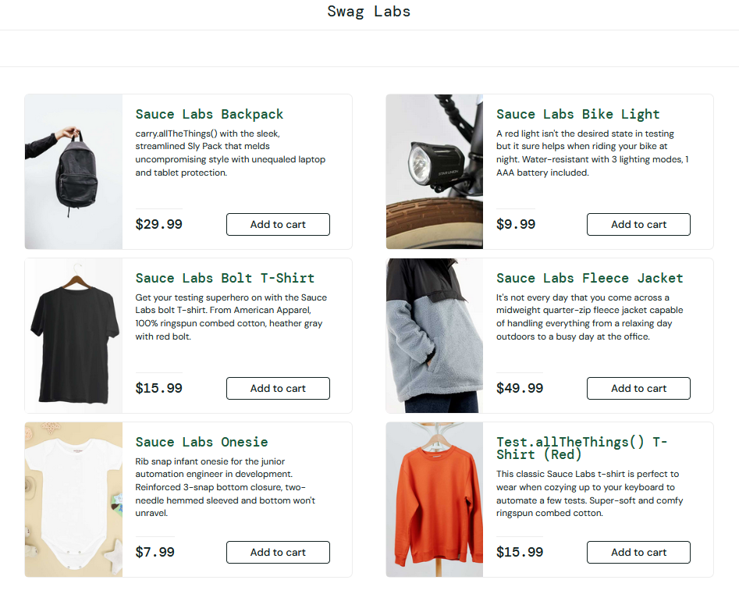
SAUCEDEMO
SauceDemo
SauceDemo
Library DB Express
https://www.saucedemo.com
E-commerce demo site for testing.
UI testing performed with:
• Selenium WebDriver (Java)
• Selenium IDE (.side)
• Playwright
Test Scenarios: 7 automated flows
Valid Login · Invalid Login · Locked-Out User
Add/Remove Product · Checkout Validation
Successful Purchase · Logout
https://www.saucedemo.com
2

Slide 5
SELENIUM WEBDRIVER — JAVA
SauceDemo — UI Automation Testing
Test Cases
ValidLoginTest.java
@Test
public void validLoginTest() {
driver.get(
"https://www.saucedemo.com/");
driver.findElement(
By.cssSelector(
"[data-test=\"username\"]"))
.sendKeys("standard_user");
driver.findElement(
By.cssSelector(
"[data-test=\"password\"]"))
.sendKeys("secret_sauce");
driver.findElement(
By.cssSelector(
"[data-test=\"login-button\"]"))
.click();
assertTrue(driver.getCurrentUrl()
.contains("inventory.html"));
}
validLoginTest()
Valid Credentials → inventory page
PASS
invalidLoginTest()
Wrong password → error message
PASS
Tools & Framework
Selenium 4 · JUnit 4 · ChromeDriver · CSS Selectors
3

Slide 6
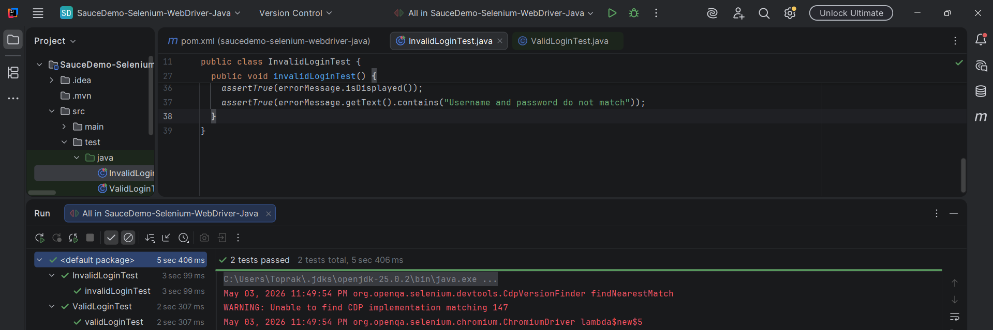
SELENIUM WEBDRIVER — TEST RESULT
Selenium WebDriver Java test execution result — 2 tests passed
4

Slide 7
SELENIUM IDE — TEST SCENARIOS
SauceDemo — 7 Automated Test Scenarios (.side file)
1
Locked-Out User Login Validation
PASS
Tests that a banned user cannot log in
2
Add Product to Cart
PASS
Logs in, adds product, proceeds to checkout
3
Remove Product from Cart
PASS
Logs in, adds product, then removes it from cart
4
Checkout Form Empty Field Validation
PASS
Attempts checkout without filling required fields
5
Successful Purchase Flow
PASS
Complete end-to-end purchase with valid data
6
Logout Process
PASS
Verifies user can successfully log out via menu
7
Multiple Product Addition Test
PASS
Adds 4 different products to cart simultaneously
5

Slide 8
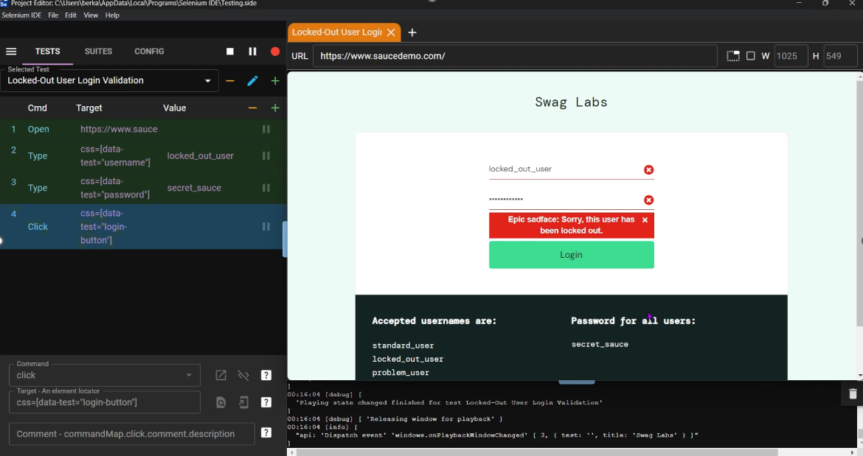
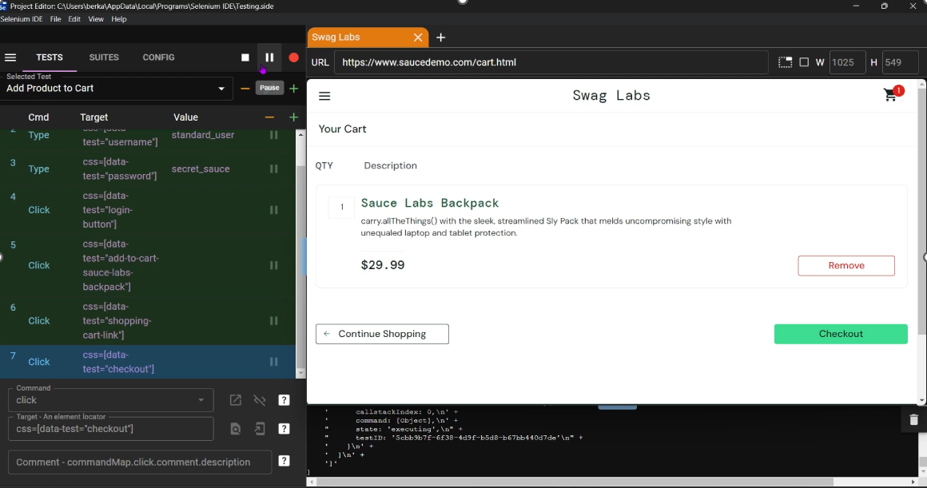
1
Locked-Out User Login Validation
Add Product to Cart
PASS
2
PASS
PASS
Tests that a banned user cannot log in
Logs in, adds product, proceeds to checkout

Slide 9
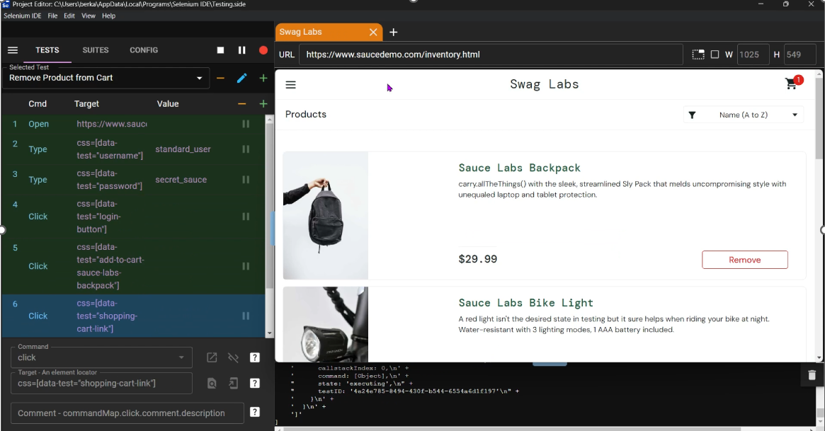
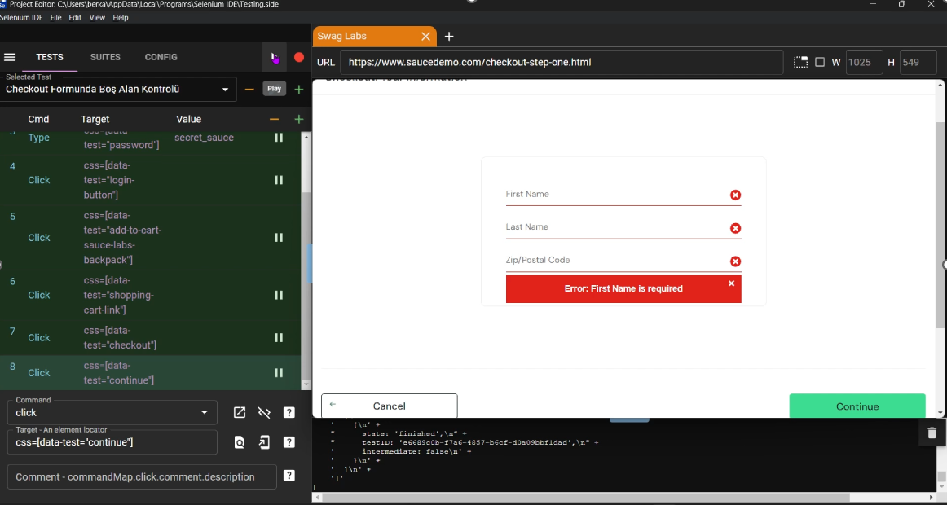
3
Remove Product from Cart
Checkout Form Empty Field Validation
4
PASS
PASS
Logs in, adds product, then removes it from cart
Attempts checkout without filling required fields

Slide 10
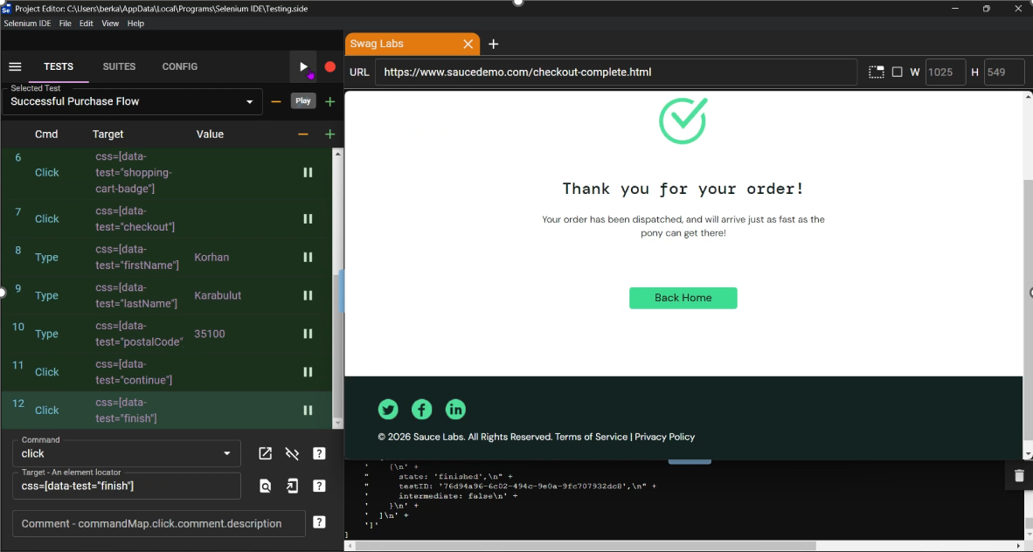
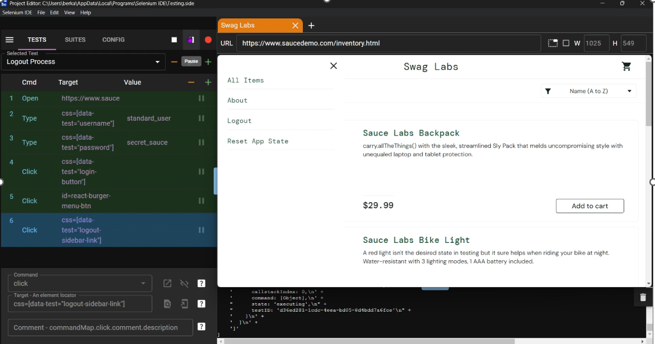
5
Successful Purchase Flow
6
Logout Process
PASS
PASS
Complete end-to-end purchase with valid data
Verifies user can successfully log out via menu

Slide 11
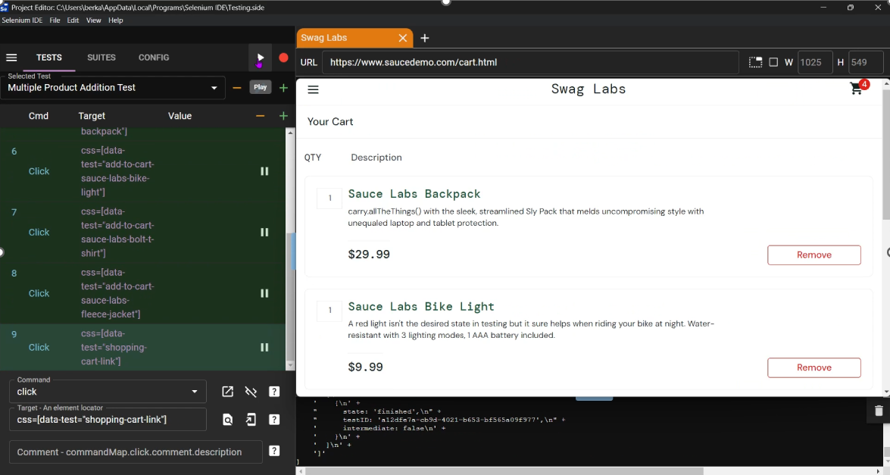
7
Multiple Product Addition Test
PASS
Adds 4 different products to cart simultaneously

Slide 12
PLAYWRIGHT — AUTOMATED UI TESTING
About Playwright
Test Scenarios Covered
Cross-browser end-to-end testing framework
✓
Valid & Invalid Login
Tests executed on Chromium browser
✓
Add Product to Cart
Covers same SauceDemo user flows
✓
Remove Product from Cart
Supports screenshots & video recording
✓
Checkout Validation (Empty Fields)
Parallel test execution capability
✓
Complete Purchase Flow
✓
Logout Process
Full test report: SauceDemo-Playwright.pdf
6

Slide 13
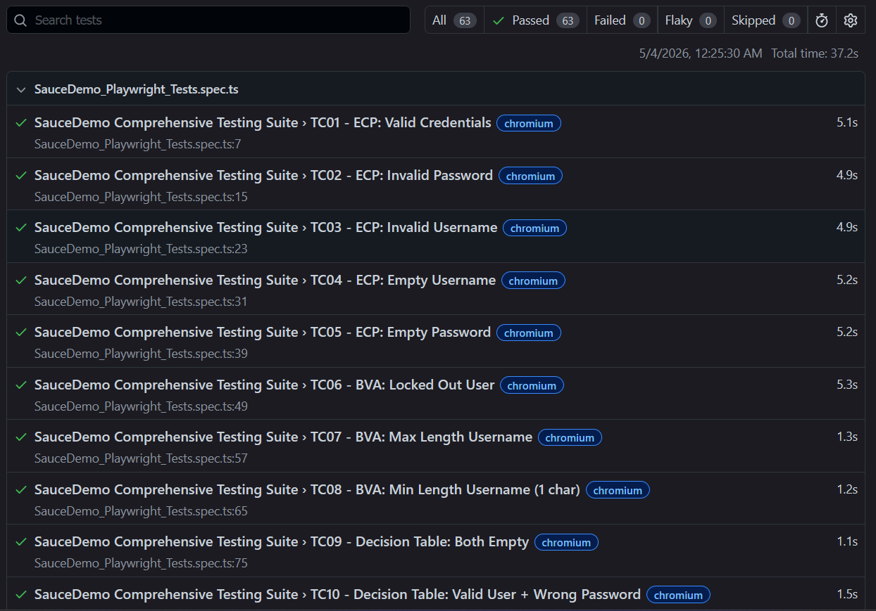
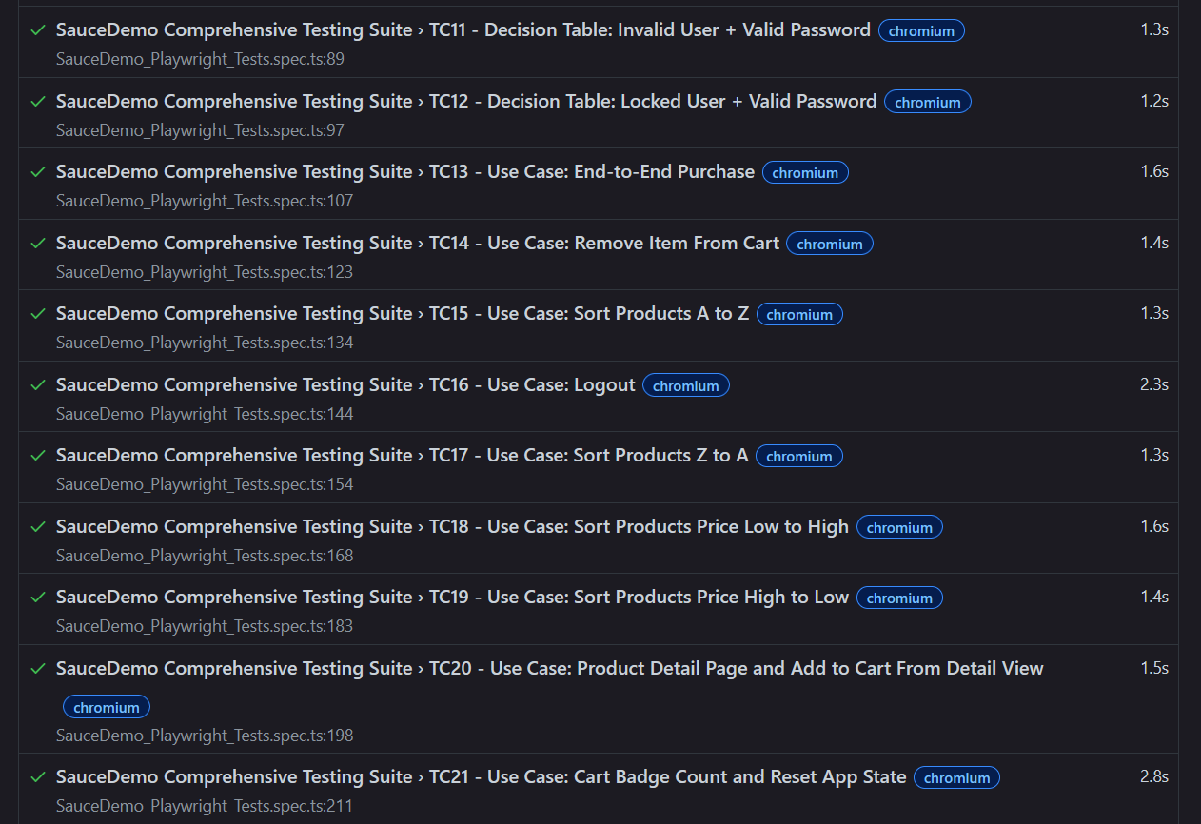

Slide 14

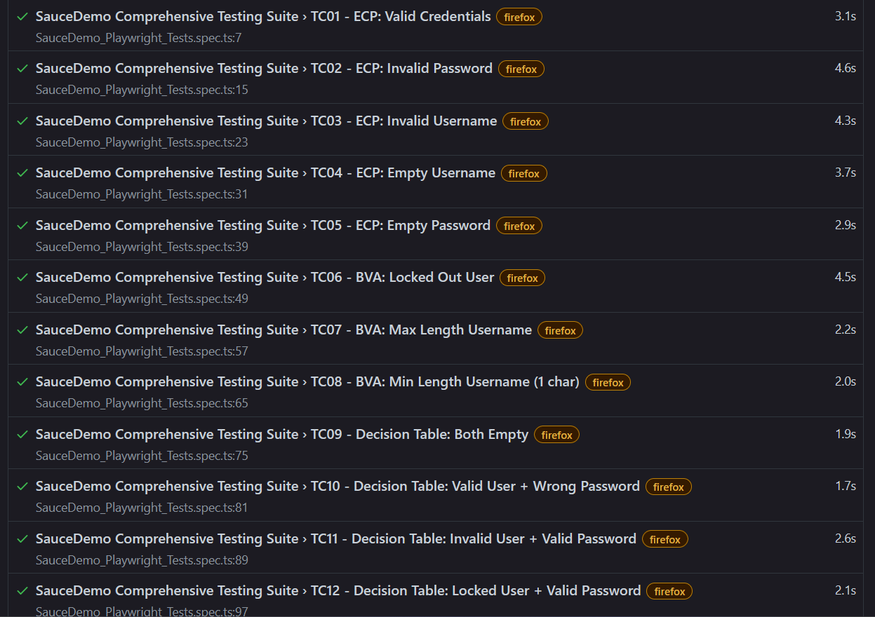
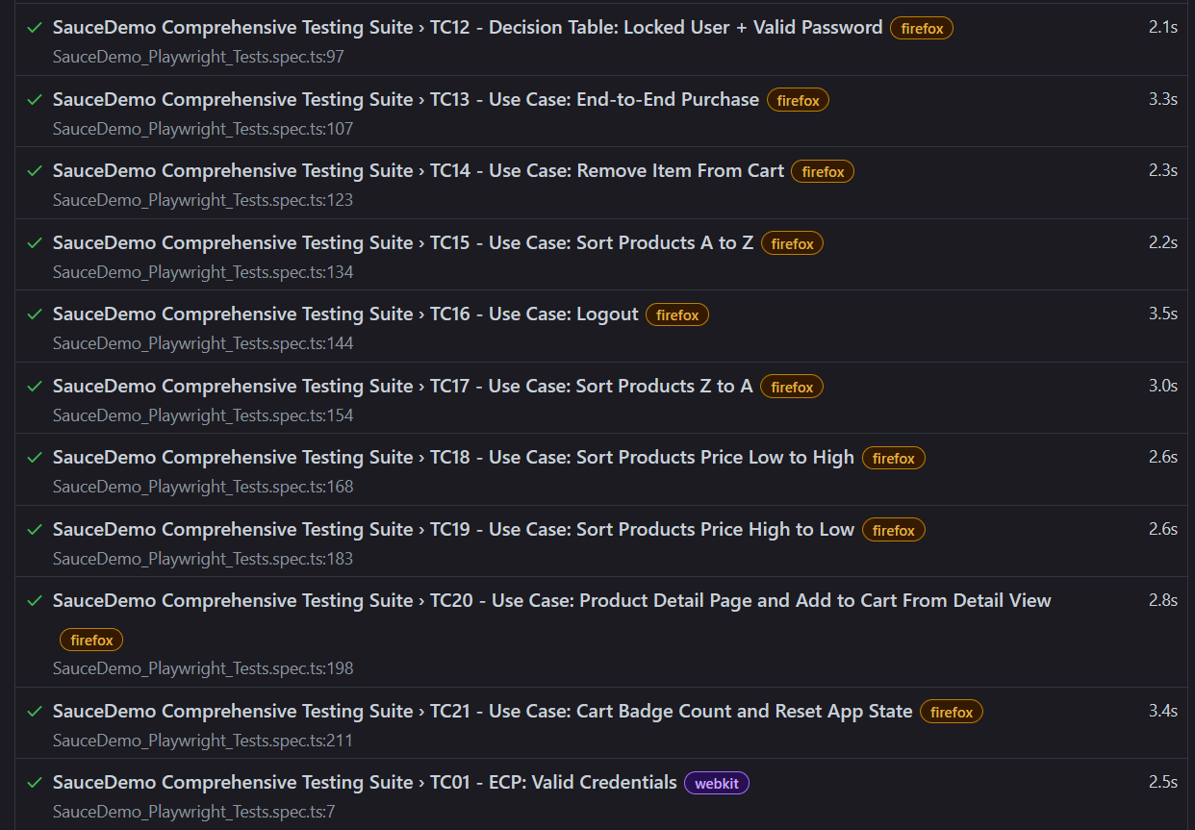

Slide 15
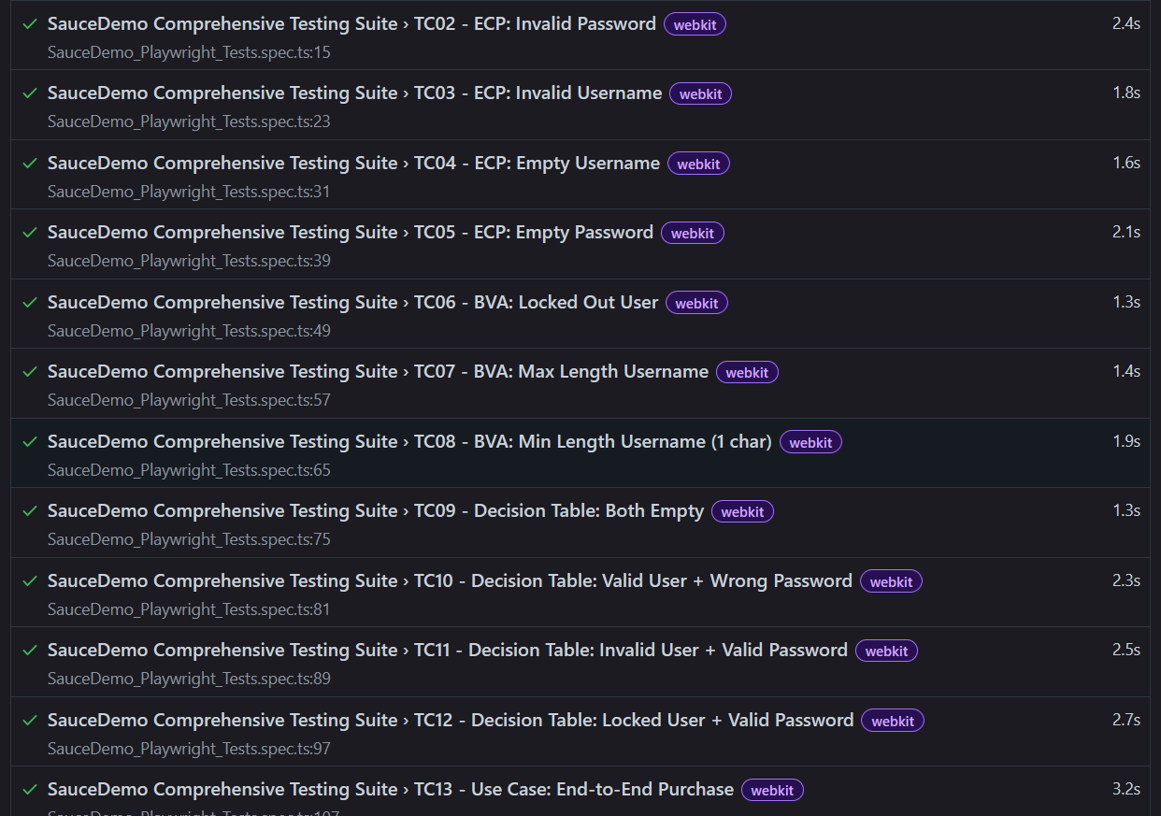
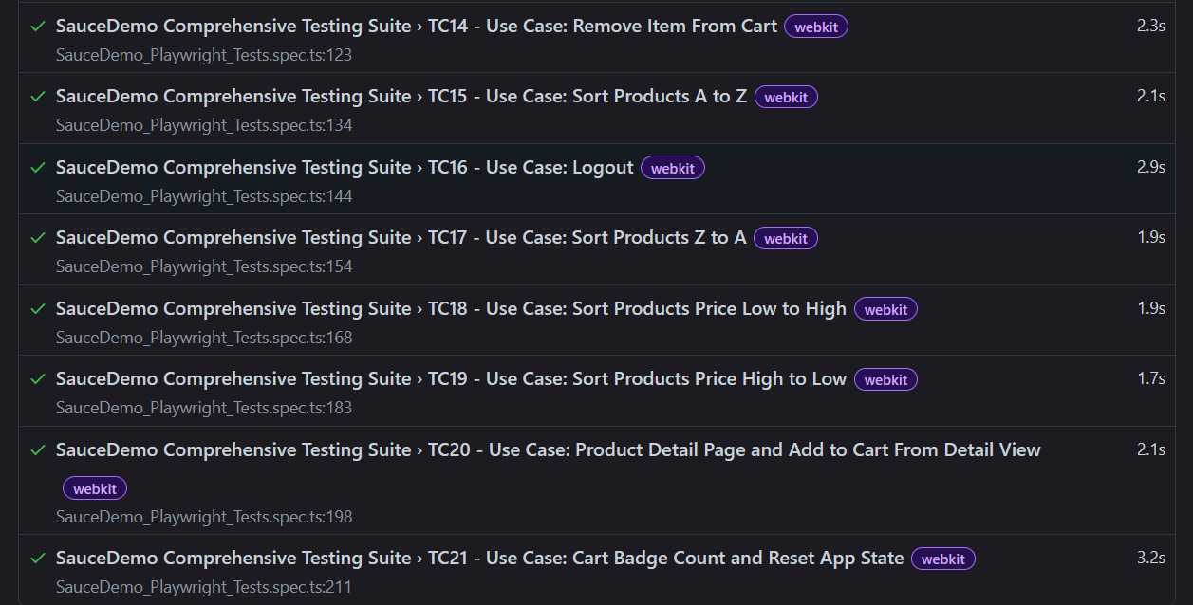

Slide 16
LIBRARY DB — APPLICATION OVERVIEW
Node.js + Express
Sequelize ORM
EJS Templates
Jest + Supertest
Backend framework
SQLite database
Server-side rendering
Testing framework
Tested API Endpoints
Endpoint
Description
Response
GET /
Redirect to /books
Redirect 302
GET /books
List all books (paginated + search)
200 OK
GET /books/new
Show add book form
200 OK
POST /books/new
Create new book (with validation)
302 / 200 error
GET /books/:id
Show book detail
200 / 500 if not found
POST /books/:id
Update book (with validation)
302 / 200 error
POST /books/:id/delete
Delete book
302 / 500 if not found
ANY *
Catch-all 404 handler
404
7

Slide 17
UNIT & INTEGRATION TESTING — JEST
48
48
0
2.7s
Tests Total
Tests Passed
Tests Failed
Run Time
Test Groups (books.test.js)
GET /
1
GET /books
5
GET /books?search=
11
Redirect to /books
List, pagination, search
Search by all fields
GET /books/new
2
POST /books/new
11
GET /books/:id
4
Form rendering
Create + validation
Book detail
POST /books/:id
9
POST /books/:id/delete
5
404 - unknown route
3
Update + validation
Delete operations
Error handler
8

Slide 18
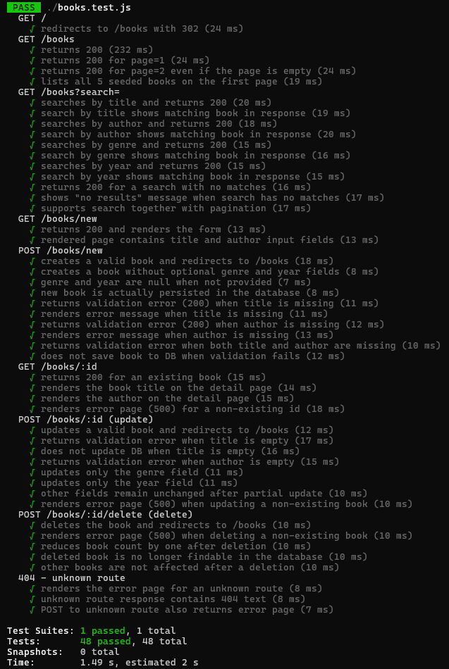
UNIT TEST EXECUTION RESULT
48/48 Tests Passed
All test suites pass with no failures.
Test run completed in 2.7 seconds.
Test Suite Summary
Test Suites
1 passed / 1 total
Tests
48 passed / 48 total
Snapshots
0 total
Time
2.702 s
9

Slide 19
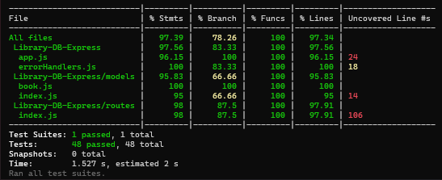
CODE COVERAGE ANALYSIS
Statements
97.39%
Branches
78.26%
Functions
100%
Lines
97.34%
Per-File Coverage
File
Stmts
Branch
Funcs
Lines
app.js
96.15%
100%
100%
96.15%
errorHandlers.js
100%
83.33%
100%
100%
models/book.js
100%
100%
100%
100%
models/index.js
95%
66.66%
100%
95%
routes/index.js
98%
87.5%
100%
97.91%
10

Slide 20
MUTATION TESTING — STRYKER
105
43
39
19
60.19%
Total Mutants
Killed
Survived
Timed Out
Mutation Score
Mutation Score Per File
Key Survived Mutants
routes/index.js
Pagination: page || 1 conditional not fully tested
pageCount calculation (/ vs *) not killed
70% — Killed: 41 Survived: 23 Timeout: 15
SequelizeValidationError checks not covered
errorHandlers.js
Error message strings not asserted in tests
404/500 error status conditions not fully tested
26.09% — Killed: 2 Survived: 16 Timeout: 4
contact@email.com
11

Slide 21
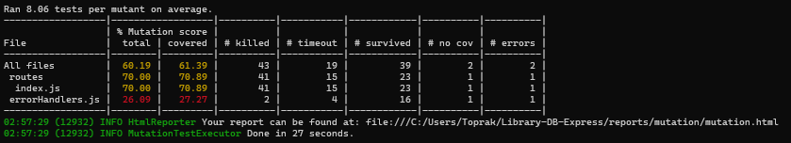
STRYKER MUTATION TEST — RESULT
Analysis & Improvement Areas
Stryker mutation test score table — routes/index.js: 70.00% | errorHandlers.js: 26.09%
errorHandlers.js mutation score (26.09%) is significantly lower — error message content and status codes are not asserted in tests
Pagination logic (page || 1) survives mutations because tests don't check what happens when page param is missing
Validation error branches survive because test assertions focus on HTTP status codes, not error response content
Overall score (60.19%) indicates room for improvement with more assertion-heavy tests
12

Slide 22
LOAD TESTING — APACHE JMETER
Test Configuration
Test Results (HTTP Request)
Target Application
Library DB Express (local)
10 Users
Avg: 23ms | Min: 13ms | Max: 60ms | Throughput: 11.9/sec | Error: 0.00%
Test Type
Load + Stress Testing
50 Users
Avg: 20ms | Min: 10ms | Max: 84ms | Throughput: 53.9/sec | Error: 0.00%
Tool
Apache JMeter
100 Users
Avg: 237ms | Min: 59ms | Max: 428ms | Throughput: 82.5/sec | Error: 0.00%
Observations
Tested Endpoints
GET /books, POST /books/new,
GET /books/:id, 404 handler
0% error rate across all scenarios. Latency increased significantly at 100 users (avg 237ms).
Endpoint Tested
GET /books — listing page under 10, 50, and 100 concurrent virtual users
Full report: JmeterLoadTesting.docx
13

Slide 23
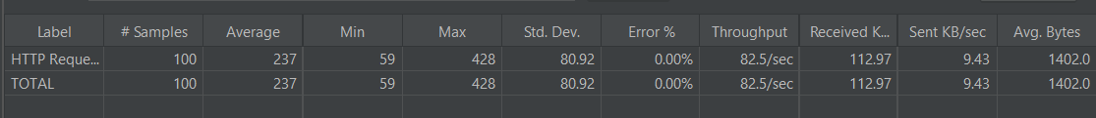
LOAD TESTING — Jmeter Load Testing Results
10 User
50 Users
50 User
100 User

Slide 24
RESULTS & CONCLUSION
Testing Type
Scope
Result
Score
SauceDemo — Selenium WebDriver
2 tests
2 passed / 0 failed
100%
SauceDemo — Selenium IDE
7 tests
7 passed / 0 failed
100%
SauceDemo — Playwright (ECP, BVA, Decision Table, Use Case)
6+ tests
All passed
100%
Library DB — Jest Unit Tests
48 tests
48 passed / 0 failed
100%
Library DB — Code Coverage
—
97.39% statements / 100% functions
✓ High
Library DB — Mutation Testing
105 mutants
43 killed / 19 timeout
60.19%
Library DB — Load Testing
3 load levels
0% error rate — 10/50/100 users tested
Stable
Key Findings
All UI automation tests pass successfully across Selenium WebDriver, Selenium IDE, and Playwright. Unit tests achieve high coverage (97.39% statements, 100% functions). Mutation testing reveals opportunities to strengthen test assertions, particularly in error handlers. Load testing shows 0% error rate at all levels; response time increases from avg 23ms (10 users) to 237ms (100 users), throughput scales from 11.9 to 82.5 req/sec.
14

Slide 25
Thank You
Questions & Discussion
SE 2226 — Software Quality Assurance and Testing
Software Engineering Department
Toprak Güçlü – —
Berkay Yıldırım – —
Serdar Sabit Güngör – 2370006081
Ege Artun – —

Slide 26
Additional Contents

Slide 27
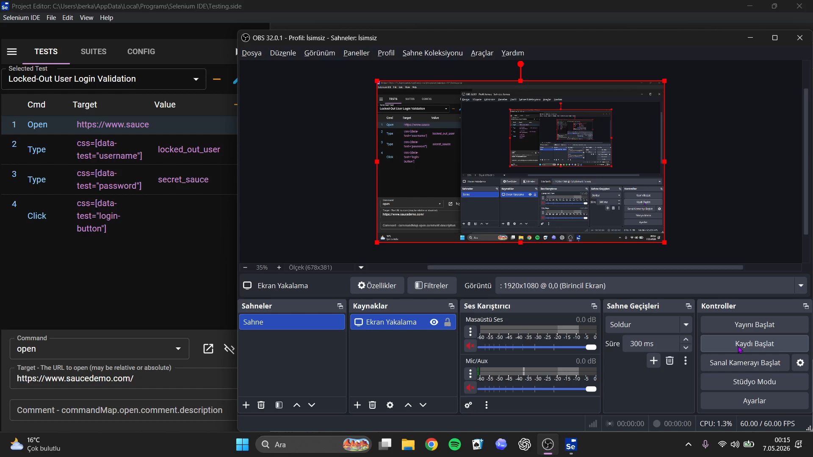

Slide 28
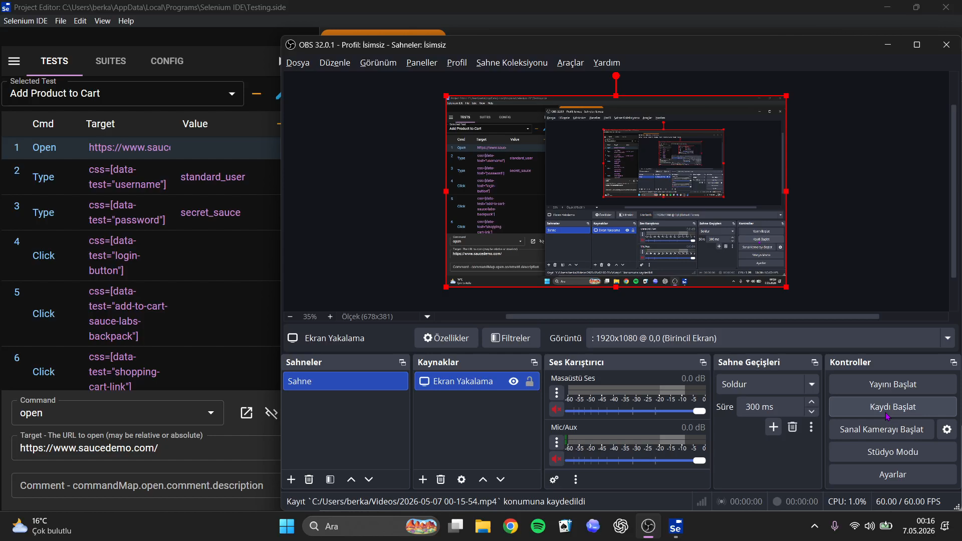

Slide 29


Slide 30
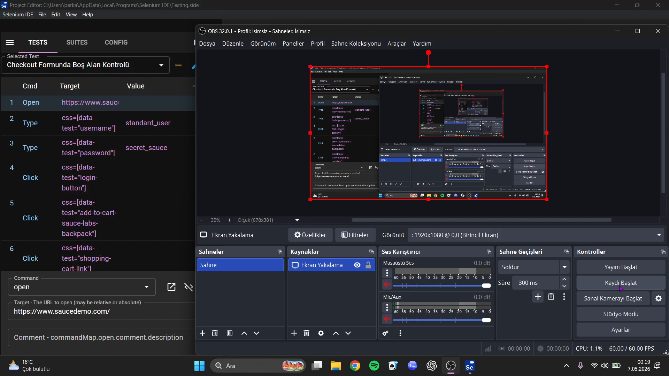

Slide 31
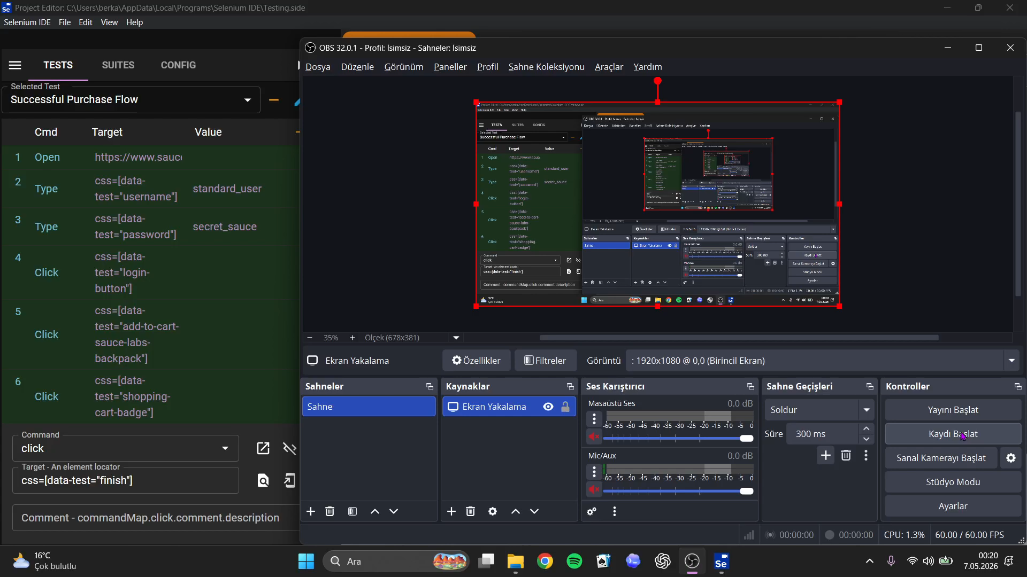

Slide 32
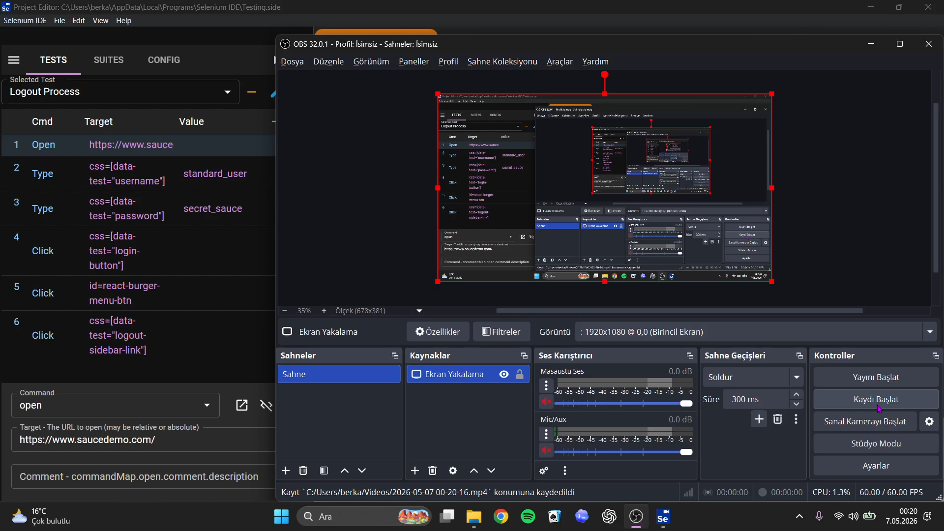

Slide 33
