Slide 1
ThirdEye: Low-Cost Audio Guidance
from Yellow Road Markings
CS 449/549 Final Presentation
Mehmet Altunören(Analytics Lead), Ege Tan(CV Engineer), Sait Kaçmaz (Back-End Dev), Eren Yıldız(Product Designer)

Slide 2
Pillar 1: User Requirements & Context
Target Users: Visually impaired pedestrians needing hands-free guidance.
Problem: Outdoor environments are dynamic, noisy, and lack consistent tactile paving.
Context: Sidewalks and campuses with yellow road markings.
Key Expectation: Real-time alignment feedback and safety warnings ('Path Lost').

Slide 3
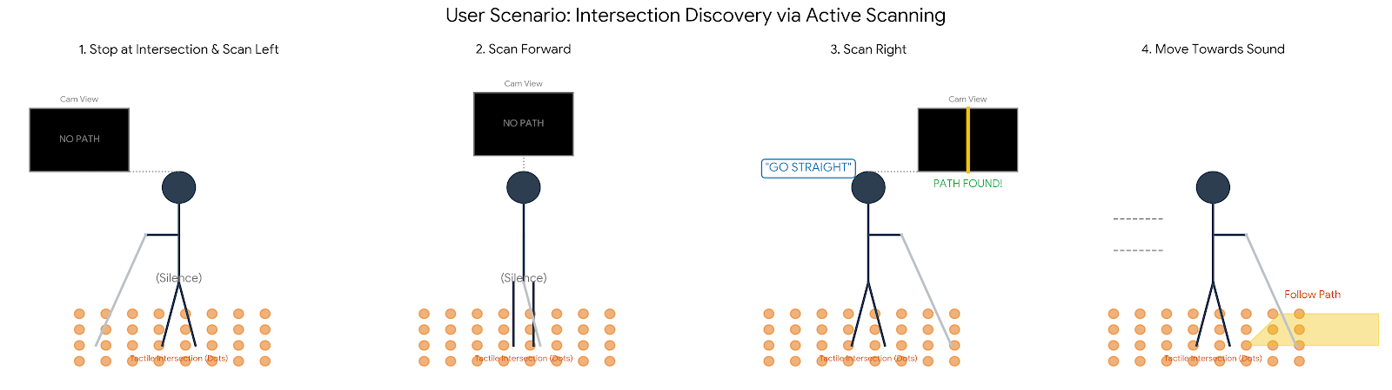
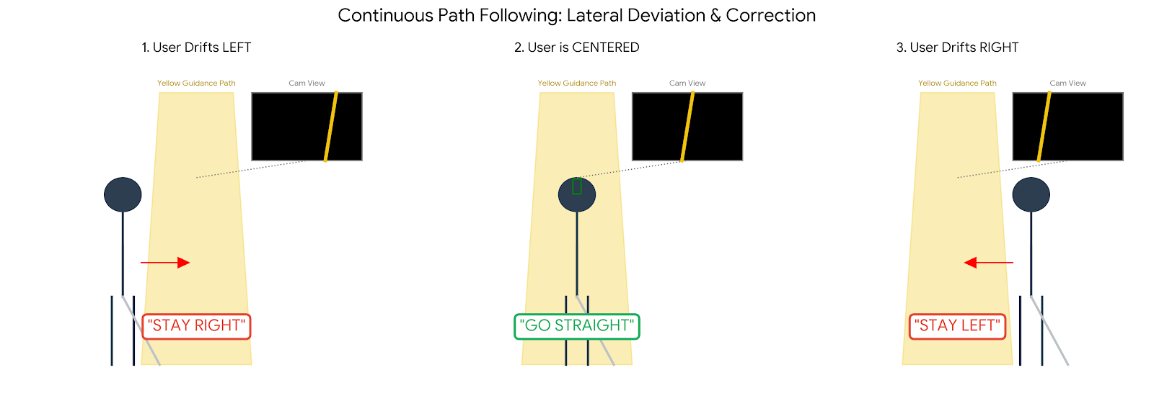
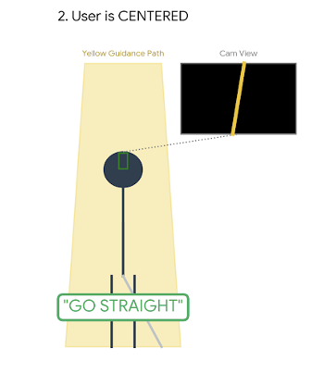

Slide 4
Pillar 2: Design Guidelines & Process
HCI Principles: Multimodal Interaction & Norman’s Mapping.
Feedback Strategy: 'Zone-Based' Audio.
- Left Zone -> 'Go Left' Sound
- Center Zone -> Silence (Minimal Cognitive Load)
- Right Zone -> 'Go Right' Sound
Design Process: Low-fidelity voice storyboards -> C4 System Design.

Slide 5
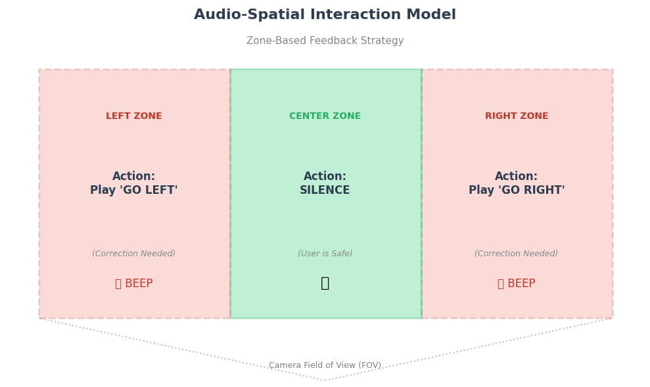

Slide 6
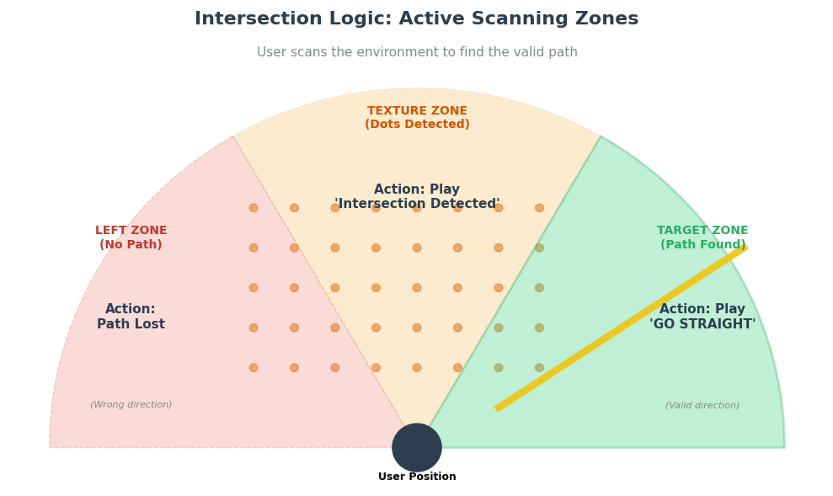

Slide 7
Pillar 3: Implementation (Architecture)
Hardware: Raspberry Pi 3 + Camera + Audio Output.
Software Stack: Python, OpenCV (Vision), Flask (Server).
System Flow (C4 Container):
1. Capture Frame
2. Detect Yellow Mask (HSV)
3. Calculate Centroid Offset
4. Trigger Audio Command

Slide 8
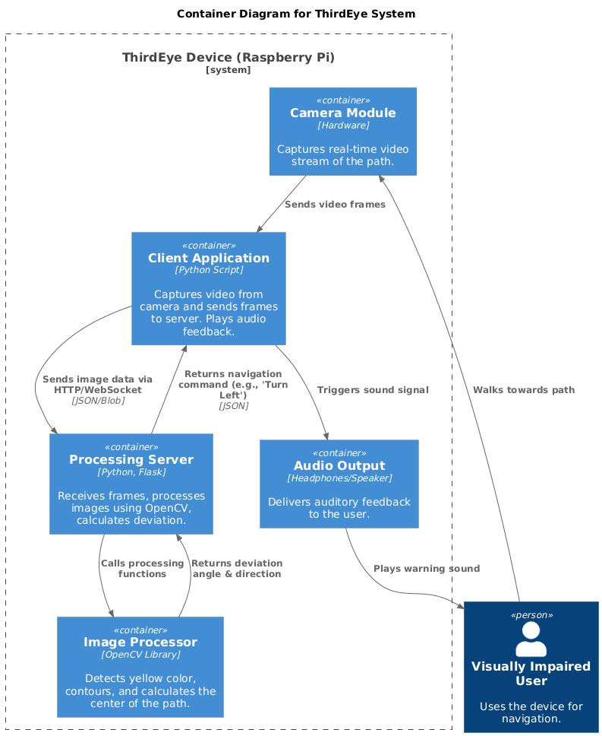

Slide 9
Pillar 3: Real-Time Vision Logic
Computer Vision Logic:
- Position-Based Tracking (Pixel Offset).
- Intersection Detection (Dot-Density Heuristic).
Developer Tools:
- Created a custom 'Debug Dashboard' to monitor threshold sensitivity and live tracking status.

Slide 10
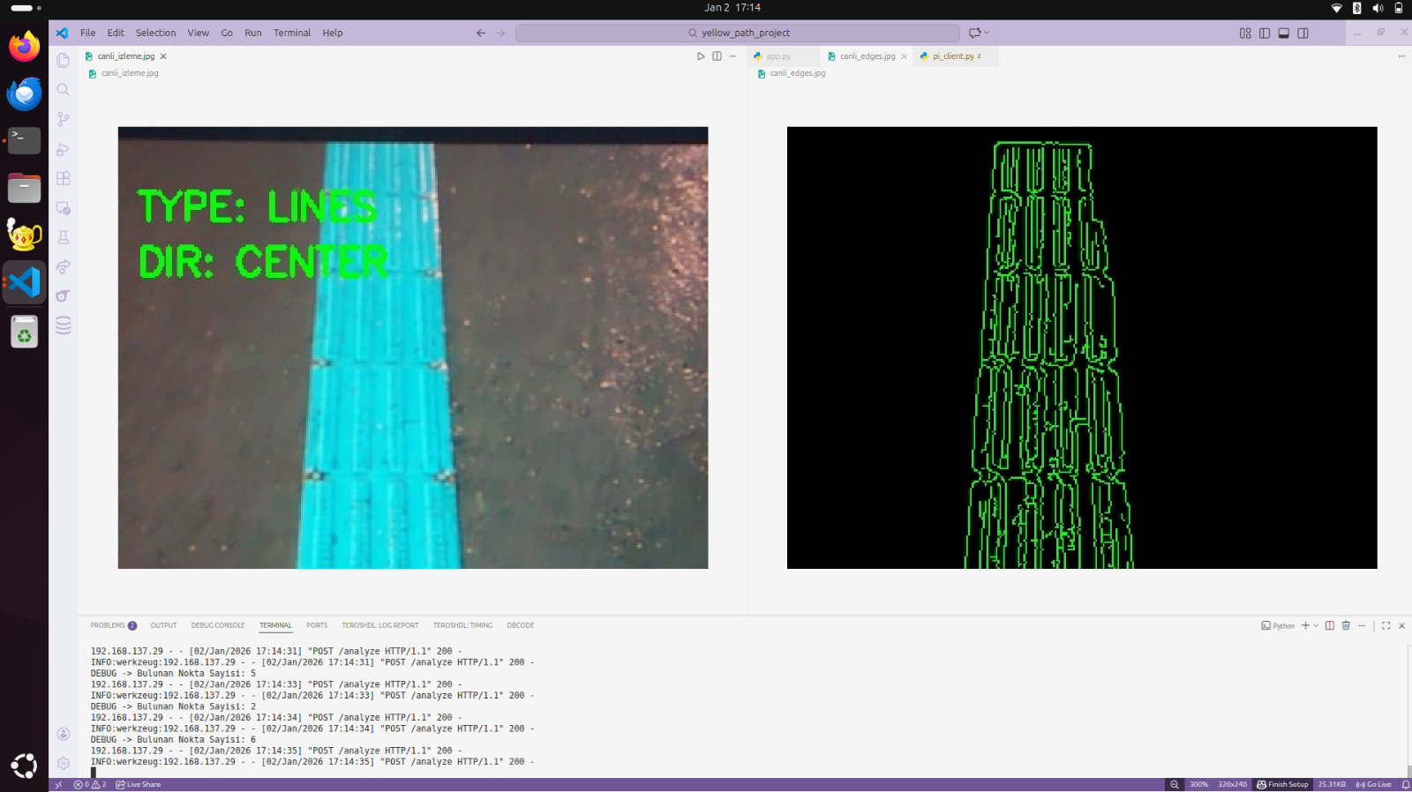
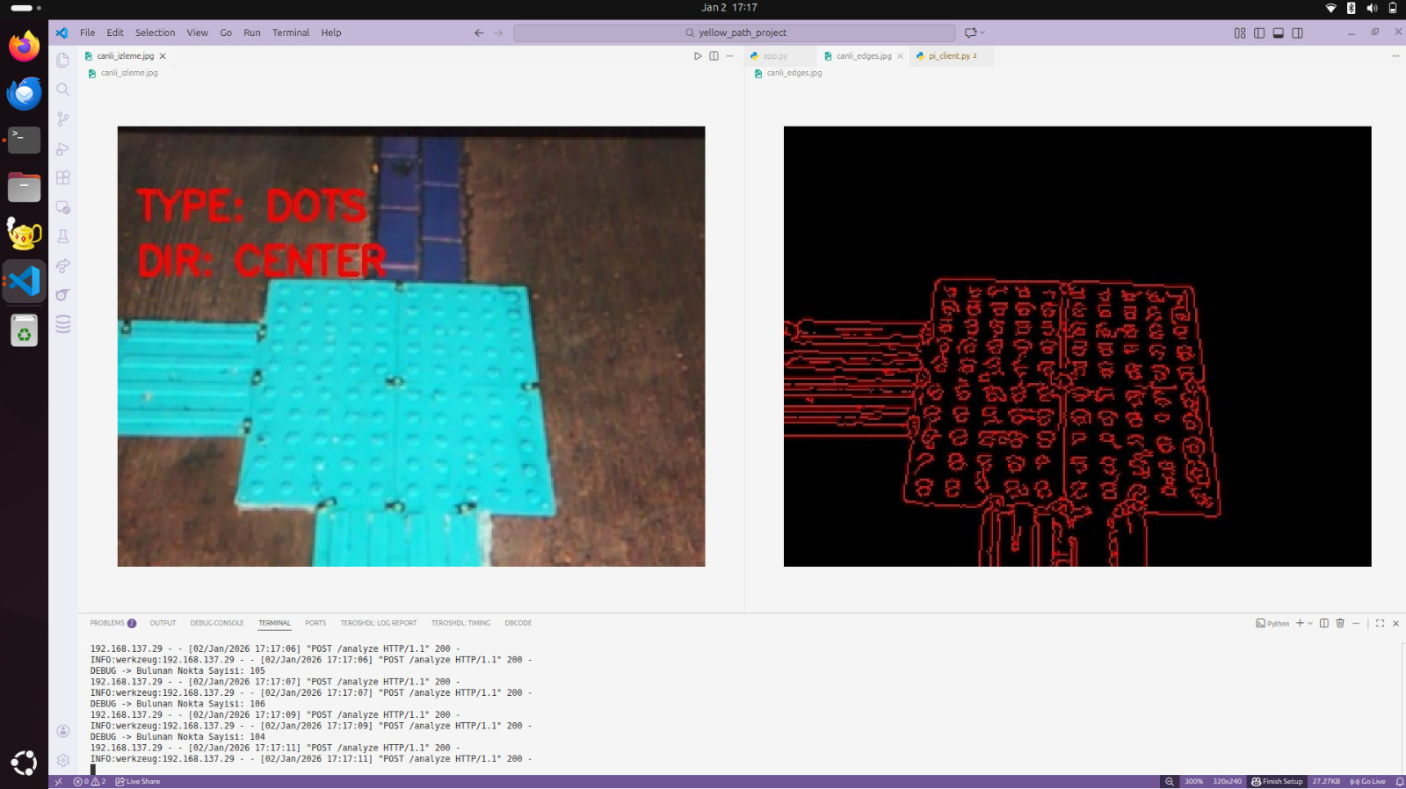

Slide 11
Pillar 4: Evaluation Methodology
Study Design: Within-Subject (Control vs. Experimental).
Participants: N=20 (Blindfolded to simulate vision loss).
Tasks:
- T1: Path Following (Alignment)
- T2: Intersection Detection
Metrics: Task Completion Time, Number of Errors, SUS Score.

Slide 12
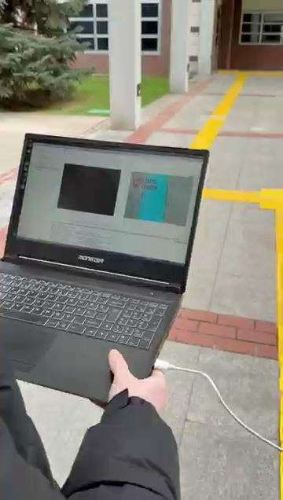

Slide 13
Pillar 4: Results & Analysis
Faster Navigation: Time reduced by ~16% (112.4s -> 93.7s, p=0.004).
Increased Safety: Errors dropped significantly (3.1 -> 1.4 errors, p<0.001).
Usability (SUS): Score 81.6 (Rated 'Excellent').
Conclusion: Audio guidance significantly improves alignment performance.

Slide 14
Conclusion & Design Motto
Summary: ThirdEye successfully digitizes physical infrastructure for accessibility using low-cost hardware.
Design Motto:
“Designing safer pedestrian guidance without expensive dedicated infrastructure.”

