Slide 1
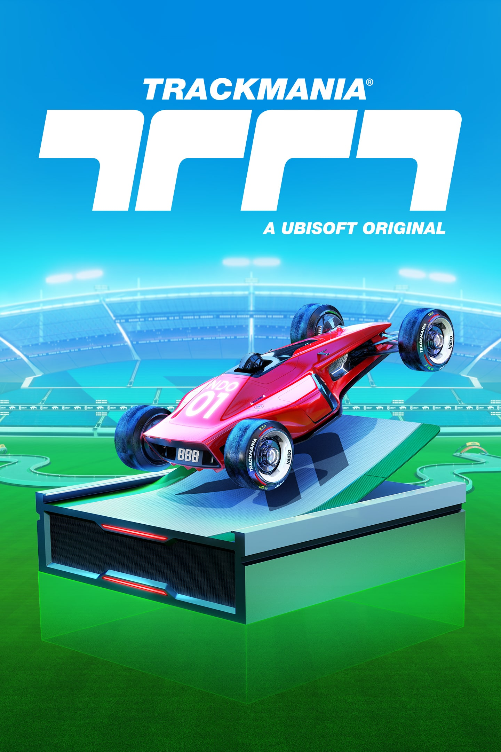
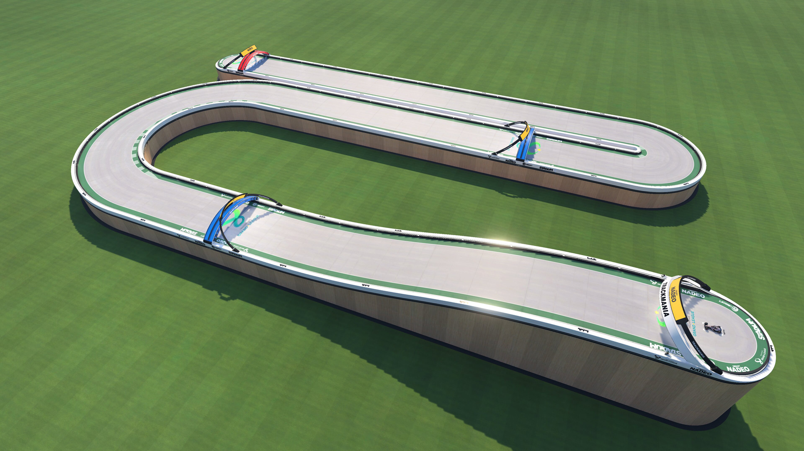
Autonomous Driving Project (Trackmania)
Deep learning model for Trackmania autonomous driving.
Goal: Navigate vehicle using directional commands in real-time gameplay.
Katoo, Ege, Francesco

Slide 2
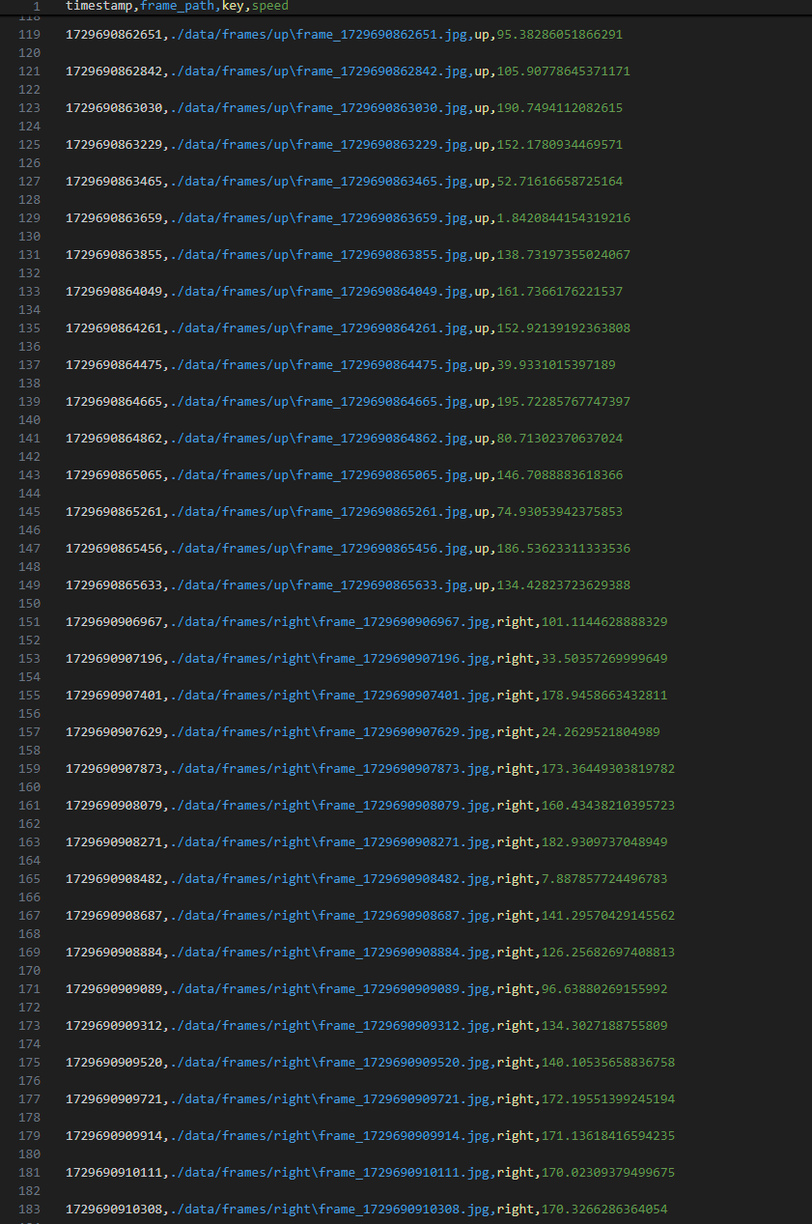
Data Capture and Logging
1
Custom Script
Captured frames and key presses to simulate human driving.
2
Dataset Expansion
Iteratively expanded dataset over multiple collection rounds.
3
Turn Underrepresentation
Impacting real-world model performance.
Notes:
Frames cropped to avoid model from memorizing wheel trurns

Slide 3
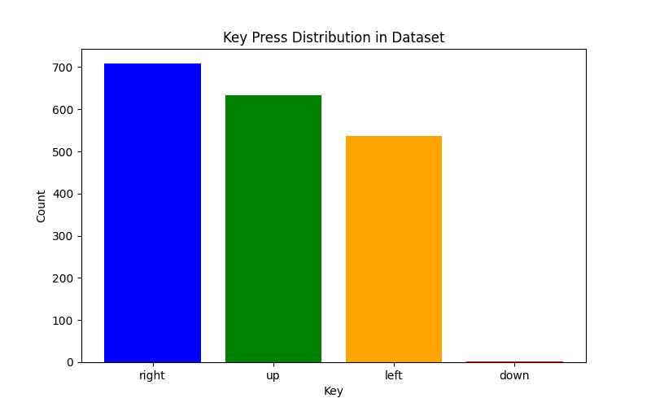
Data Augmentation and Balancing
Augmentation Techniques
Employed to expand dataset and improve generalization.
Balance Issues
Data imbalance persisted, affecting model performance.
Turn Data
Focus on increasing representation of turn scenarios.
Notes:
Randomized crop and resize it automatically to 224x224

Slide 4
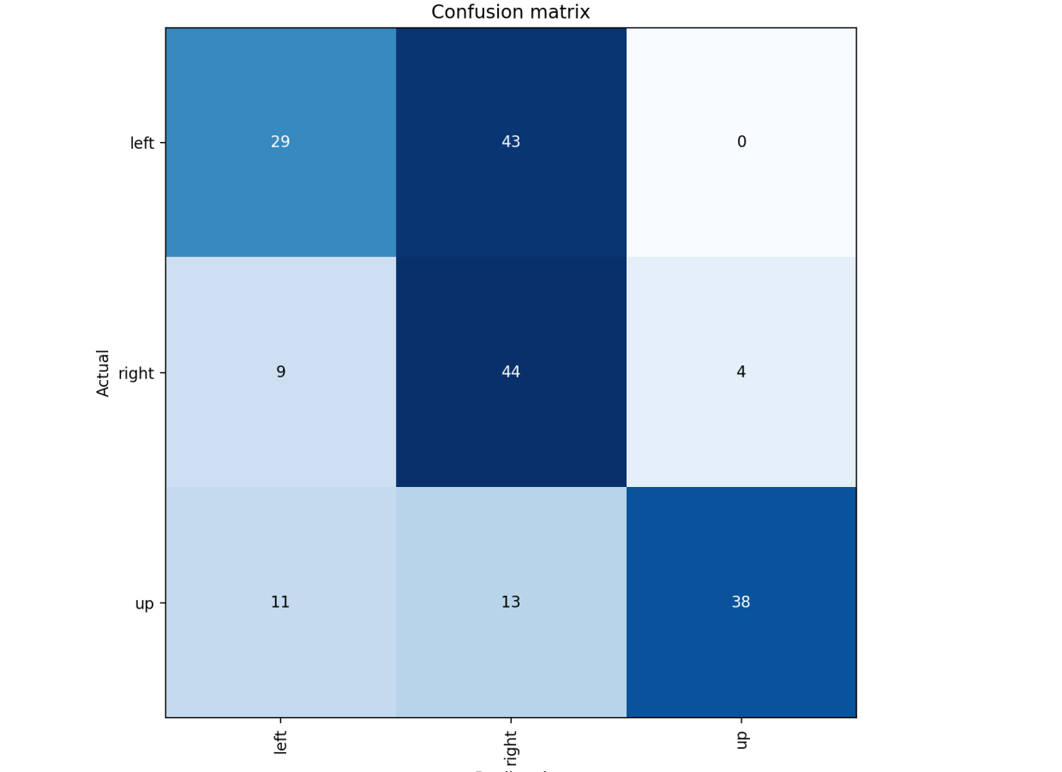
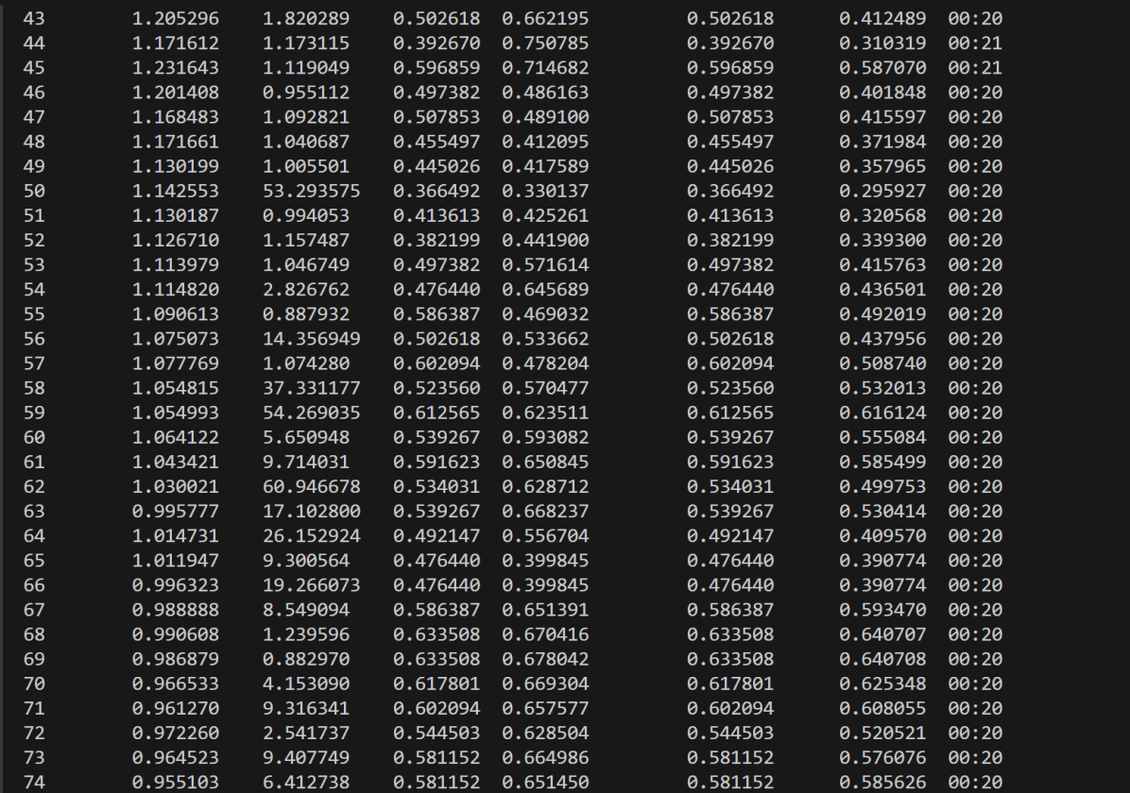
Initial Models: ResNet-18 and ResNet-34
Non-Pretrained ResNet-18
Pretrained ResNet-18 and ResNet-34
Baseline with 65-70% accuracy, struggled with turns.
Improved straight paths, issues in turn interpretation remained.
Notes:
ResNet makes it easier to train deep networks by adding shortcuts so the model can learn better, faster, and with fewer errors

Slide 5



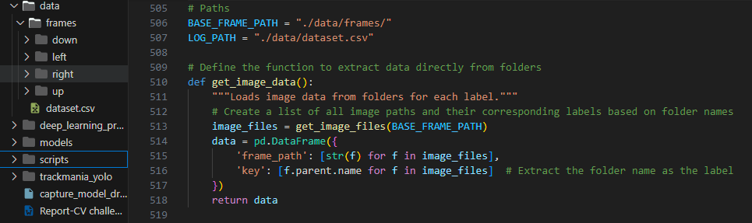
Dataset Restructuring
Reorganization
Folder-Based
Retraining
Restructured data for
better distribution control.
Organized dataset into
structured folder system.
Models retrained on
newly structured dataset.

Slide 6
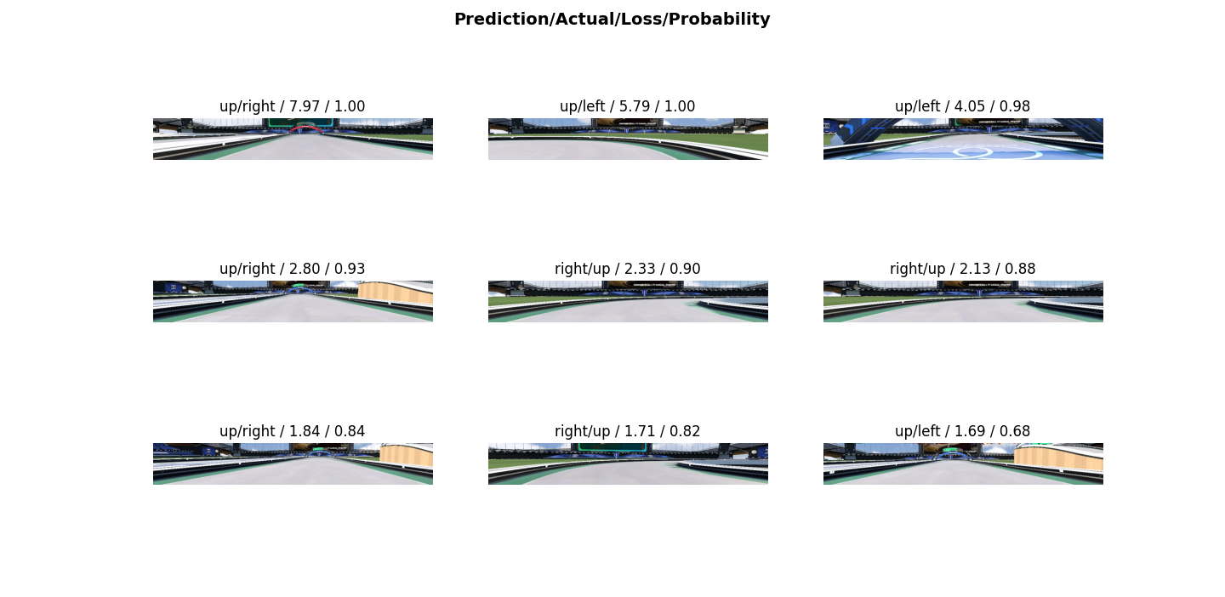
Advanced Models: ResNet-34 and ResNet-50
Pretrained ResNet-50
Model
Pretrained
Non-Pretrained
ResNet-34
~95% accuracy
~85% accuracy
ResNet-50
~95% accuracy
~85% accuracy

Slide 7

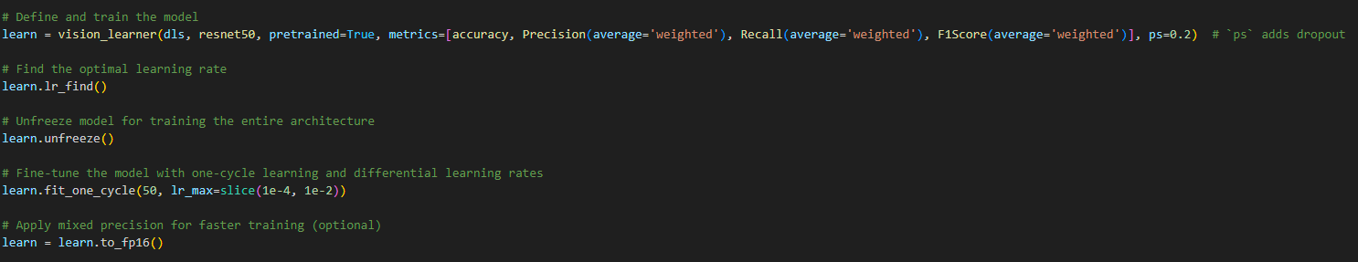

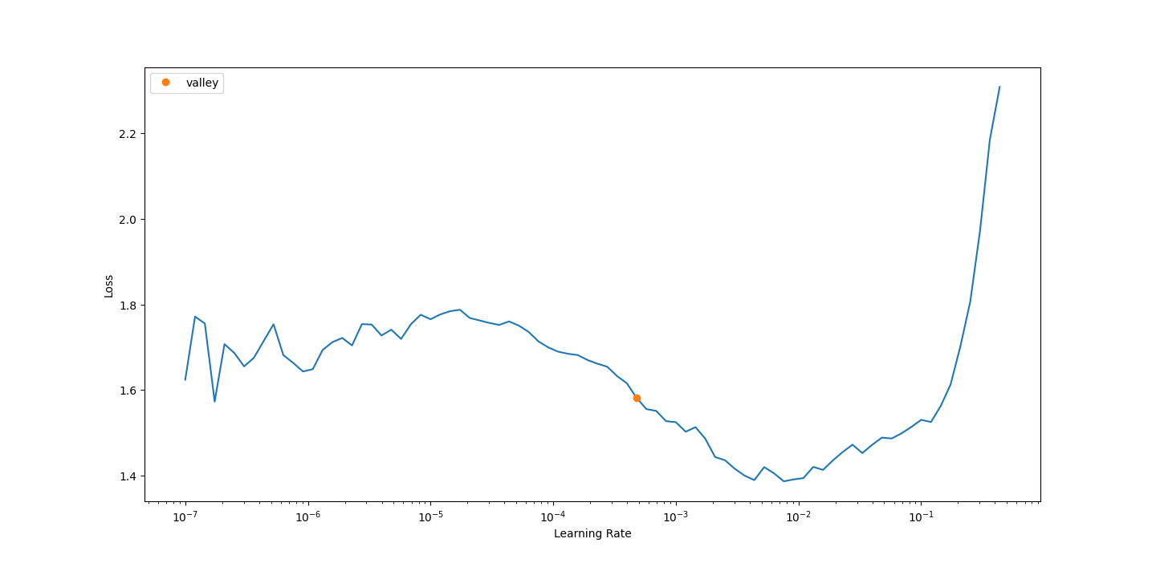

Training Techniques and Optimization
One-Cycle Policy
Used for faster convergence, limited turn prediction improvement.
Dropout Regularization
Applied to reduce overfitting, minimal impact on turns.
Mixed Precision Training
Allowed for larger models within resource limits.

Slide 8
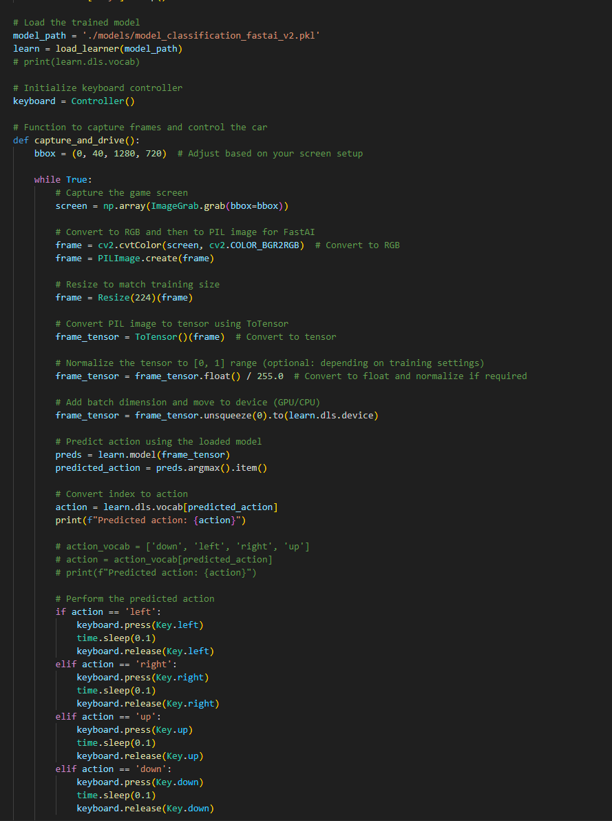
Real-Time Autonomous Driving
Capture
Real-time frame capture from Trackmania gameplay.
Process
Frame processing and action prediction.
Drive
Predicted actions applied for autonomous vehicle control.

Slide 9
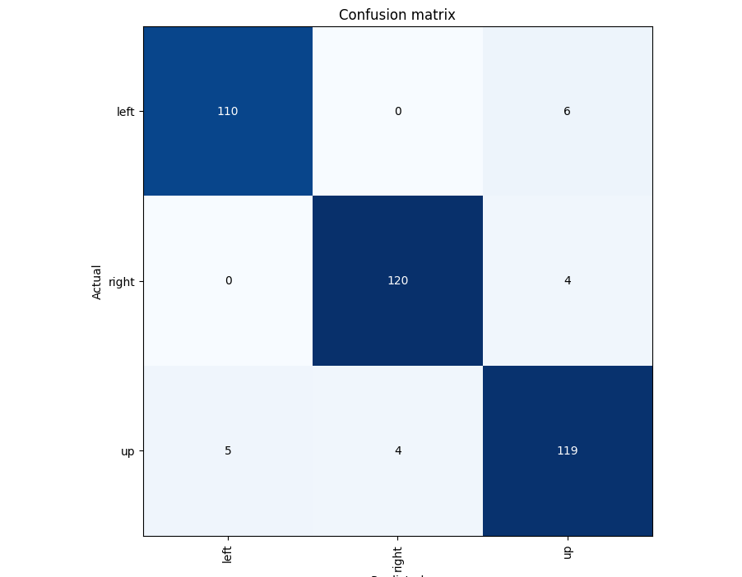
Performance Evaluation
Confusion Matrix
Top Loss Frames
Gameplay Testing
Misclassifications of turns as straight paths.
High loss in turn scenarios.
Real-world limitations despite high validation accuracy.

Slide 10
Limitations and Future Recommendations
1
Data Imbalance
2
Model Overfitting
Poor turn performance due to straight path dominance.
High test accuracy, poor real-world generalization.
3
Temporal Modeling
4
Future Directions
Static CNNs lack complexity for dynamic driving.
Explore vision transformers, reinforcement learning for improvements.

Slide 11
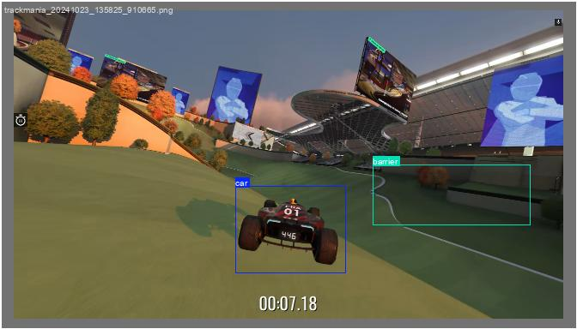
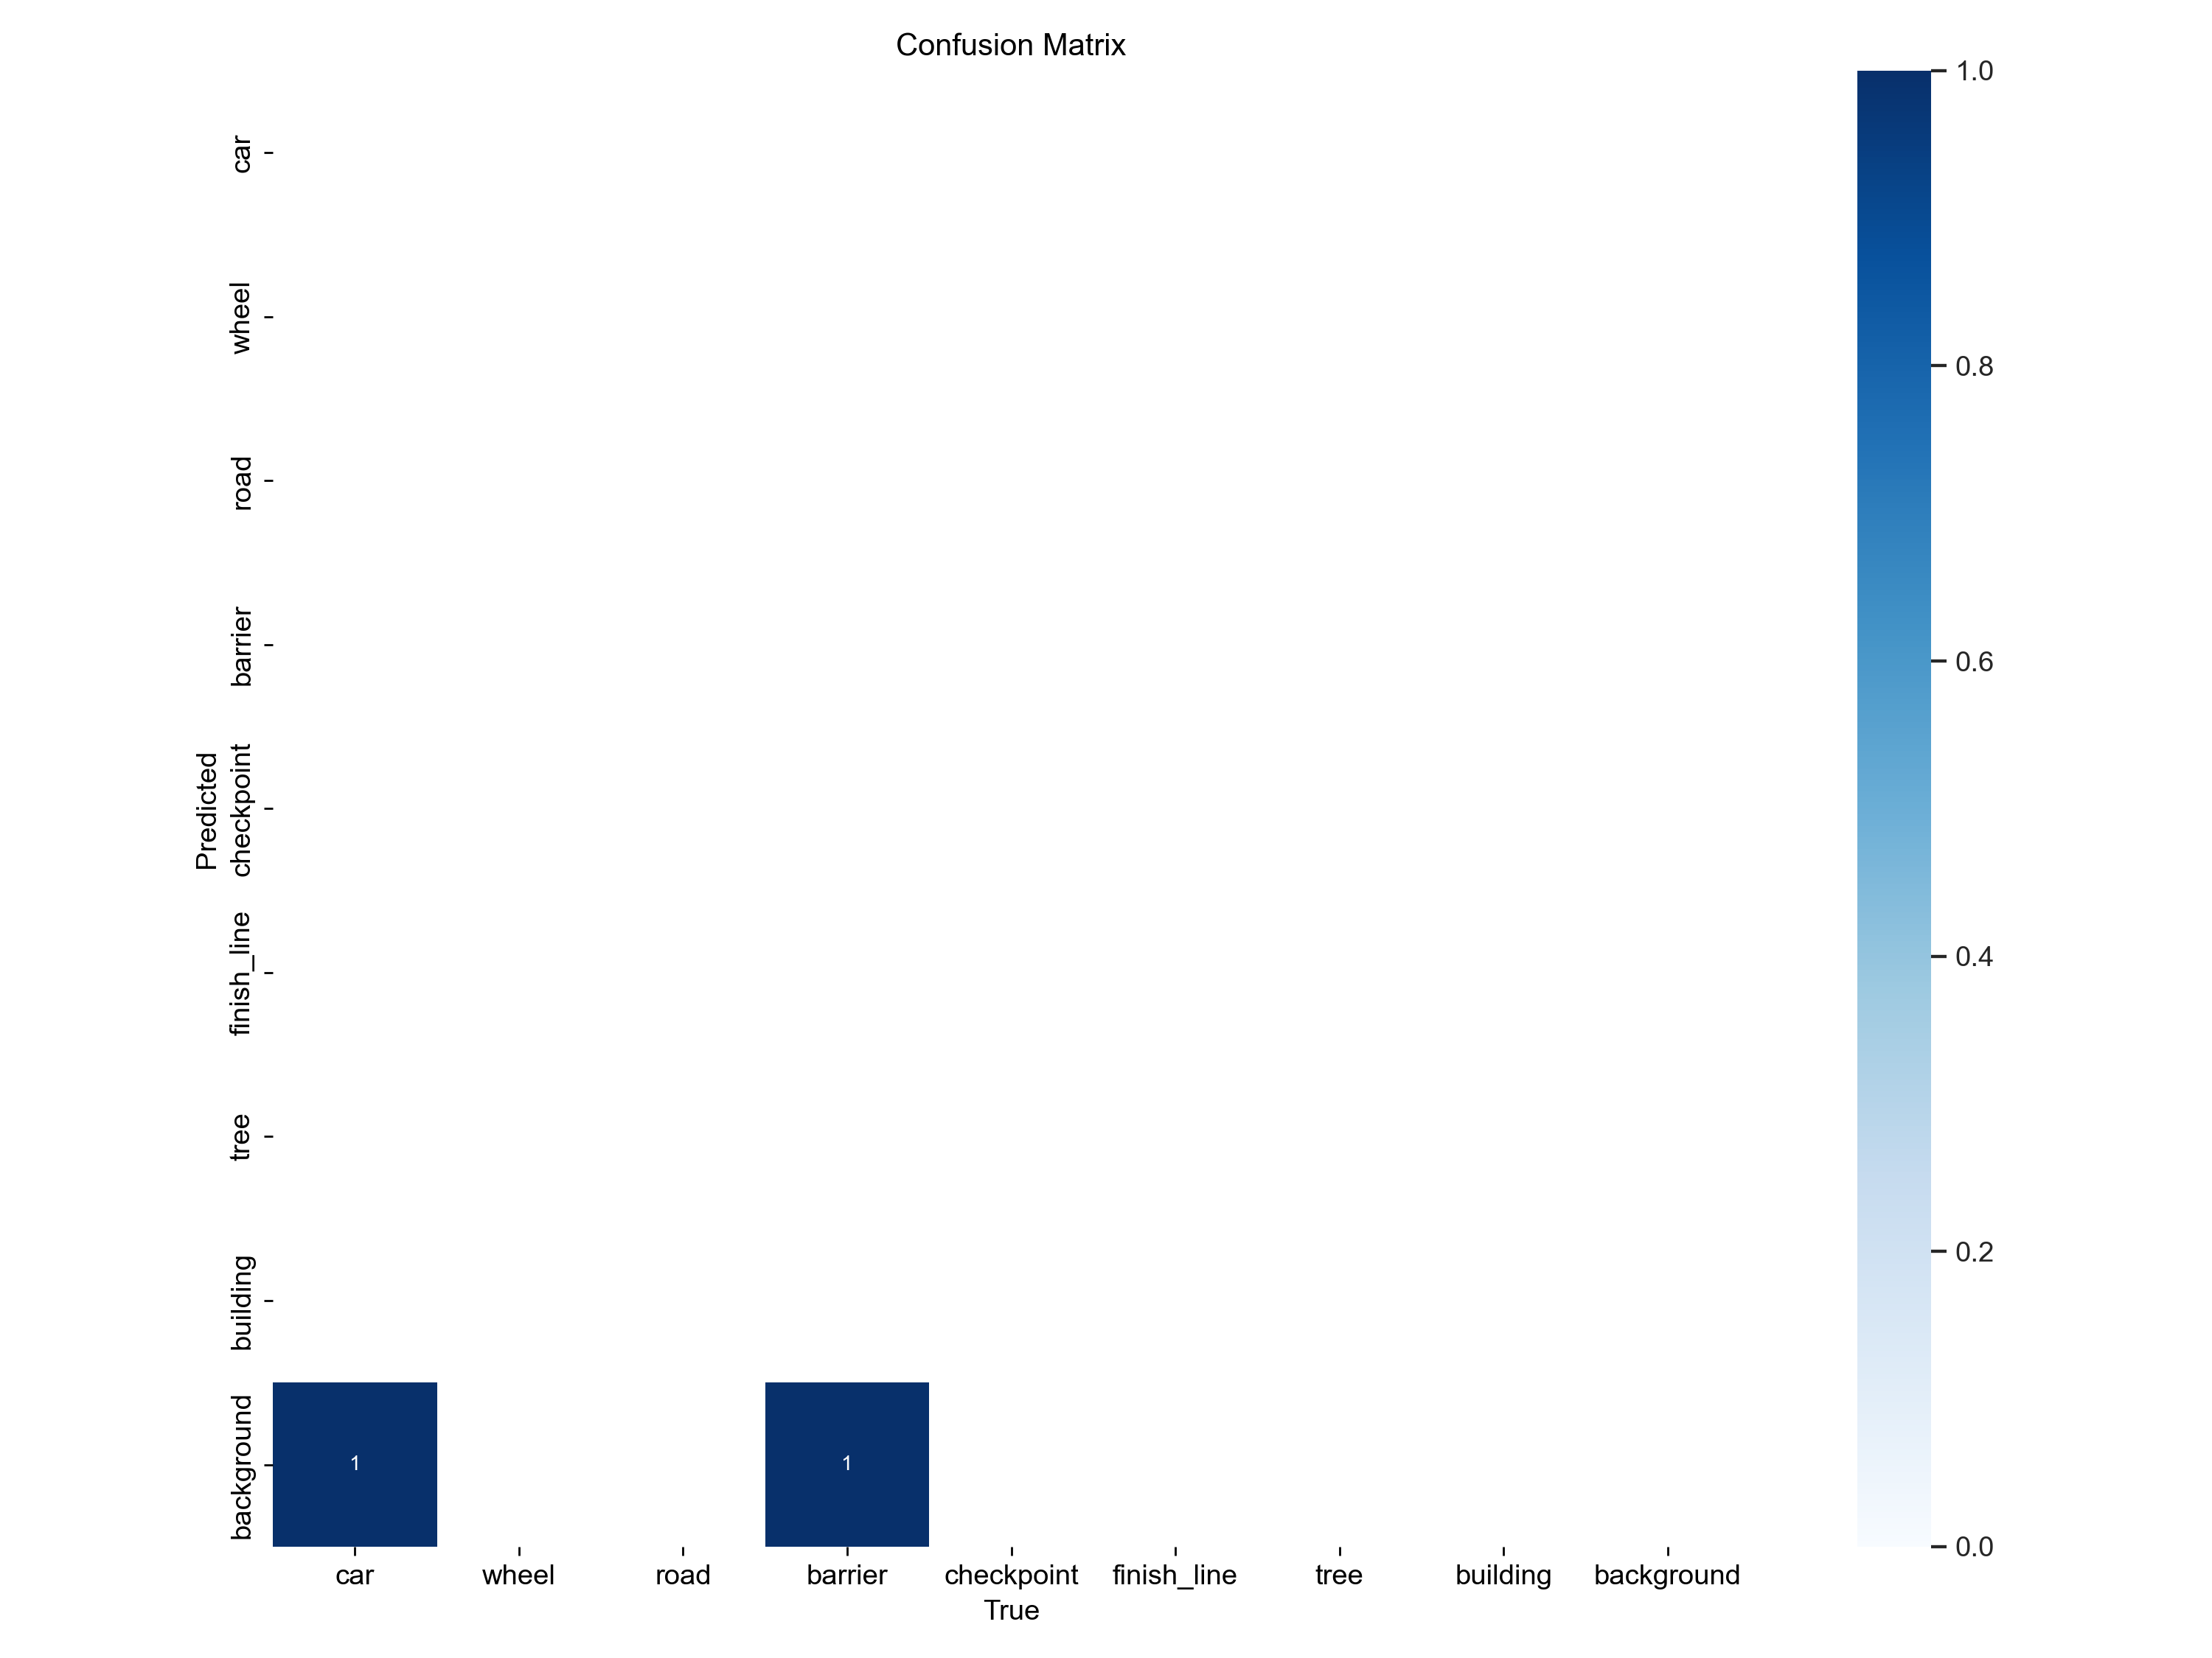
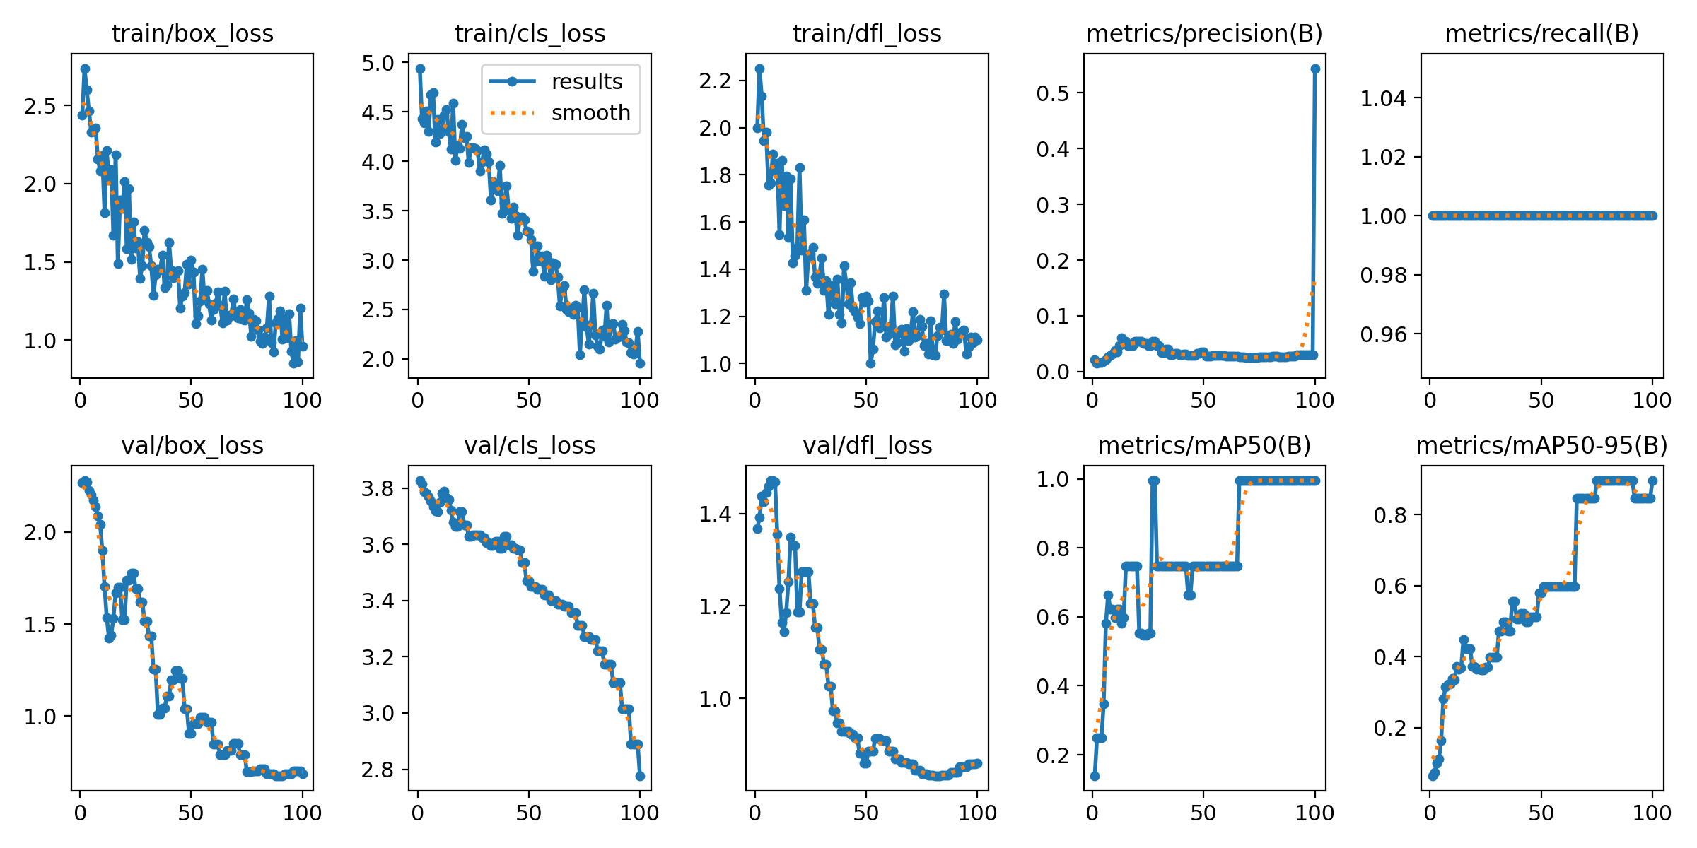
YOLO-Based Object Detection
1
Architecture
2
Process
3
Application
Single-pass object detection
model for real-time applications.
Predicts bounding boxes and
classifies objects with confidence scores.
Adapted for Trackmania
object detection tasks.

Slide 12
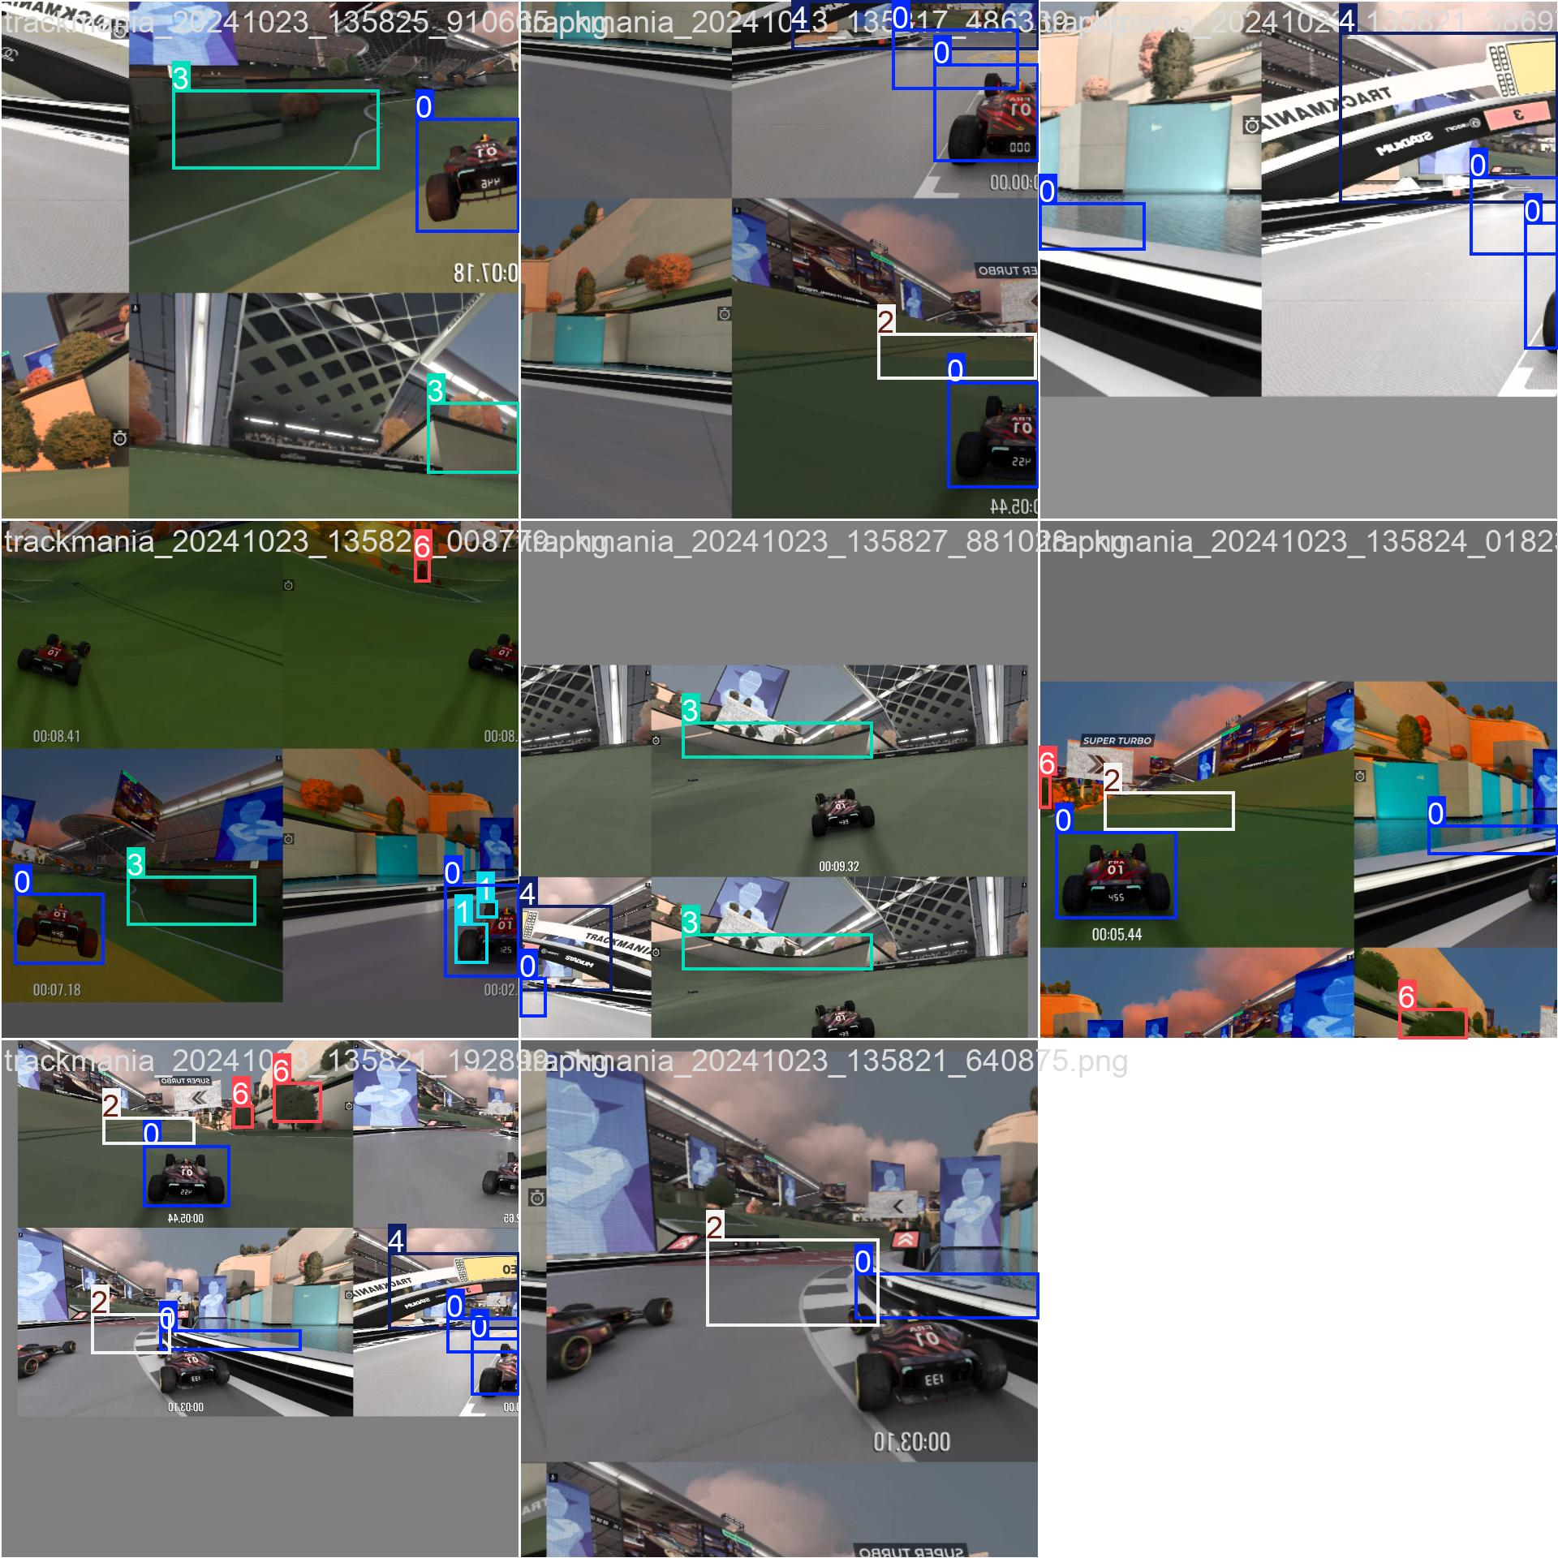
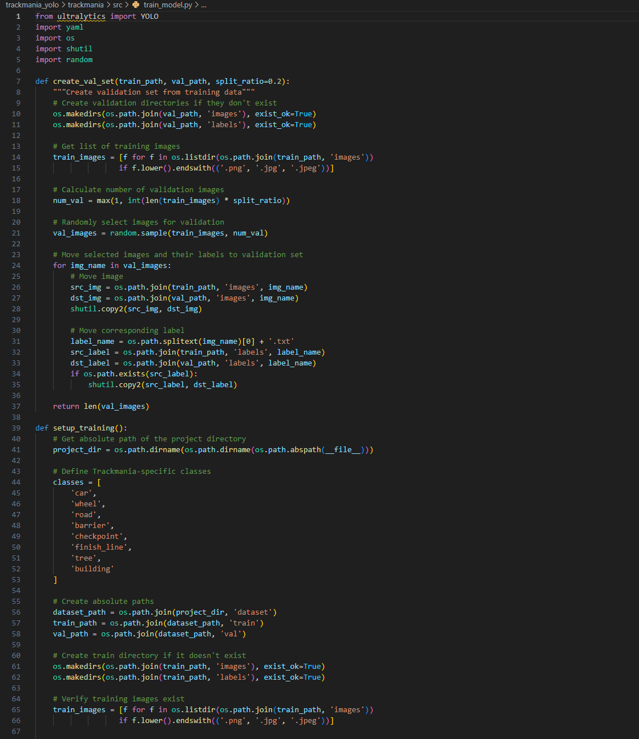
YOLO Implementation and Labeling
1
Code Workflow
Splits data into train/val sets, creates a YOLO-compatible configuration, and trains YOLOv8 on custom Trackmania dataset
2
Labeling Process
Manual labeling of ~40 images to refine detection.
3
Dataset Limitation
Small dataset size limiting robust accuracy across scenarios.

Slide 13
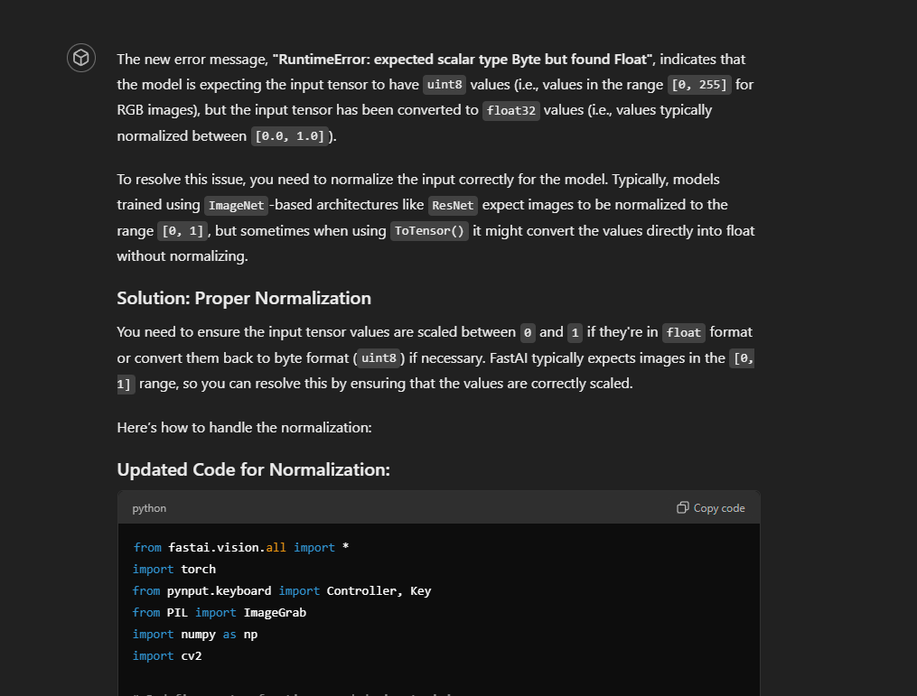
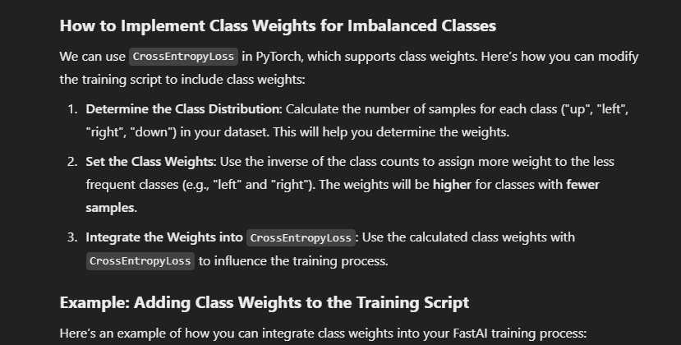

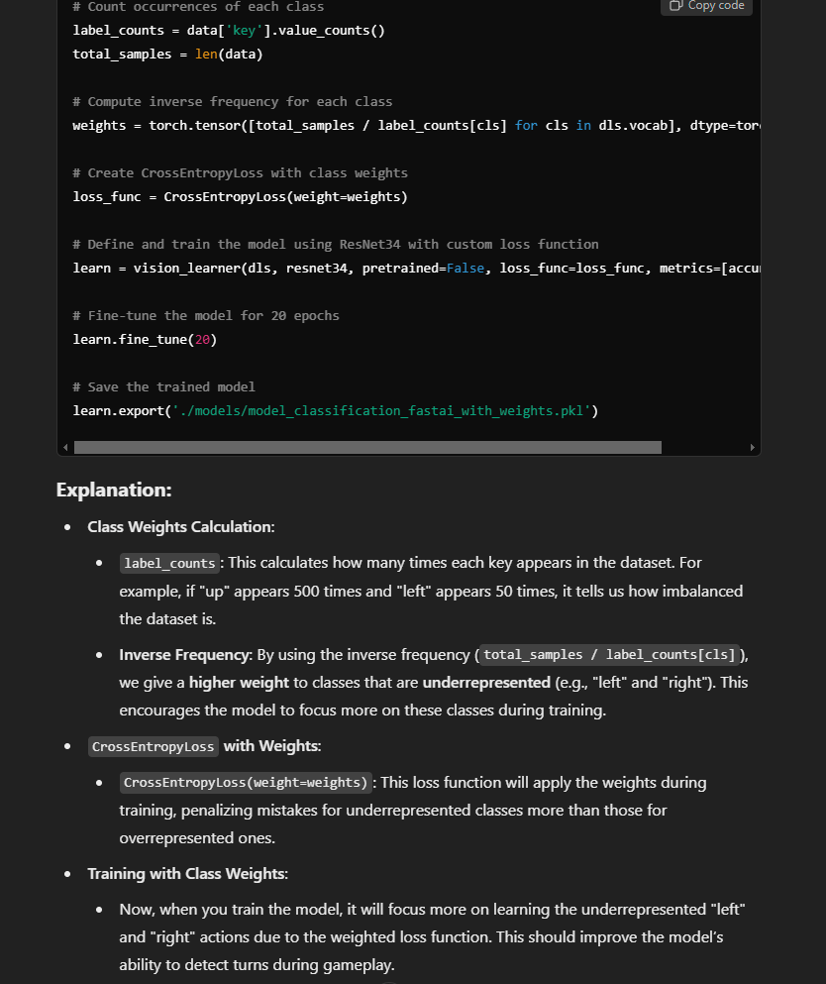

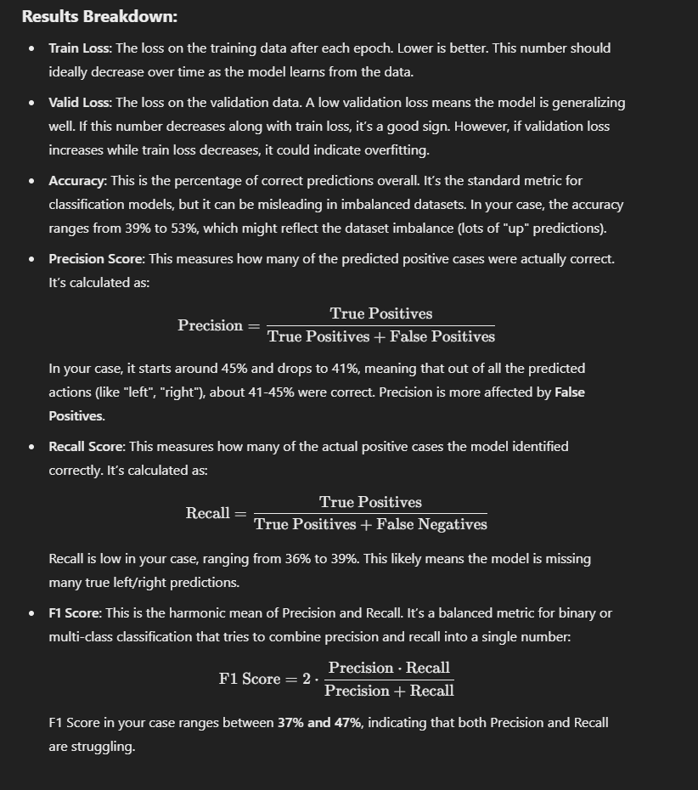

Use of Generative AI Tools
Model Optimization
ChatGPT provided guidance on tuning and structures.
Report Drafting
AI assisted in organizing and clarifying complex explanations.
Debugging
AI tools helped resolve preprocessing and training issues.

Slide 14
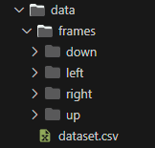
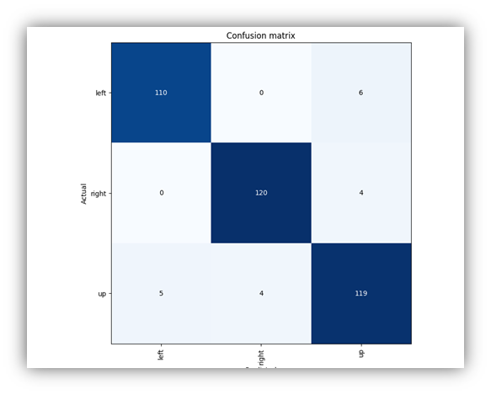
Conclusion
Data Balance
Turn data essential for accurate navigation.
Architecture Limitations
Static CNNs lack temporal and spatial complexity.
Future Enhancements
Temporal models and contextual inputs could improve performance.

