Slide 1
Datathon Use Case 2
Wind Power Plant Production Forecasting
Alp Özen
Alkım Ece Toprak
Ayda Geçim

Slide 2
Business Understanding
It is an electricity producer’s responsibility to inform the market every day of the electricity volume we will produce hourly for the next day. This is done to keep the electricity grid balanced and a financial cost is reflected on the producer if the actual produced volume differs from the value that was informed.
In this report, we are trying to forecast the power output of a wind power plant for the 5th of June, 2021. If we manage to accurately forecast the power production of our power plant for the next day, we can minimize the imbalance cost.

Slide 3
Data Understanding
To be able to forecast the power output of the given wind power plant, we have historic forecast data for:
Wind Speed
Wind Direction
Temperature
Pressure
Humidity
Production from 3 forecast providers and
Actual Power Production data of the power plant up until the forecast period.

Slide 4
Data Understanding
Time Related Feature Extraction
We tried adding several time related features.
  Season (One-hot encoding is used)
  Hour (sin, cos and tan functions are used to represent the periodicity of this feature)
  Month (sin, cos and tan functions are used to represent the periodicity of this feature)
  Holidays (national holidays of Turkey)
  Weekdays (One-hot encoding is used)
We dropped holidays, weekdays and tan(month) columns later on.

Slide 5
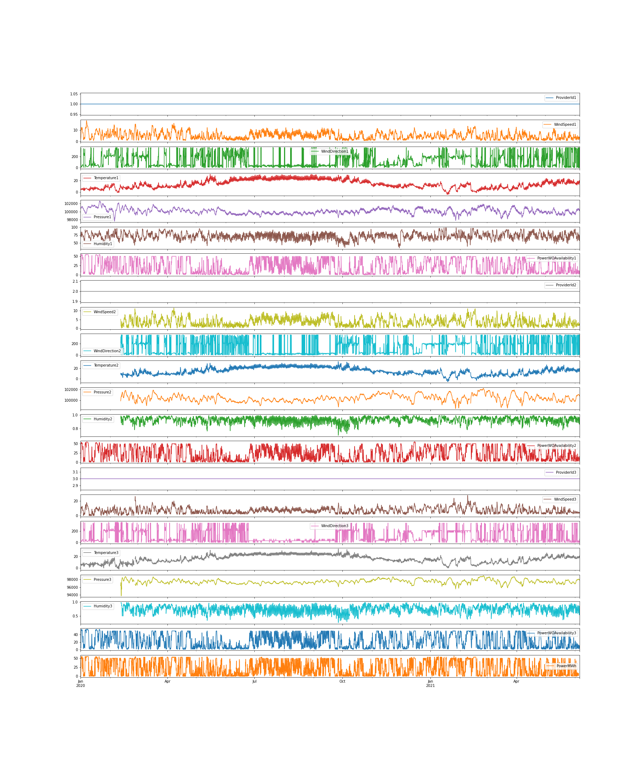
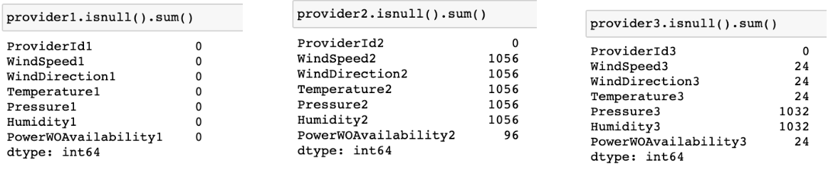
Data Understanding
Missing Values
Here we can see the columns of the data and their distributions.
We can see that there are missing values in some columns.
But before imputing, it is important to check that data for outliers too.

Slide 6
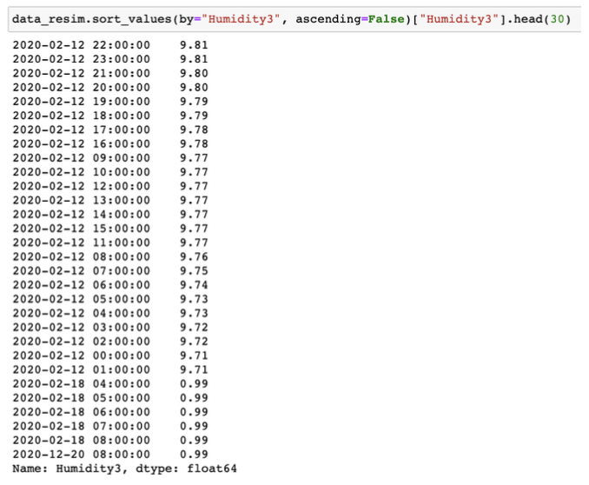
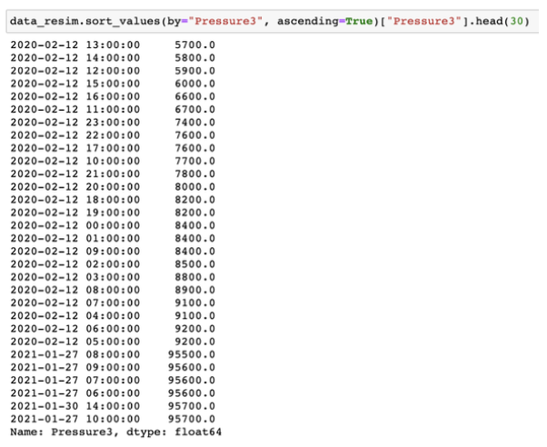
Data Understanding
Outliers
For the extreme values in Humidity and Pressure data of Provider 3, we first tried to observe the values:
Humidity values: We assumed these extreme values should be on par with the rest, so we divided them by 10.
Pressure values: We assumed these extreme values should be around the rest of the values, so we added “88000” to these.

Slide 7
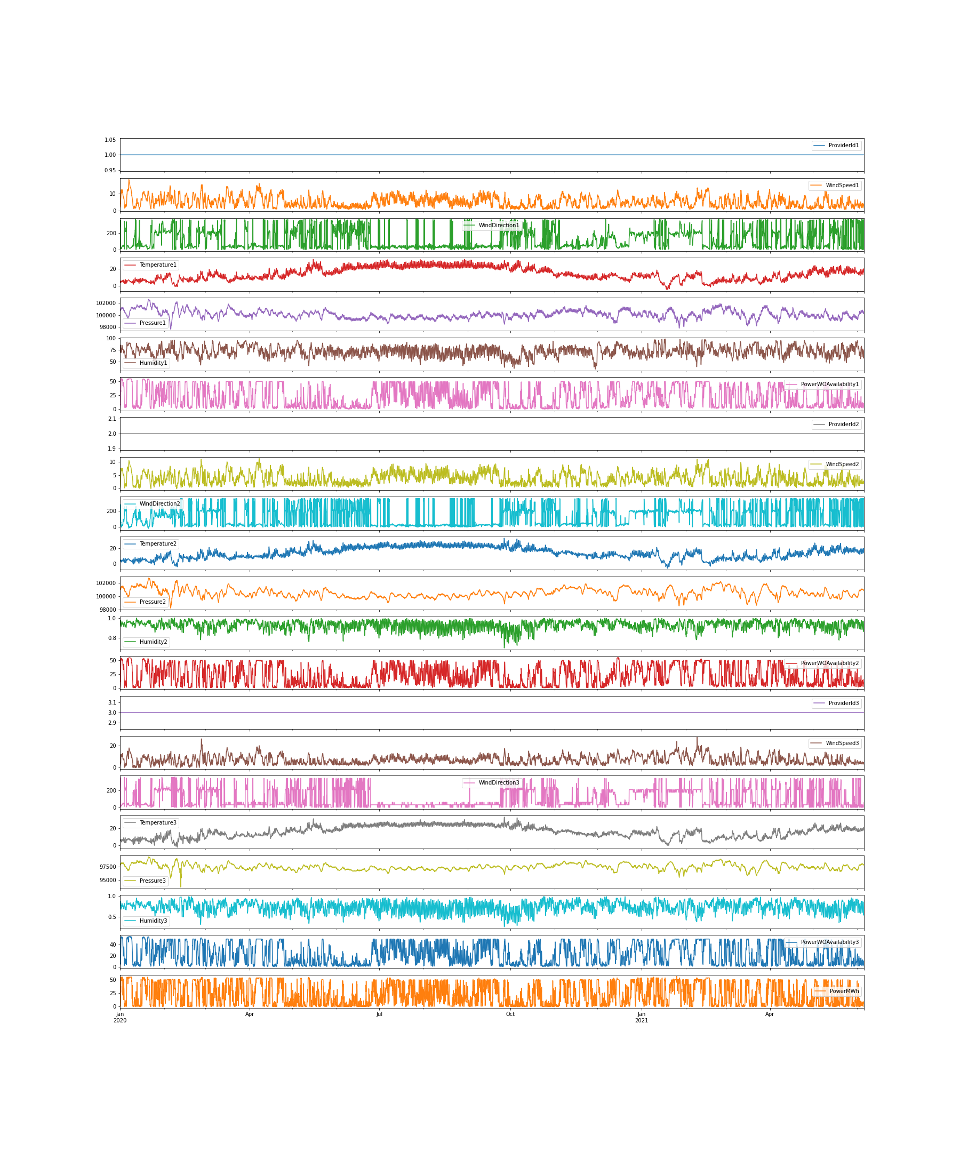
Data Understanding
Missing Value Imputing
We used two methods to impute the missing values:
  KNNImputer with 5 neighbors, which tries to impute the missing values by using a k_neighbors algorithm.
  IterativeImputer
We preferred IterativeImputer’s results which can be seen on the right.

Slide 8
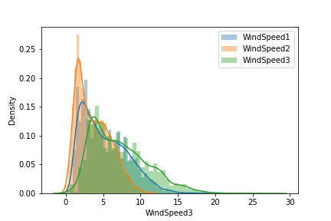
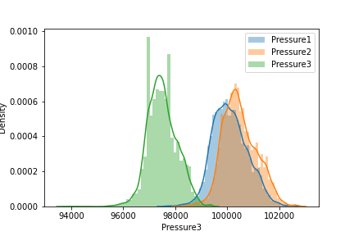
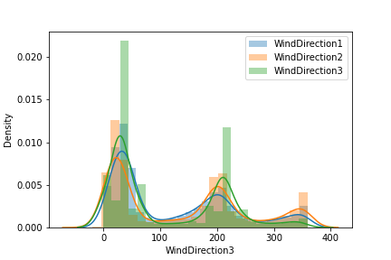
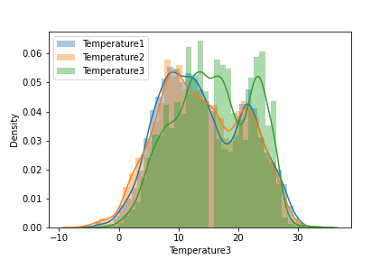
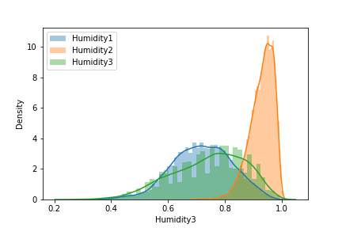
Data Understanding
Distributions
The distribution of all the values in our data an be seen on the right.
The distributions are very close together except for pressure of provider 3 and humidity of provider 2.

Slide 9
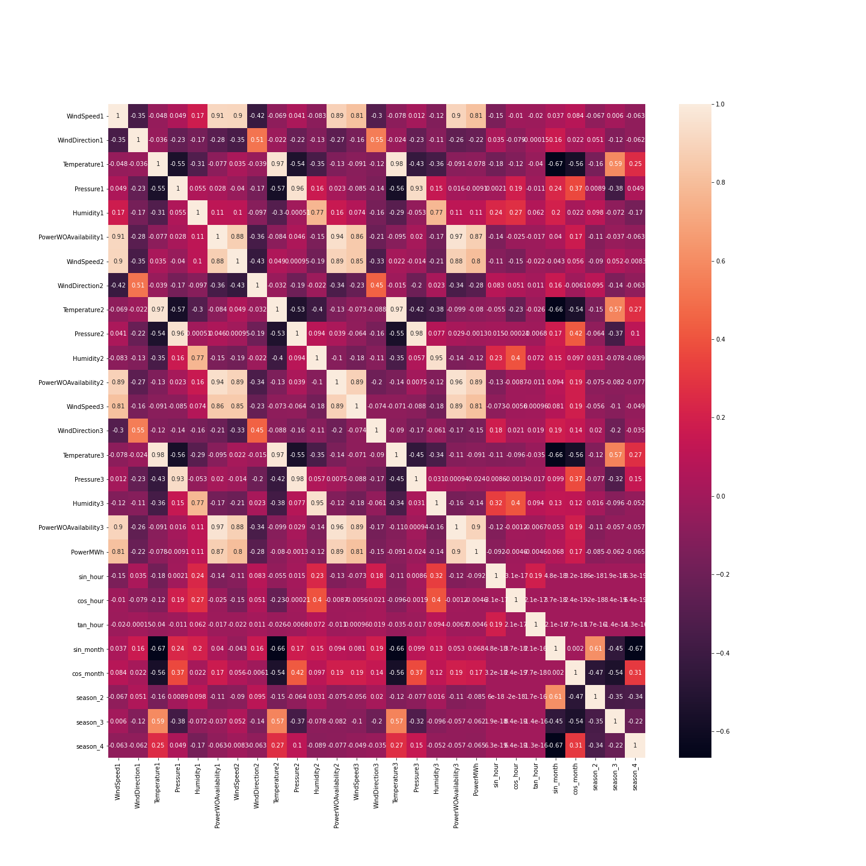
Data Understanding
Correlation of the Features
The correlation of all the features can be seen on the right.
We can see all the production forecasts are highly correlated with each other.
The actual power generation is correlated with the feature “PowerWOAvailability” of the Provider 3 the most.
We can expect Provider 3’s forecast to be the best in the following analyses.

Slide 10
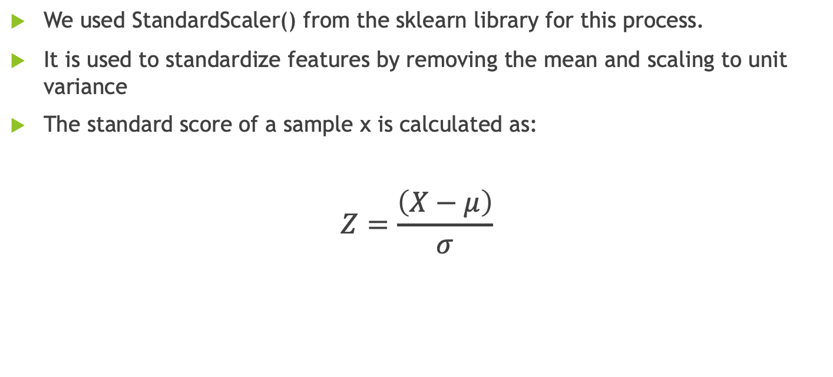
Data Preperation
Scaling the Data
We used StandardScaler() from the sklearn library for this process.
It is used to standardize features by removing the mean and scaling to unit variance
The standard score of a sample x is calculated as:
$$Z=\frac{\left(X−μ\right)}{σ}$$

Slide 11
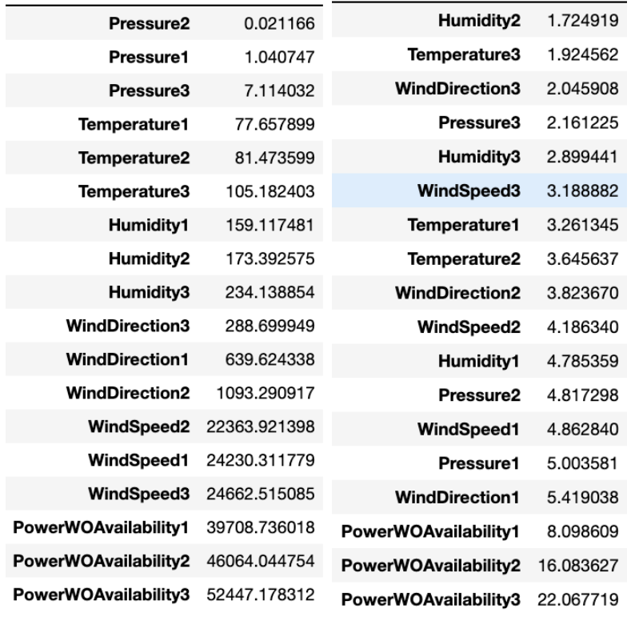
Data Preperation
Feature Selection of the Original Features
We first checked the feature importances of the given data by using 2 algorithms.
  SelectKBest with f-regression (left)
  CatBoost Feature Importance (right)
We can see that the most important features are the forecasts of the providers, 3 being the maximum, which is the result we expected from the correlation chart.
CatBoost Regressor’s feature importances suggests we should not remove these features.

Slide 12
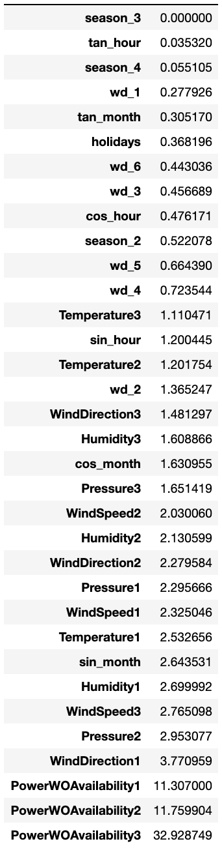
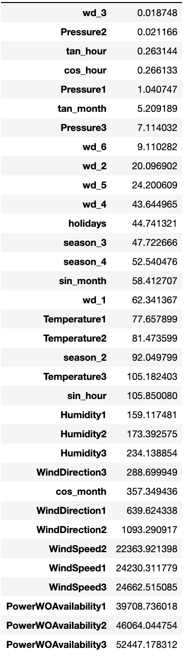
Data Preperation
Feature Selection of the Time Related Features
We first checked the feature importances of the given data by using 2 algorithms.
  SelectKBest with f-regression (left)
  CatBoost Feature Importance (right)
We dropped weekday, holidays and tan(month) features as a result.

Slide 13
Modeling
Models we tried
We used the following models:
  Linear Regression
  Lasso Regression
  Ridge Regression
  ElasticNet Regression
  Support Vector Regression
  K Neighbors Regression
  RandomForest Regression
  GradientBoosting Regression
  CatBoost Regression
  Facebook Prophet
  LightGBM Regression

Slide 14
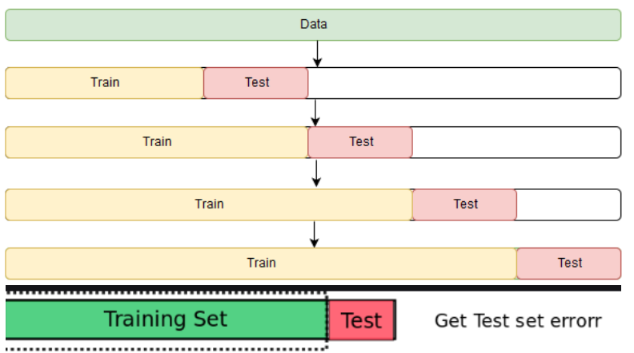
Modeling
Cross Validation and Train-Test Split
Cross validation is used to lower the bias of a model by training on a part of the data and validating on another.
Time series data should not be randomly split, to avoid data leakage, otherwise we would simply be cheating by training with the future data.
We used a five fold time series split for our cross validation scheme for these reasons.
We selected the last 4 days of June (2021-06-01 00:00 - 2021-06-04 23:00) as our test set and remaining data as our training set.

Slide 15
Modeling
Hyperparameter Search
We used Grid Search and Randomized Search to optimize our model parameters. The final parameters chosen:
Linear Regression : {‘fit_intercept’: True}
Lasso Regression : {‘alpha’: 1}
Ridge Regression : {‘alpha’: 100}
ElasticNet Regression : {‘alpha’: 1, ‘l1_ratio’: 1}
Support Vector Regression : {‘C’: 0.1, ‘tol’: 0.01, ‘max_iter’: 10000}
RandomForest Regression : {‘oob_score’: False, ‘n_estimators’: 800, ‘max_samples_leaf’: 9, ‘max_samples’: 0.1, ‘max_features’: 0.75}
GradientBoosting Regression : {‘n_estimators’: 600, ‘max_depth’ : 1, ‘learning_rate’: 0.01}
CatBoost Regression: {‘depth’: 8, ‘l2_leaf_reg’ : 5, ‘learning_rate’: 0.01}
LightGBM Regression:{‘n_estimators’: 400, ‘num_leaves’: 8, ‘max_depth’: 7,’learning_rate’ : 0.01}
*Default values were used for not mentioned parameters

Slide 16
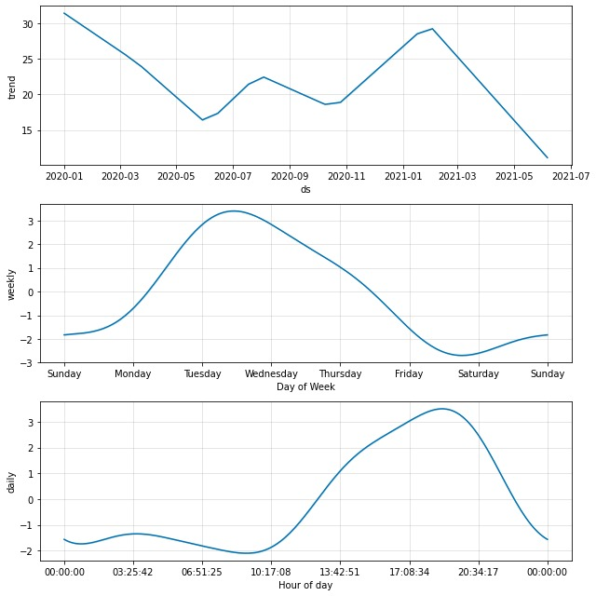
Models
Prophet Time Series Analysis
We conducted a time series analysis and prediction using FB Prophet.
You can see decomposition of seasonal elements on the right.
We didn’t prefer to use this model as it’s pretty much a black-box model and because we have less than 1.5 years of data, which is not enough to capture seasonality.

Slide 17
Evaluation
Metrics
We evaluated our models according to three different metrics:
  Mean Absolute Error
  Root Mean Squared Error
  R2 Score
The final selection was based on mean absolute error. We understand that mean absolute error is the most important metric as it directly represents the imbalance cost that will be reflected on us.

Slide 18
Evaluation
Results
 | Mean Absolute Error | Root Mean Squared Error | R2
Provider1 | 6.40 | 10.09 | 3%
Provider2 | 6.56 | 8.60 | 29%
Provider3 | 5.71 | 8.03 | 38%
Linear Regression | 5.50 | 7.73 | 43%
Lasso Regression | 5.68 | 7.91 | 40%
Ridge Regression | 5.38 | 7.75 | 43%
ElasticNet Regresion | 5.68 | 7.91 | 4%
Support Vector Regression | 12.14 | 13.31 | -70%
Random Forest | 5.73 | 8.03 | 38%
Gradient Boost | 5.83 | 7.97 | 39%
CatBoost | 5.61 | 8.01 | 39%
LGBM | 5.80 | 8.10 | 37%
These are the results of the last 4 days of June (our test set).
We can see the Provider 3 is the best one among the three, which means their service is the most valuable for our business.
The best model is found to be Ridge Regression with a regularization parameter of 100.

Slide 19
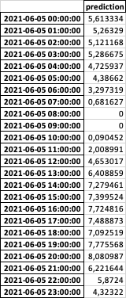
Evaluation
Our Final Prediction
You can see our final prediction for the 5th of June on the right.
Our model’s output was negative for the hours 8 and 9, so we used postprocessing to make the negative forecasts 0.

Slide 20
Thank You For Listening!

