Slide 1
Football Market Predictor
Ege Demir
150200319
demireg20@itu.edu.tr

Slide 2
Contents
Introduction
Related Studies
Dataset
Methodology
Data Preperation
Modelling
Experimental results
Conclusion & Future Work

Slide 3
Introduction
Why do football teams need to predict
the market values of their players

Slide 4
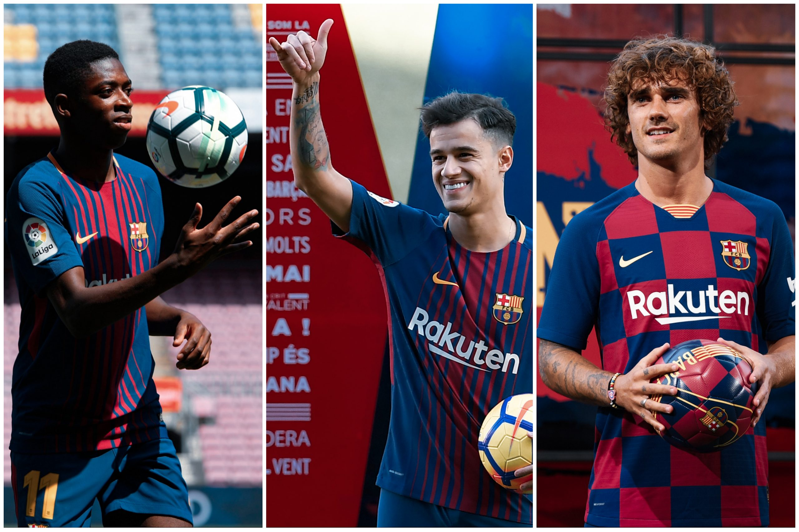
Introduction
Transfer Date | Football Player | Transfer Value | Actual Value
25 Aug 2017 | Ousmane Dembélé | 140 | 33 - 80
8 Jan 2018 | Philippe Coutinho | 150 | 65 - 90
14 Jul 2019 | Antoine Griezmann | 120 | 120 - 130

Slide 5
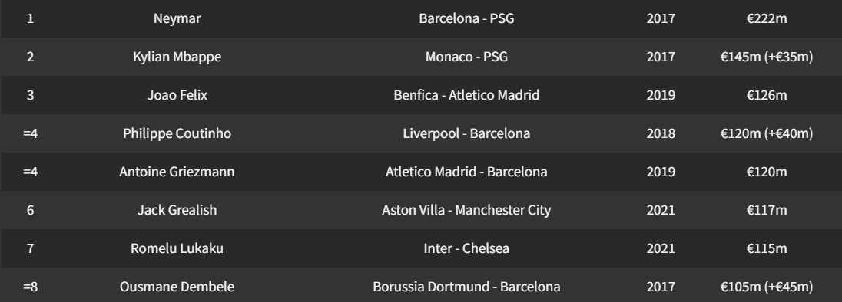

Introduction
https://www.goal.com/en/news/100-most-expensive-football-transfers-all-time/ikr3oojohla51fh9adq3qkwpu

Slide 6

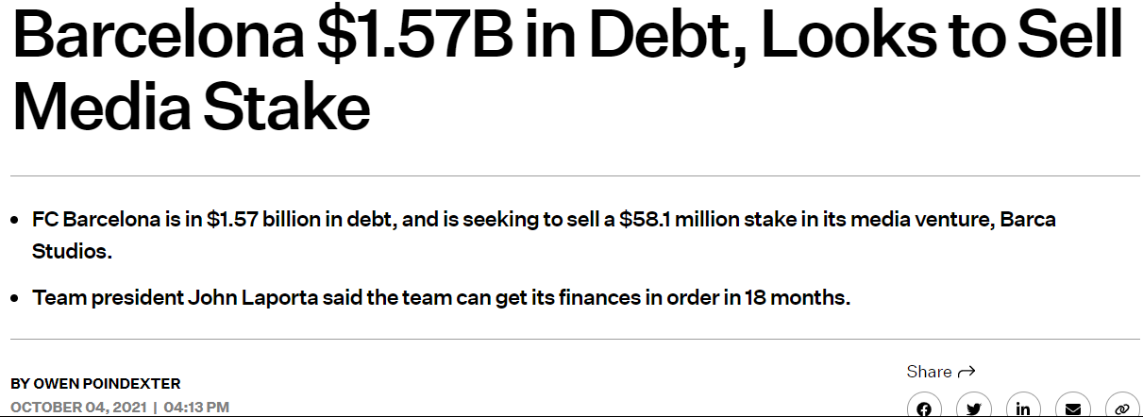

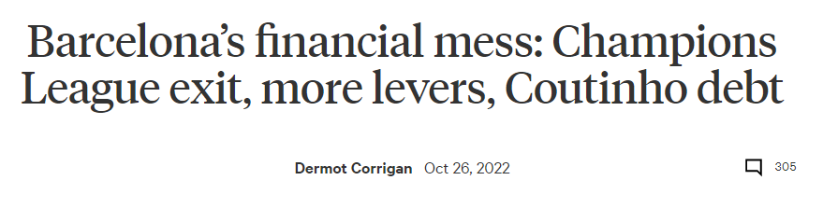
Introduction

Slide 7
Introduction
Not predicting the the market values of the football players accurate enough, nearly bankrupted one of the greatest football teams.
Barcelona example makes it obvious that every team has to accurately predict the values of their players and transfer targets.

Slide 8
Introduction – Proposed System
Predicting the market values of football players is the main purpose of this project. After data cleaning and feature extraction processes, ridge regression is used to train the model.
A ridge regression model makes sense with the chosen dataset, because the correlation is high between the features.

Slide 9
Related Studies

Slide 10
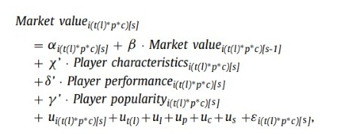
1- Beyond Crowd Judgments: Data-Driven Estimation of Market Value in Association Football
They combine 3 clusters of data: player characteristics, player performance and player popularity.
And they use market values from Transfermarkt (https://www.transfermarkt.com/) as labels.
In the modelling process, multilevel regression analysis, which fits their hierarchically structured data is used.

Slide 11
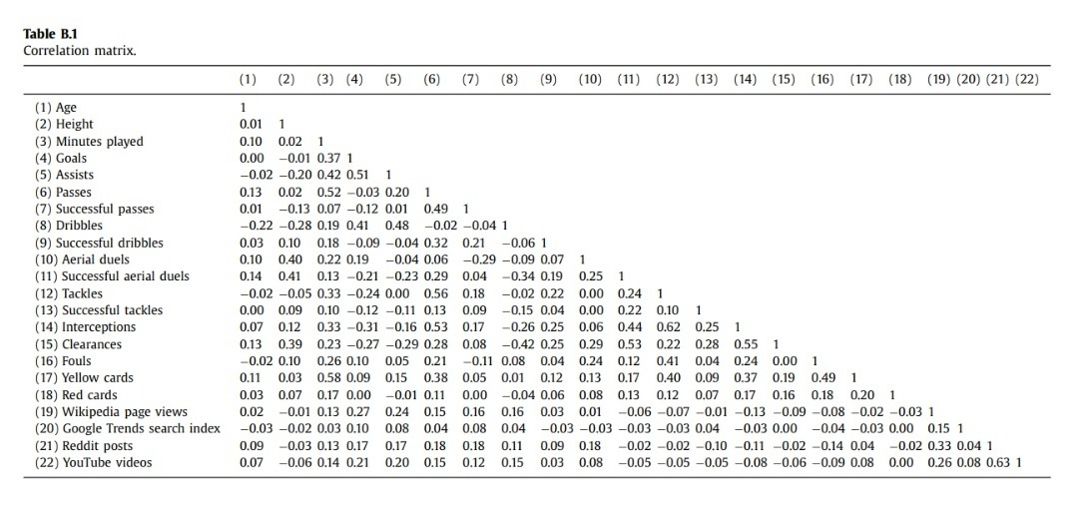
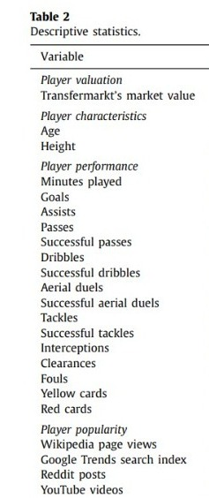
1- Beyond Crowd Judgments: Data-Driven Estimation of Market Value in Association Football

Slide 12
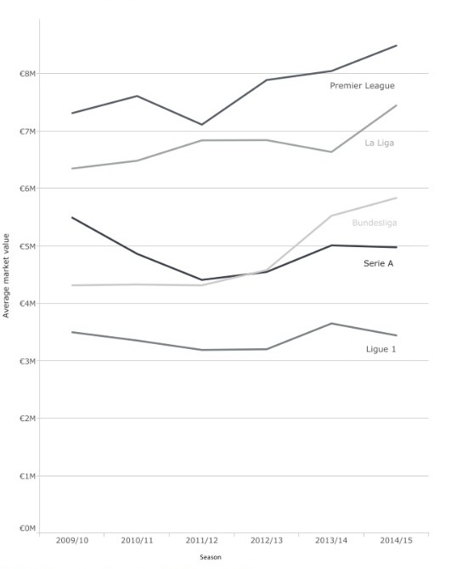
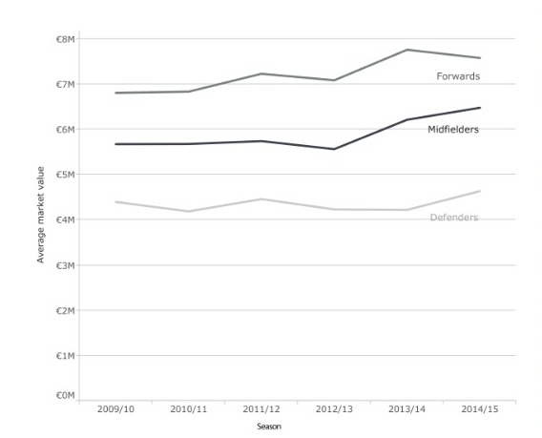
1- Beyond Crowd Judgments: Data-Driven Estimation of Market Value in Association Football
O. Muller, A. Simons, ve M. Weinmann, “Beyond crowd judgments: ¨ Data-driven estimation of market value in association football”, European Journal of Operational Research, vol. 263, no 2, pp. 611-624, 2017, doi: 10.1016/j.ejor.2017.05.005.

Slide 13
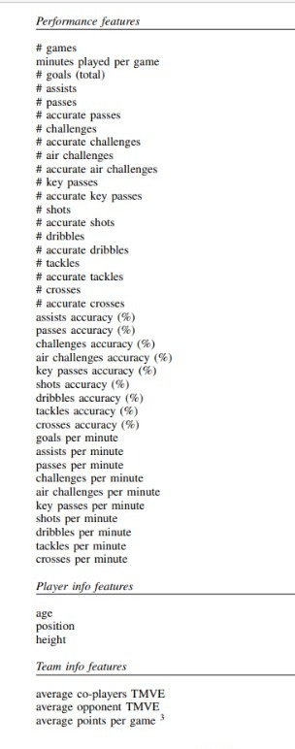
2- Towards data-driven football player assessment
They approach the same problem with a similar dataset as the previous project. Player information and performance features are almost the same, but they don’t include the popularity attribute.
Another difference is the handling of the team information. They add average score of the team players, and average score of the opponent’s players and use them as coefficients of the performance indicators for each game; rather than simply using the team name.

Slide 14
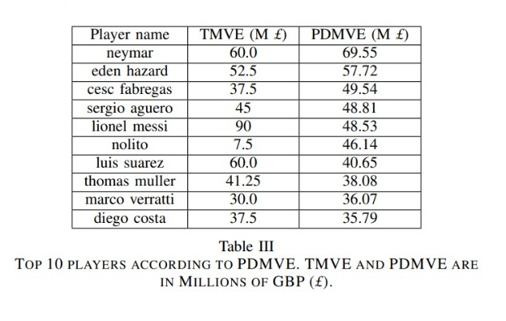
2- Towards data-driven football player assessment
For the model,, they use linear regression, and I think that is a mistake. As Muller et. al. (2017) stated, the features of the dataset are unlikely independent, and linear regression, which assumes independent features, can’t be used.
For example, assists per minute is most likely affected by key passes per minute.
R. Stanojevic and L. Gyarmati, ”Towards Data-Driven Football Player Assessment,” 2016 IEEE 16th International Conference on Data Mining Workshops (ICDMW), 2016, pp. 167-172, doi: 10.1109/ICDMW.2016.0031.

Slide 15
3- A novel machine learning method for estimating football players’ value in the transfer market
This paper attracted me the most, because their dataset is nearly same as mine. They work on the data from FIFA 20.
They divided their data to 4 clusters: goalkeepers, defenders, midfielders, and forwards; and I don’t think that is an efficient way. For example central defensive midfielders are more alike to central backs (which classified as defenders), rather than central attacking midfielders.
I think there should be 8 (gk, rb/lb/rwb/lwb, cb, cdm, cm, cam, rm/lm/rw/lw/rf/lf, st/cf), or 2 (goalkeeper or not) clusters.
Goalkeepers must be handled as a separate case, because their performance scores is nothing like a player from another positions.

Slide 16
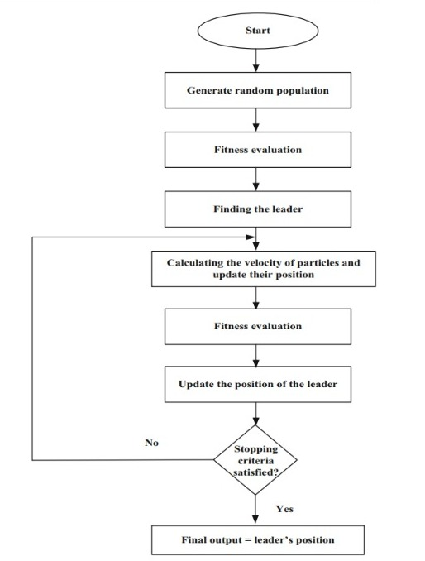
3- A novel machine learning method for estimating football players’ value in the transfer market
At the modelling part, they use particle swarm optimization, where they start with random parameters, and update them at the end of every iteration, and repeating this process until stopping criteria is met.
Behravan, I., and Razavi, S. M. (2020). A novel machine learning method for estimating football players’ value in the transfer market. Soft Computing. doi:10.1007/s00500-020-05319-3

Slide 17
Dataset

Slide 18
Dataset
The dataset, is a matrix, and it’s from a csv file. It has 18540 rows and 90 columns.
Each row represents a football player, and each column carries a piece of information about that player. While some columns are about general information about players (age, team, position etc.), others are various scores (agility, strength, positioning etc.) from FIFA 23, one of the most popular football games of all time.
The market value column which is called ”ValueEUR” will be the label, and the other columns will be features.
Source: https://www.kaggle.com/datasets/cashncarry/fifa23-complete-player-dataset (FIFA 23 Complete Player Dataset [UPD:29/09/22] | Kaggle)

Slide 19
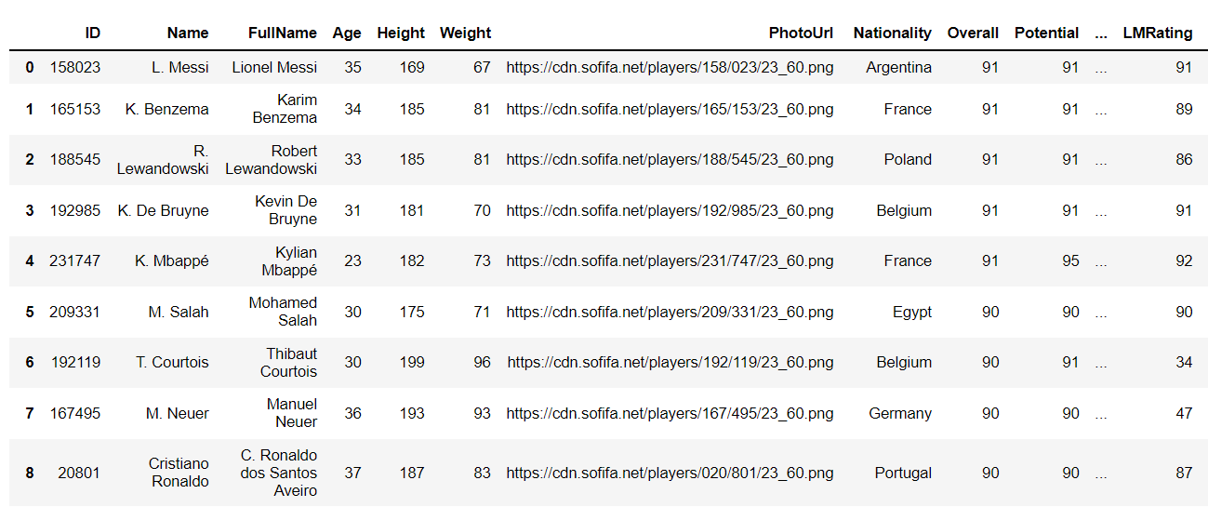
Dataset

Slide 20
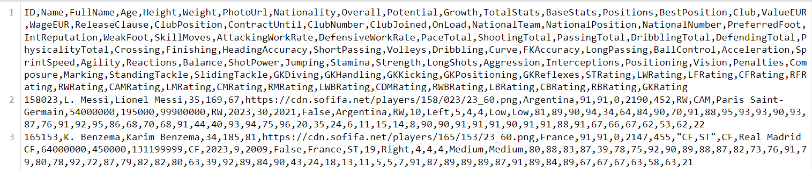
Dataset

Slide 21
Methodology
Data Preperation

Slide 22
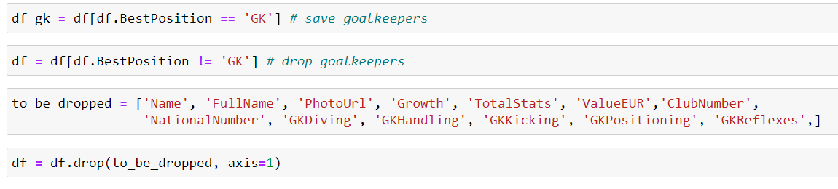
Data Preperation
Split goalkeepers and remove unnecesarry columns

Slide 23
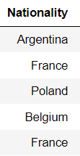
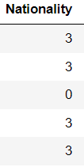
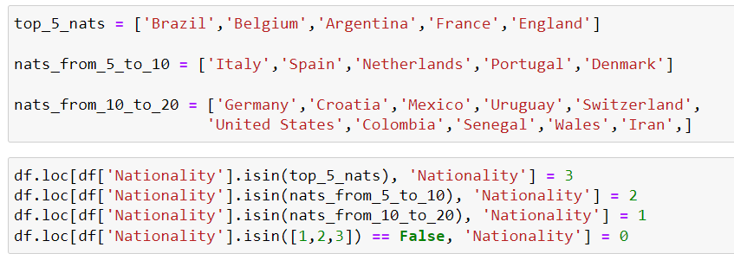
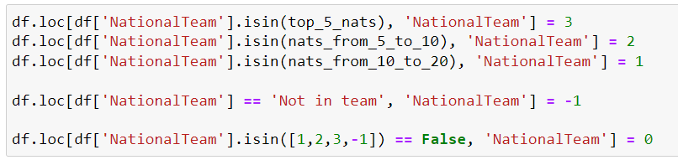
Data Preperation
Numerize the nationality column

Slide 24
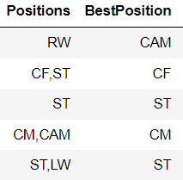
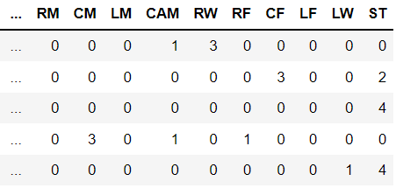
Data Preperation
Numerize the position columns
(best position, club position, nationality position, positions)

Slide 25
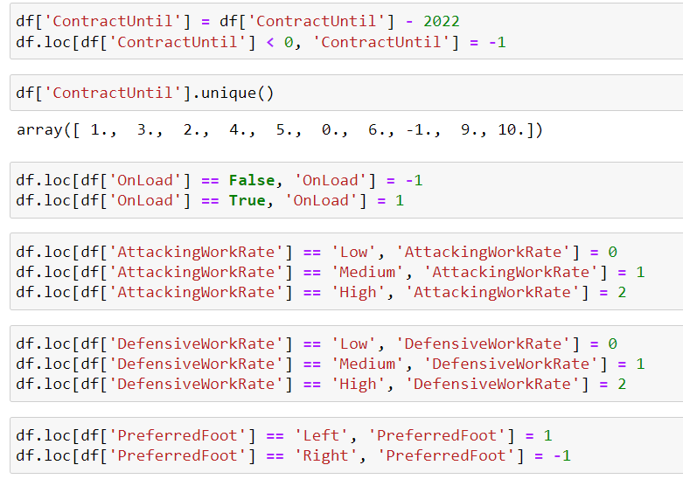
Data Preperation
Numerize other columns
Contract duration, Work-rate, OnLoan, Preferred foot

Slide 26
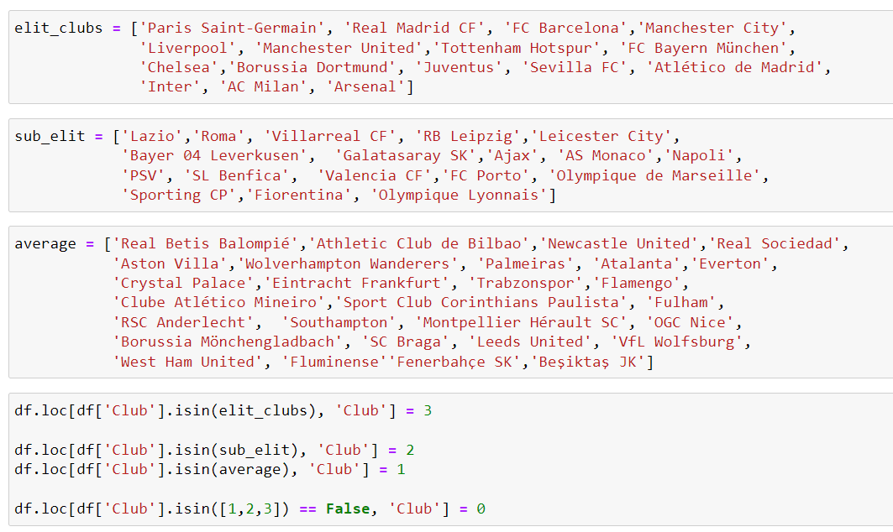
Data Preperation
Numerize the club column

Slide 27
Methodology
Modelling

Slide 28

Model
As I said earlier, I used ridge regression, because it’s suitable for correlated datasets, just like the data I have
I also used cross validation to maximize the efficiency of my limited dataset
Ridge Regression Formula:

Slide 29
Experimental results

Slide 30
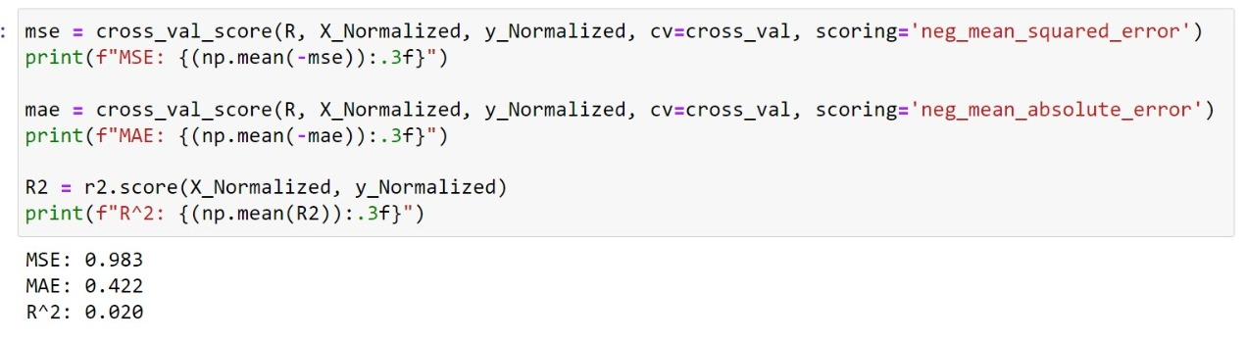
Experimental results
For players:
When n_splits = 10, n_repeats=5 for RepeatedKFold function
and alphas=[0.001, 0.01, 0.1, 1, 10] for RidgeCV function

Slide 31
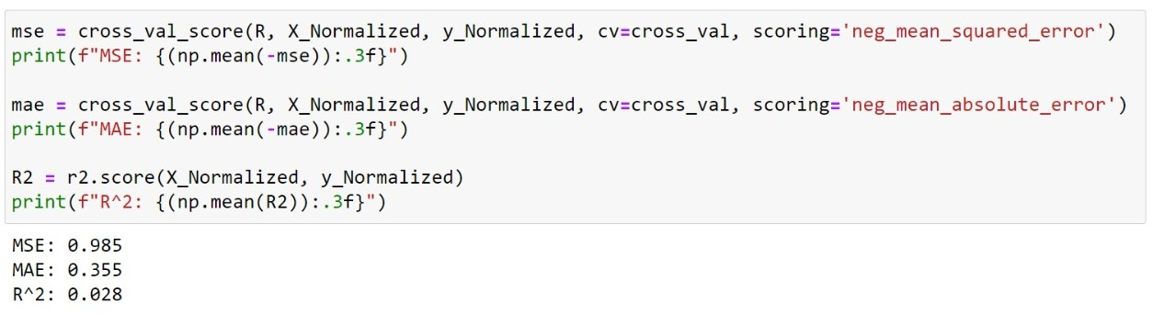
Experimental results
For goalkeepers:
When n_splits = 10, n_repeats=5 for RepeatedKFold function
and alphas=[0.001, 0.01, 0.1, 1, 10] for RidgeCV function

Slide 32
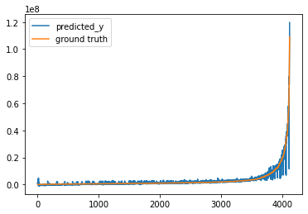
Experimental results
For players:

Slide 33
Conclusion & Future Work

Slide 34
Conclusion & Future Work
I think it’s safe to say that, a ridge regression model with cross validation gives satisfactory results for mean squared error, mean absolute error, and R^2 evaluation metrics for predicting football players’ market value problem.
Other regression methods and classification models can and should be used for this problem to make sure which method is the most suitable one.

