Slide 1

Weekday vs Weekend Walking Distance Analysis
Ege Taş
32378

Slide 2

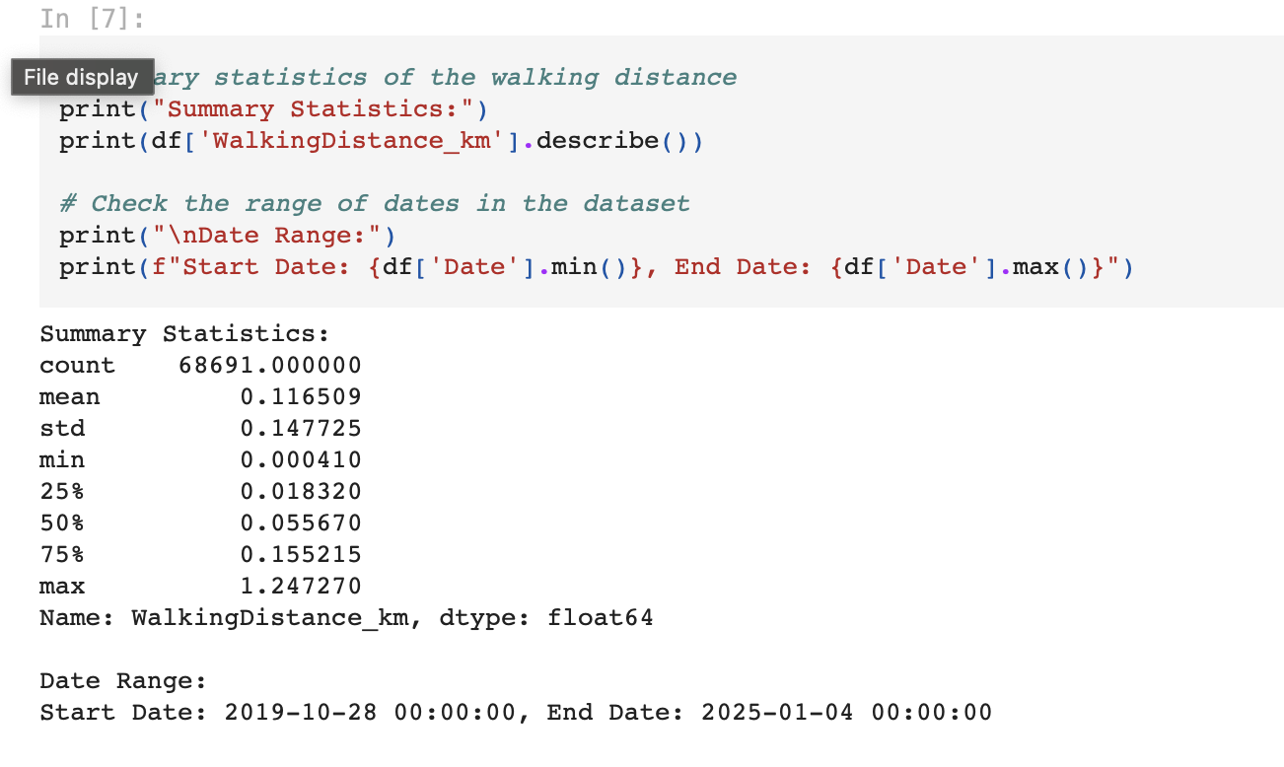
My Data Set
-Walking distance data collected from Apple Health App.
-Data spans from October 2019 to January 2025.
Dataset includes:
-Date: To distinguish weekdays and weekends.
-Walking Distance (km): The total distance walked each day.

Slide 3

Hypothesis
"My walking distance is higher on weekdays because I spend more time at school and attending classes, whereas on weekends, my physical activity levels decrease."

Slide 4
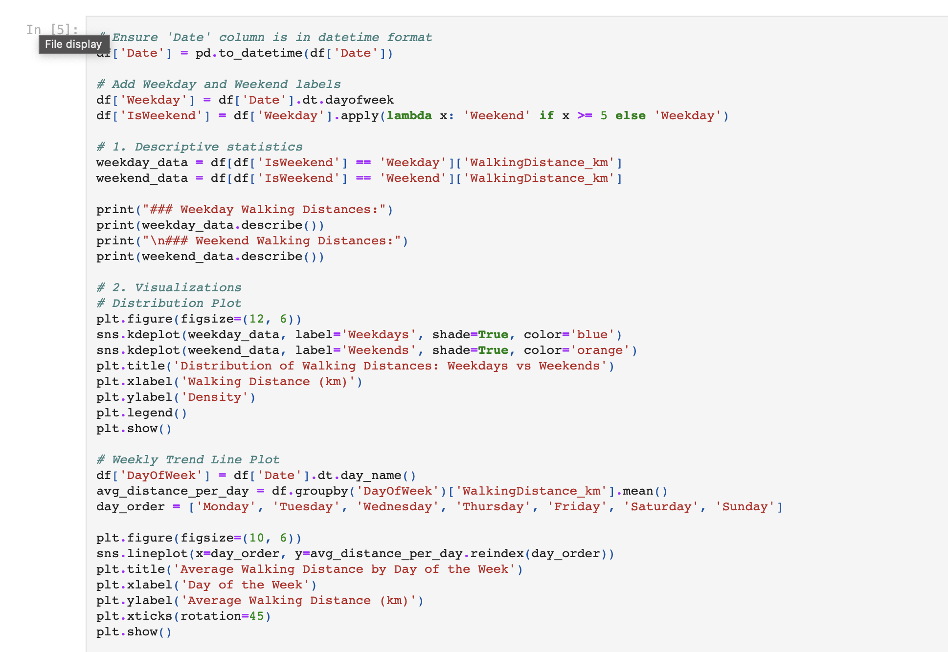
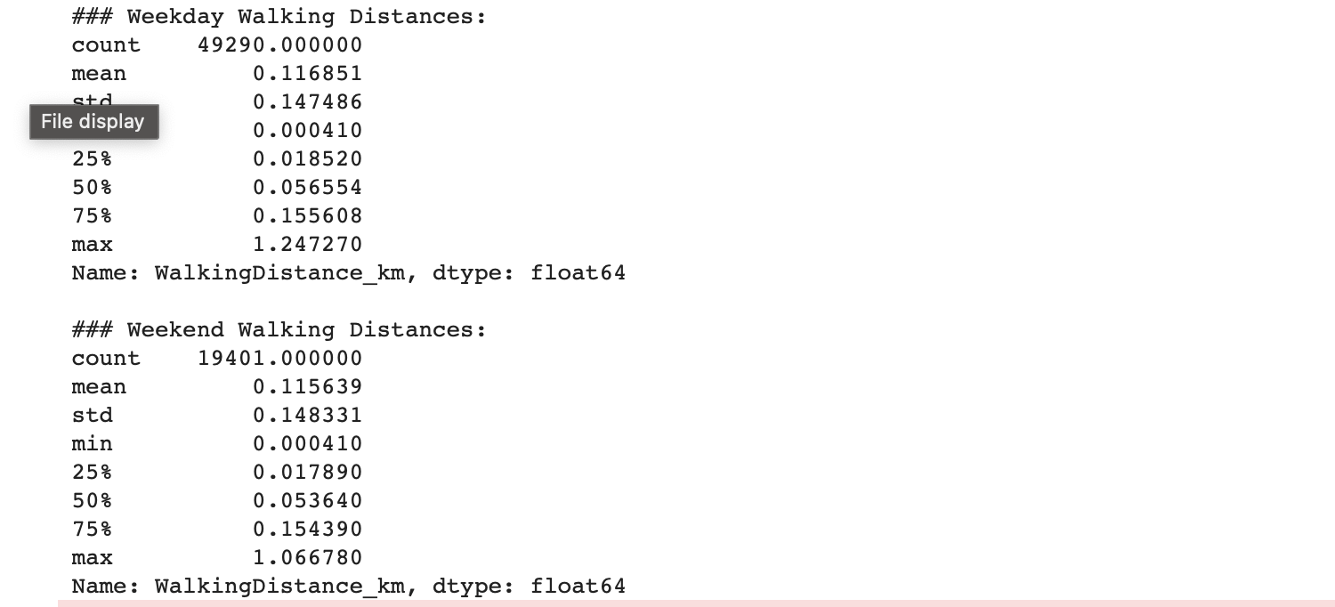
Exploratory Data Analysis
Initial Insights:
• Exploring walking distance trends for weekdays and weekends.
• Investigating seasonal patterns and yearly variations.

Slide 5
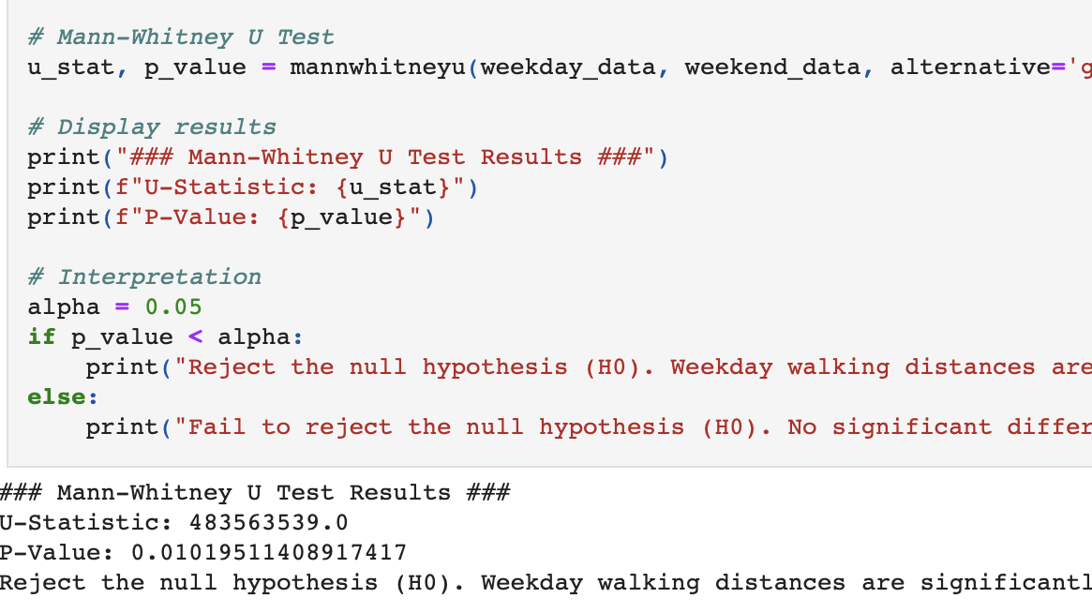
Hypothesis Testing
We will perform the Mann-Whitney U Test, a non-parametric test to compare walking distances between weekdays and weekends.
Hypotheses:
Null Hypothesis ((H_0)): Weekday walking distances are not higher than weekend walking distances.
Alternative Hypothesis ((H_a)): Weekday walking distances are significantly higher than weekend walking distances.

Slide 6
Hypothesis Testing Results
Results:
Hypothesis testing reveals a significant difference (p-value < 0.05).
Rejecting the H(0) to accept H(a).
Weekday walking distances are higher than weekends, confirming the hypothesis.

Slide 7
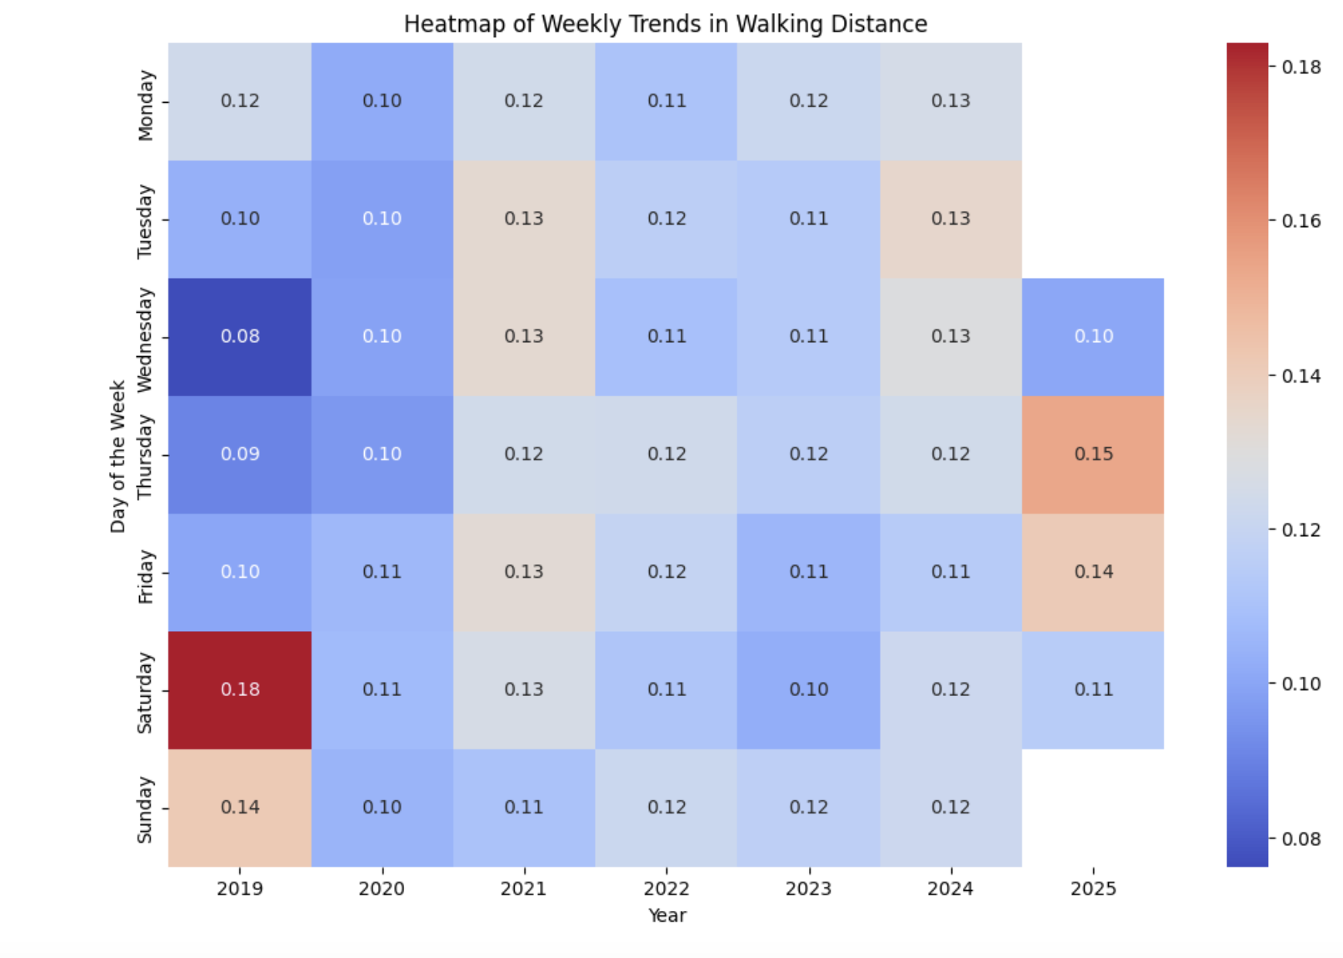
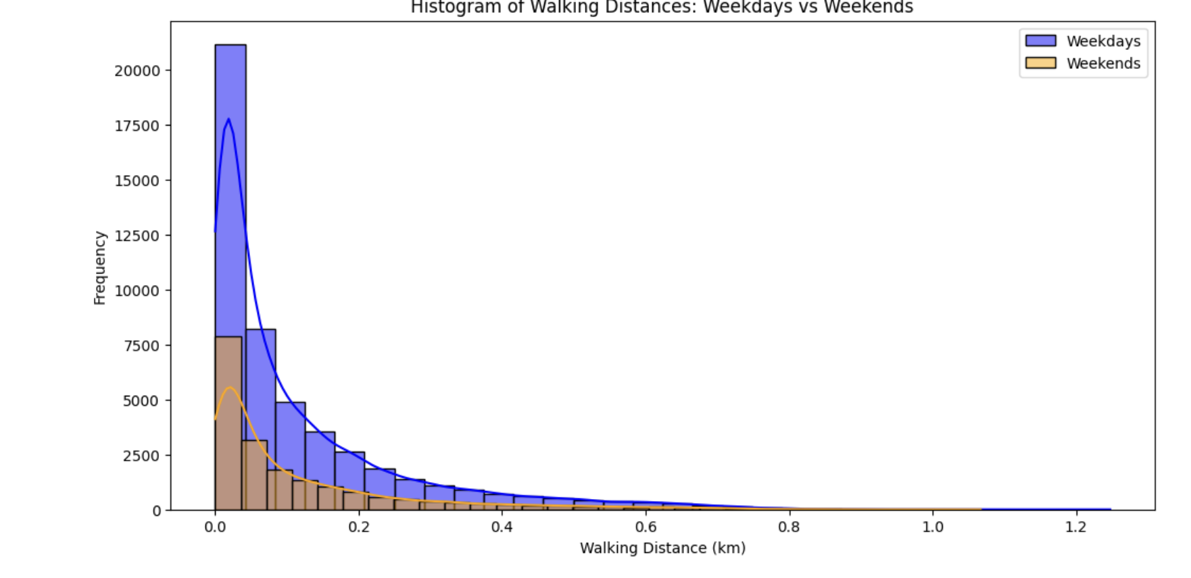
DATA VISUALISATION
The upcoming two slides will consist data visualization techniques in order to provide insights into walking+running distance through week days and weekends.

Slide 8
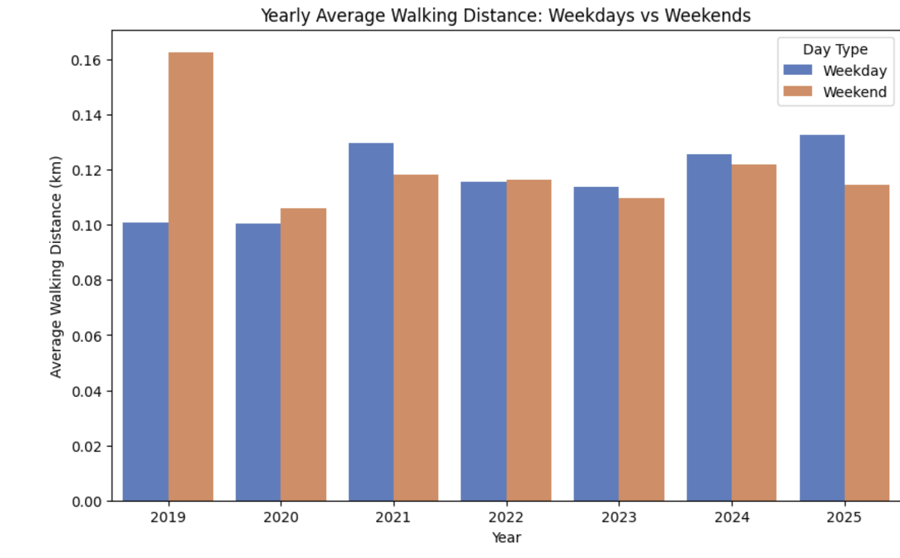
Key Considerations:
2019 Data Limitation:
The dataset for 2019 only includes the last month of the year.
Due to this limited data availability, the weekend walking distance appears higher than the weekdays in 2019.
This could be misleading and may skew the hypothesis test results.
Cumulative Data Analysis (Next Slide):
The next slide presents a cumulative line graph, which further illustrates how the incomplete data from 2019 and the pandemic effect could impact the results.
The cumulative trend helps in visualizing the overall distribution and how data gaps could affect the hypothesis testing.

Slide 9
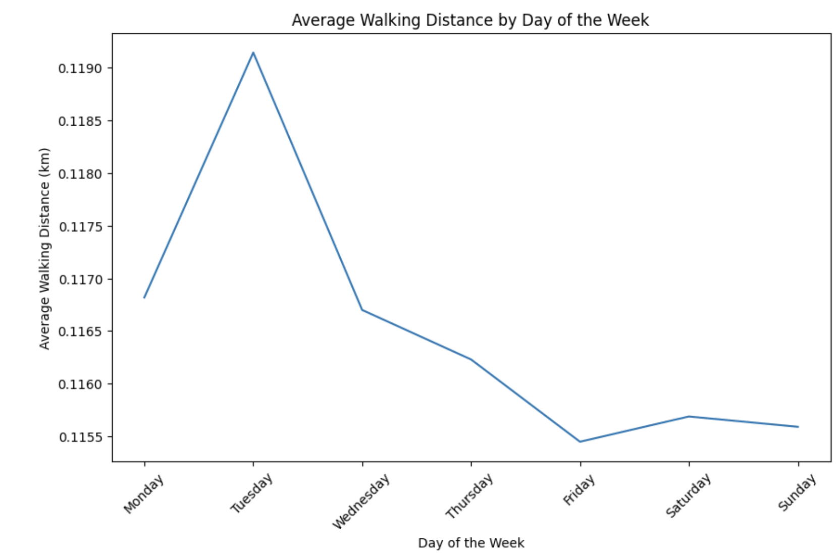
The line graph shows higher walking distances during weekdays, peaking on Tuesday, and consistently decreasing towards the weekend. This pattern supports rejecting the null hypothesis, as it clearly indicates lower physical activity on weekends compared to weekdays.

Slide 10
Findings
• Weekday Walking Distances:
Walking distances are generally higher on weekdays due to structured schedules, such as school and work routines.
• Weekend Walking Distances:
Weekend distances show greater variability, with lower medians likely due to reduced structured activities.
• 2019 Data Specifics:
Data for 2019 starts from the last months, possibly due to the dataset’s collection timeframe. Despite this limitation, a noticeable increase in weekend walking distances can be observed, likely due to school-related weekend activities or pandemic-related restrictions during early 2020.

Slide 11
Limitations
Data Scope: The dataset only includes walking distances and excludes other physical activities like gym workouts, which could affect the overall activity measurement.
2019 Data Limitation: Data from 2019 only covers the last month and coincides with the pandemic period, potentially skewing results due to reduced physical activity during lockdowns.
Dataset Size: The dataset is limited to personal data and not large enough for generalization. Additionally, the full dataset could not be uploaded to GitHub due to its size.
Potential Bias: The limited timeframe and personal data may introduce bias and affect the reliability of statistical conclusions.

Slide 12
THANK YOU FOR YOUR TIME AND ATTENTION

