Slide 1


Brunchmarks!
CPU Performance Testing: Cloud Compute

Slide 2

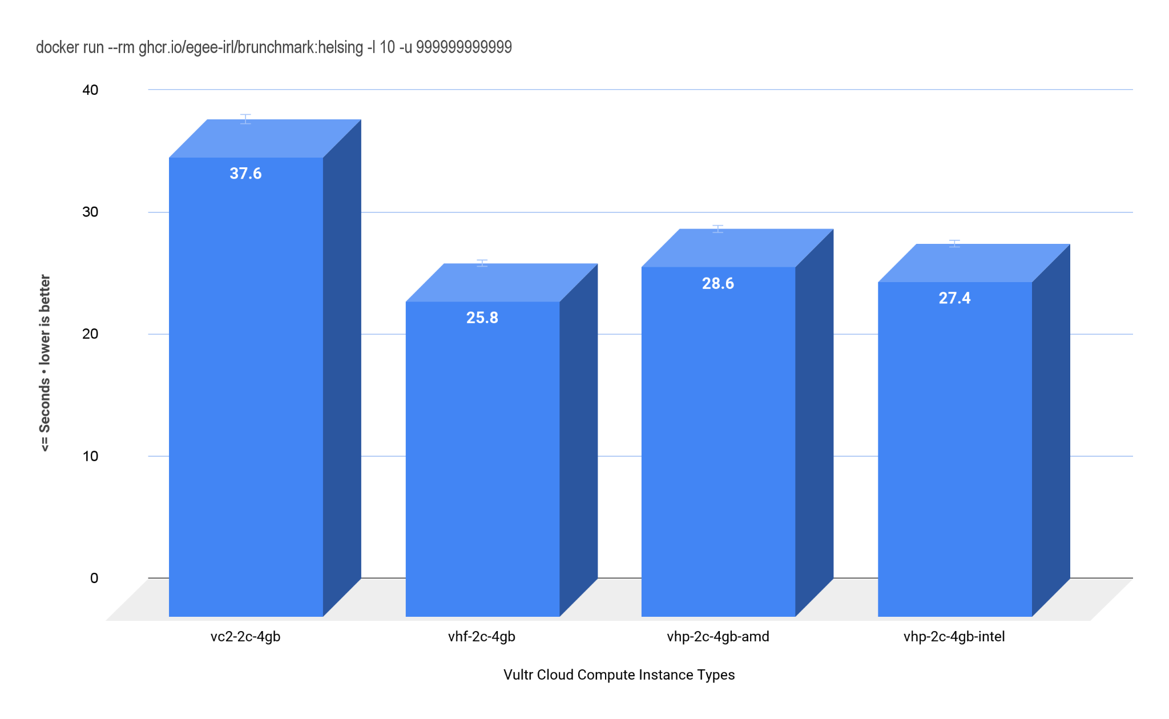

Test: Helsing - Vampire Number Generator
vc2-2c-4gb: Intel Skylake Xeon@2.5GHz
vhf-2c-4gb: Intel Skylake Core@3.6GHz
vhf2-2c-4gb-amd: AMD Epyc Rome@1.9GHz
vhf2-2c-4gb-intel: Intel Cascade Lake Xeon@2.8GHz

