Slide 1

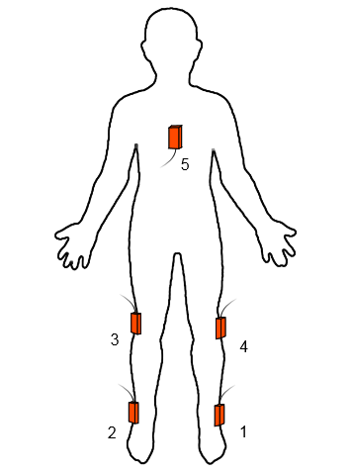
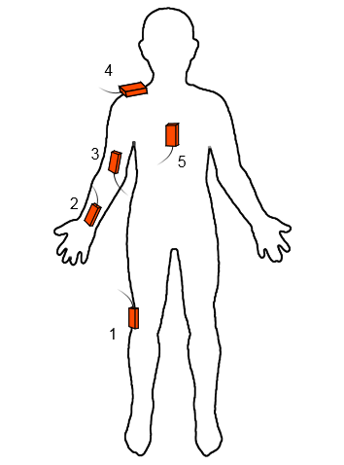
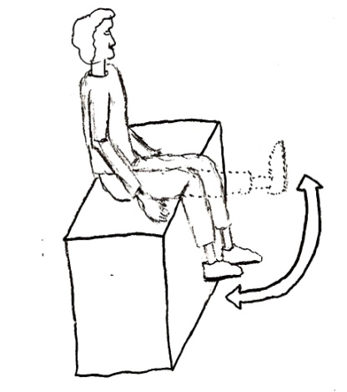
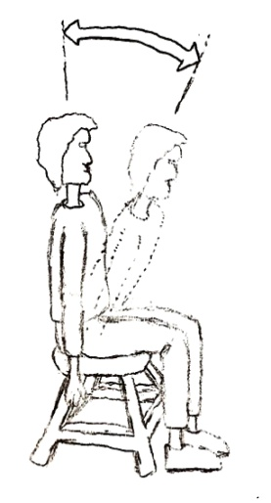
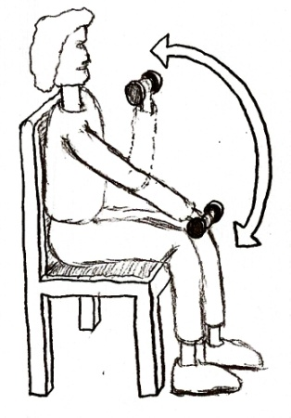
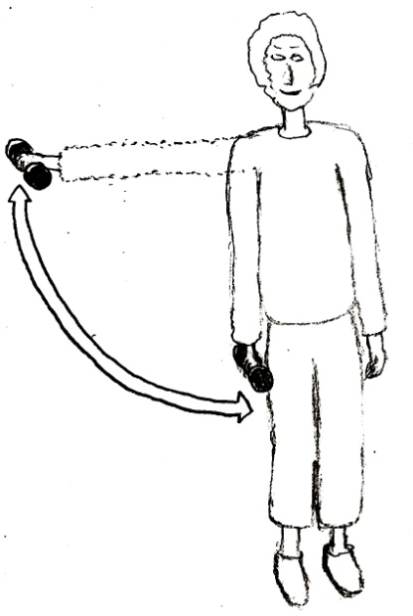
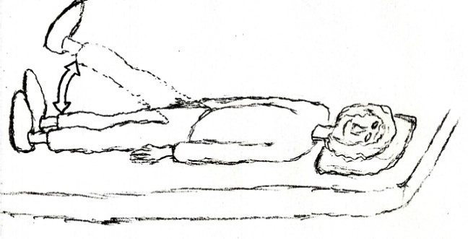
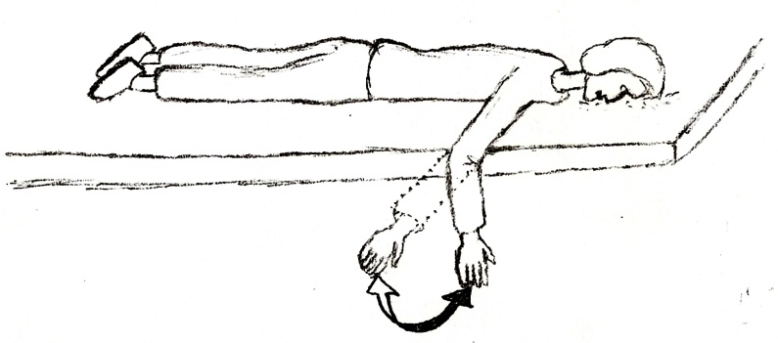
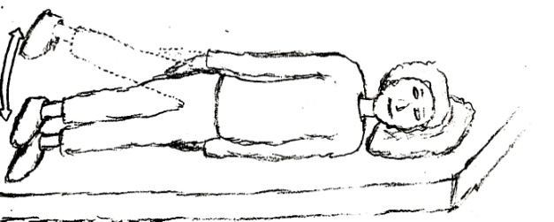
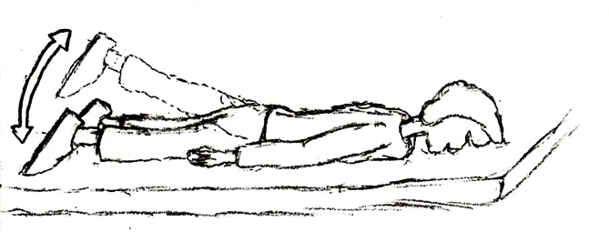
Automated Evaluation of Physical Therapy Exercises by Multi-Template Dynamic Time Warping of Wearable Sensor Signals
Aras Yurtman and Billur Barshan
Department of Electrical and Electronics Engineering, Bilkent University
yurtman@ee.bilkent.edu.tr, billur@ee.bilkent.edu.tr
Introduction
Dataset
Physical therapy often requires repeating certain exercise movements.
Patients first perform the required exercises under supervision in a hospital or rehabilitation center. → PARTIAL AND SUBJECTIVE FEEDBACK
Most patients continue their exercises at home. → NO FEEDBACK
The intensity of a physical therapy session is estimated by the number of correct executions.
OBJECTIVE : to detect and evaluate all exercise executions in a physical therapy session by using wearable motion sensors based on template recordings
5 wearable motion sensors, each containing a tri-axial accelerometer, gyroscope, and magnetometer
8 exercise types performed by 5 subjects
Each exercise is assumed to have 3 execution types: one correct and two erroneous (fast and low-amplitude execution)
one template for each execution type of each exercise of each subject → 120 TEMPLATES IN TOTAL
To simulate a physical therapy session, for each exercise, each subject performs the exercise 10 times in the correct way, then 10 times with type-1 error, and finally 10 times with type-2 error. Between these 3 blocks, the subject is idle. → 1,200 TEST EXECUTIONS IN TOTAL
EXECUTION TYPES:
correct
type-1 error (executed too fast)
type-2 error (executed in low amplitude)
XSENS MTx SENSOR UNIT
1 of 3
executions selected
=
120
templates
TEMPLATES
5
subjects
✕
8
exercises
✕
3
execution types
✕
10
repetitions
=
1,200
executions
TEST
LEG EXERCISES
EXPERIMENTS SIMULATING A PHYSICAL THERAPY SESSION
For each exercise, each subject has simulated a therapy session by executing the exercise
10 times in the correct way,
waiting idly,
10 times with type-1 error,
waiting idly, and then
10 times with type-2 error.
ARM EXERCISES
1
2
Algorithm
Experimental Results
6
7
3
Standard DTW
measures the similarity between two signals that are different in time or speed
matches two signals by transforming their time axes nonlinearly to maximize the similarity
Multi-Template Multi-Match DTW (MTMM-DTW) has been developed based on DTW to
detect multiple occurrences of multiple template signals in a long test signal
both detect and classify the occurrences
Features of MTMM-DTW:
The number of templates, occurrences, their positions, and lengths of the template and test signals may be arbitrary.
The signals may be multi-D.
A threshold factor can be selected to prevent relatively short matches compared to the matching template.
The amount of overlap between the matched subsequences can be adjusted.
Any modification to the DTW algorithm may be used in MTMM-DTW.
We apply the proposed MTMM-DTW algorithm to each test signal with the 24 template signals of the same subject for 8 exercise types × 3 execution types.
Each detected exercise must be at least half the length of the matching template.
Detections with a normalized DTW distance larger than 10 are omitted.
8
4
5
Conclusion
The proposed system can be used in tele-rehabilitation to provide feedback to the patient exercising remotely and assessing the effectiveness of the exercising session.
In previous systems, each execution is recorded separately or cropped manually.
Our system
automatically detects the individual executions and idle time periods,
classifies each execution as one of the exercise types,
evaluates its correctness, and
identifies the error type if any.
Number of total executions | 1,200
Number of executions detected | 1,125
Accuracy of exercise classification | 93.5%
Accuracy of exercise and execution type classification | 88.7%
Misdetection rate (MDs / positives) | 8.6%
False alarm rate (FAs / negatives) | 4.9%
Sensitivity | 91.4%
Specificity | 95.1%
DETECTION
CORRECT CLASSIFICATION
INCORRECT EXECUTION TYPE CLASSIFICATION
INCORRECT EXERCISE CLASSIFICATION
References
[1] A. Yurtman and B. Barshan, “Automated evaluation of physical therapy exercises using multi-template dynamic time warping on wearable sensor signals,” Comp. Meth. and Prog. Biomed., 117(2):189–207, Nov. 2014.
[2] P. Tormene, T. Giorgino, S. Quaglini, and M. Stefanelli, “Matching incomplete time series with dynamic time warping: an algorithm and an application to post-stroke rehabilitation,” Artif. Intell. Med., 45(1):11–34, Jan. 2009.

