Slide 1
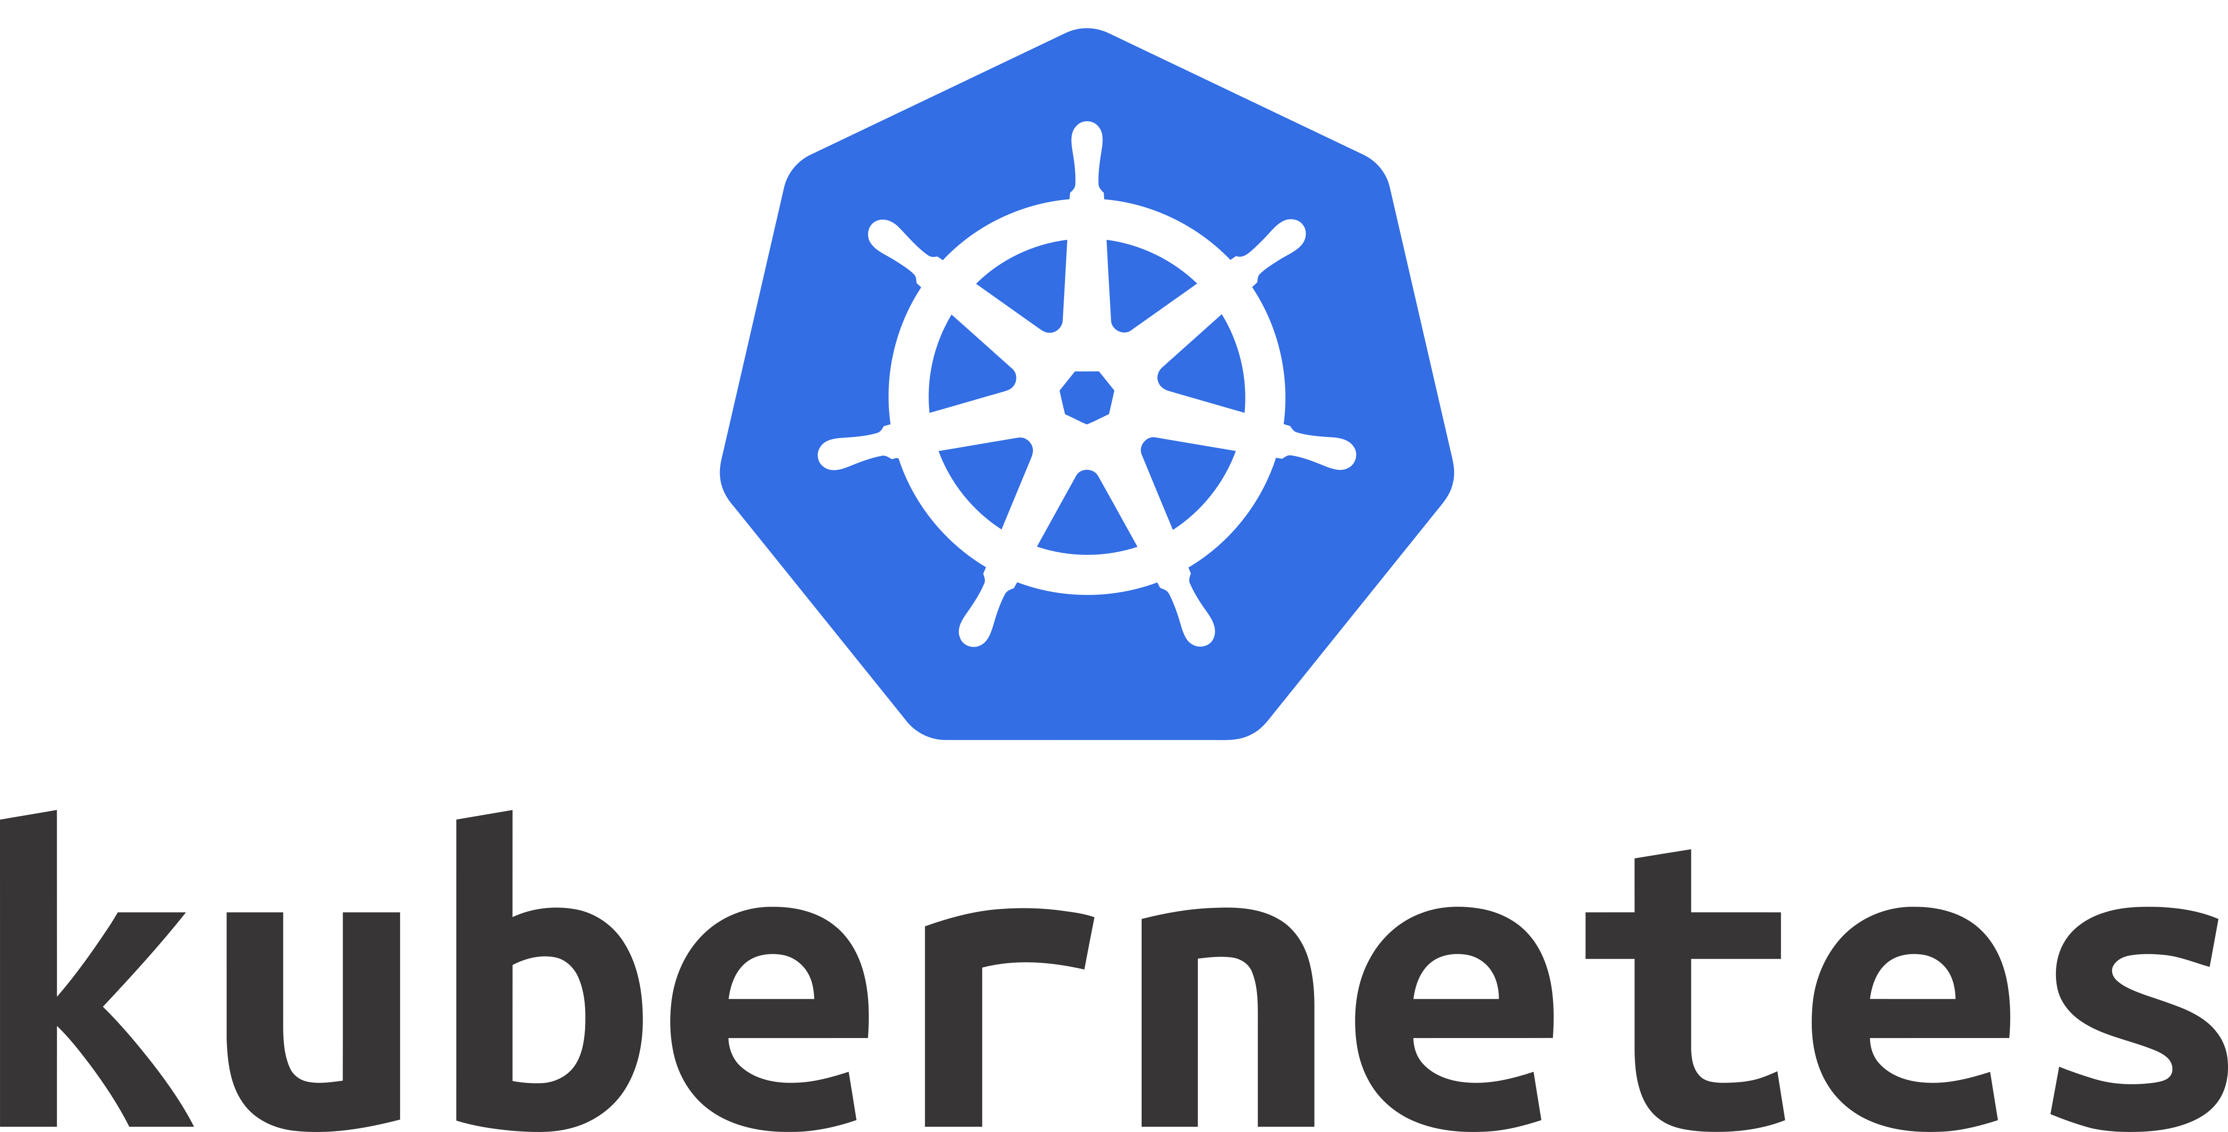

Slide 2


What is Kubernetes?
It is an Open Source Project, initially written by Google
It is maintained by CNCF
It is born to use Containers in a Production Environment

Slide 3
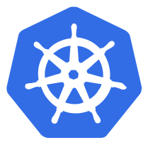
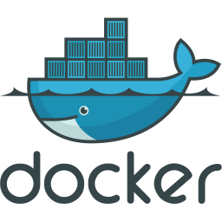
Kubernetes Cluster
Node 1
Master
Node 2

Slide 4


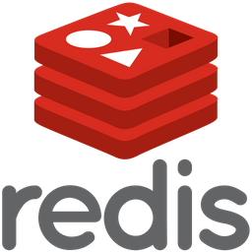

Kubernetes Cluster
Node 1
Master
Node 2

Slide 5
Production Feature
Horizontal Autoscaling
HealthChecks
Resource Quotas
Rolling Update
Externalized Configuration
Secrets Handling
Persistent Volumes
Network Segmentation
RBAC
…

Slide 6
Namespace
Namespaces are a logical cluster or environment, and are the primary method of partitioning a cluster or scoping access.
$ kubectl get namespaces
NAME STATUS AGE
default Active 1d
kube-system Active 1d
kube-public Active 1d

Slide 7
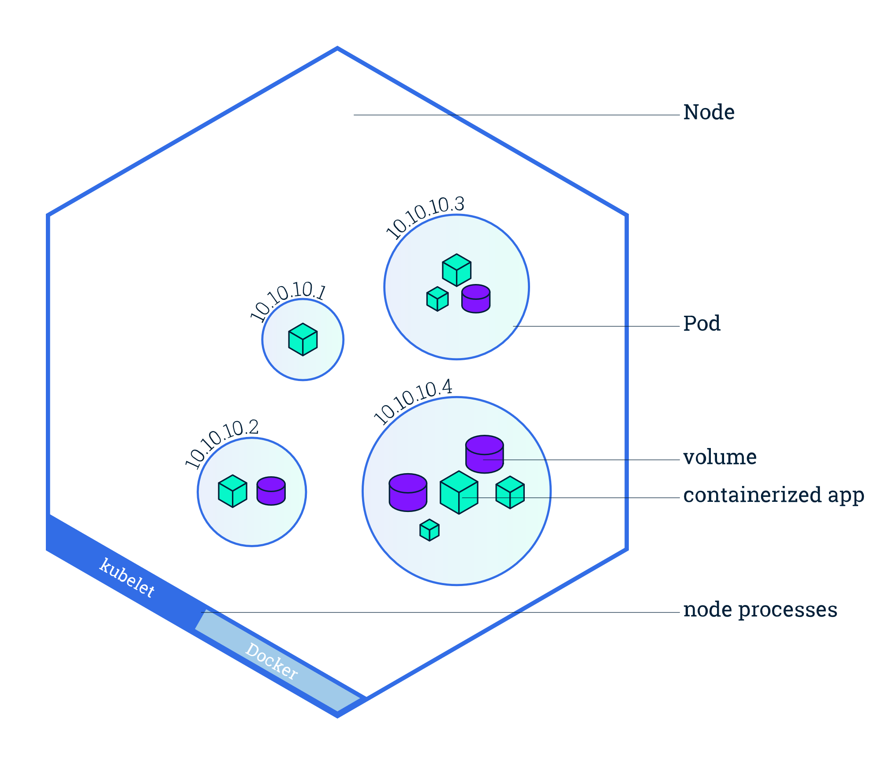
Pod
Atomic unit or smallest “unit of work” of Kubernetes.
Pods are one or MORE containers that share volumes, a network, and are a part of a single context.

Slide 8
Workloads
Workloads are higher level objects that manage Pods.
ReplicaSet
Deployment
StatefulSet
DaemonSet
Job
CronJob

Slide 9
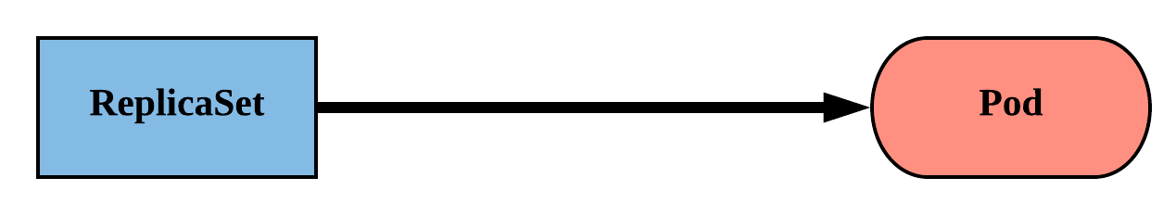
ReplicaSet
Primary method of managing pod replicas and their lifecycle.
Includes their scheduling, scaling, and deletion.
Their job is simple: Always ensure the desired number of pods are running.

Slide 10
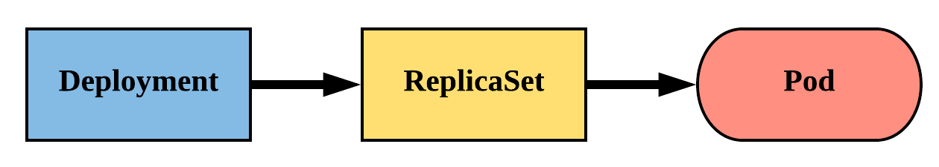
Deployment
Declarative method of managing Pods via ReplicaSets.
Provide rollback functionality and update control.

Slide 11
Service
A set of routing rules that defines how to access the Pods.
ClusterIP (default)
NodePort
LoadBalancer
ExternalName

Slide 12
Service NodePort
Exposes a port on every node’s IP.
Port can either be statically defined, or dynamically taken from a range between 30000-32767.

Slide 13

Service NodePort
192.168.0.56
8080
10.115.134.129
10.115.134.130
10.115.134.131
Node 1
32465
Node 2
32465
Node 3
32465

Slide 14
Configuration
Kubernetes has an integrated pattern for decoupling configuration from application or container.
This pattern makes use of two Kubernetes components: ConfigMaps and Secrets.

Slide 15
ConfigMap
Externalized data stored within kubernetes.
Can be referenced through several different means:
environment variable
a command line argument (via env var)
injected as a file into a volume mount
Can be created from a manifest, literals, directories, or files directly.

Slide 16
Service ClusterIP
ClusterIP services exposes a service on a strictly cluster internal virtual IP.

Slide 17
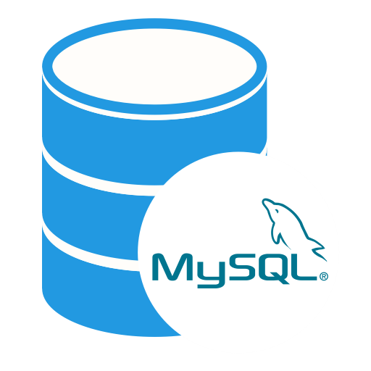
Service ClusterIP
192.168.0.56
192.168.0.87
8080
3306
mysql
Service
10.108.134.167:3306
mysql:3306
10.115.134.129
10.115.134.130
10.115.134.131
Node 1
Node 2
Node 3

Slide 18
Secret
Functionally identical to a ConfigMap.
Stored as base64 encoded content.
Ideal for username/passwords, certificates or other sensitive information that should not be stored in a container.
Can be created from a manifest, literals, directories, or from files directly.

