Slide 1
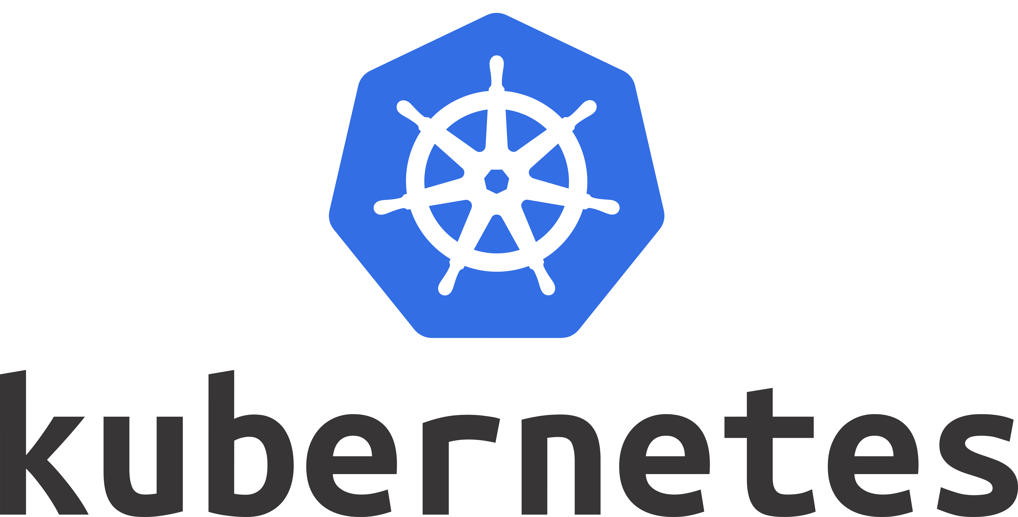

Slide 2


Fabio Sforza
I Work in Relatech
I am DevOps Engineer
I'm a sofa sportsman
I'm a wasted talent in baking

Slide 3


Slide 4

What is Kubernetes?
It is an Open Source Project
Initially developed by Google, with name Borg
It is maintained by CNCF
It is written in Go
It is a Container Orchestrator

Slide 5
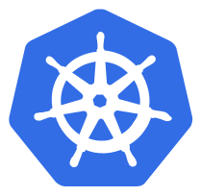
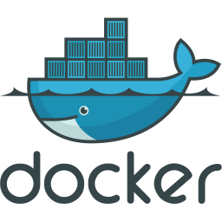
Kubernetes Cluster
Node 1
Master
Node 2

Slide 6


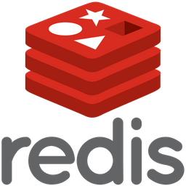
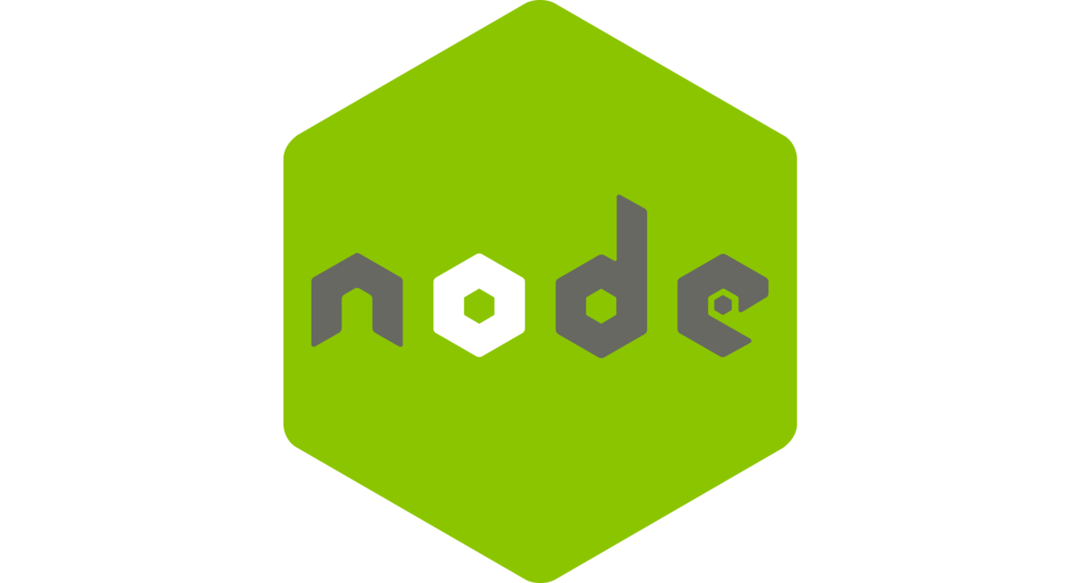
Kubernetes Cluster
Node 1
Master
Node 2

Slide 7
Production Features
Horizontal Application Scaling
HealthChecks
Resource Quotas
Rolling Update
Externalized Configuration
Secrets Handling
Persistent Volumes
Network Segmentation
RBAC
…

Slide 8
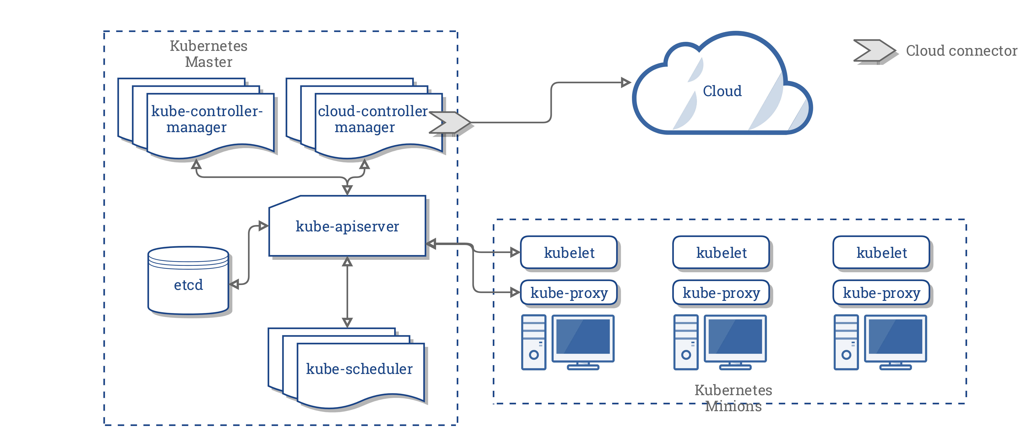
Kubernetes Architecture

Slide 9
Namespace
Namespaces are a logical cluster or environment, and are the primary method of partitioning a cluster or scoping access.
$ kubectl get namespaces
NAME STATUS AGE
default Active 1d
kube-system Active 1d
kube-public Active 1d

Slide 10
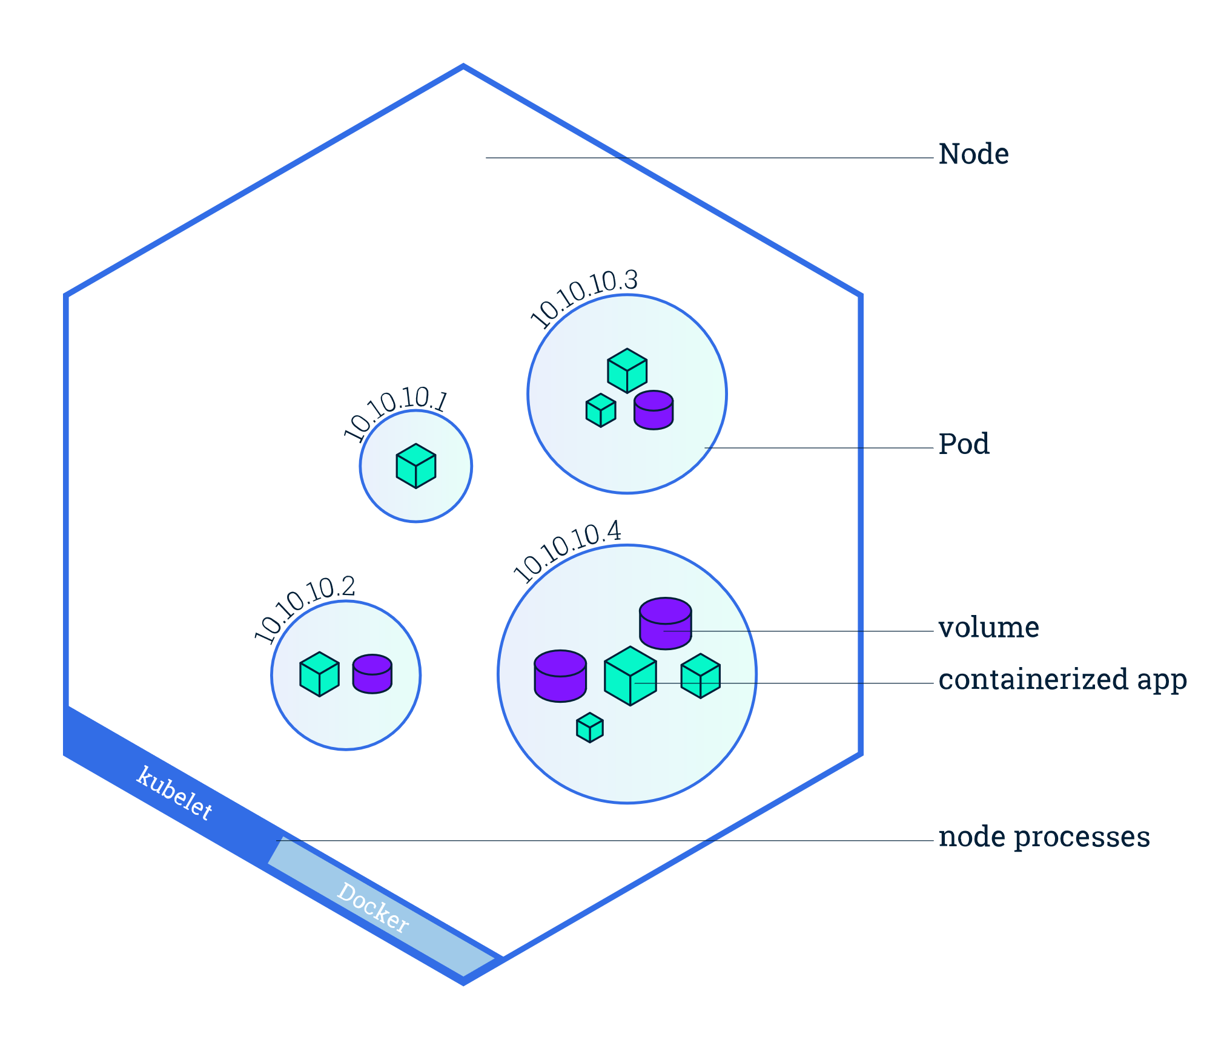
Pod
Atomic unit or smallest “unit of work” of Kubernetes.
Pods are one or MORE containers that share volumes, a network, and are a part of a single context.

Slide 11
Workloads
Workloads are higher level objects that manage Pods.
ReplicaSet
Deployment
StatefulSet
DaemonSet
Job
CronJob

Slide 12
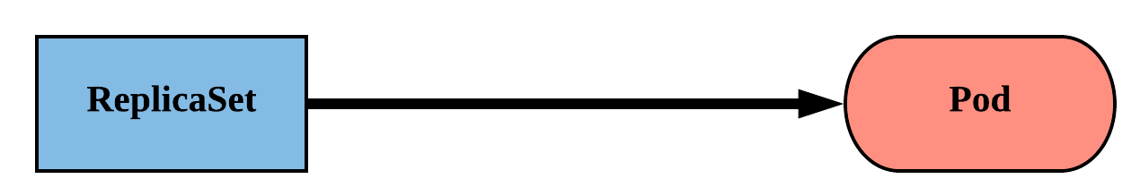
ReplicaSet
Primary method of managing pod replicas and their lifecycle.
Includes their scheduling, scaling, and deletion.
Their job is simple: Always ensure the desired number of pods are running.

Slide 13
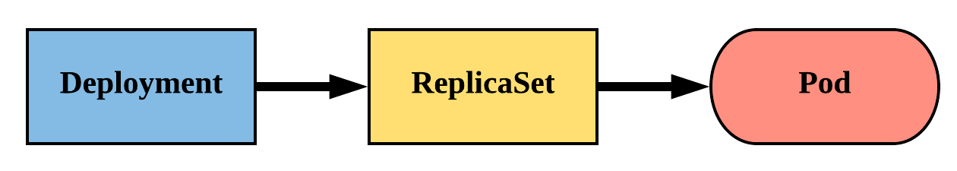
Deployment
Declarative method of managing Pods via ReplicaSets.
Provide rollback functionality and update control.

Slide 14
Persistent Volume
A PersistentVolume (PV) represents a storage resource.
PVs are a cluster wide resource linked to a backing storage provider: NFS, GCEPersistentDisk, Ceph, Azure Disk etc.
Their lifecycle is handled independently from a pod
CANNOT be attached to a Pod directly. Relies on a PersistentVolumeClaim

Slide 15
Persistent Volumes Claim
A PersistentVolumeClaim (PVC) is a namespaced request for storage.
Ensures that an application’s ‘claim’ for storage is portable across numerous backends or providers.

Slide 16
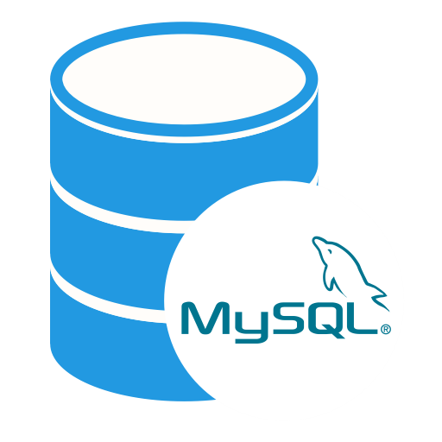


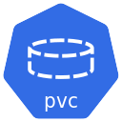
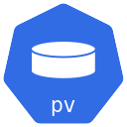
Persistent Volumes Claim
Namespace A
Namespace B
10Gb
20Gb
30Gb
10Gb
50Gb
Cluster Wide Resources

Slide 17
Service
A set of routing rules that defines how to access the Pods.
ClusterIP (default)
NodePort
LoadBalancer
ExternalName

Slide 18
Service ClusterIP
ClusterIP services exposes a pod on a strictly cluster internal virtual IP.
192.168.0.56
192.168.0.87
8080
3306
mysql
Service
10.108.134.167:3306
mysql:3306
Node 1
Node 2

Slide 19
Configuration
Kubernetes has an integrated pattern for decoupling configuration from application or container.
This pattern makes use of two Kubernetes components: ConfigMaps and Secrets.

Slide 20
ConfigMap
Externalized data stored within kubernetes.
Can be referenced through several different means:
environment variable
a command line argument (via env var)
injected as a file into a volume mount
Can be created from a manifest, literals, directories, or files directly.

Slide 21
Secret
Functionally identical to a ConfigMap.
Stored as base64 encoded content.
Ideal for username/passwords, certificates or other sensitive information that should not be stored in a container.
Can be created from a manifest, literals, directories, or from files directly.

Slide 22
Ingress
Is a Load Balancer placed in the context of Kubernetes
Exposes a Service to external clients by reachable URLs
Operate at the application layer of the network stack (HTTP)

Slide 23




Ingress
Jenkins Service
jenkins.example.com
gitlab.example.com
Ingress Controller
Gitlab Service
Kubernetes Cluster

Slide 24
Backup

Slide 25
Service NodePort
Exposes a port on every node’s IP.
Port can either be statically defined, or dynamically taken from a range between 30000-32767.

Slide 26

Service NodePort
192.168.0.56
8080
10.115.134.129
10.115.134.130
10.115.134.131
Node 1
32465
Node 2
32465
Node 3
32465

