Slide 1
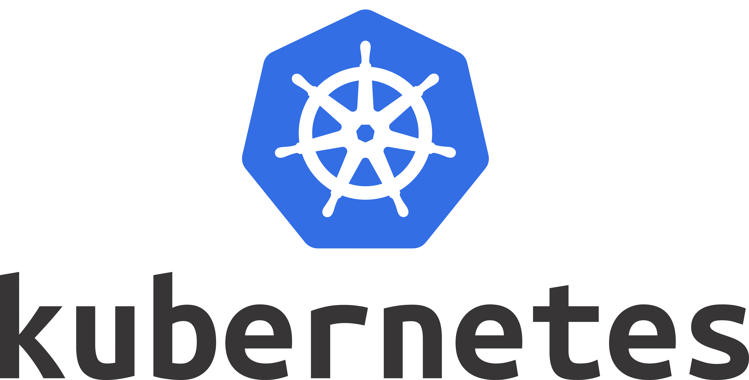

Slide 2
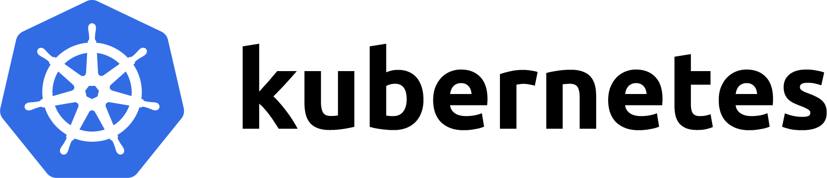



Fabio Sforza
@fabio_sforza
@fsforza
I Work in Relatech
I am a DevOps Engineer
I'm a sofa sportsman
I'm a wasted talent in baking

Slide 3
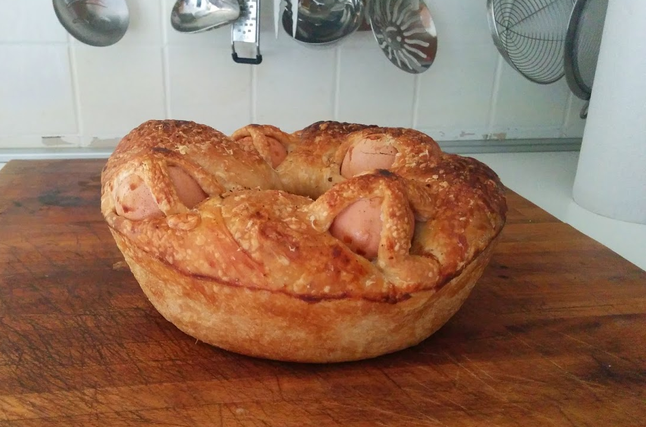

Slide 4
Zero To Hero

Slide 5

What is Kubernetes?
It is an Open Source Project
Initially developed by Google, with name Borg
It is maintained by CNCF
It is written in Go
It is a Container Orchestrator

Slide 6
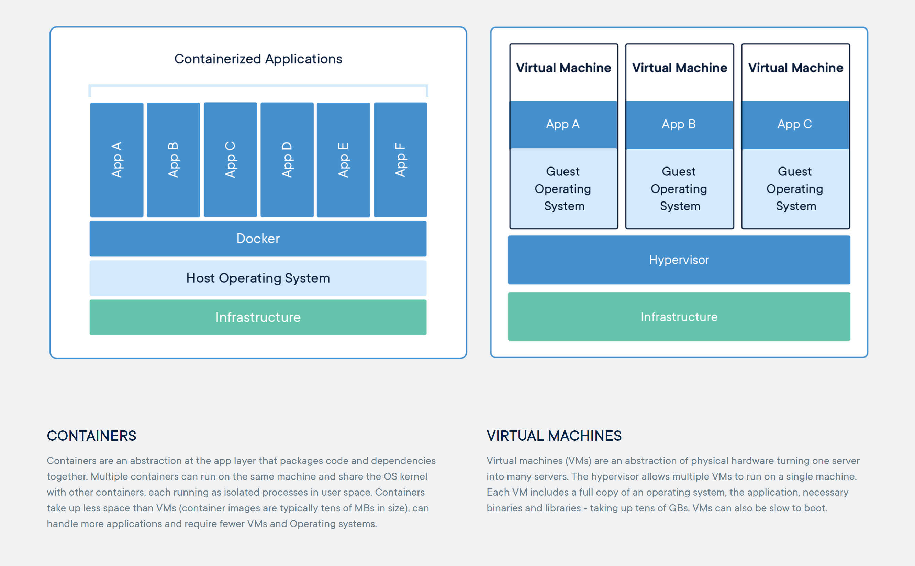
What is a Container?

Slide 7
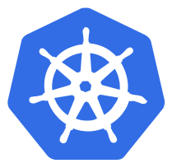
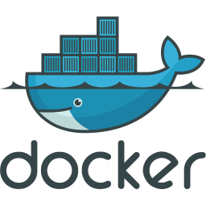
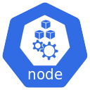

Kubernetes Cluster

Slide 8


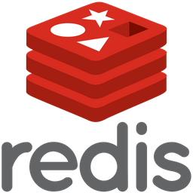
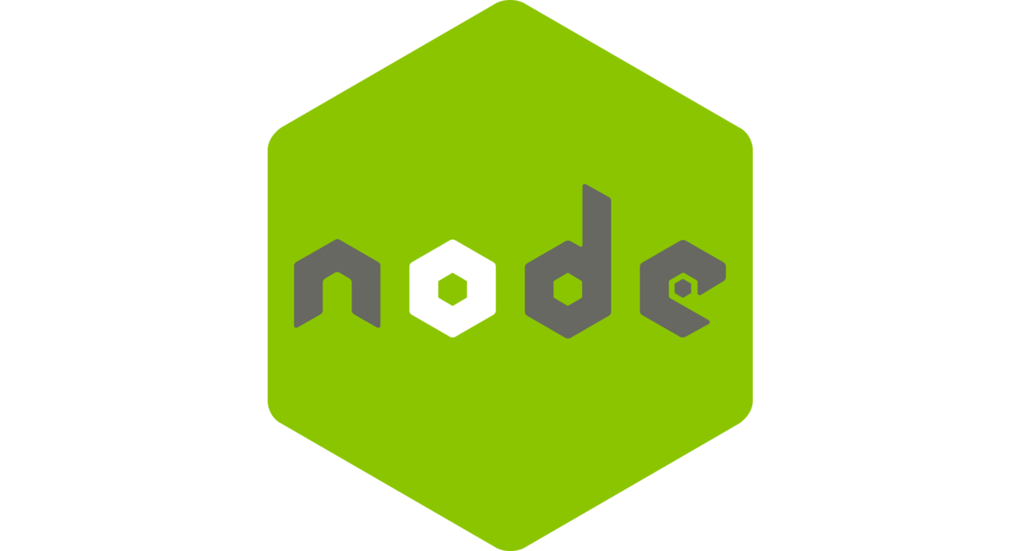
Kubernetes Cluster

Slide 9
Production Features
Application Horizontal Scaling
HealthChecks
Resource Quotas
Rolling Update
Externalized Configuration
Secrets Handling
Persistent Volumes
Network Segmentation
RBAC
…

Slide 10
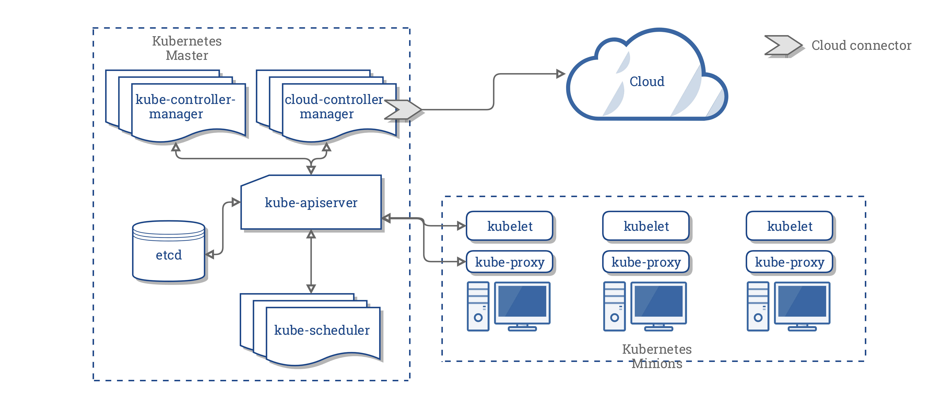
Kubernetes Architecture

Slide 11
Namespace
Namespaces are a logical cluster or environment, and are the primary method of partitioning a cluster or scoping access.
$ kubectl get namespaces
NAME STATUS AGE
default Active 1d
kube-system Active 1d
kube-public Active 1d

Slide 12
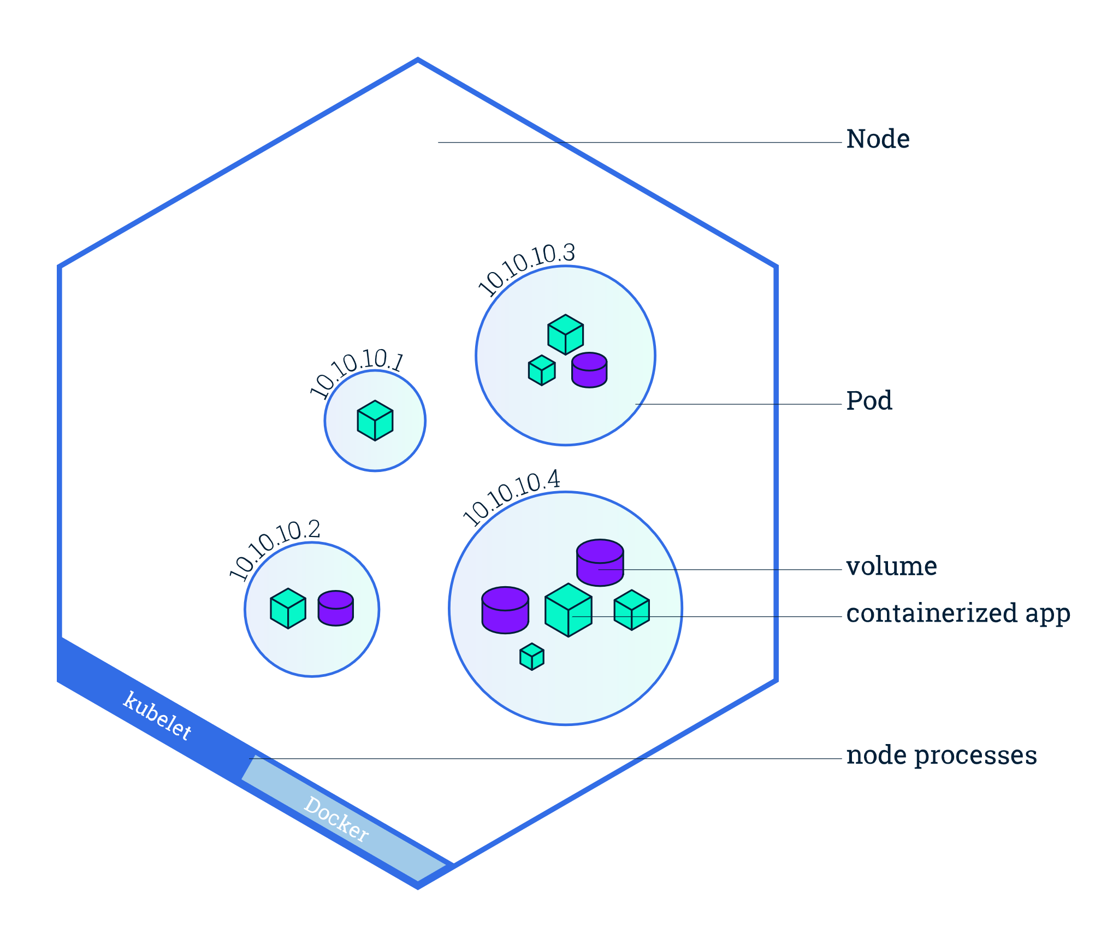
Pod
Atomic unit or smallest “unit of work” of Kubernetes.
Pods are one or MORE containers that share volumes, a network, and are a part of a single context.

Slide 13
Workloads
Workloads are higher level objects that manage Pods.
ReplicaSet
Deployment
StatefulSet
DaemonSet
Job
CronJob

Slide 14
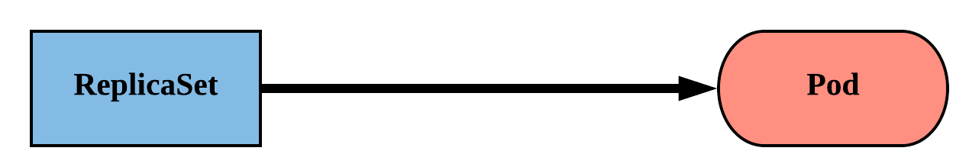
ReplicaSet
Primary method of managing pod replicas and their lifecycle.
Includes their scheduling, scaling, and deletion.
Their job is simple: Always ensure the desired number of pods are running.

Slide 15
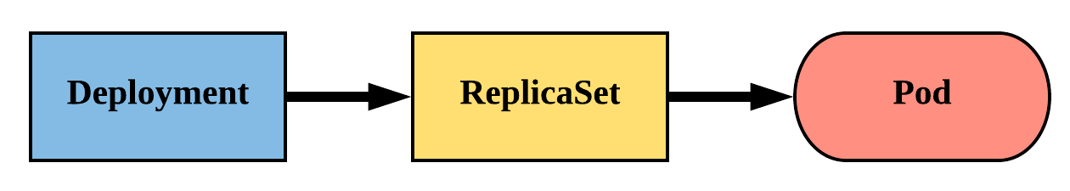
Deployment
Declarative method of managing Pods via ReplicaSets.
Provide rollback functionality and update control.

Slide 16
Persistent Volume
A PersistentVolume (PV) represents a storage resource.
PVs are a cluster wide resource linked to a backing storage provider: NFS, GCEPersistentDisk, Ceph, Azure Disk etc.
Their lifecycle is handled independently from a pod
CANNOT be attached to a Pod directly. Relies on a PersistentVolumeClaim

Slide 17
Persistent Volumes Claim
A PersistentVolumeClaim (PVC) is a namespaced request for storage.
Ensures that an application’s ‘claim’ for storage is portable across numerous backends or providers.

Slide 18
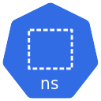
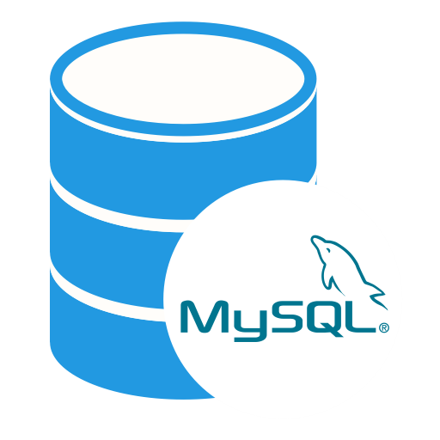


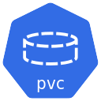

Persistent Volumes Claim
10Gb
20Gb
30Gb
10Gb
50Gb
Cluster Wide Resources

Slide 19
Service
A set of routing rules that defines how to access the Pods.
They define:
Static and Unique Cluster IP addresses
Static DNS names

Slide 20
Service
Service Types:
ClusterIP (default)
NodePort
LoadBalancer
ExternalName

Slide 21
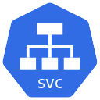
Service ClusterIP
ClusterIP services exposes a pod on a strictly cluster internal virtual IP.
192.168.0.56
MySQL
ClusterIP Service
192.168.0.87
8080
3306
10.108.134.167:3306
mysql:3306

Slide 22
Configuration
Kubernetes has an integrated pattern for decoupling configuration from application or container.
This pattern makes use of two Kubernetes components: ConfigMaps and Secrets.

Slide 23
ConfigMap
Externalized data stored within kubernetes.
Can be referenced through several different means:
environment variable
a command line argument (via env var)
injected as a file into a volume mount
Can be created from a manifest, literals, directories, or files directly.

Slide 24
Secret
Functionally identical to a ConfigMap.
Stored as base64 encoded content.
Ideal for username/passwords, certificates or other sensitive information that should not be stored in a container.
Can be created from a manifest, literals, directories, or from files directly.

Slide 25


Service LoadBalancer
Works in conjunction with an external system (Cloud Provider) to map a cluster external IP to the exposed service.
Cloud Provider
Load Balancer
10.108.134.167:8080
Microservice
Load Balancer
Service
Microservice
Pod

Slide 26
Ingress
Is a Load Balancer placed in the context of Kubernetes
Exposes a Service to external clients by reachable URLs
Operate at the application layer of the network stack (HTTP/HTTPS)

Slide 27



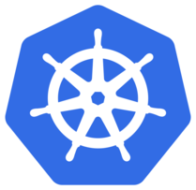
Ingress
Cloud Provider
Load Balancer
jenkins.example.com
Jenkins
ClusterIP Service
Jenkins Pod
Ingress
LoadBalancer
Service
gitlab.example.com
Ingress
Controller
Gitlab
ClusterIP Service
GitLab Pod

Slide 28
Thank you!
Questions?

