Slide 1
Become Public with Registration Agent !
https://github.com/egekorkan/RegistrationAgent

Slide 2
What is it?
A virtual Thing that can make your local TD available to public in a directory.
This new TD will have modified URIs that incorporate a gateway address.
After finding the TD in the directory, you can communicate with a local Thing through a gateway.

Slide 3
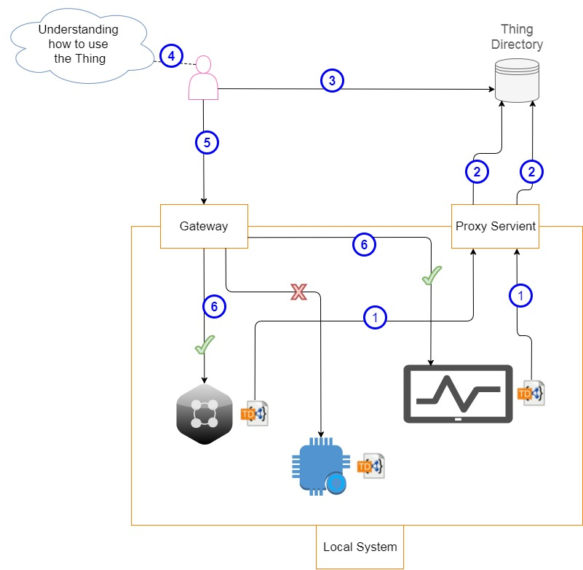
Use Scenario
Registration Agent

Slide 4
Use Scenario
Gateway Address: e.g. 8.8.8.8
Public Directory Address: e.g. http://myrepo.com
Things have URIs like:
http://localhost:9000/MyTemperatureThing
http://localhost:9000/MyTemperatureThing/actions/increaseTemp
http://localhost:9000/MyTemperatureThing/properties/temperature
In the directory they will be:
- http://8.8.8.8/MyTemperatureThing
- http://8.8.8.8/MyTemperatureThing/actions/increaseTemp
- http://8.8.8.8/MyTemperatureThing/properties/temperature

Slide 5
How to Talk with the Registration Agent
Details given in:
Readme of the GitHub repository
Thing Description of the Registration Agent

Slide 6
How to Use the Registration Agent (Without Management)
Set the directoryAddress property
Set the gatewayAddress property
From a Thing:
Invoke makeMePublic action with the TD
The TD will be modified to a public version and put in public directory
Invoke updateMe action with the TD and the id returned from the makeMePublic action
Invoke deleteMe action with the id returned from the makeMePublic
You can specify the the time you want to be public

Slide 7
Further Questions
Please contact Sebastian Käbisch from Siemens or send me an email at egekorkan@gmail.com

