Slide 1

Chapter Two
Intelligent Agent
Notes:
IT Project Management - ITec 2063

Slide 2
What is an Agent in AI?
An agent is anything that can be viewed as:
  Perceiving its environment through sensors and
  Acting upon that environment through actuators.
Human agent:-
  uses Eyes, Nose, Tongue, and other sensory organs as sensors to perceive information from the environment and,
  Hands, legs, mouth, and other body parts as actuators to perform an action based on the information.
Robotic agent:-
  uses cameras and infrared radars as sensors to record information from the Environment.

Slide 3
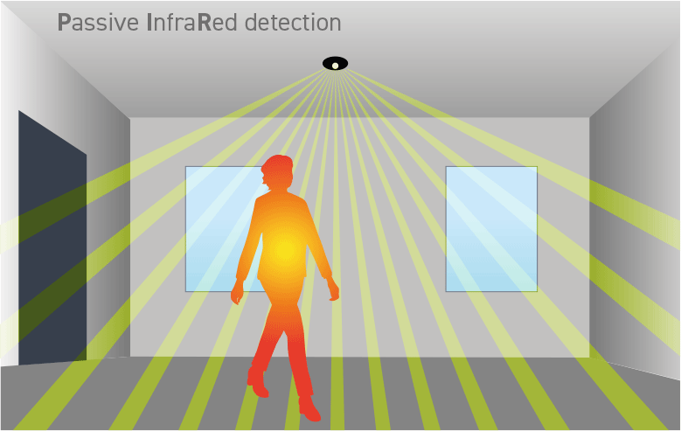
Cont...
  It uses reflex motors as actuators to deliver output back to the environment.
Software Agent:-
  use keypad strokes, audio commands as input sensors and
  display screens as actuators.

Slide 4

Cont...
Agents interact with environments through sensors and actuators.
The agent function maps from percept histories to actions:-
[f: P* → A]
        A percept is a piece of information perceived by the agent.
The agent program runs on the physical architecture to produce f.
Agent = Architecture + Program

Slide 5

Vacuum - Cleaner World
Figure below indicates a typical agent's world called - A vacuum cleaner world with just two locations.
Percepts: location and contents, e.g., [A, Dirty]
Actions: Left, Right, Suck, ……
Notes:
akk

Slide 6
Cont...
Percept | Action
[A, Clean] | Right
[A, Dirty] | Suck
[B, Clean] | Left
[B, Dirty] | Suck

Slide 7
Rational agents
Rational agent is an agent that strives to do the right thing,
  Based on what it can perceive and the actions it can perform.
The right action is the one that will cause the agent to be most successful. But how can we measure the success of a given agent? Ans.
Performance measure: is the criteria, which determines how successful the agent is.
Example: performance measure of a vacuum - cleaner agent could be:
    Amount of dirt cleaned up,
    Amount of time taken,
    Amount of electricity consumed,
    Amount of noise generated, etc.

Slide 8
Cont...
Rational Agent: for each possible percept sequence,
  A rational agent chooses the action that maximizes its expected performance, based on the percept sequence and its built-in knowledge.
  An agent’s percept sequence is the complete record of everything it has ever perceived.

Slide 9
Omniscient agent Vs Rational agent
Rationality is not the same as omniscience.
An omniscient agent is all-knowing, with infinite knowledge.
Such an agent would know the actual outcome of every action before acting.
It would have complete and accurate knowledge of its environment, past, present, and future.
With this knowledge, it could always make optimal decisions.
In practice, omniscience is impossible. No agent can have perfect knowledge of the environment.

Slide 10
Cont...
A rational agent does not need complete knowledge of its environment.
Instead, it makes the best possible decisions using the knowledge it does have.
These decisions are always guided by the agent’s goals and objectives.
In conclusion, omniscient agents know everything about the environment. Rational agents, instead, base decisions on available information and their objectives.

Slide 11
What makes Autonomous agent different then?
An agent is autonomous if its behavior is determined by its own experience (with ability to learn and adapt).
- Without any other interference.
An omniscient agent and a rational agent may require human intervention to operate effectively, while an autonomous agent is designed to operate independently.

Slide 12
PEAS in AI
Performance, Environment, Actuators, and Sensors are abbreviated as PEAS.
PEAS is an AI agent representation system that focuses on evaluating: the performance of an agent, the environment, sensors, and actuators.
We need to be aware of our job environment to create an agent.
And hence, PEAS system aids in defining the task environment for an intelligent agent.

Slide 13
PEAS Description
PEAS:
  Performance measure: A measure of how good the behaviour of agents operating in the environment is?
  Environment: What things are considered to be a part of the environment and what things are excluded?
  Actuators: How can an agent perform actions in the environment?
  Sensors:How can the agent perceive the environment?

Slide 14
PEAS - Example 1: Taxi-Driving System
Consider the task of designing an automated taxi driver:
  Performance measure:
    Safe, fast, legal, comfortable trip, maximize profits
  Environment:
    Roads, other traffic, pedestrians(walkers), customers
  Actuators:
    Steering wheel, accelerator, brake, indicators, horn(alert/alarm)
  Sensors:
    Cameras, sonar, speedometer, GPS, engine sensors, keyboard

Slide 15
PEAS - Example 2: Medical Diagnosis System
Consider the task of designing a Medical diagnosis system
Performance measure:
Healthy patient, minimize cost, avoid lawsuits(charges)
Environment:
Patient, hospital, staff
Actuators:
Screen display (questions, tests, diagnoses, treatments, referrals)
Sensors:
Keyboard (entry of symptoms, findings, patient's answers)

Slide 16
PEAS -Example 3: Interactive English tutor
Consider, the task of designing a: Interactive English tutor
Performance measure:
  Maximize students’ scores on test
Environment:
  Set of students
Actuators:
  Screen display (exercises, suggestions, corrections)
Sensors:
  Keyboard (student's answers)

Slide 17
PEAS - Example 4: Part Picking Robot
Consider the task of designing a Part-picking robot
Performance measure:
  Percentage of parts placed in the correct bins.
Environment:
  Conveyor belt with parts, bins
Actuators:
  Jointed arm and hand
Sensors:
  Camera, joint angle sensors

Slide 18
Environment Types (1)
Fully observable (vs. partially observable):
  Sensors determine how much of the environment an agent can perceive.
  Full access → The agent observes the complete state of the environment.
  Partial access → the environment is partially observable.
  No sensors → the environment is non-observable.
  Deterministic (vs. stochastic):
  Deterministic: The next state is fully determined by the current state and the agent’s action.
  Stochastic: Random events can make the next state unpredictable.
  Strategic: The environment is deterministic except for the actions of other agents.

Slide 19
Environment Types (2)
Episodic (vs. sequential):
  An agent’s experience can be divided into episodes.
  Each episode consists of the agent perceiving the environment and then performing a single action.
  The choice of action depends only on the current episode.
  If the agent’s actions depend on past episodes, the experience is sequential.
Static (vs. dynamic):
  Static: The environment does not change while the agent is deciding on an action.
  Dynamic: The environment continues to change even while the agent is thinking.
  Semi-dynamic: The environment itself remains unchanged, but the agent’s performance score can change.

Slide 20
Environment Types (3)
Discrete (vs. continuous):
  Discrete: The agent has a limited number of possible actions and percepts.
  Continuous: The agent has an effectively unlimited number of actions and/or percepts..
Single agent (vs. multi-agent):
  An agent operating alone in an environment.
  Single-agent environment: No other agents are present.
  Multi-agent environment: Other agents are present alongside the agent.

Slide 21
Environment Types….
Example for some of the environment types
Single-agent → Sudoku puzzle
Multi-agent → Chess / Traffic navigation
Static → Crossword puzzle
Dynamic → Driving in traffic / Stock trading
Discrete → Tic-tac-toe
Continuous → Robot arm in 3D space
The environment type largely determines the agent design:
  Easiest environments: Fully observable, deterministic, episodic, static, discrete, single-agent.
  Real-world environments: Partially observable, stochastic, sequential, dynamic, continuous, multi-agent.

Slide 22
Agent program for a vacuum-cleaner agent
Function Vacuum-Agent ([location,status]) returns an action
{
If status = Dirty then return Suck
Else if location = A then return Right
Else if location = B then return Left
}

Slide 23
Agent Types
There are five basic types of agents in order of increasing generality:
  Simple reflex agents
  Model-based reflex agents
  Goal-based agents
  Utility-based agents
  Learning agent

Slide 24
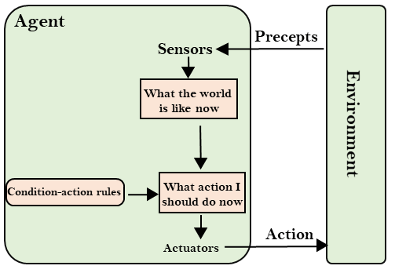
Simple reflex agents
The simplest kind of agent.
These use a set of condition-action rules that specify which action to choose for each given percept.
These agents use only the current percept, so they have no memory of past precepts.
In particular, they cannot base decisions on things that they cannot directly perceive, i.e., they have no model of the state of the world.
Figure - Schematic diagram of a simple reflex agent.

Slide 25
Cont...
Thermostat: Turns on the heat when the temperature drops below a set threshold.
Decision is based only on the current percept (temperature).
Vacuum cleaner agent: Chooses an action based only on its current location and whether there is dirt.
No memory or model of the environment, decisions depend solely on the present percept.

Slide 26
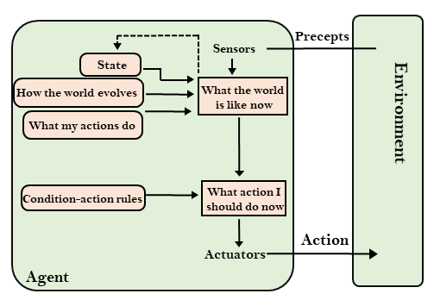
Model-based reflex agents
A more complex type of agent is the model-based agent.
Model-based agents maintain an internal model of the world, which is updated by precepts as they are received.
In addition, they have built-in knowledge (i.e., prior knowledge) of how the world tends to evolve.
They also contain knowledge about how their actions affect the state of the world.
Figure - Schematic diagram of a model-based reflex agent.

Slide 27
Cont...
Model-based agents maintain an internal model of the environment.
They use this model to make decisions based on both current percepts and past percept history, as well as the effects of their actions.
Example: A self-driving car uses sensors to perceive its surroundings and relies on a model of the road network to plan safe and efficient routes.

Slide 28
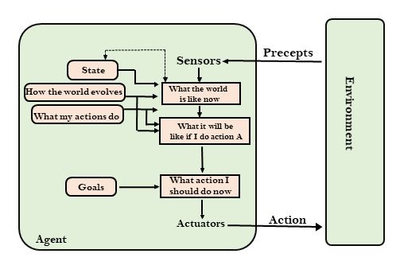
Goal-based agents
Goal based agents are the same as model-based agents, except
  They contain an explicit statement of the goals of the agent.
  These goals are used to choose the best action at any given time.
Goal based agents can therefore choose an action which does not achieve anything in the short term, but in the long term may lead to a goal being achieved.
Figure - Schematic diagram of a goal-based agent.

Slide 29
Cont...
For example, consider an agent that assists you in planning a trip based on your preferences, such as your desired travel dates and budget.
Based on this information, the agent selects actions to achieve its goal of planning a trip that aligns with your preferences and budget.
As it takes actions and receives feedback from you, it updates its internal model and adjusts accordingly, continuing to select actions that help meet your preferences.

Slide 30
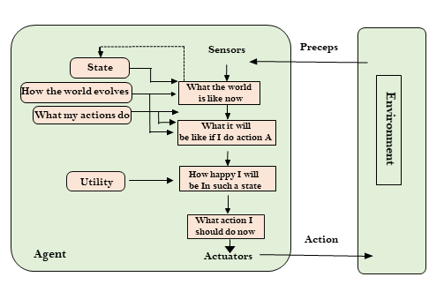
Utility-based agents
Goals can be useful, but are sometimes too simplistic.
Utility based agents deal with this by:
  Assigning a utility to each state of the world.
  This utility defines how “happy” the agent will be in such a state.
  This type of agent makes decisions based on the expected utility or value of each possible action.
Figure - Schematic diagram of a utility-based agent.

Slide 31
Cont...
An example would be an agent that helps you decide which car to buy. The agent's goal is to help you select a car that maximizes your overall satisfaction or utility. The agent has a set of actions it can take, such as researching different car models, comparing prices and features.
Note: Both utility-based and goal-based agent focused on achieving a specific objective however, the key difference is in how each type of agent selects its actions. A goal-based agent selects actions that are expected to directly lead to the achievement of its goals, while a utility-based agent selects actions that are expected to maximize its overall expected utility or value.

Slide 32
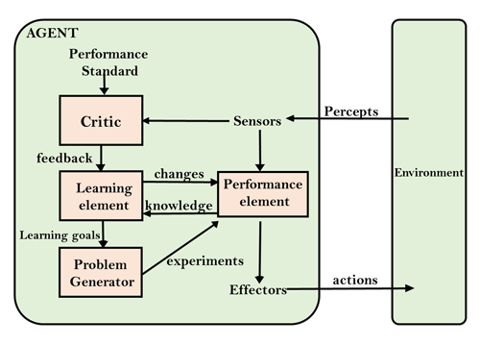
Learning agents
A learning agent is an agent which can learn from its past experiences, or it has learning capabilities.
learns something new by trying something different.
It starts with some basic knowledge and is then able to act and adapt autonomously, through learning, to improve its own performance.
are able to perform tasks, analyze performance, and look for new ways to improve on those tasks - all on their own.
Figure - Schematic diagram of a Learning agent.

Slide 33
Cont...
  A learning agent has mainly four conceptual components, these are:
  Learning element: It is responsible for making improvements by learning from environment
  Critic: Learning element takes feedback from critic which describes that how well the agent is doing with respect to a fixed performance standard.
  Performance element: It is responsible for selecting external action
  Problem generator: This component is responsible for suggesting actions that will lead to new and informative experiences.

Slide 34
Cont...
An example would be a chatbot that uses machine learning to improve its responses based on user feedback.

Slide 35
Summary
How to define the AI problem?
  PEAS description of environments
Categories of AI environment:
  Fully-observable, partially-observable, etc.
Basic agent types:
  Simple reflex, model-based, goal-based, utility-based, learning agents

Slide 36

Any Question?

