Slide 1
1. Basic Idea of ANN
An Artificial Neural Network (ANN) is a computational model inspired by the human brain.
It consists of interconnected processing units called neurons, which work together to learn patterns from data.

Slide 2
The ANN algorithm works in two main phases:
Forward Propagation
Backward Propagation (Training)

Slide 3
Structure of ANN
An ANN consists of:
Input Layer
Hidden Layer(s)
Output Layer
Each layer contains neurons connected by weights.

Slide 4
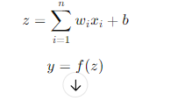
Mathematical Model of a Neuron
Each neuron performs the following computation:

Slide 5
Variable | Meaning
(x_i) | Input feature (e.g., age, salary, pixel value)
(w_i) | Weight associated with input (x_i)
(n) | Number of input features
(b) | Bias term (shifts activation function)
(z) | Weighted sum of inputs
(f(z)) | Activation function
(y) | Output of the neuron

Slide 6
Forward Propagation (Prediction Phase)
Input data x=(x1,x2,...,xn)x is given to the input layer
Each neuron calculates weighted sum:
z=∑wi​xi​+b Activation function is applied:
Y=f(z) The output of one layer becomes input to the next layer
Final layer produces predicted output y

Slide 7
Common Activation Functions
The activation function is also called the transfer function.
Activation function is mathematical formulae that determine the output of processing nodes.
It transforms inputs in to outputs.
They introduce a degree of nonlinearity that is valuable for most ANN applications, which governs the relationship between inputs and outputs of a node and a network.

Slide 8
Activation Function
Example: a single neuron with two inputs. Each input is weighted with an appropriate w.
The sum of the weighted inputs and the bias forms the input to the transfer function f.
Neurons can use any differentiable transfer function f to generate their output.

Slide 9
Activation Function cont.
Each activation function is characterized by its shape, output range, and derivative function.
In general, activation functions can be categorized as binary or continuous (differentiable) activation functions.

Slide 10
Activation Function cont.
There are different types of activation functions,
the two types are threshold function and sigmoid function.
commonly used activation function are: Tan-Sigmoid, Log-Sigmoid and linear (purelin) activation function, ramp and Gaussian function. See below figure.

Slide 11
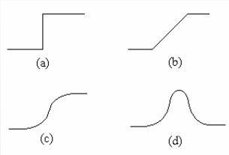
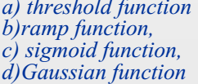
Activation Function cont.

Slide 12

Activation Function cont.
Threshold Function: In engineering, this form of a threshold function is commonly referred to as a Heaviside function

Slide 13
Activation Function cont.
B. Sigmoid Function
The sigmoid function, whose graph is “S”-shaped, is by far the most common form of activation function used in the construction of neural networks.
It is defined as a strictly increasing function that exhibits a graceful balance between linear and nonlinear behavior.
An example of the sigmoid function is the logistic function defined by

Slide 14


Slide 15

Loss (Error) Calculation
The difference between actual output and predicted output is measured using a loss function.
Loss Function | Formula | Used For
Mean Squared Error (MSE) | ( (y –Y^)^2 ) | Regression
Binary Cross-Entropy |  | Binary classification

Slide 16
Variables
Variable | Meaning
(y) | True (actual) output
(y^) | Predicted output
(L) | Loss value

Slide 17
Example
Input = (2, 3)= (x1,x2)
Weights = (0.4, 0.6) = (w1,w2)
Bias = 0.1
z=(2×0.4)+(3×0.6)+0.1=2.7
Using ReLU:y=max(0,2.7)=2.7

Slide 18

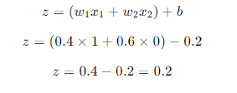
Example
Given
W1=0.4 x1=1
W2=0.6 x2=0
Actual out put=1
Activation Function
Sigmoid
Calculate Weighted Sum (Net Input)

Slide 19

Apply Sigmoid Activation

Slide 20
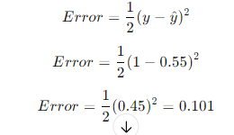
Compare with Actual Output
Actual =1
Predicted output=0.2
Calculate Error (MSE)
Why This Error Matters
Large error → weights need big change
Small error → weights need small change
Error is used in backpropagation to update:
Weights
Bias

Slide 21
Designing and Training an ANN
Design:
Architecture of ANN network
Determines number of network weights
How many layers and nodes per layer?
Structure of artificial neurons
Connectivity and choice of activation (transfer) function
Training:
Ensuring optimum training
Learning parameters
learning rate, momentum and weight-cost

Slide 22
Network Design & Training Issues
Data preparation
The quality of results relates directly to quality of the data(70%).
Consolidation, cleaning, selection and preprocessing and Transformation
General Steps
Get the data set
Determine the network topology
Training
Optimization
Testing

Slide 23
Network Design & Training Issues
Learning rate controls how fast ANN learns
Momentum smooths learning and speeds convergence
Weight cost prevents overfitting by penalizing large weights
Proper selection ensures:
Fast convergence
Stable training
Good generalization

Slide 24

Performance Testing Parameters in ANN
After training an ANN, we evaluate it using performance metrics. These metrics depend on whether the task is classification or regression.
1Accuracy_Accuracy measures the percentage of correct predictions.
Where:
TP – True Positives
TN – True Negatives
FP – False Positives
FN – False Negatives

Slide 25

Performance Testing Parameters in ANN
Precision
Precision measures how many predicted positives are actually positive.
Important when
False positives are costly (e.g., spam detection)

Slide 26
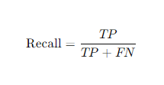
Performance Testing Parameters in ANN
Recall (Sensitivity):mesures how many actual positives are correctly identified.
Important when
Missing a positive is costly (e.g., disease detection)

