Slide 1

Lachancea thermotolerans
• The transcriptome analysis •
Neus Pou
Natasa Mortvanski
Ana Mendizabal
Principles of Genome Bioinformatics
MSc Bioinformatics for Health Sciences

Slide 2
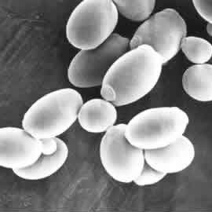
• Introduction
Lachancea thermotolerans is a species of yeast of the genus Lachancea. It is a diploid yeast associated with fruits, known for the ability to produce lactic acid through fermentation.
Its genome has a median total length of 10.6 Mb, a median protein count of 5092 and median GC content of 47.3%. Its representative genome assembly has 10 contiges and 8 scaffolds (chromosomes).

Slide 3
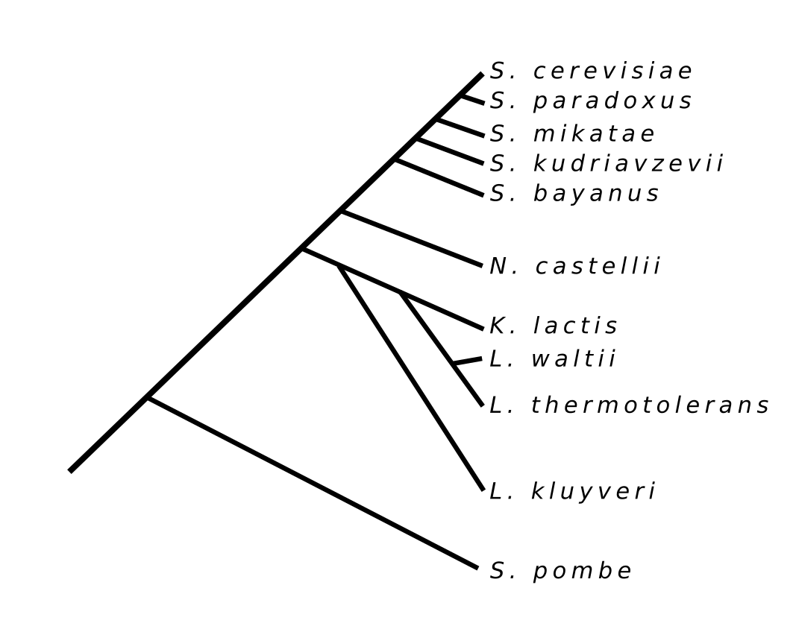
• Introduction
The picture shows the position of Lachancea thermotolerans in yeast phylogenetic tree .
It shares a common ancestor with 11 yeasts. All of them except the S. pombe belong to the family Saccharomycetaceae.

Slide 4
• Project objectives •
To compare known and novel transcripts.
To determine possible functions of novel transcript products by finding homologues in related yeast species.

Slide 5
• Project overview:
02
04
01
03
05
BLASTX
Alignment and assembling
Hisat2
StringTie
Samtools
Bedtools
Enrichment analysis
Quality
Control
Known vs Novel transcripts
FastQC
Trimmomatic
Infoseq
Mann-Whitney-Wilcoxon test
g:Profiler

Slide 6
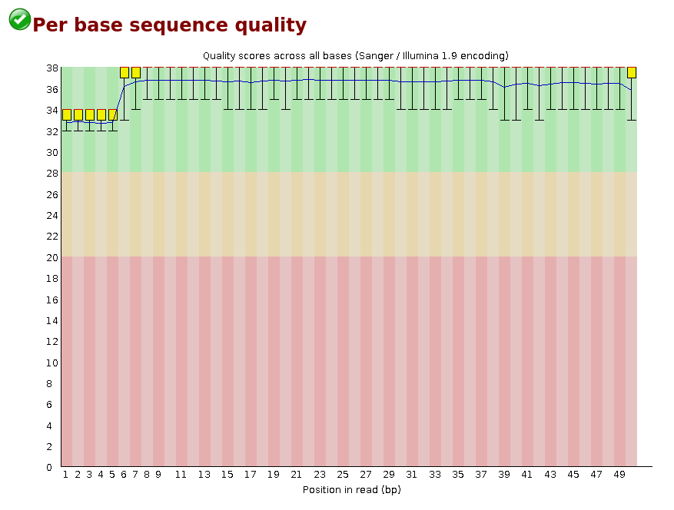
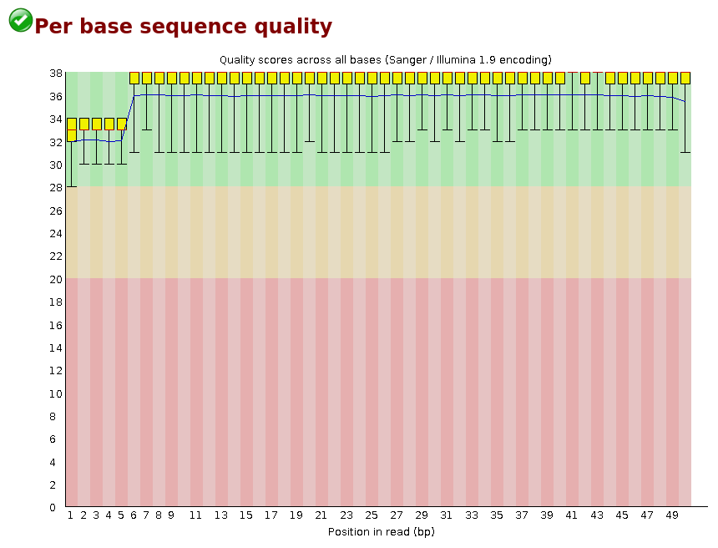
• Quality control
FASTQC is a quality control tool for high throughput sequence data. In the Per base sequence quality section we obtained the following graph that shows an overview of the range of quality values across all bases at each position.
Our data showed a good sequence quality with a higher quality score than 28 for the most of the positions.
Beginnings and ends of both read 1 and read 2 have some lower quality positions

Slide 7
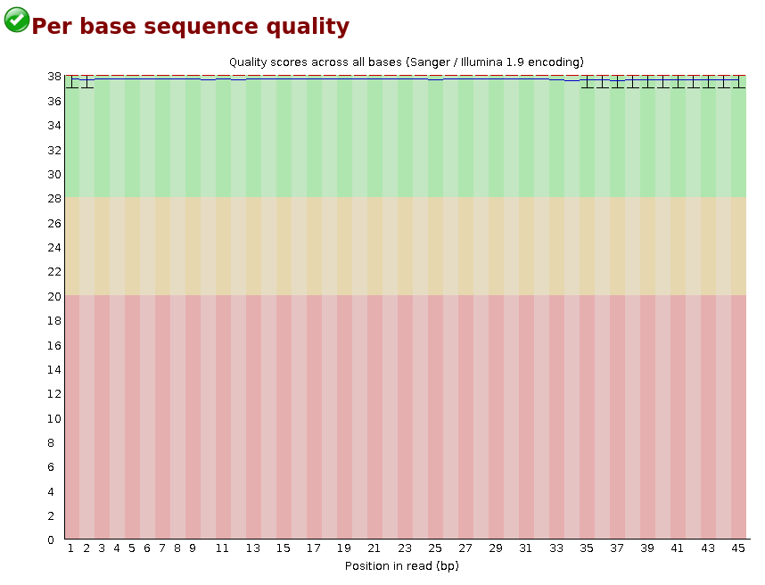
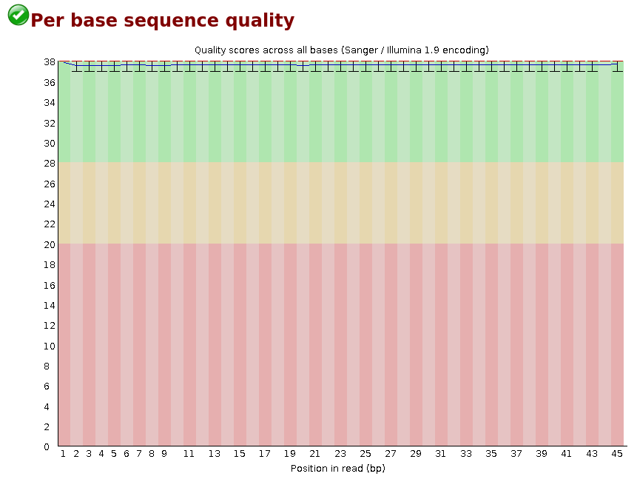
• Quality control
Therefore, we processed our files with Trimmomatic, a tool for read trimming and filtering to improve overall sequence quality. We checked again the quality with FASTQC to obtain the Per base sequence quality graph.
It showed a better sequence quality with a extremely high quality score for all positions.

Slide 8
• Alignment and assembling
Hisat2 & SAMtools
LT genome.fasta
LT genome.index
LT paired.fastq
LT.sam
LT.bam
Hisat2
SAMtools
StringTie
LT.gff
LT.bam
LT transcriptome.gff
LT known.gff
LT novel.gff
StringTie
AWK
GREP
BEDtools
LT genome.fasta
LT known.gff
LT novel.gff
LT known.fasta
LT novel.fasta
BEDTools

Slide 9
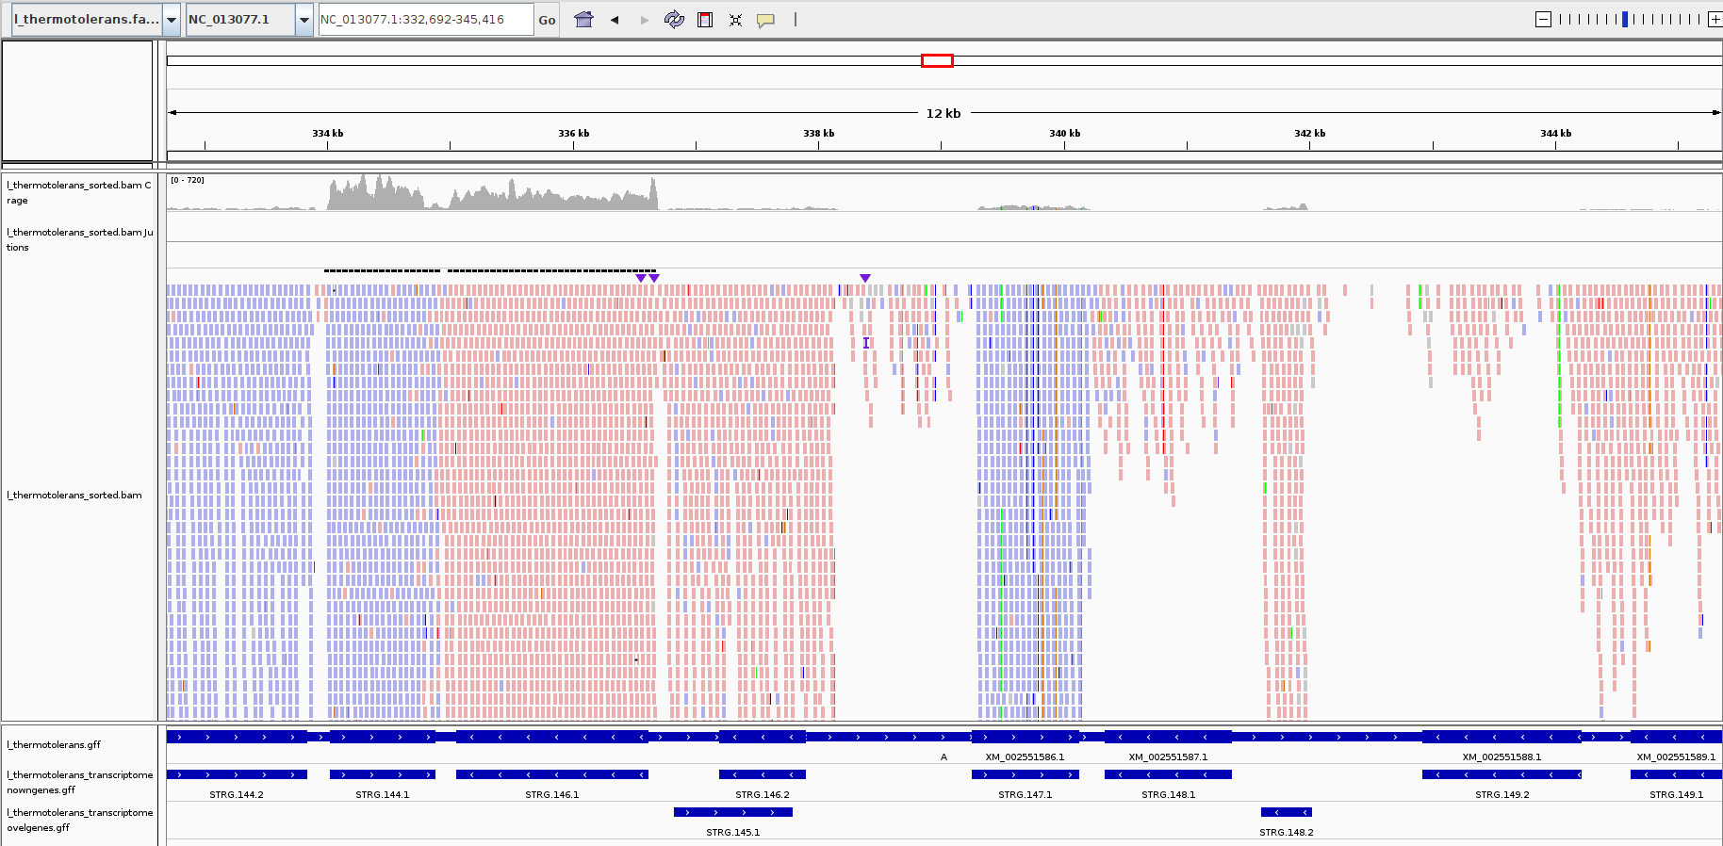
• Alignment and assembling
Lt genome.fasta
Lt sorted.sam
Coverage
Lt sorted.sam
Junctions
Lt sorted.sam
Lt genome.gff
Lt known.gff
Lt novel.gff

Slide 10
• Known vs Novel • Transcripts

Slide 11
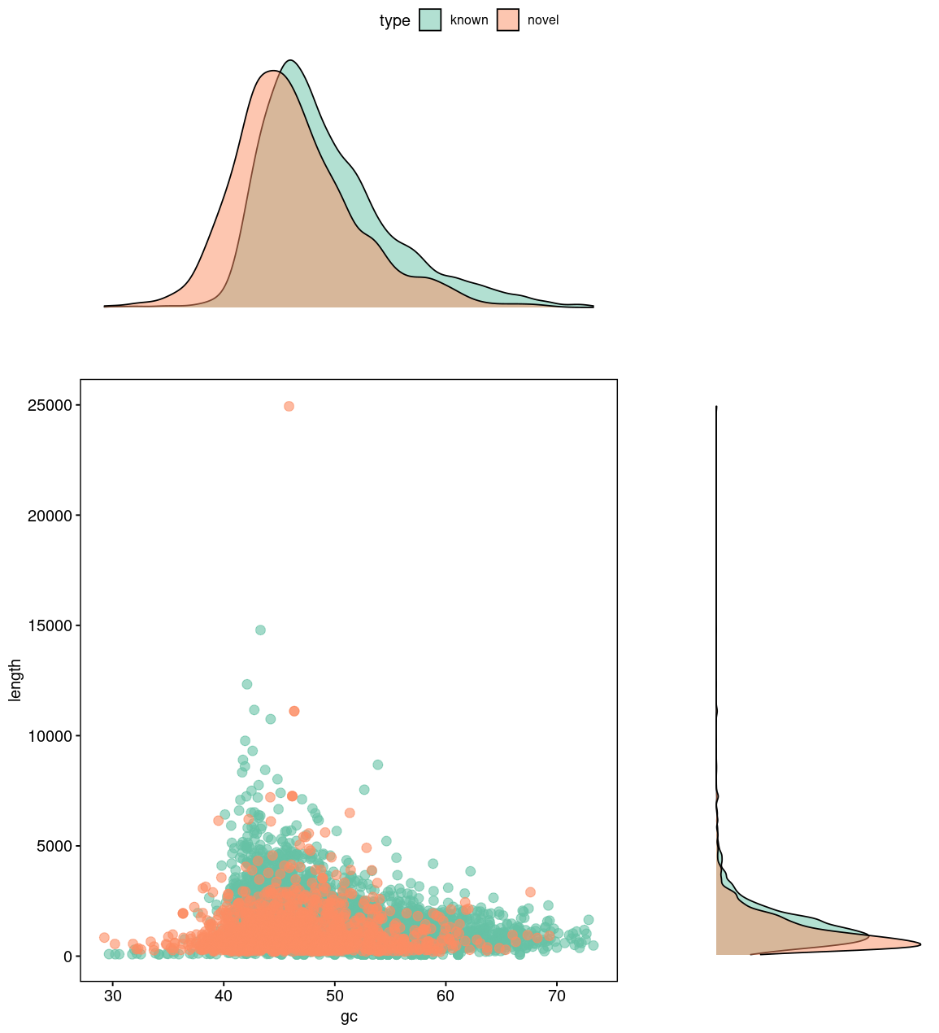
• Transcripts
GC%
Length
49.30
1209
Mean GC% for known
transcripts
Median length for known
transcripts
46.41
872
Mean GC% for novel
transcripts
Median length for novel
transcripts
Mann-Whitney-Wilcoxon test,
p-value < 2.2e-16

Slide 12
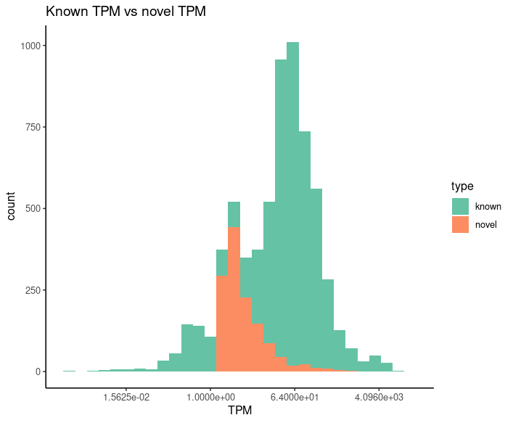
• TPM
(Transcripts per million)
A way of comparing expression levels is comparing TPM values between known and novel genes.
179.91
21.46
Mean TPM for known
transcripts
Mean TPM for novel
transcripts
Mann-Whitney-Wilcoxon test,
p-value < 2.2e-16
TPM scale was transformed by log10 for better representation of the results.

Slide 13
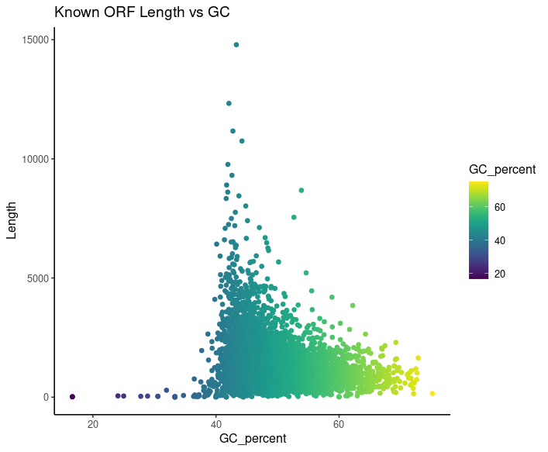
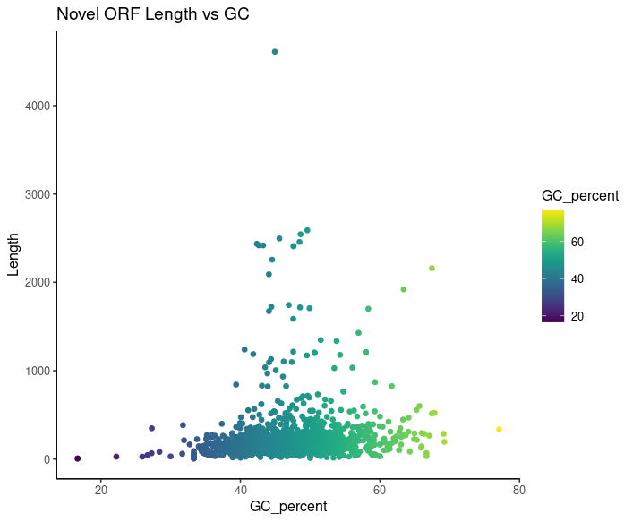
• ORFs GC% vs Length

Slide 14
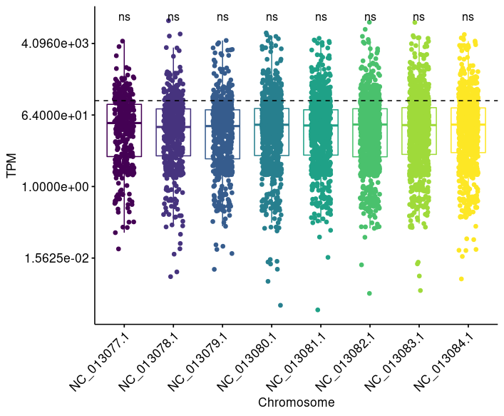
• Chromosome location
We have performed the same analysis mentioned before but sorting the transcripts by chromosomes/scaffolds.
We expected that there might be difference in the expression levels between the chromosomes.
However, all of them seemed to have similar TPM values.
Anova,
p-value = 0.76

Slide 15
Novel •
Transcripts

Slide 16
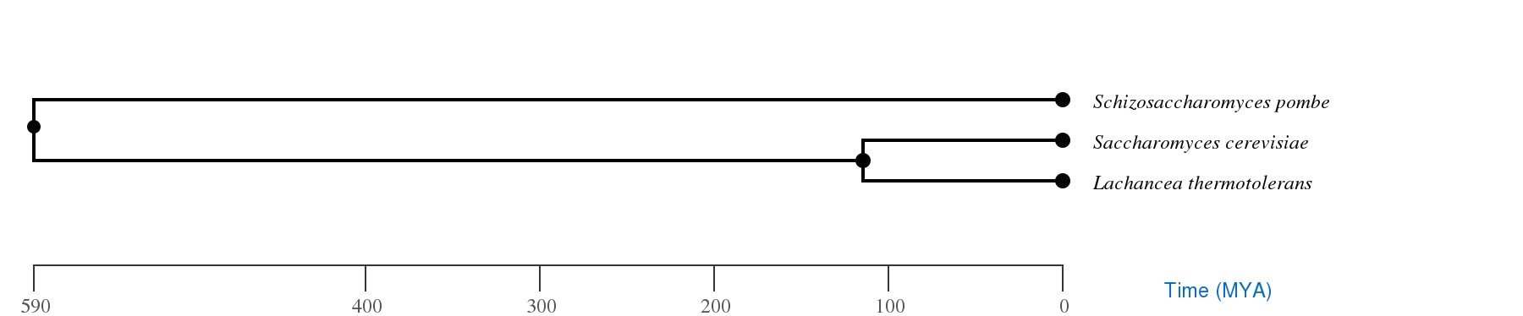
• BLASTX
L. thermotolerans vs
S. pombe
555 matches
L. thermotolerans vs
S. cerevisiae
871 matches
The genome annotation is incomplete.

Slide 17
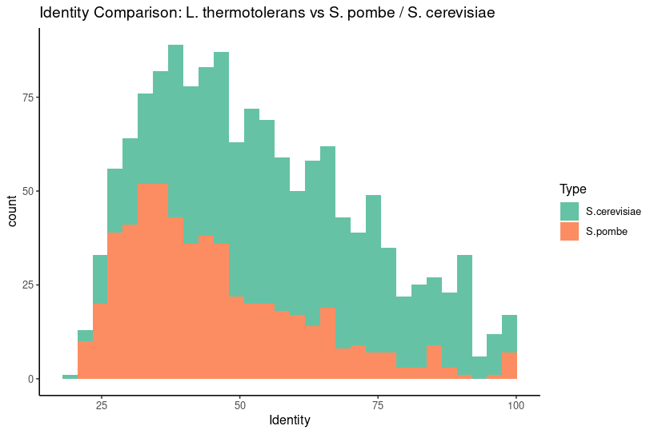
• BLASTX

Slide 18
• Enrichment analysis
S. pombe | S. cerevisiae
Vacuole related cellular components (p-value=1.439x10⁻³) | Vacuole related cellular components (p-value=1.693x10⁻³)
Autophagy (p-value=8.555x10⁻³)
Transporter activity (p-value=8.806x10⁻⁵) | Autophagy (p-value=4.961x10⁻²)
Molecules binding (p-value=6.946x10⁻⁴)
Essential proteins in yeast, especially through the fermentation process.
We find 13 proteins that are part of the ‘fermentome’ of
S. cerevisiae.

Slide 19
• Conclusions •
Mann-Whitney-Wilcoxon test proved that known and novel transcripts found in L. thermotolerans transcriptome have significant differences in lengths, GC% and expression values (TPM).
We found that protein products of novel transcripts are conserved among the phylogenetic tree. It suggests that the genome annotation is incomplete. They are proteins with functions related to the fermentation process.

Slide 20
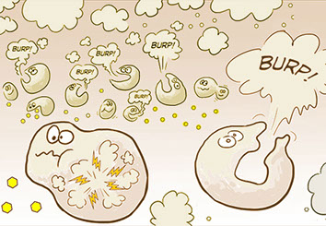
Thank you for your attention!

Slide 21
• Bibliography
Blevins, W.R., Carey, L.B. & Albà, M.M. (2019). Transcriptomics data of 11 species of yeast identically grown in rich media and oxidative stress conditions. BMC Res Notes 12, 250. https://doi.org/10.1186/s13104-019-4286-0
Walker, M. E., Nguyen, T. D., Liccioli, T., Schmid, F., Kalatzis, N., Sundstrom, J. F., Gardner, J. M., & Jiranek, V. (2014). Genome-wide identification of the Fermentome; genes required for successful and timely completion of wine-like fermentation by Saccharomyces cerevisiae. BMC genomics, 15(1), 552. https://doi.org/10.1186/1471-2164-15-552
https://www.ncbi.nlm.nih.gov/genome/?term=Lachancea%20thermotolerans[Organism]&cmd=DetailsSearch
http://samtools.sourceforge.net/
https://software.broadinstitute.org/software/igv/
http://www.timetree.org/
https://biit.cs.ut.ee/gprofiler/gost
https://fungi.ensembl.org/info/data/ftp/index.html

