Slide 1
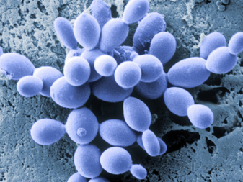
RNA SEQUENCING DATA ANALYSIS OF Naumovozyma castellii
PRINCIPLES OF GENOME BIOINFORMATICS (UPF)
Xavier Soler
Sergio Suárez
Marina Vallejo
01/12/2021
Esta foto de Autor desconocido está bajo licencia CC BY-SA

Slide 2
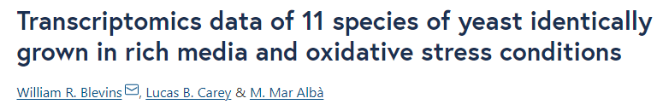
RAW DATA
FILES
illumina_truseq_adapters.fa
n_castellii.fa
n_castellii.gff
n_castellii _read1.fastq.gz
n_castellii _read2.fastq.gz
https://bmcresnotes.biomedcentral.com/articles/10.1186/s13104-019-4286-0/tables/1

Slide 3
ANALYSIS
BASIC:
Read filtering
RNA-Seq alignment
Transcript assembly
FASTA and ORF obtention
EXTENDED:
Codon usage
GC content
BLASTp
Sequence length extended
Coding Score (CIPHER)
TPM extended

Slide 4
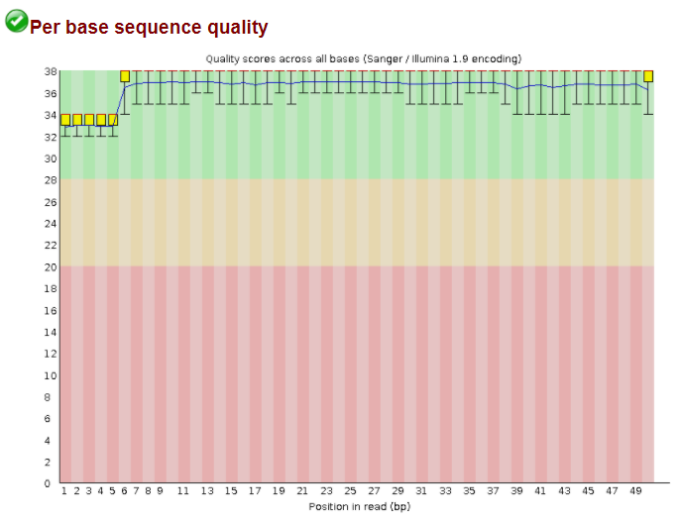
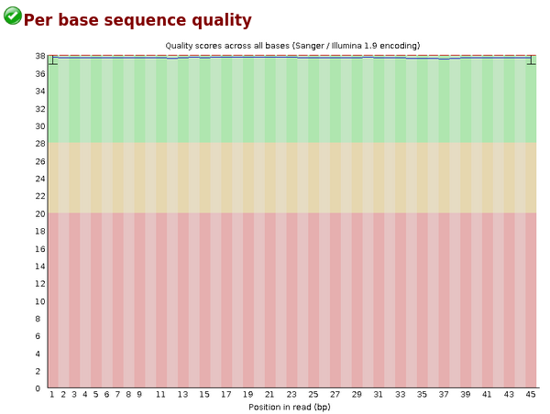
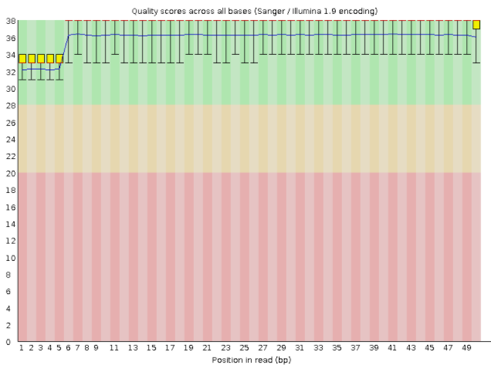
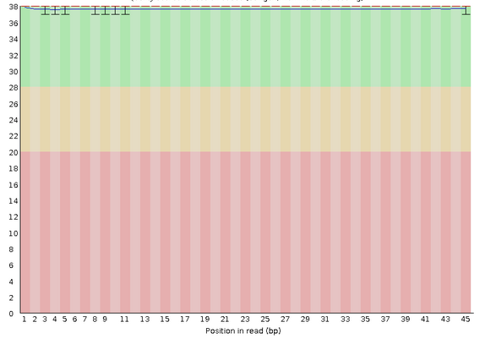
READ FILTERING
BEFORE TRIMMOMATIC
AFTER TRIMMOMATIC
Drop 7,548,312 sequences
READ 1, 26769999 sequences
READ 1, 19221687 sequences
READ 2, 26769999 sequences
READ 2, 19221687 sequences

Slide 5
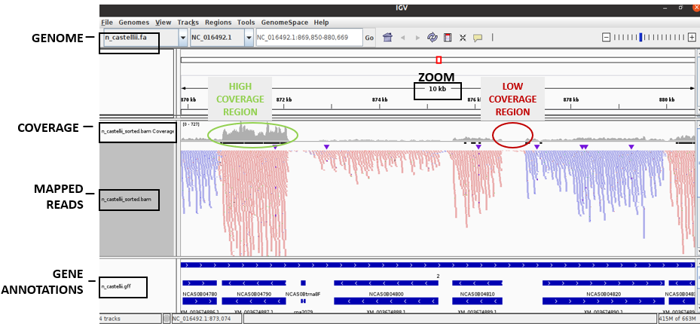
RNA-SEQ ALIGNMENT
hisat2, samtools, IGV

Slide 6
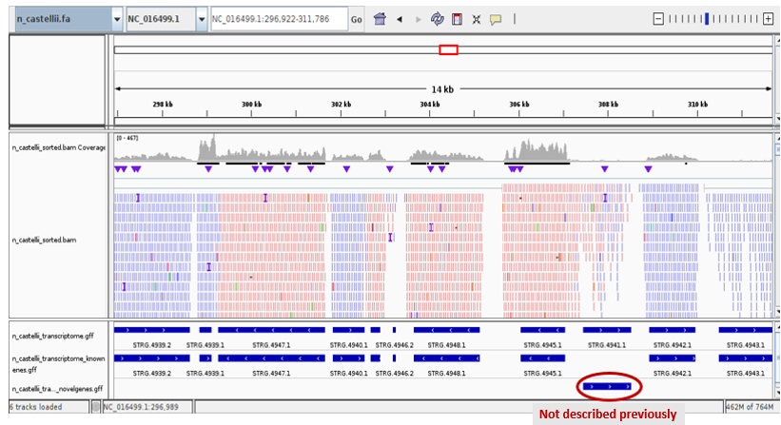
TRANSCRIPT ASSEMBLY
stringtie + awk
TRANSCRIPT
815 Novel (12%)
5969 Known (88%)
6511 Total
Known = annotated

Slide 7
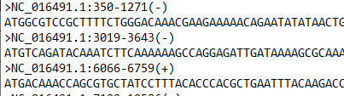

FASTA AND ORF OBTENTION
FASTA
getfasta (bedtools)
Input: global FASTA+ known/novel gff
Output: known/novel FASTA
Number of sequences:
ORF
Perl script
Input: known/novel FASTA
Output: longest ORF FASTA +
randomized ORF FASTA +
lengths
MAX ORF LENGTH (nt)
Known: 14805
Known random: 564
Novel: 5367
Novel random: 666

Slide 8
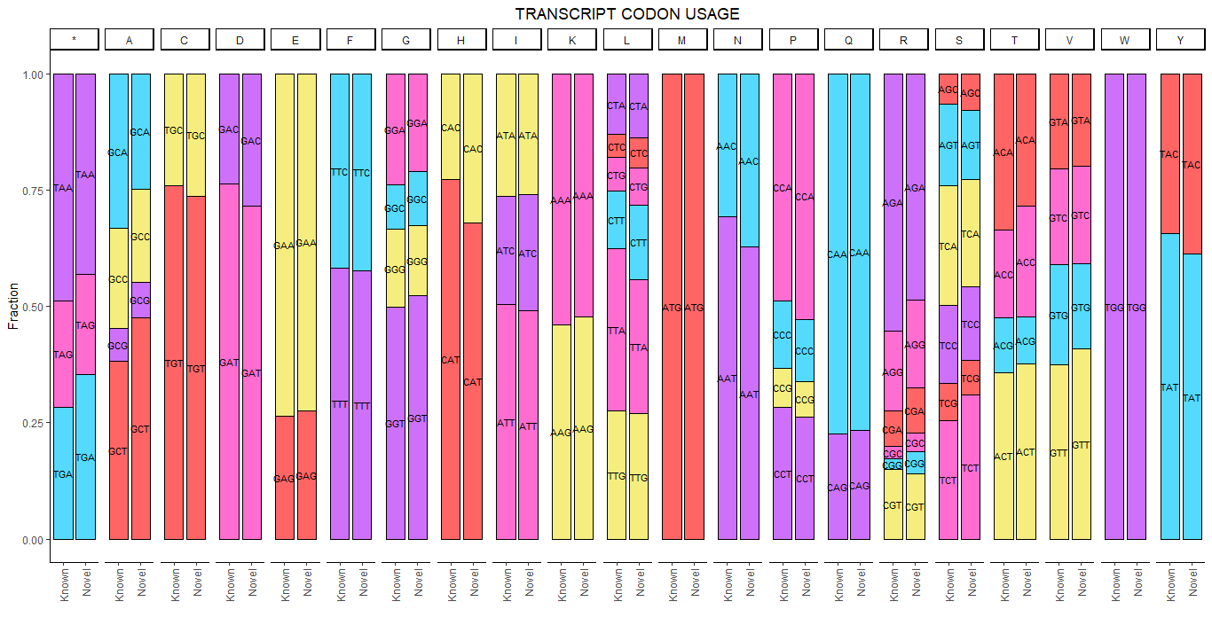
CODON USAGE
cusp (EMBOSS)

Slide 9
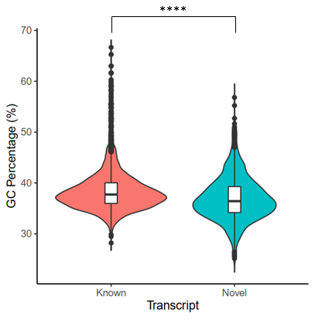
GC CONTENT
infoseq (EMBOSS)
Descriptive statistics:
Kolmogorov-Smirnov test:
GC content lower in Novel transcript
 | TRANSCRIPT
 | KNOWN | NOVEL
Min. | 28.21 | 25.15
1st Qu. | 35.99 | 34.19
Median | 37.74 | 36.43
Mean | 38.59 | 37.01
3rd Qu. | 40.04 | 39.30
Max. | 66.67 | 56.82
Higher GC content related with mRNA stabilization
New gens evolution positive to increase
GC content
 | TRANSCRIPT
P value | <0.0001
P value summary | ****
Significantly different (P < 0.05)? | Yes
Kolmogorov-Smirnov D | 0.2043

Slide 10
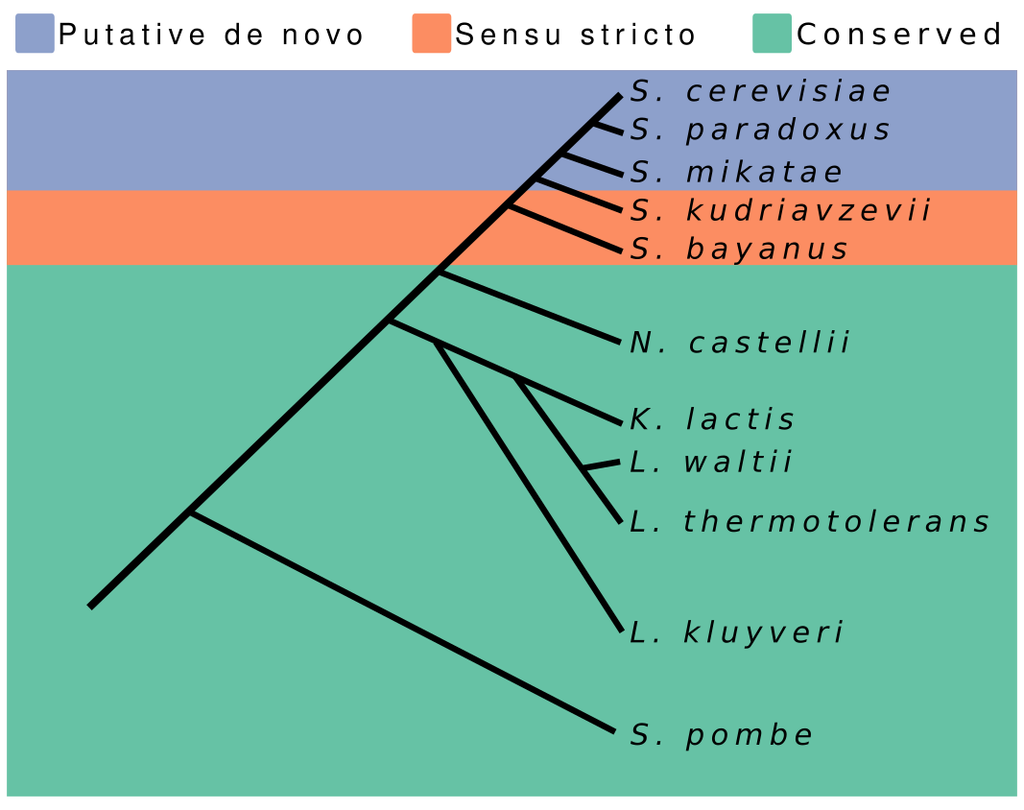
BLASTp
BLASTp - Compare our transcript with proteins of other organisms
Reference
N. castellii
S. Cerevisae
Closer
5867 gens
95.3% coding
6464 gens
93.1% coding
First – More studied
K. lactis
S. pombe
Will Blevins
5335 gens
95.3% coding
6974 gens
73.6% coding

Slide 11
Transcript
Matches
e-value > 0.1
Known
Novel
Database
573
84
541
3 – 0.5%
0 – 0%
5 – 0.9%
S. cerevisiae
Known
Novel
Database
644
117
591
2 – 0.3%
1 – 0.9%
2 – 0.3%
K. lactis
Known
Novel
Database
628
134
607
4 – 0.6%
0 – 0%
4 – 0.7%
S. pombe

Slide 12
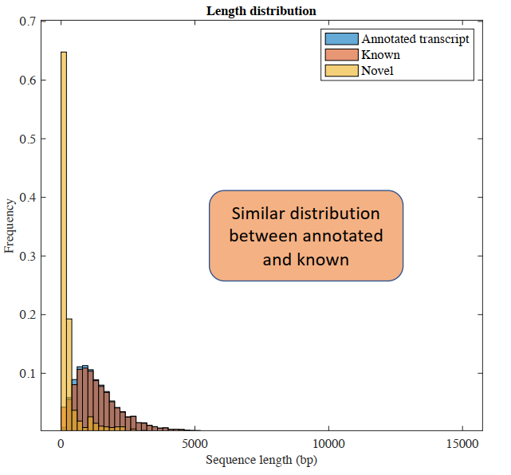
SEQUENCE LENGTH
All groups have statistical significance
Novel most part sort Probably no-coding

Slide 13
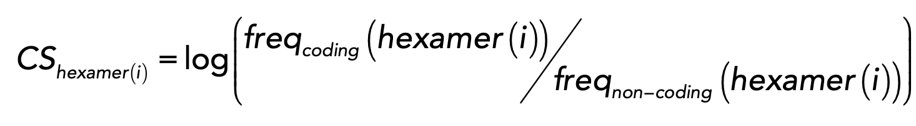
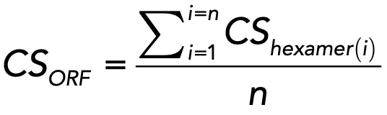
CODING SCORE (CIPHER)
https://github.com/jorruior/CIPHER

Slide 14
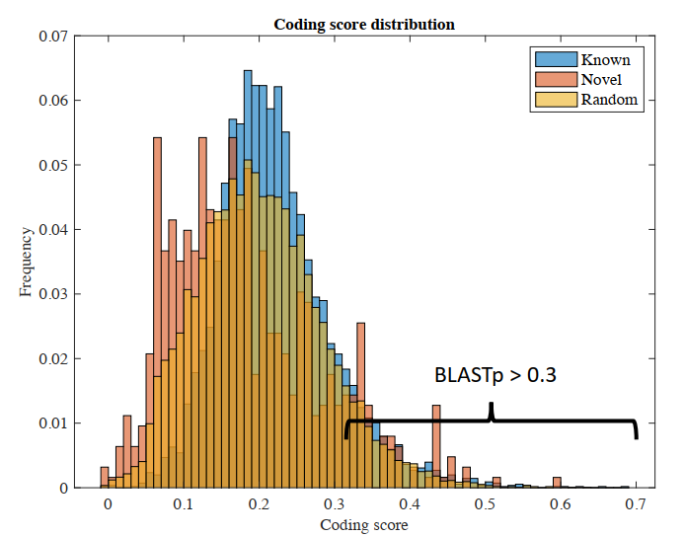
CODING SCORE (CIPHER)
Novel transcripts with high coding capacity are specie-specific

Slide 15
ORFS PER TRANSCRIPT
Pervasive translation of the transcriptome reflected in the novel transcripts
95% CI for difference: (0.1561422 - 0.3842968)

Slide 16
TRANSCRIPT PER MILION (TPM)
We cannot be sure of the coding capacity of the short transcripts

Slide 17
CONCLUSIONS
Novel genes seem to be developed in novel transcript
Lower GC content
Low homology in BLAST
Higher ORF number
Uncertainty about the coding capacity of the short transcripts
Low homology in BLAST
High variability in TPM and CS

Slide 18
MACHINES AND TOOLS
MACHINE 1 | MACHINE 2 | MACHINE 3
macOS 11.6 - Darwin 20.6.0 | MacOS Monterey – 12.0.1 | 20.04.2-Ubuntu
Intel Core i5 CPU 2.3 GHz | Intel Core i5 CPU 2.3 GHz | Intel Core i7 CPU 2.7 GHz
8 GB RAM | 8 GB RAM | 12 GB RAM
2 Cores | 2 Cores | 2 Cores
TOOLS BASIC ANALYSIS | TOOLS EXTENDED ANALYSIS
fastQC 0.11.5 | EMBOSS 6.6.0
SRA 2.4.1 | blastp 2.12.0+
stringtie 1.3.4d | CIPHER 1.0.0
Trimmomatic 0.36 | Python 2.7
PERL v5.30.0 | R 4.0.2
hisat2-2.2.0 | MATLAB_R2021a
bedtools-2.28.0

