Slide 1
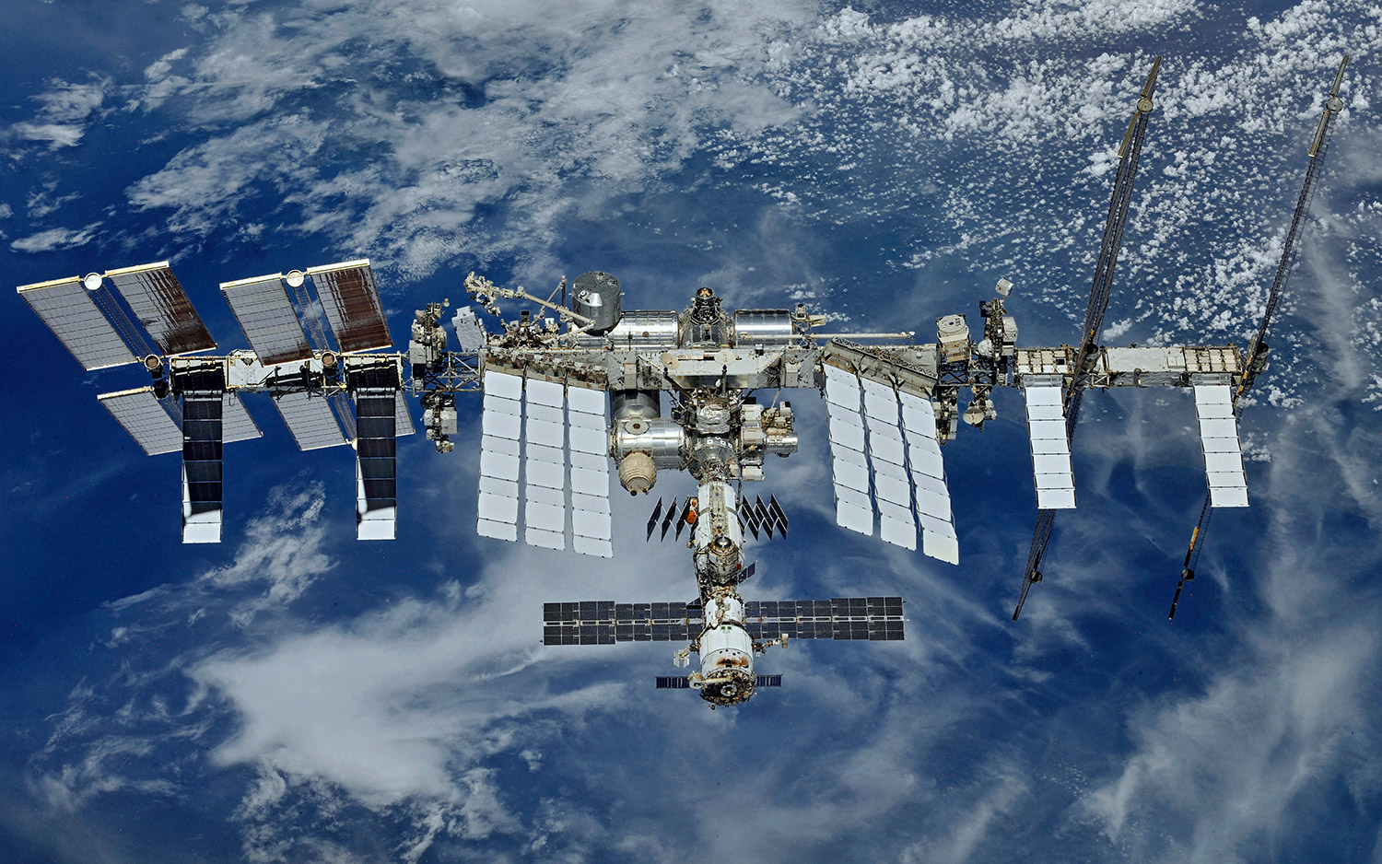
Where is the International space station?

Slide 2
The iss has gone missing!!
UNFORTUNATELY, SOMEONE SPILLED COFFEE ON OUR MAIN COMPUTER, CORRUPTING THE PYTHON FILE THAT TRACKS THE ISS. LUCKILY, WE HAVE A BACKUP DATABASE THAT HAS ALL OF THE INFORMATION WE NEED. YOUR MISSION TODAY IS TO WRITE A PROGRAM THAT TAKES THE DATA FROM THE BACKUP DATABASE AND UPDATES YOUR CONSOLE WITH REAL-TIME ISS COORDINATES. GOOD LUCK!

Slide 3
How can we accomplish our goal?
WE NEED TO LOCATE THE PRE-EXISTING DATABASE THAT FETCHES THE DATA
WE CAN FIND THIS INFORMATION THROUGH “API”
API STANDS FOR “APPLICATION PROGRAMMING INTERFACE”
API IS THE MIDDLEMAN THAT TAKES A REQUEST FROM YOU (THE CLIENT) AND ALLOWS YOU TO RECEIVE A RESPONSE FROM A SERVER (THE HOST)

Slide 4
MAIN THINGS TO REMEMBER WHEN USING AN API
FIND DOCUMENTATION ON WHAT THE RESPONSE WILL LOOK LIKE
http://api.open-notify.org/iss-now.json
RESPONSES WILL BE IN JSON FORMAT
API RESPONSES CAN SOMETIMES BE VERY CLUTTERED AND CONFUSING TO LOOK AT
INSTALLING A JSON VIEWER EXTENSION IS RECOMMENDED
PATIENCE!

Slide 5
HOW CAN WE IMPLEMENT AN API INTO A PYTHON PROGRAM?
THE REQUESTS LIBRARY MAKES API REQUESTS SIMPLE TO USE
pip install requests
import requests
WE’LL ALSO NEED TO FIGURE OUT A WAY TO NOT OVERLOAD THE SERVER WITH MULTIPLE REQUESTS
import time (natively comes with python)
THIS LIBRARY WILL BE IMPLEMENTED AT THE END OF OUR WHILE LOOP

Slide 6
Getting an api response through python
MAKING A REQUEST TO A SERVER
response = requests.get(“URL”)
“response” IS A JSON OBJECT
PRINT STATUS CODE
print(response.status_code)
TURN RESPONSE INTO SOMETHING WE CAN PARSE
data = response.json()
“data” IS NOW A DICTIONARY THAT WE CAN PARSE THROUGH

Slide 7
Iterating through dictionaries
DICTIONARIES ARE A USEFUL AND COMMON WAY OF STORING AND USING DATA
UNLIKE ARRAYS, DICTIONARIES CAN STORE MULTIPLE VARIABLES UNDER ONE “KEY”
BASIC DICTIONARY SYNTAX FOR PYTHON
DICTIONARY_NAME[KEY]
RETURNS VALUE ASSOCIATED WITH KEY

Slide 8

URL: KAHOOT.IT
Notes:
Day 4: Intro to API recap

Slide 9
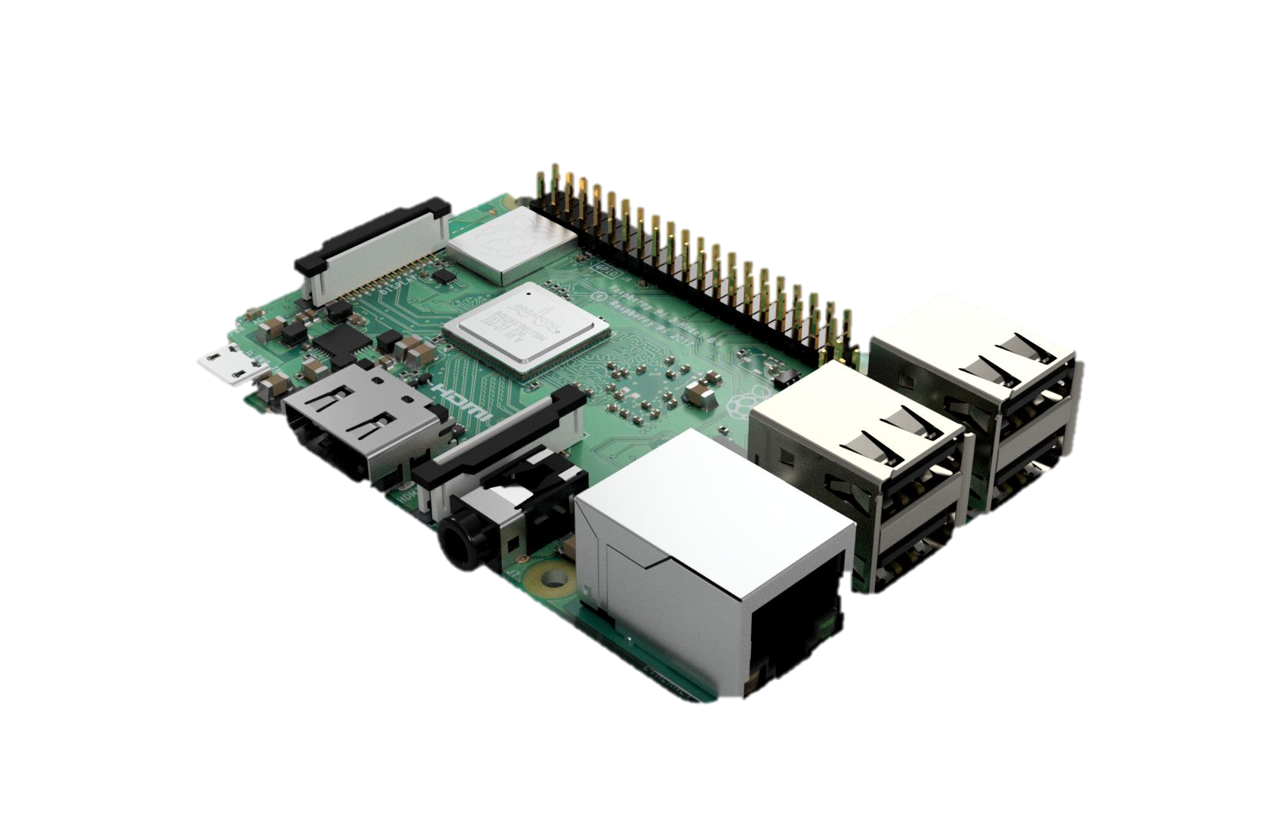
WEB SERVER

Slide 10
Downloads
APACHE WEB SERVER
https://www.raspberrypi.org/documentation/remote-access/web-server/apache.md

Slide 11

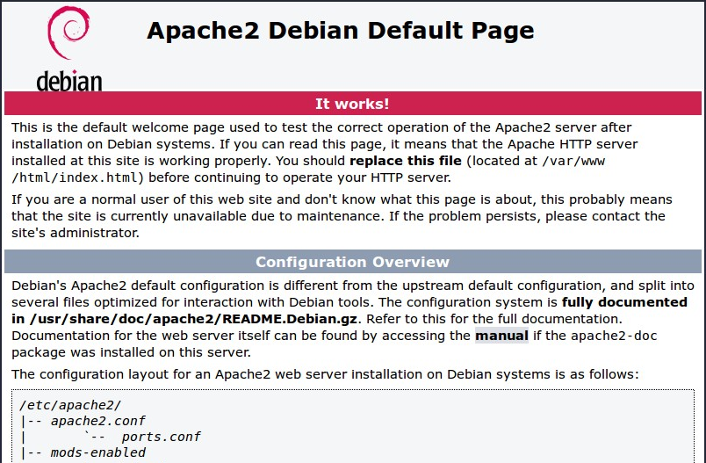
TEST YOUR WEBSERVER
FIND WHAT YOUR PI’S IP ADDRESS IS
hostname -I
YOU SHOULD SEE AN APAPCHE2 DEBIAN DEFAULT WEB PAGE
NOW LET’S GET INTO EDITING THE WEB PAGE!

Slide 12
How do we make a website
There are 3 main components to a website
HTML – Hyper Text Markup Language
Defines the content for a website
CSS – Cascading Style Sheets
Adds style to website and can be done in many ways
JavaScript – Adds functionality to a website and allows us to edit content on the page
For today we will mostly be working with HTML to make the page and add some content to the page and maybe some CSS to play with some colors

Slide 13
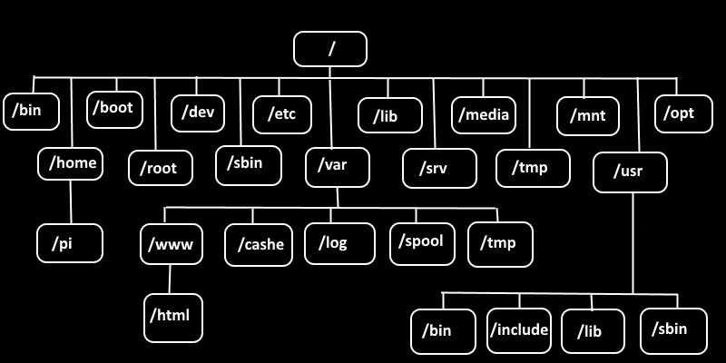
EDITING YOUR WEB PAGE
NAVIGATE TO THE DIRECTORY CONTAINING THE HTML FILE
cd /var/www/html
CHANGE THE OWNERSHIP OF THE FILE TO ALLOW US TO EDIT
sudo chown [USER_NAME]: index.html # “pi” IS DEFAULT USER NAME

Slide 14
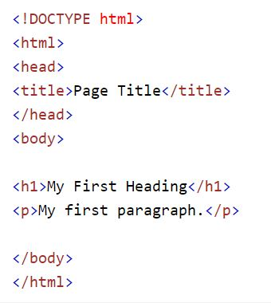
BASIC HTML SYNTAX
GREAT RESOURCE FOR HTML
https://www.w3schools.com/html/default.asp

Slide 15
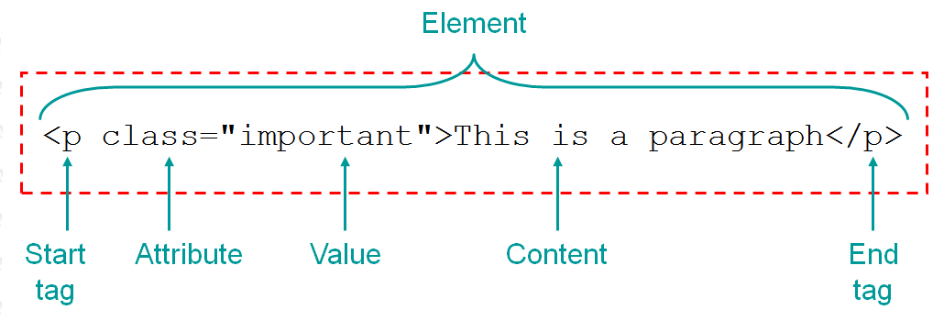
TAGs
<tagname>content goes here...</tagname>
DEFINE HTML HEADINGS
<h1> to <h6>
DEFINE A PARAGRAPH HEADING
<p>

Slide 16
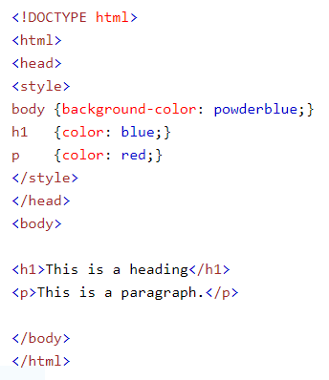
Style attribute
<tagname style=“property:value;“>
PROPERTIES
background-color:color
color:color
font-family:font
font-size:percentage%
text-align:alignment

Slide 17
images
<img src=“url”>
USE THE style ATTRIBUTE WITH width AND height PROPERTIES TO PLAY AROUND WITH IMAGE DIMENSIONS
style=“width:[pixels]px; height:[pixels]px;”

Slide 18
BACKGROUND IMAGE
PUT THE style ATTRIBUTE WITHIN THE body TAG
1
STYLE WILL TAKE IN A property CALLED “background-image” WITH A VALUE CALLED “url”
2
PUT THE URL OF YOUR IMAGE IN PARENTHESIS AFTER url
3
DON’T FORGET A SEMICOLON AFTER YOUR URL AND TO WRAP THE URL INSIDE QUOTATIONS
4

Slide 19
WHY IS MY BACKGROUND REPEATING?
ATTRIBUTES NEEDED
background-repeat
background-size

Slide 20
URL: KAHOOT.IT
Notes:
Day 4: Intro to API recap

