Slide 1


Public Safety Center
Energy Performance Assessment
Utility Use & Cost Analysis and Estimated Avoided Costs
July 23, 2015
Bill Eger
Energy Manager
City of Alexandria

Slide 2
Office of Energy Management – Business Units
Utility Acquisition, Billing, & Analysis
Utility resource acquisition & contracting
Billing receipt & payment on behalf of City
Performance Analysis & Reporting
City Operations Energy Management
Energy efficiency, renewable energy, and fuel reductions for City facilities, operations (i.e. parks), and fleet
High-performance building design
Electrical Infrastructure Management
Analysis, diagnostics, design, project management for City facility & operations electrical systems and infrastructure
Community Energy Management
Community energy efficiency programs, education, & outreach
Neighborhood/Small Area Planning
Green Building Policy administration
Eco-City Alexandria/EAP implementation
Energy Assurance & Reliability
Emergency Generator program
ESF-12
Regulatory & Policy Affairs
Consumer advocate for regulatory (SCC) proceedings
Federal, state, and local energy policy

Slide 3
5-year (FY) Total Utility Cost Trend

Slide 4
5-year (FY) Total Electricity Use Trend

Slide 5
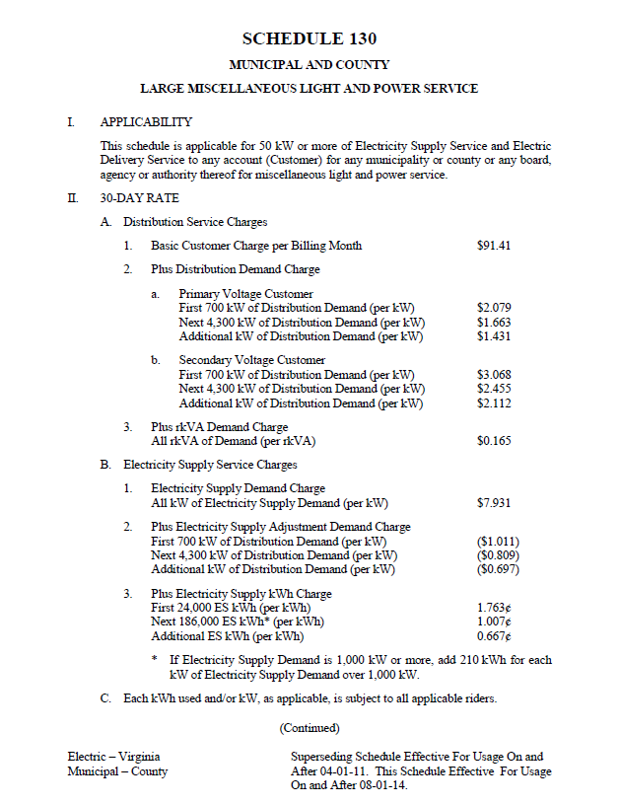
Electricity Billing – Administrative, Demand, & Energy Costs

Slide 6
5-year (FY) Electricity Price Trends – Average & Avoided Price
Fiscal Year | Average Unit Cost ($/kWh) | Avg Avoided Cost of Demand ($/kW) | Avg Avoided Cost of Energy ($/kWh)
2011 | $ 0.0570 | $ 10.43 | $ 0.0342
2012 | $ 0.0646 | $ 11.99 | $ 0.0411
2013 | $ 0.0632 | $ 13.22 | $ 0.0373
2014 | $ 0.0614 | $ 13.61 | $ 0.0339
2015 | $ 0.0615 | $ 13.84 | $ 0.0329

Slide 7
5-year (FY) Total Natural Gas Use Trend

Slide 8
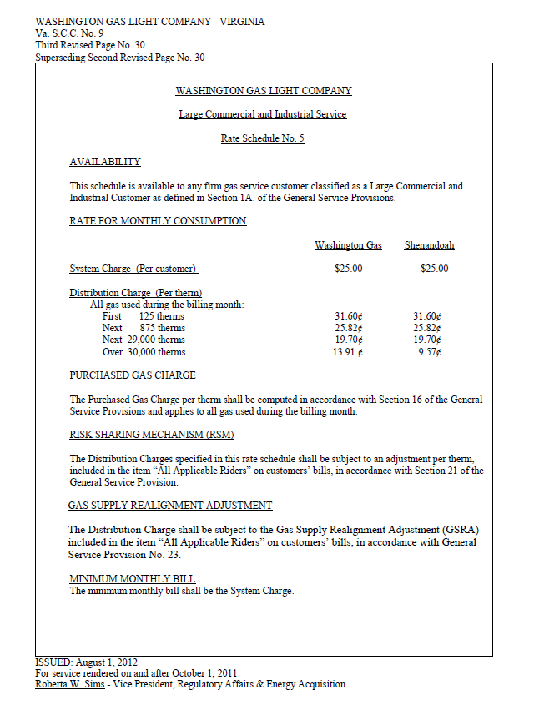
Natural Gas Billing – Administrative, Distribution, & Commodity Costs

Slide 9
5-year (FY) Natural Gas Price Trends – Average & Avoided Price
Fiscal Year | Average Unit Cost ($/kWh) | Avg Avoided Cost of Distribution ($/kW) | Avg Avoided Cost of Commodity ($/kWh)
2011 | $ 1.116
2012 | $ 1.048
2013 | $ 0.892 | $ 0.370 | $ 0.522
2014 | $ 0.720 | $ 0.198 | $ 0.522
2015 | $ 0.711 | $ 0.189 | $ 0.522

Slide 10
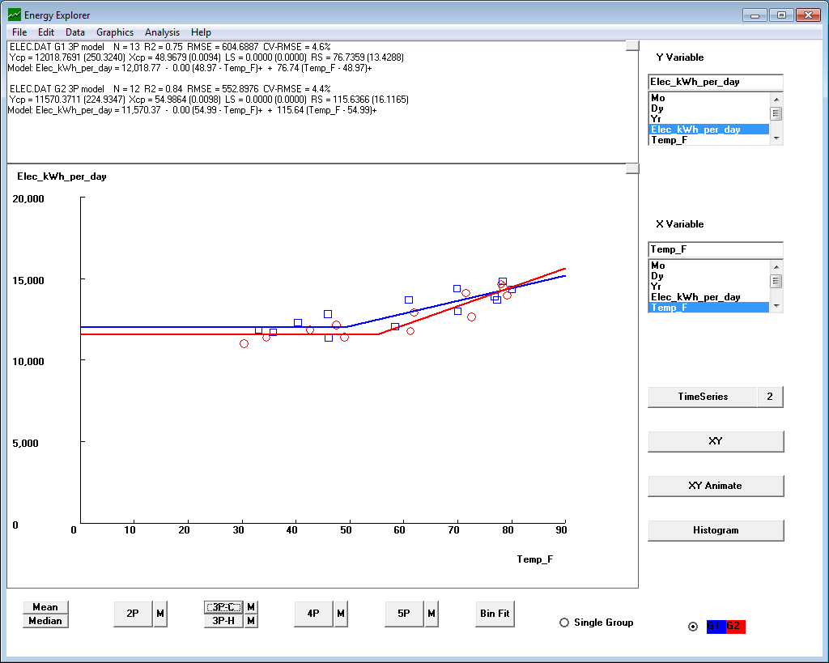
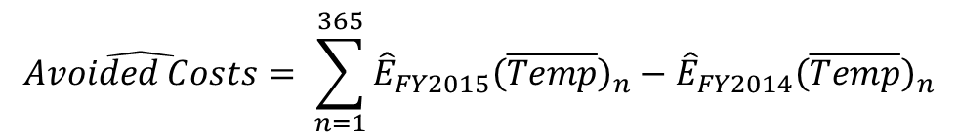
Use & Cost Savings Methodology
$$\hat{Avoided Costs}= \sum_{n=1}^{365}{{{\hat{E}}_{FY2015}\left(\overline{Temp}\right)}_{n}−{{\hat{E}}_{FY2014}\left(\overline{Temp}\right)}_{n}}$$

Slide 11
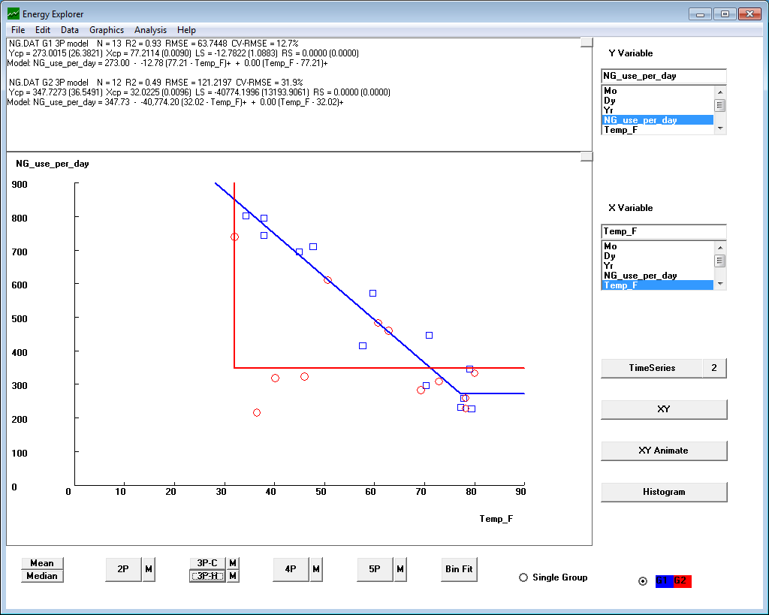
Use & Cost Savings Results
 | FY2014 | FY2015 | Difference | Estimated Avoided Costs ($)
Natural Gas* | 195,565 | 181,880 | 13,685 | $ 9,730
Electricity | 4,729,657 | 4,589,399 | 140,258 | $ 8,626
* Under estimation of natural gas avoided costs due to data concerns

Slide 12
Weather-Independent vs. Weather Dependent
 | Weather-independent | Weather-dependent
Electricity | 92% | 8%
Natural Gas | 55% | 45%

Slide 13
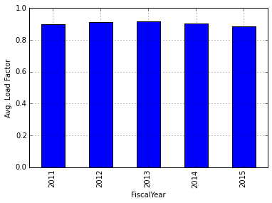
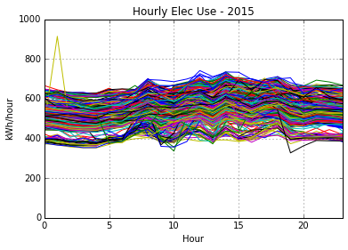
5-year (FY) Electricity Load Factor Analysis

Slide 14
Upcoming Opportunities
AHU & ERU Replacement and Ventilation
Lighting
Re-commissioning & Control System Review
Demand Response
Working with Alexandria Sheriff’s Office employees

Slide 15
Next Steps

