Slide 1

Effect of Music On Daily Activity
Ege Yardımcı 31024

Slide 2


My Data Set

Slide 3
My Hypothesis
My step count increases according to the average energy and tempo of the music I listen in a day.

Slide 4


Slide 5

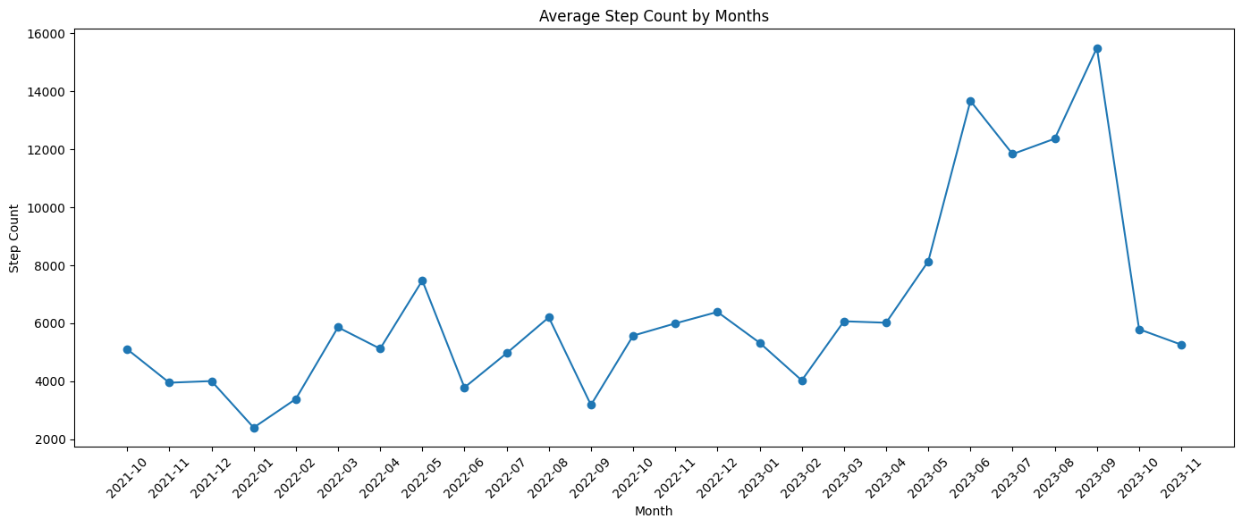
I have started exploring my health data by ploting my monthly avarage step counts by day.
We see some high and low spots at various dates. There seems to be no trend.

Slide 6
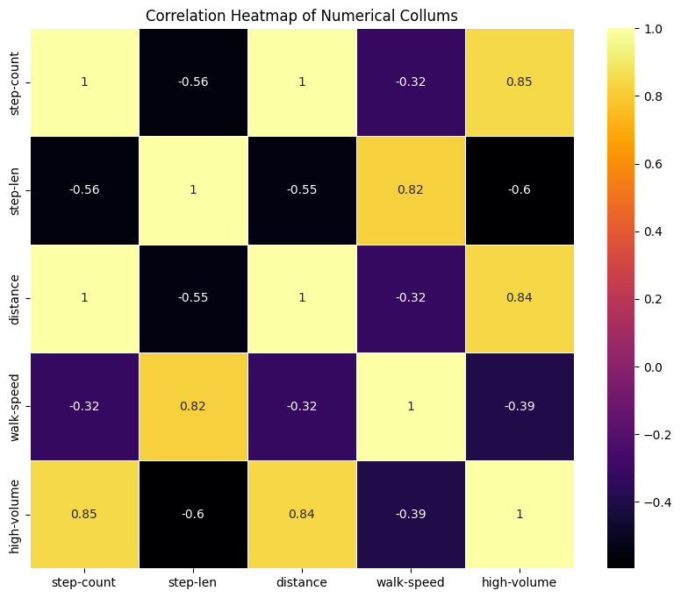
The I explored the data further by plotting a heatmap to see the relations.
Here we see high-volume notification are strongly correlated with my step count, it is a good sign for the start but it is not enough.

Slide 8

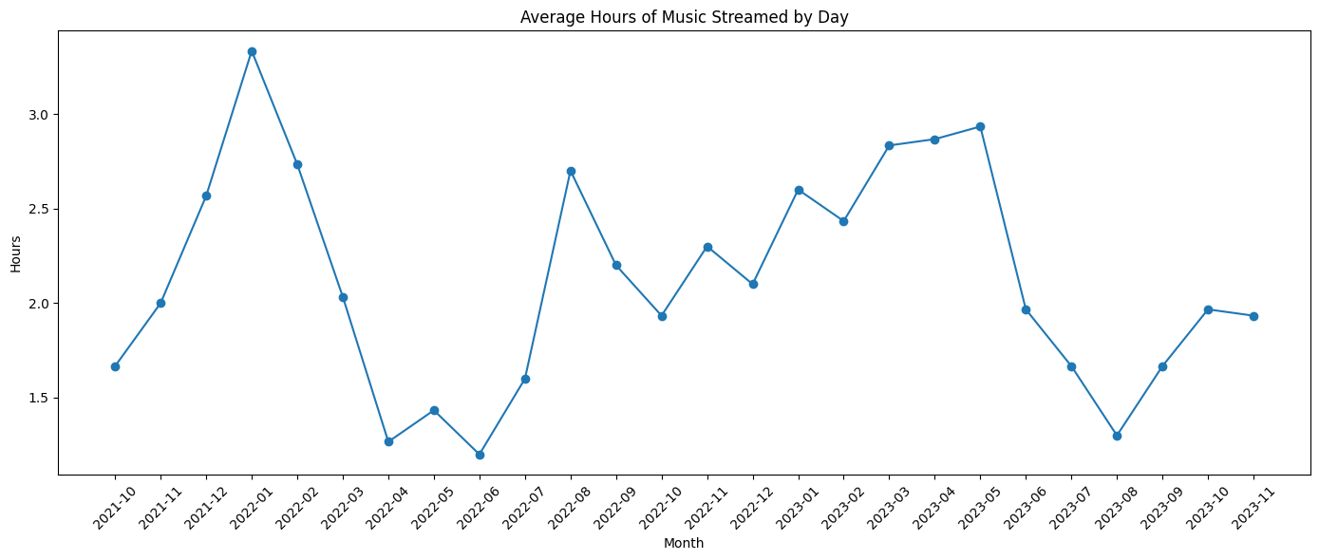
I continued with exploring my Spotify data, ploted my monthly average hours of music streamed by day.
We see some high and low spots at various dates. There seems to be no trend again.

Slide 9
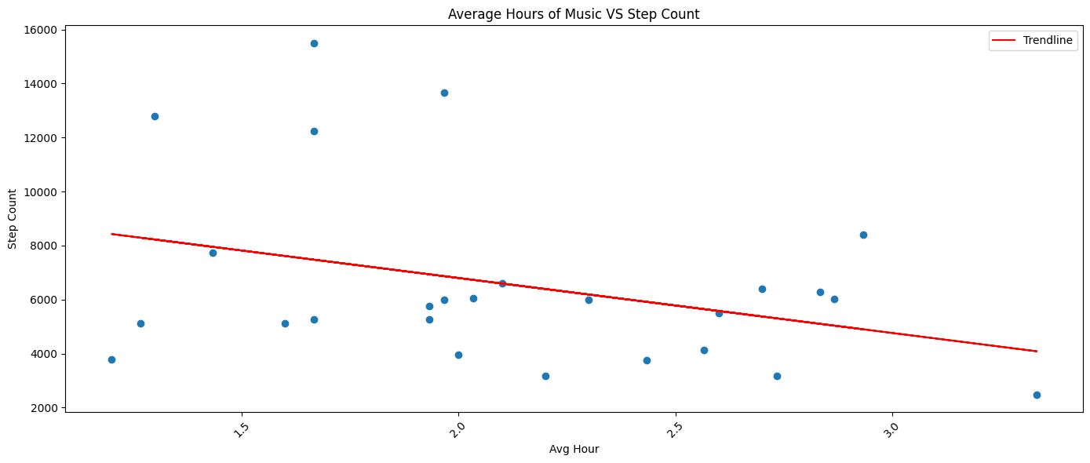
Here is the step count vs average hours of music graph.
Surprisingly there is a negative correlation between them, not exactly what I have expected.

Slide 10
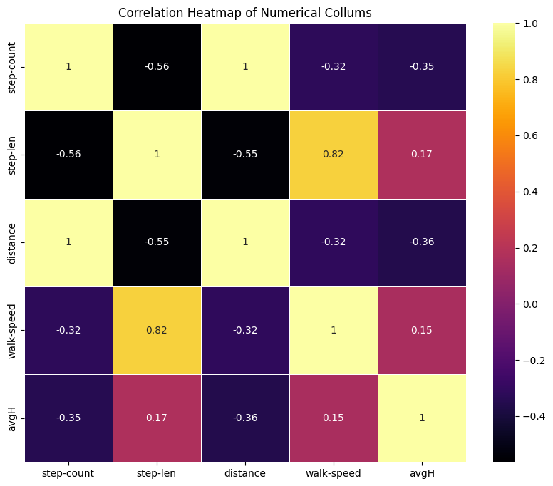
Here we have the extended version of the health data correlation matrix with average hours of music, we see that there is a -0.35 negative correlation between my step counts and avarage music listening time.

Slide 11
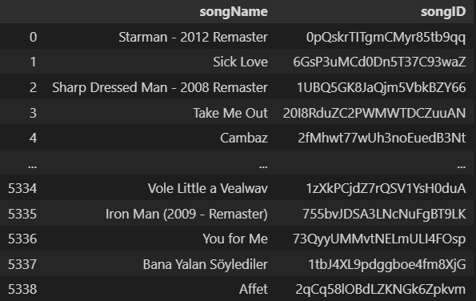
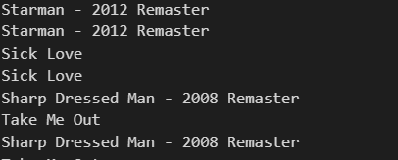
After some general analysis on my Spotify data I started the setup for my hypothesis.
Firstly, I got rid of the duplicates on my data set, since I listen the same songs bunch of times.
Then, I matched the unique songs with their Spotify URI (a unique id for a song) with the help of Spotify API.

Slide 12
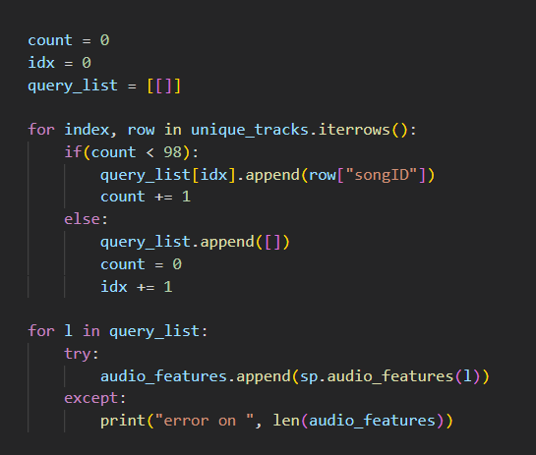
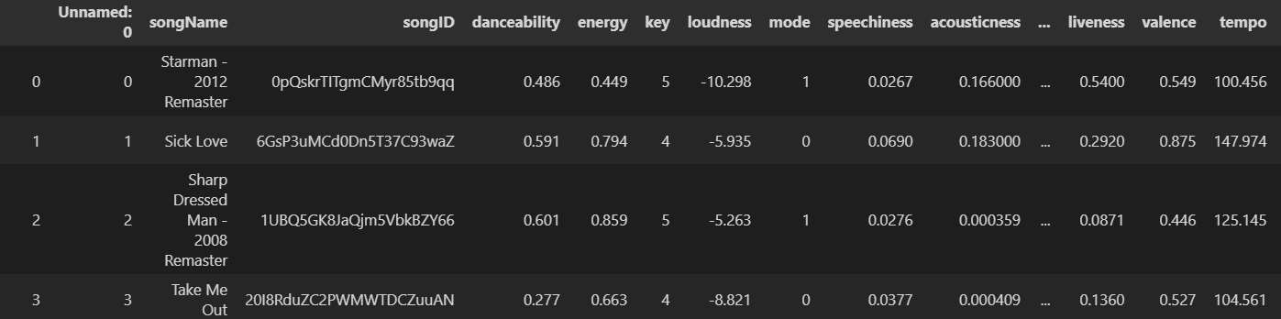
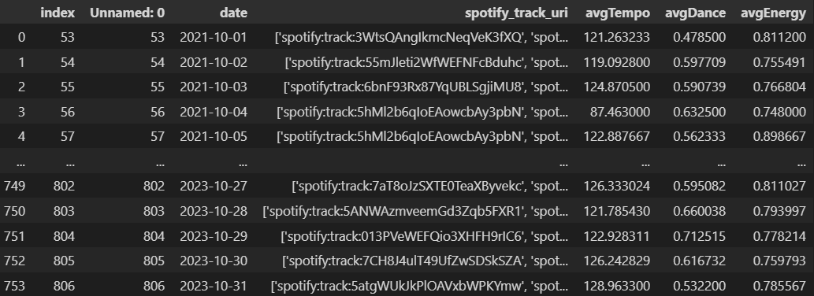
I packed the 5000 unique songs in 100 song query packages to get their audio features from the API. So that i would only need 50 API requests instead of 5000 (in which Spotify blocks you).
With that data I created another data set in which includes all the data features for the unique songs that I listened. With the combination of this data set and my daily stream history I calculated the daily average values of Tempo, Dance and Energy.

Slide 13

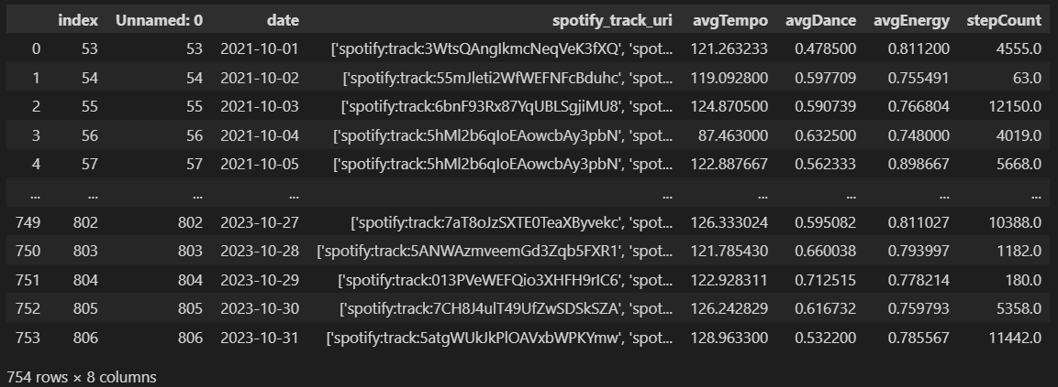
After I have done my researches on both data sets I combined them and created a data set which involves daily music attributes and step counts.

Slide 14
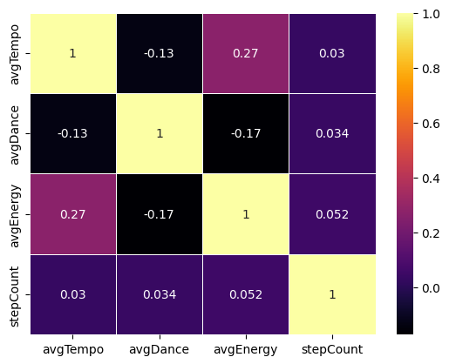
I ended up with this correlation matrix.
Which clearly shows that there is nearly zero correlation between my step count and energy and tempo of the music with my daily step count.

Slide 15
In conclusion I have rejected my Null Hypotesis that:
«My step count increases according to the avarage energy and tempo of the music I have listened that day.»
I concluded that there is nearly no relation between the energy and tempo attributes of the music's I listen and my daily average activity.

Slide 16
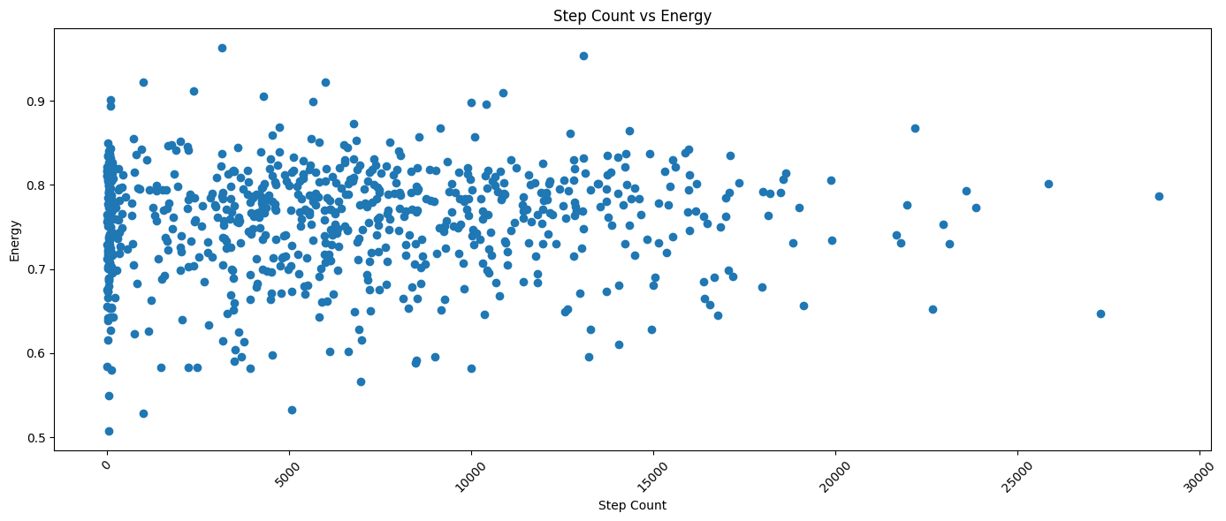
Some Additional Data
A totally random distribution.

Slide 17
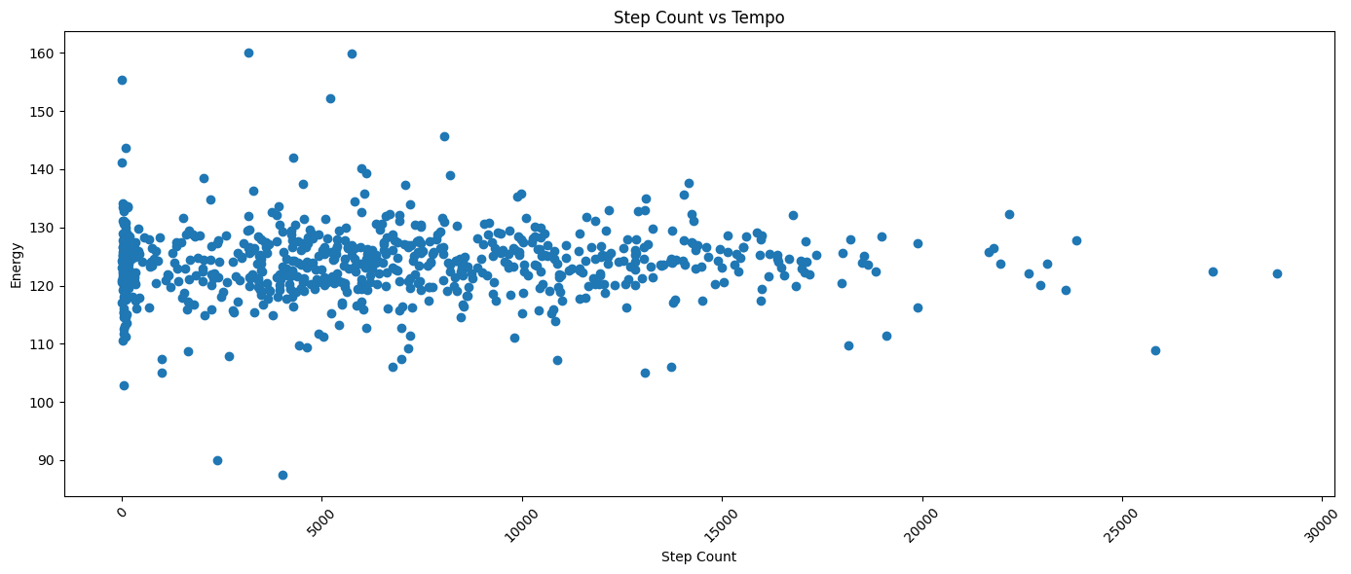
Similar distribution here as well.

Slide 18
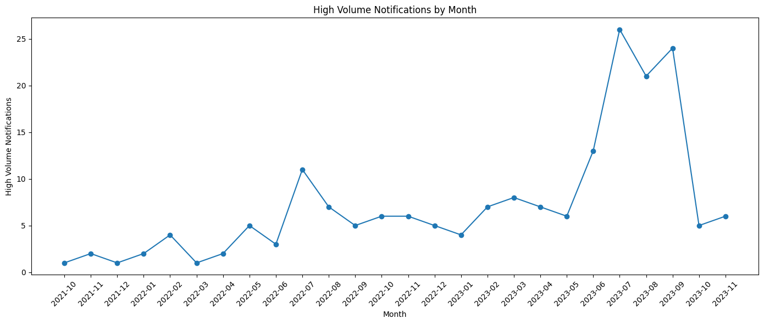
By this correlation it can be stated that I tend to listen my music loud when I am walking.

Slide 19
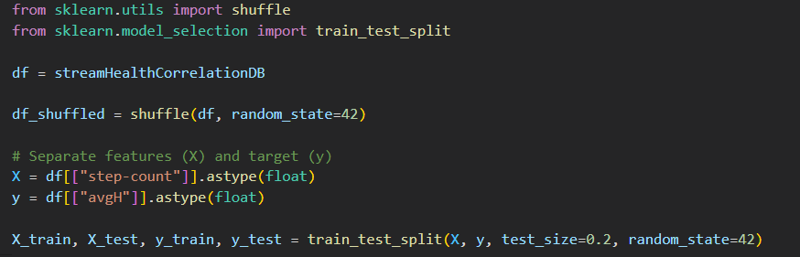
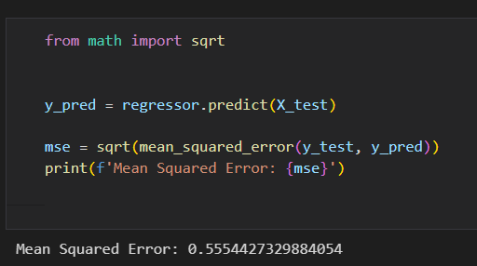
I also tried to came up with a ML model which will predict the hours of music I listen based on step count but since I did not have enough data the model became an overfitted model, so I gave up on that idea.

Slide 20
Thank you for your time.

