Slide 1
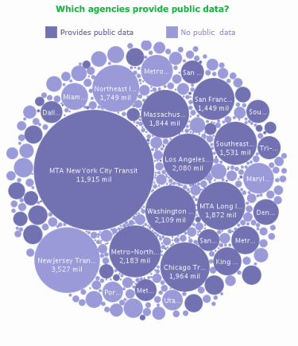

Public Data and Data Mining Competitions – what are the Lessons?
Gregory Piatetsky-Shapiro
KDnuggets

Slide 2
My Data
PhD (‘84) in applying Machine Learning to databases
Researcher at GTE Labs – started the first project on Knowledge Discovery in Databases in 1989
Organized first 3 Knowledge Discovery and Data Mining (KDD) workshops (1989-93), cofounded Knowledge Discovery and Data Mining (KDD) conferences (1995)
Chief Scientist at 2 analytics startups 1998-2001
Co-founder SIGKDD (1998), Chair, 2005-2009
Analytics/Data Mining Consultant, 2001-
Editor, KDnuggets, 1994-, full time 2001-

Slide 3
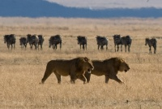
Patterns – Key Part of Intelligence
Evolution: Animals better able to find, use patterns – more likely to survive
People have an ability and desire to find patterns
People “pattern intuition” does not scale
Science is what helps separate valid from invalid patterns (astrology, fake cures, …)
Horoscope for August: The Mars-Jupiter tandem in Cancer seems to indicate a febrile activity related to the accommodation, houses, premises, real estate investments. You'll build, redecorate, move out, change your furniture, refurbish, set up your yard or garden …

Slide 4
Outline
What do we call it?
Data competitions – short history
Government and Public Data
Big Data Hype and Reality

Slide 5
What do we call it?
Same Core Idea:
Finding Useful Patterns in Data
Different
Emphasis
Statistics
Data mining
Knowledge Discovery in
Data (KDD)
Business Analytics
Predictive Analytics
Data Science
Big Data
… ?

Slide 6
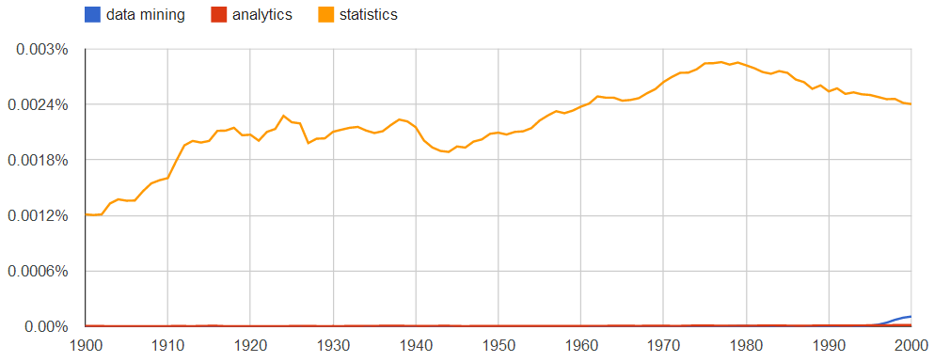
20th Century Statistics dominates
Google Ngrams, smoothing=1
statistics
Note: Google Ngrams are case-sensitive. Here used lower case as more
representative

Slide 7
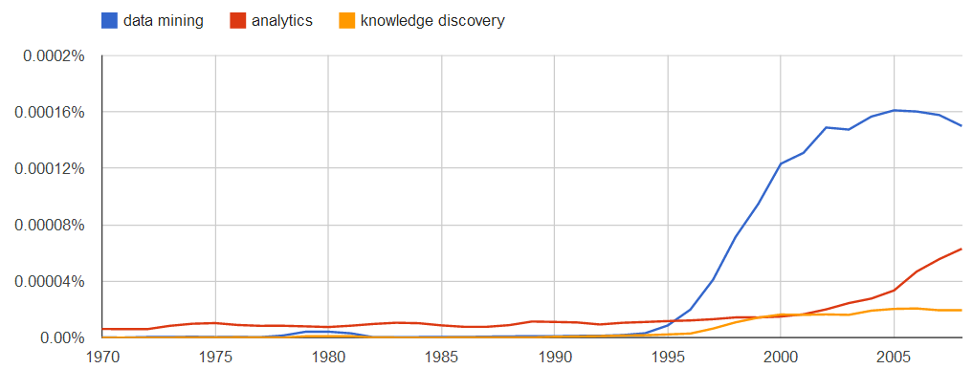

“Data Mining” surges in 1996, peaks in 2004-5
Google Ngrams, smoothing=1
data mining
analytics
KDD-95, 1st Conference on Knowledge Discovery and Data Mining, Montreal
Advances in Knowledge Discovery and Data Mining, AAAI/MIT Press, 1996, Eds: U. Fayyad, G. Piatetsky-Shapiro, P. Smyth, and R. Uthurusamy

Slide 8
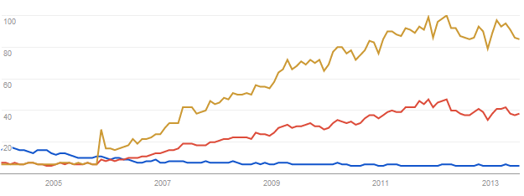
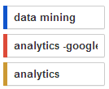
Analytics surges in 2006, after Google Analytics introduced
Slow-down in analytics in 2012?
Google Trends, Jan 2005 – July 2013
analytics
“analytics - google” is 50% of “analytics” searches
Google Analytics introduced,
Dec 2005

Slide 9
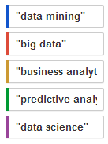
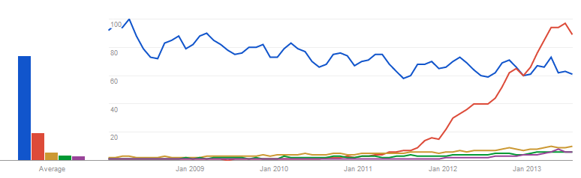
In 2013: Big Data > Data Mining > Business Analytics > Predictive Analytics > Data Science
Big Data
slowdown?
Data mining
Big Data
Google Trends search, Jan 2008 - July 2013

Slide 10
History
1900 - Statistics
1960s Data Mining = bad activity, data “dredging”
1990 - “Data Mining” is good, surges in 1996
2003 - “Data Mining” peaks, image tarnished (Total Information Awareness, invasion of privacy)
2006 - Google Analytics appears
2007 - Business/Data/Predictive Analytics
2012 - Big Data surge
2013 - Data Science
2015 - ??

Slide 11
Data Competitions – Short History

Slide 12
1st Data Mining Competition: KDD-CUP 1997
Organized by Ismail Parsa (then at Epsilon)
Task: given data on past responders to fund-raising, predict most likely responders for new campaign
Data:
Population of 750K prospects, 300+ variables
10K (1.4%) responded to a broad campaign mailing
Competition file was a stratified sample of 10K responded, 26K non-resp. (28.7% response rate)
Big effort on leaker detection (false predictors)
KDD Cup was almost cancelled - several times Charles Elkan found leakers in training data
Notes:
7

Slide 13
Evaluating Targeted List: Cumulative Pct Hits (Gains)
Cumulative % Hits
Pct list
5% of random list have 5% of targets,
but 5% of model ranked list have 21% of targets
Cum Pct Hits (5%,model)=21%.

Slide 14
KDD-CUP Participant Statistics
45 companies/institutions participated
23 research prototypes
22 commercial tools
16 contestants turned in their results
9 research prototypes
7 commercial tools
Evaluation: Best Gains (CPH) at 40% and 10%
Joint winners:
Charles Elkan (UCSD) with BNB, Boosted Naive Bayesian Classifier
Urban Science Applications, Inc. with commercial Gain, Direct Marketing Selection System
3rd place: MineSet (SGI, Ronny Kohavi)
Notes:
9

Slide 15
KDD-CUP Results Discussion
Top finishers very close
Naïve Bayes algorithm was used by 2 of the top 3 contestants (BNB and 3rd place MineSet)
Naïve Bayes tools did little data preprocessing, used small number of variables
Urban Science implemented a tremendous amount of automated data preprocessing and exploratory data analysis and developed more than 50 models in an automated fashion to get to their results
Notes:
22

Slide 16
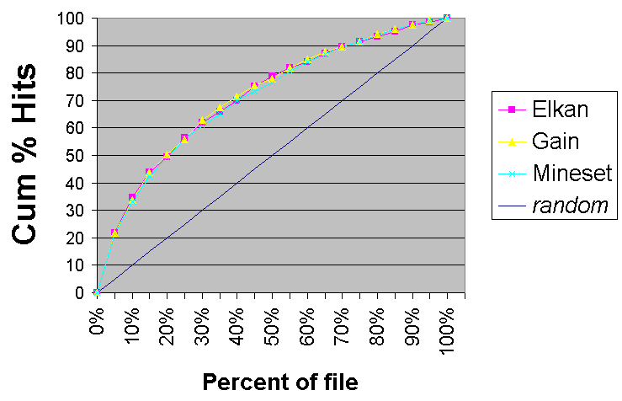
KDD Cup 1997: Top 3 results
Top 3 finishers
are very close

Slide 17
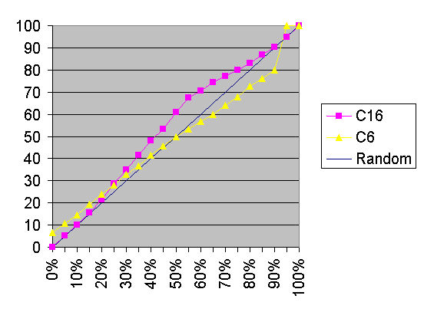
KDD Cup 1997 – worst results
Note that the worst
result (C6) was actually
worse than random.
Competitor names were
kept anonymous,
apart from top 3 winners

Slide 18
KDD Cup Lessons
Data Preparation is key, especially eliminating “leakers” (false predictors)
Avoid overfitting the test data
Simple models work well for predicting human behavior

Slide 19
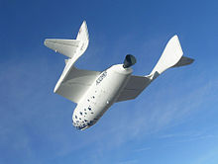
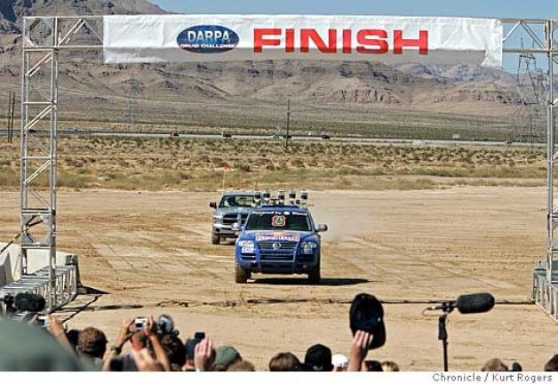
Big Competition Successes
Ansari X-Prize 2004: Spaceship One went to space twice in 2 weeks
DARPA Grand Challenge, 2005: 150 mi Off-road robotic car navigation

Slide 20


Netflix Prize
Started in 2006, with 100M ratings, 500K users, 18K movies, $1M prize
Goal: reduce RMSE error in “star” rating by 10% (was 0.95 for Netflix own system Cinematch)
Public training data, public & secret test sets
Predicted
Actual

Slide 21
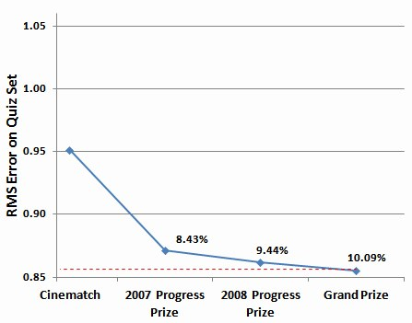
Netflix Prize Milestones
In just one week, WXYZ consulting team beat Netflix system with RMSE 0.9430
Progress in 2007-8 was very slow:
In 2007 KDnuggets Poll
32% thought prize will
never be won
Took 3 years to reach
10% improvement

Slide 22
Netflix Prize Winners
Winning team used a complex ensemble of many algorithms
Two teams had exactly the same RMSE of 0.8567, but winner submitted 20 minutes earlier !

Slide 23
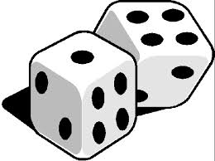
Netflix Prize lessons, 1
Competitions work
Limits to predicting human behavior – inherent randomness, noisy data
Privacy concerns
Researchers found a few people with matching IMDB and Netflix ratings – potential privacy breach
4 Netflix users sued
Netflix Prize Sequel – cancelled

Slide 24
Netflix Prize lessons, 2
Winning algorithm was too complex, too tailored to specific data set, never used ☹
Netflix blog, Apr 2012
A basic SVD algorithm, proposed by Simon Funk (KDnuggets Interview w. Simon Funk) got ~6% improvement
SVD++ version by Yehuda Koren & winning team reached ~ 8% improvement, was used by Netflix

Slide 25
Netflix Prize lessons, 3
Wrong question was asked ! (Minimizing RMSE of predicted vs actual ratings)
RMSE gives big penalty for errors > 2 stars, so an algo. that fails big a few times will be worse than an algo. that is often worse by 1.
Errors are not equal, but RMSE treats 2 vs 3 stars same as 4 vs 5 or 1 vs 2.
Also, Netflix Instant became more popular
Better question would be “what do you like to watch” (anything on Instant likely to rank > 3)

Slide 26
Focus on the right question ? and the right GOAL

Slide 27
Kaggle Competition Platform
Launched by Anthony Goldbloom in 2010
Quickly became the top platform for competitions
Few people know of TunedIT competition platform launched in 2009
Kaggle in Class – free for Universities
Achieved 100,000 members in July 2013

Slide 28
Kaggle Successes
Allstate competition: Winner model was 270% more accurate than baseline
Identified sound of the endangered North American Right whale in audio recordings
GE FlightQuest
Heritage Health Prize - $3M competition, 2011-13
But … Competitions - very time consuming

Slide 29
Kaggle Business Model
Initial business model - % of prize
Kaggle Job Boards (currently free)
Kaggle Connect: Offers consulting with top 0.5% of Kagglers (at $300/hr ? see post), or $30-100K/month (IW , Mar 2013)
Private competitions (Masters) open to top Kagglers
Heritage Health Prize 2

Slide 30
Winning on Kaggle
Kaggle Chief Scientist: Specialist knowledge – useless & unhelpful (Slate, Dec 2012)
Big-data approaches
Use good tools: R, Random forests
Curiosity, Creativeness, Persistence, Team, Luck? (also Quora answer)
Many (most?) winners – not professional data scientists (physicists, math profs, actuary) (RW, Apr 2012)

Slide 31
”your Ivy League diploma and IBM resume don't matter so much as my Kaggle score”
Almost true

Slide 32
Data: Public, Government, Portals, Marketplaces

Slide 33
Public Data
www.KDnuggets.com/datasets/
Government, Federal, State, City, Local and public data sites and portals
Data APIs, Hubs, Marketplaces, Platforms, Portals, and Search Engines.
Data Markets: DataMarket
Data Platforms: Enigma, InfoChimps (acq. By CSC), Knoema, Exversion, …
Data Search Engines: Qandl , qunb, Zanran
Location: Factual
People and places: Freebase

Slide 34
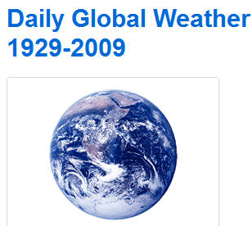
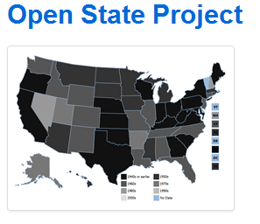
Public and Government Data
Datamob.org: tracks government data in developer-friendly format
data about U.S. state legislative activities, including bill summaries, votes, sponsorships, legislators and committees.

Slide 35
US Project Open Data
In May 2013, White House announced Project Open Data
“information is a valuable national asset whose value is multiplied when it is made easily accessible to the public”.
“The Executive Order requires that, going forward, data generated by the government be made available in open, machine-readable formats, while appropriately safeguarding privacy, confidentiality, and security.”

Slide 36
Using Public Data
Google – biggest success ?
Data Science for Social Good (Chicago) (Fast Company, Aug 2013)
predict when bikeshare stations run out of bikes
forecast local crime
warn local hospitals about impending heart attacks

Slide 37
Big Data
2nd Industrial Revolution
Do old activities better
Create new activities/businesses

Slide 38
Doing Old Things Better
Application areas
Direct marketing/Customer modeling
Churn prediction
Recommendations
Fraud detection
Security/Intelligence
…
Improvement will be real, but limited because of human randomness
Competition will level companies

Slide 39
Big Data Enables New Things !
Google – first big success of big data
Social networks (Facebook, Twitter, LinkedIn, …) success depends on network size, i.e. big data
Location analytics
Health-care
Personalized medicine
Semantics and AI ?
Imagine IBM Watson, Google Now, Siri in 2023 ?

Slide 40
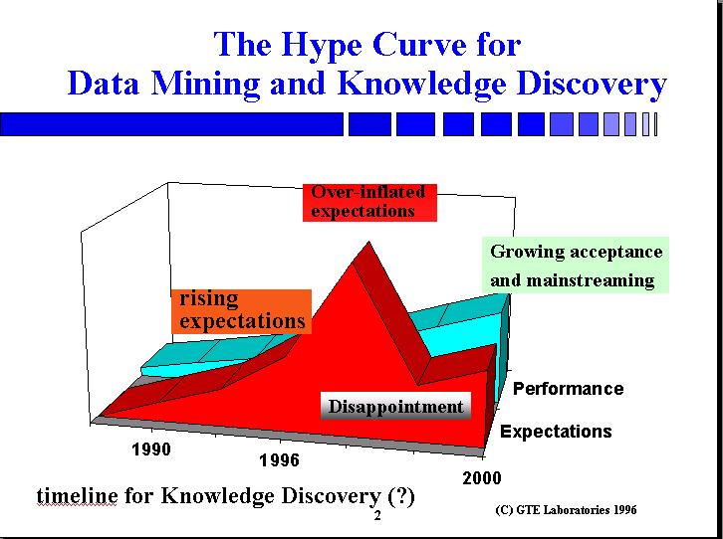

Slide 41
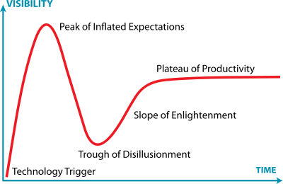

Big Data Bubble?
Big Data
Gartner Hype Cycle

Slide 42
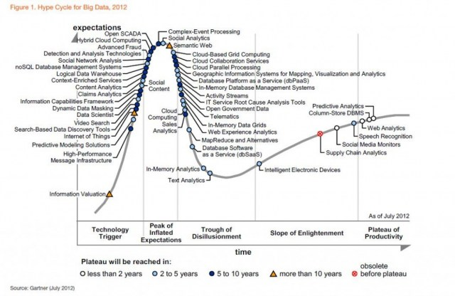
Gartner Hype Cycle for Big Data, 2012
Social Analytics, 2-5
Social Network Analysis, 5-10
Data Scientist,
2-5 yrs
Predictive Analytics, <2
MapReduce & Alternative - Disillusionment
Notes:
Future is Bright for Big Data, but need use caution when evaluating claims

Slide 43

Questions?
KDnuggets: Analytics, Big Data, Data Mining
News, Jobs, Software, Courses, Data, Meetings, Publications, Webcasts, … www.KDnuggets.com/news
Subscribe to KDnuggets News email at www.KDnuggets.com/subscribe.html
: @kdnuggets
Email to editor1@kdnuggets.com

