Slide 1
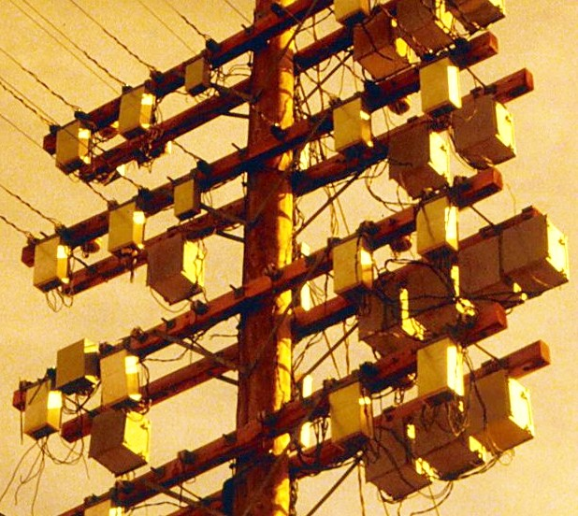
Power Line Communication
By
Petr Lavrenov Hany Chowdhury Oleg Kelner
https://the-electric-orphanage.com

Slide 2
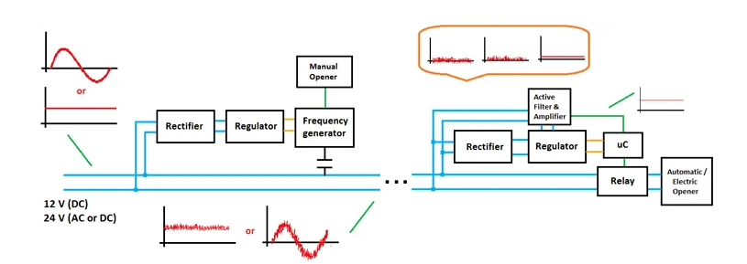
Basic Principle:
https://circuitdigest.com/article/what-is-power-line-communication-plc-and-how-does-it-work

Slide 3

M1 carrier telephone system
https://the-electric-orphanage.com

Slide 4
Challenges of PLC:
In the M1 carrier telephone system in 1925, Wolfe and co-authors identified three main development problems:
1) Understanding the line behaviour:
The high-frequency behaviour of power lines and related equipment had to be studied together with power companies.
2) Coupling to high-voltage lines:
A safe and efficient way was needed to connect carrier communication equipment to high-voltage conductors.
3) Developing the communication equipment:
Only after the line behaviour and coupling problems were understood could the actual communication circuits and devices be designed.

Slide 5

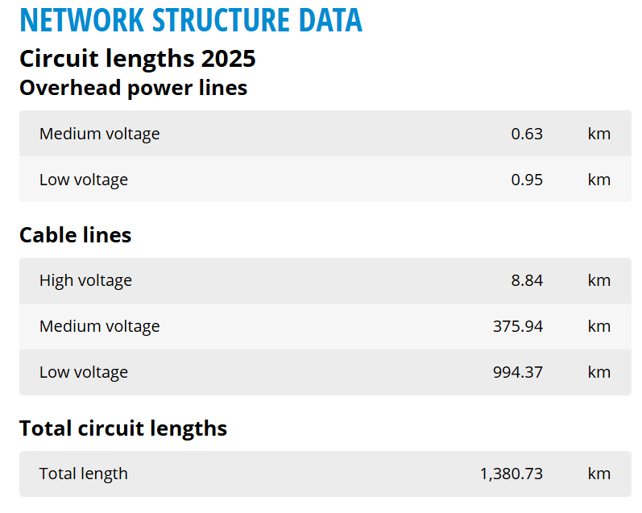
https://www.stadtwerke-lippstadt.com Translated With Google Translate

Slide 6
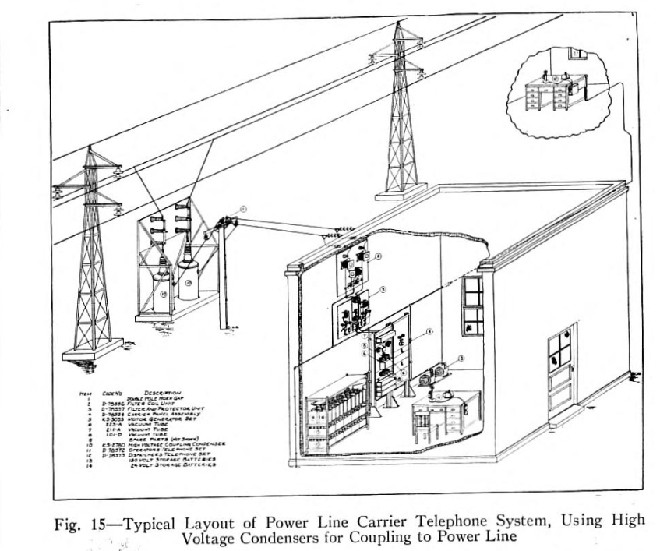
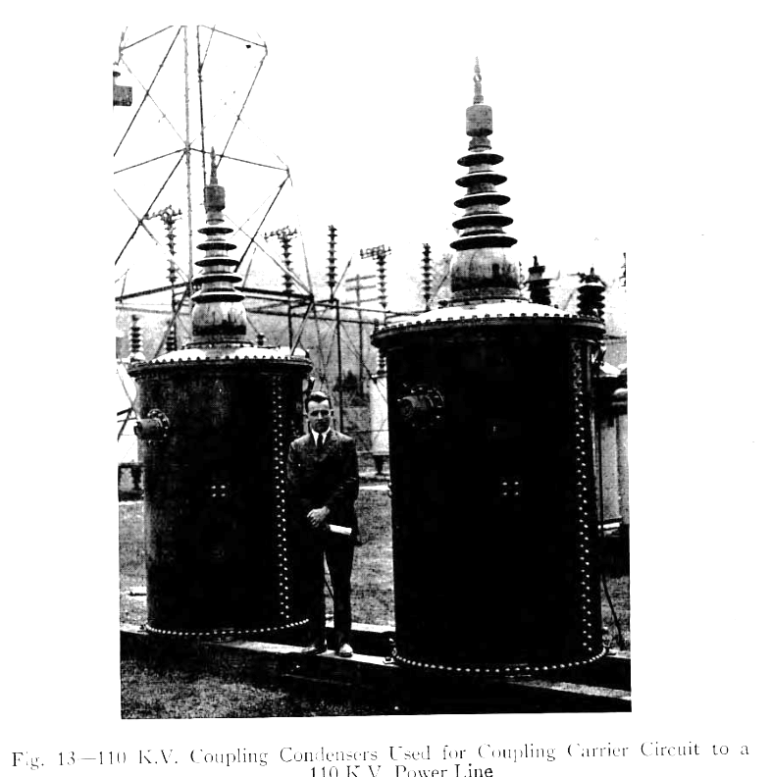
Carrier Telephony on High Voltage Power Lines - Wolfe, W. V.

Slide 7

Home Applications

Slide 8
Residential PLC Network Architecture
How it works
Internet
①
Router receives internet signal
Router
②
PLC adapter injects high-freq. data signal onto power wiring
③
Signal travels through household electrical cables
PLC Adapter (TX)
④
Filtering separates data from power at receiving end
⚡ Power Line (data + power)
⑤
Devices get network access — no new cables needed
PLC (RX)
PLC (RX)
Smart TV
IoT / PC
Based on [5] Ferreira et al., 1996

Slide 9


PLC vs. Wi-Fi
PLC
Wi-Fi
https://bit-electronix.eu/STRONG-POWERL1000WFDUOEUV2-Powerline-Adapter-1000-Mbit-s-HomePlug-AV2-mit-WLAN-Wi-Fi-5-Gigabit-Ethernet-Eingebaute-Steckdose-2er-Pack-Weiss/POWERL1000WFDUOEUV2-B?srsltid=AfmBOorKLFhGo9cOX4sqe6Q-D7m39huLvb1pVorQQd23vnpV79ju-zYB
https://img.magnific.com/premium-photo/new-wifi-router-white-wooden-table-against-brick-wall-space-text_495423-56020.jpg?semt=ais_hybrid&w=740&q=80

Slide 10
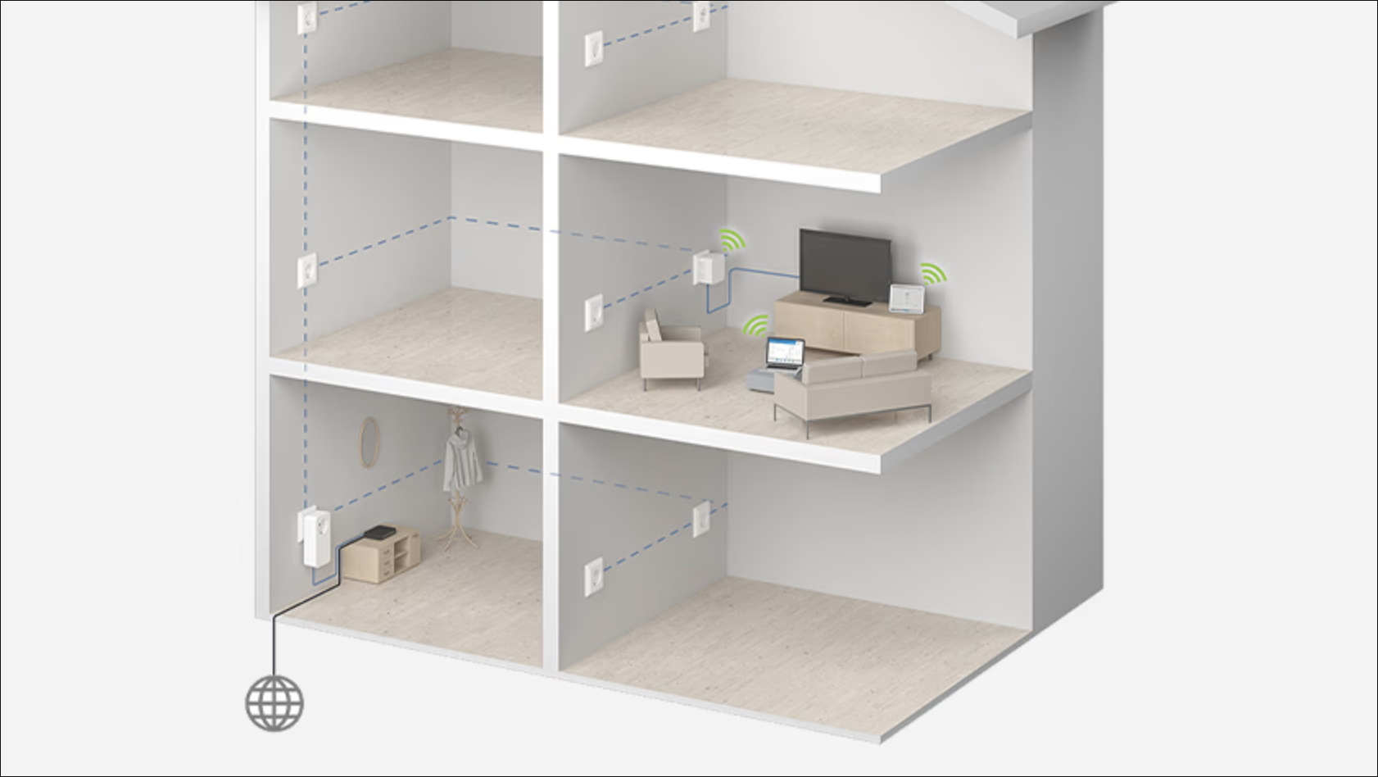
Mixed-medium applications
https://www.coolblue.de/beratung/was-ist-ein-powerline-adapter.html?srsltid=AfmBOoqSkLL6MXCIGVrYFFz0zFCm3wwPmQHnD2SPEzxj-_4C2faRWMKj

Slide 11
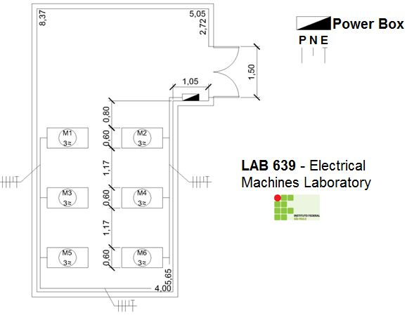
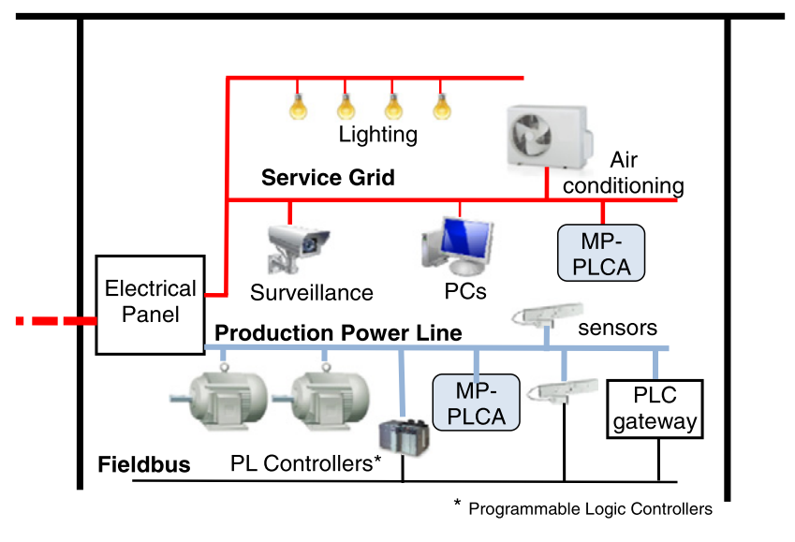
Industrial Applications
The main problem – heavy machinery, which causes interference.
S. C. Pereira, A. S. Caporali, and I. R. S. Casella, ‘Power line communication technology in industrial networks’, 2015 IEEE International Symposium on Power Line Communications and Its Applications, ISPLC 2015, pp. 216–221, Jul. 2015, doi: 10.1109/ISPLC.2015.7147617.

Slide 12
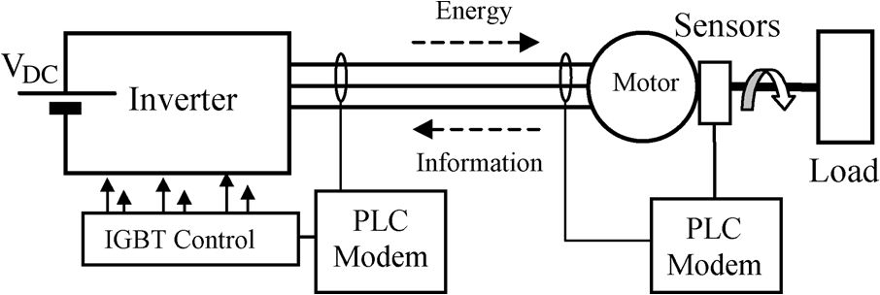
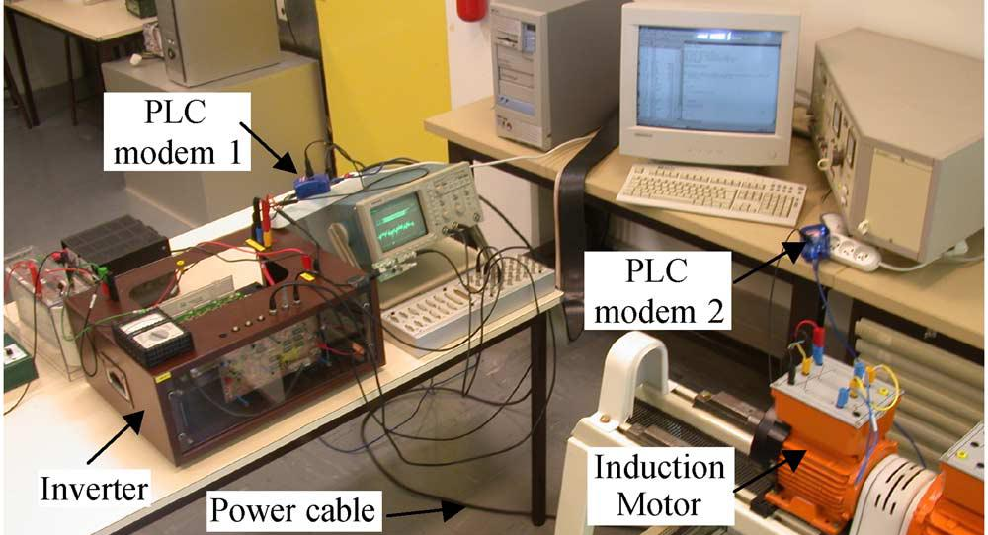
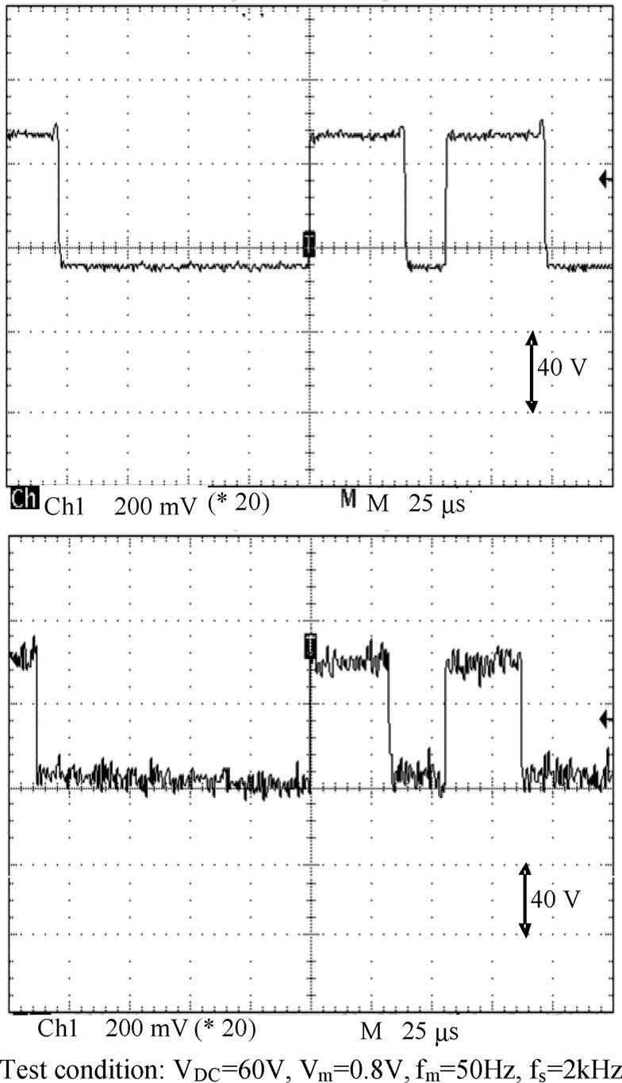
Case Study – PWM Motor Loop Back
N. Ginot, M. A. Mannah, C. Batard, and M. Machmoum, ‘Application of Power Line Communication for Data Transmission Over PWM Network’, IEEE Trans Smart Grid, vol. 1, no. 2, pp. 178–185, Sep. 2010, doi: 10.1109/TSG.2010.2053225.

Slide 13
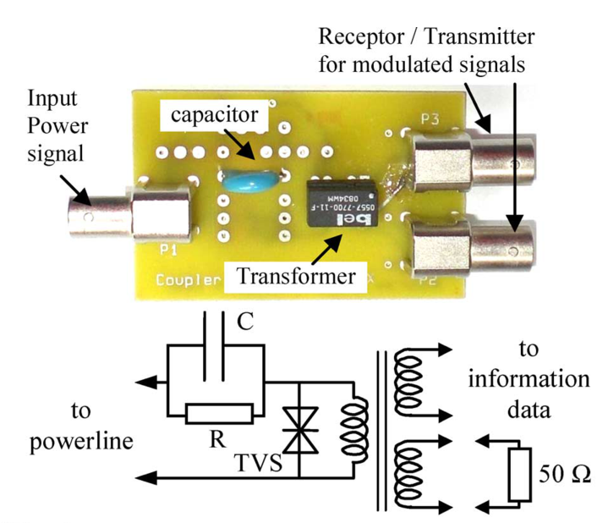
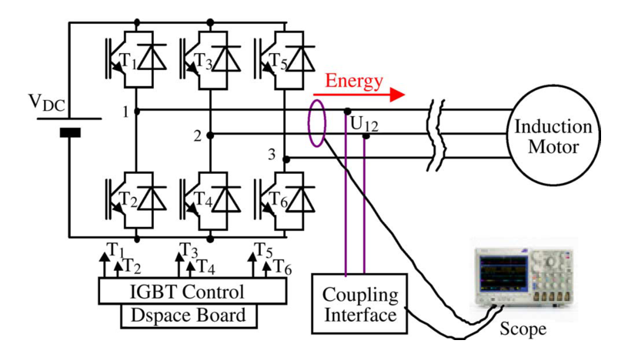
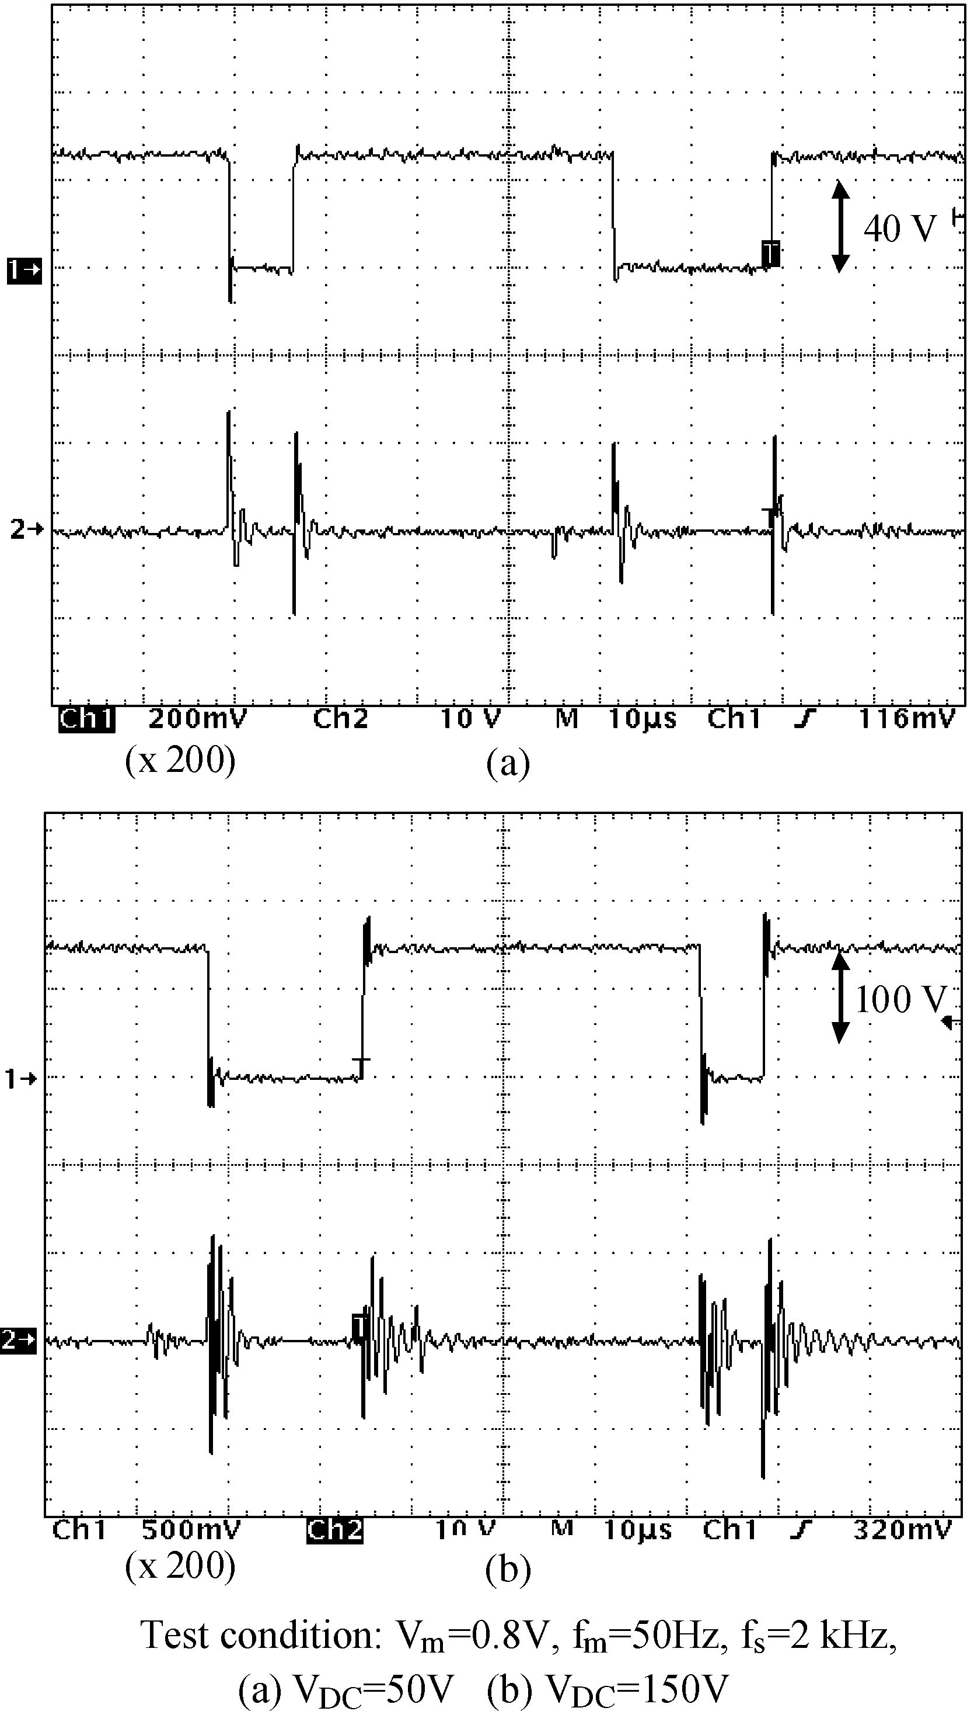
Case Study – PWM Motor Loop Back
N. Ginot, M. A. Mannah, C. Batard, and M. Machmoum, ‘Application of Power Line Communication for Data Transmission Over PWM Network’, IEEE Trans Smart Grid, vol. 1, no. 2, pp. 178–185, Sep. 2010, doi: 10.1109/TSG.2010.2053225.

Slide 14
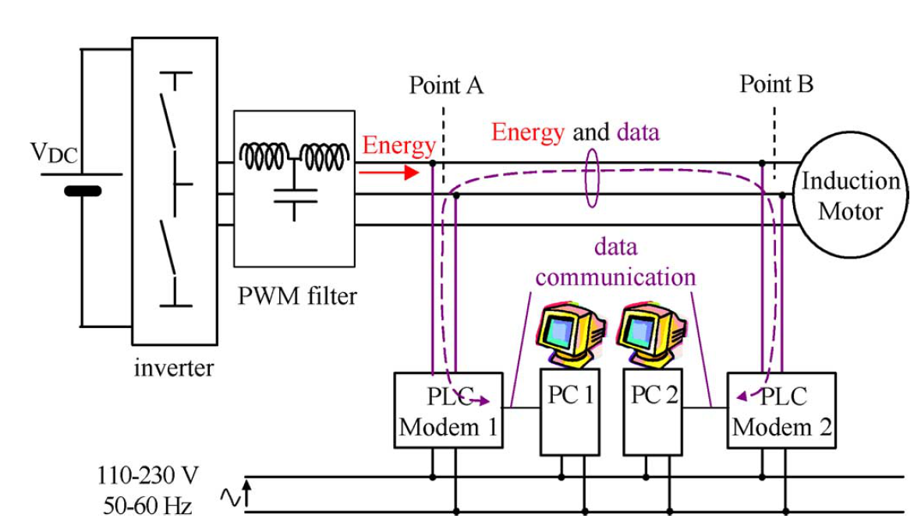
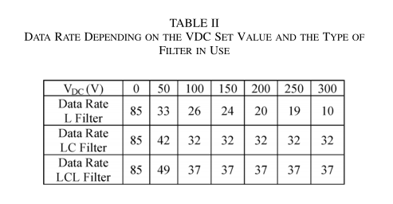
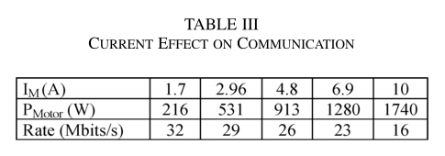
Industrial Applications
And even though authors manage to make it work, the decrease of the data rate with higher PWM operating voltages and load current still significant.
N. Ginot, M. A. Mannah, C. Batard, and M. Machmoum, ‘Application of Power Line Communication for Data Transmission Over PWM Network’, IEEE Trans Smart Grid, vol. 1, no. 2, pp. 178–185, Sep. 2010, doi: 10.1109/TSG.2010.2053225.

Slide 15


