Slide 1
Simulated Annealing Scheduling Algorithm
By Oleg Kelner

Slide 2
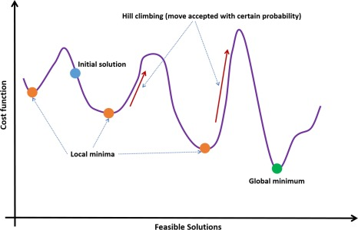
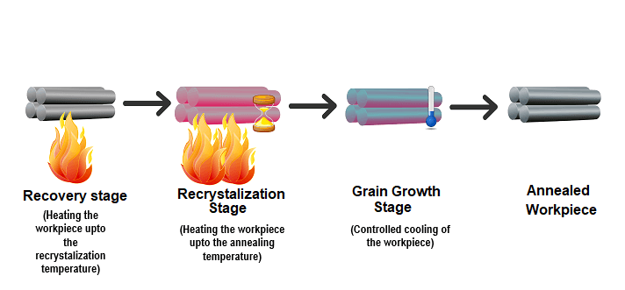
Algorithm
Goal: escape local minimum, optimize cost function
Underlying physics principle – annealing is a heat treatment process that alters a material's microstructure to increase its ductility, reduce hardness, and relieve internal stresses.
M. Blocho, ‘Heuristics, metaheuristics, and hyperheuristics for rich vehicle routing problems’, Smart Delivery Systems: Solving Complex Vehicle Routing Problems, pp. 101–156, Jan. 2020, doi: 10.1016/B978-0-12-815715-2.00009-9.
https://wanzhifence.com/why-choose-annealed-wire/

Slide 3
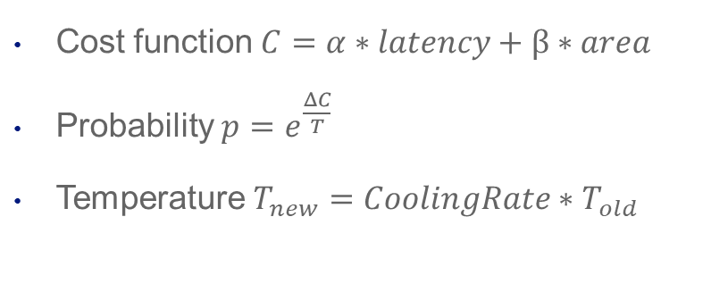
Algorithm
Cost function $C=α∗latency+β∗area$
Probability $p=e^{\frac{ΔC}{T}}$
Temperature $T_{new}=CoolingRate∗T_{old}$

Slide 4
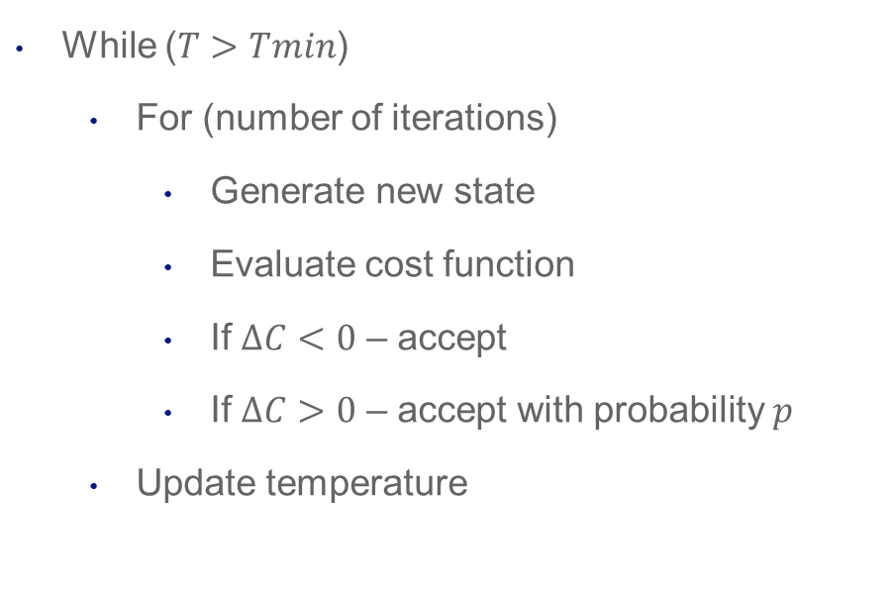
Algorithm
While ($T>Tmin$)
For (number of iterations)
Generate new state
Evaluate cost function
If $ΔC<0$ – accept
If $ΔC>0$ – accept with probability $p$
Update temperature

Slide 5
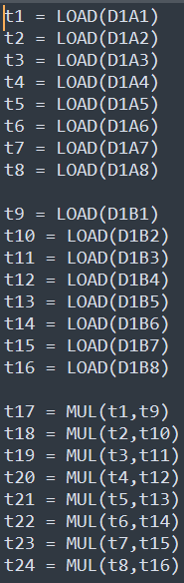
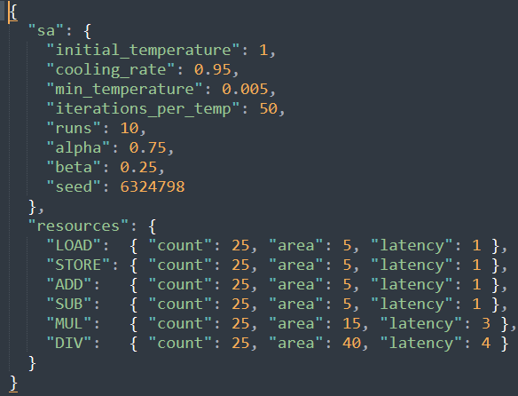
Implementation

Slide 6

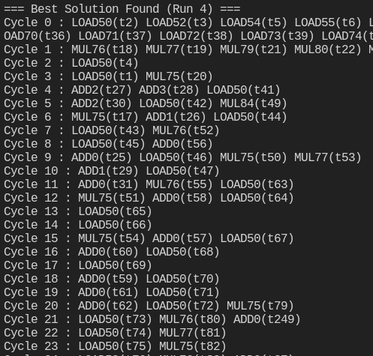
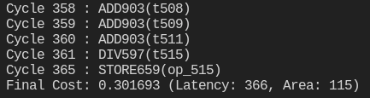
Implementation

Slide 7
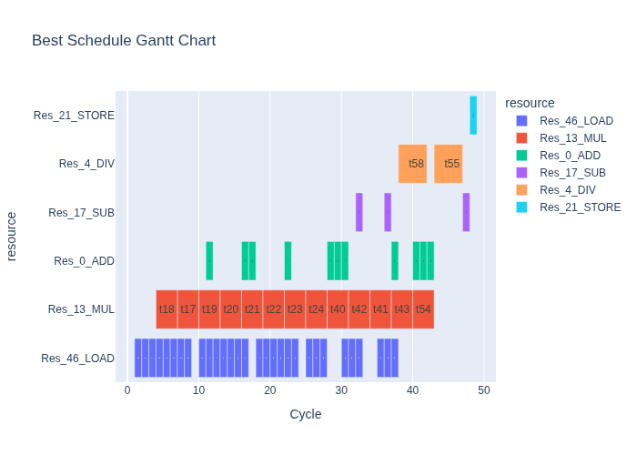
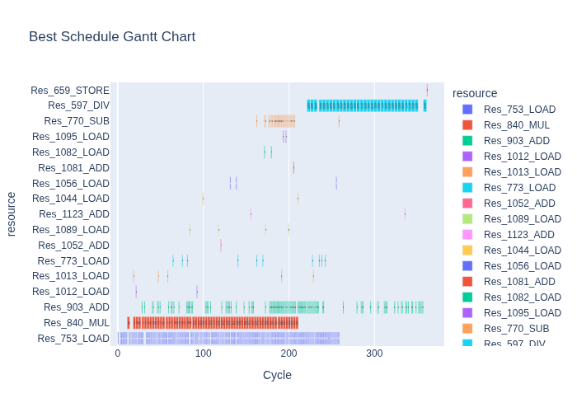
Implementation

Slide 8
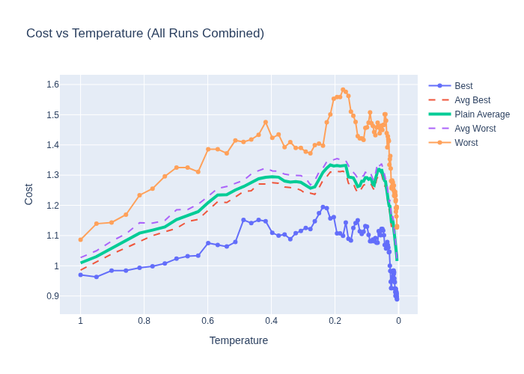

Implementation
$$C=0.5∗latency+0.5∗area$$

Slide 9
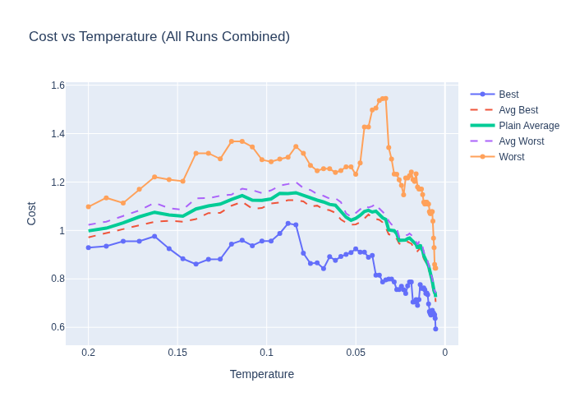
Implementation
$$C=0.5∗latency+0.5∗area$$

Slide 10
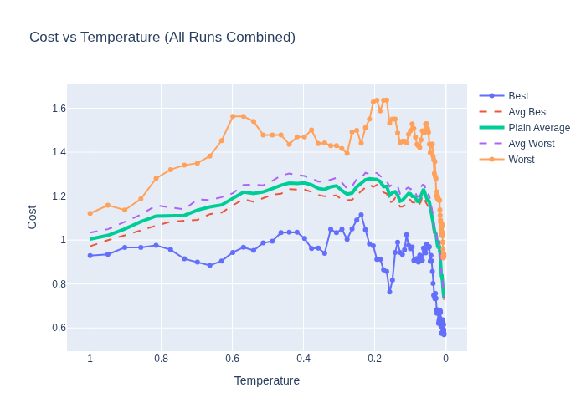

Implementation
$$C=0.25∗latency+0.75∗area$$

Slide 11
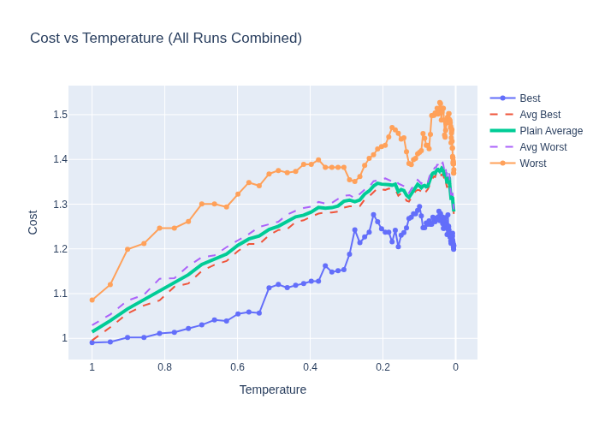

Implementation
$$C=0.75∗latency+0.25∗area$$

Slide 12



Implementation
$$C=0.25∗latency+0.75∗area$$
$$C=0.5∗latency+0.5∗area$$
$$C=0.75∗latency+0.25∗area$$
When cost function favors area optimization it is easier for the algorithm to “escape” potential minimum where latency is optimized

Slide 13
Conclusion
Overhead is small:
we store only two states
runtime depends mostly on the iteration number, not program length (no recursion)
Result is not guaranteed:
No guarantee after a single run if the result is true minimum

Slide 14
References
S. Devadas and A. R. Newton, ‘Algorithms for hardware allocation in data path synthesis’, IEEE Transactions on Computer-Aided Design of Integrated Circuits and Systems, vol. 8, no. 7, pp. 768–781, Jul. 1989, doi: 10.1109/43.31534.
ChatGPT (OpenAI, GPT-5.5) was used to assist in the development of the simulation code, literature analysis, and drafting of non-technical text. All generated content was reviewed and validated by the authors.

