Slide 1
The Dynamic Sporadic Server Algorithm
By Oleg Kelner

Slide 2
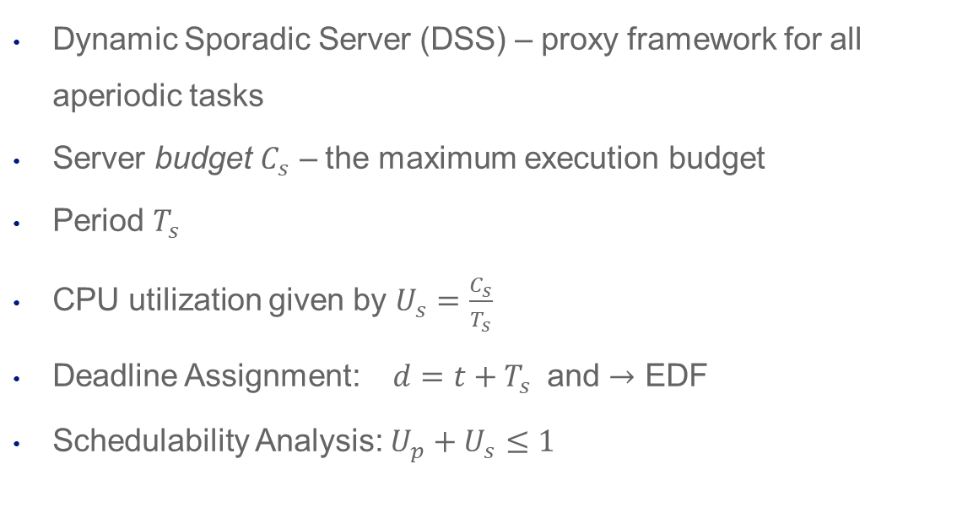
Algorithm
Dynamic Sporadic Server (DSS) – proxy framework for all aperiodic tasks
Server budget $C_{s}$ – the maximum execution budget
Period $T_{s}$
CPU utilization given by $U_{s}=\frac{C_{s}}{T_{s}}$
Deadline Assignment: $d=t+T_{s}$ and $→$ EDF
Schedulability Analysis: $U_{p}+U_{s}≤1$

Slide 3
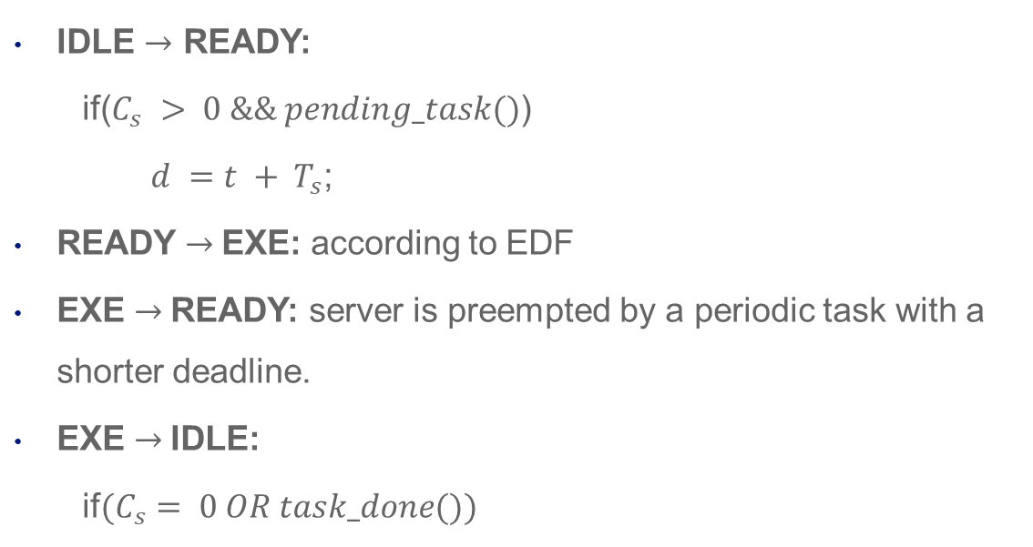
State Transitions
IDLE $→$ READY:
$\text{if}\text{(}C_{s} > 0 \&\& pending_task()$)
$d =t + T_{s}$;
READY $→$EXE: according to EDF
EXE $→$READY: server is preempted by a periodic task with a shorter deadline.
EXE $→$IDLE:
if$(C_{s}= 0 OR task_done())$

Slide 4
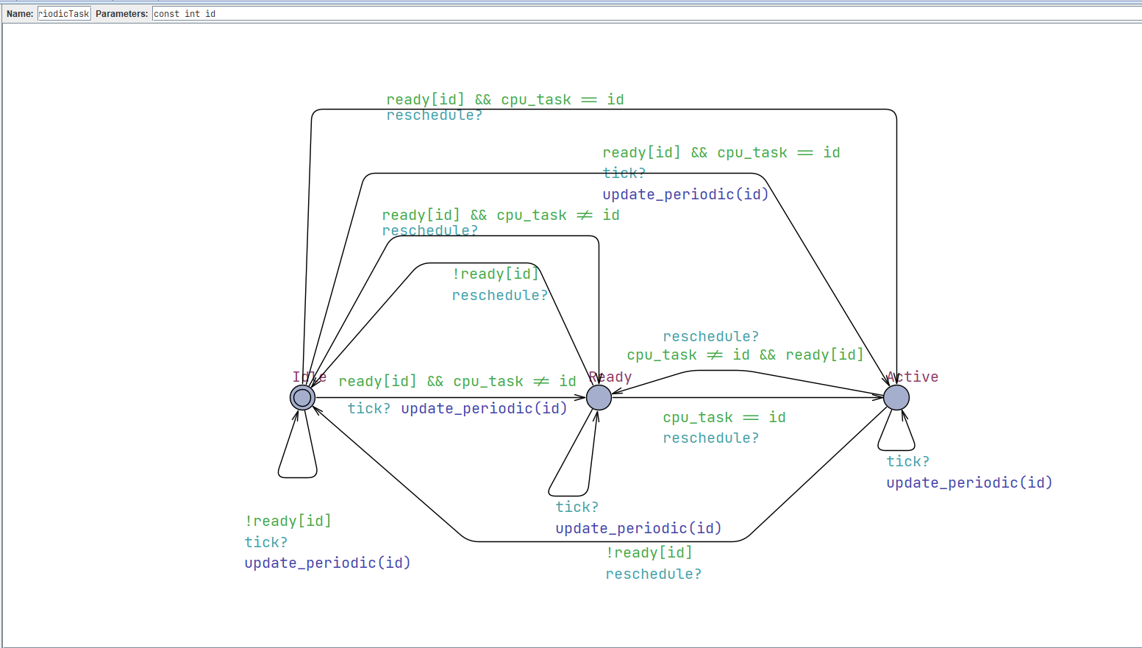
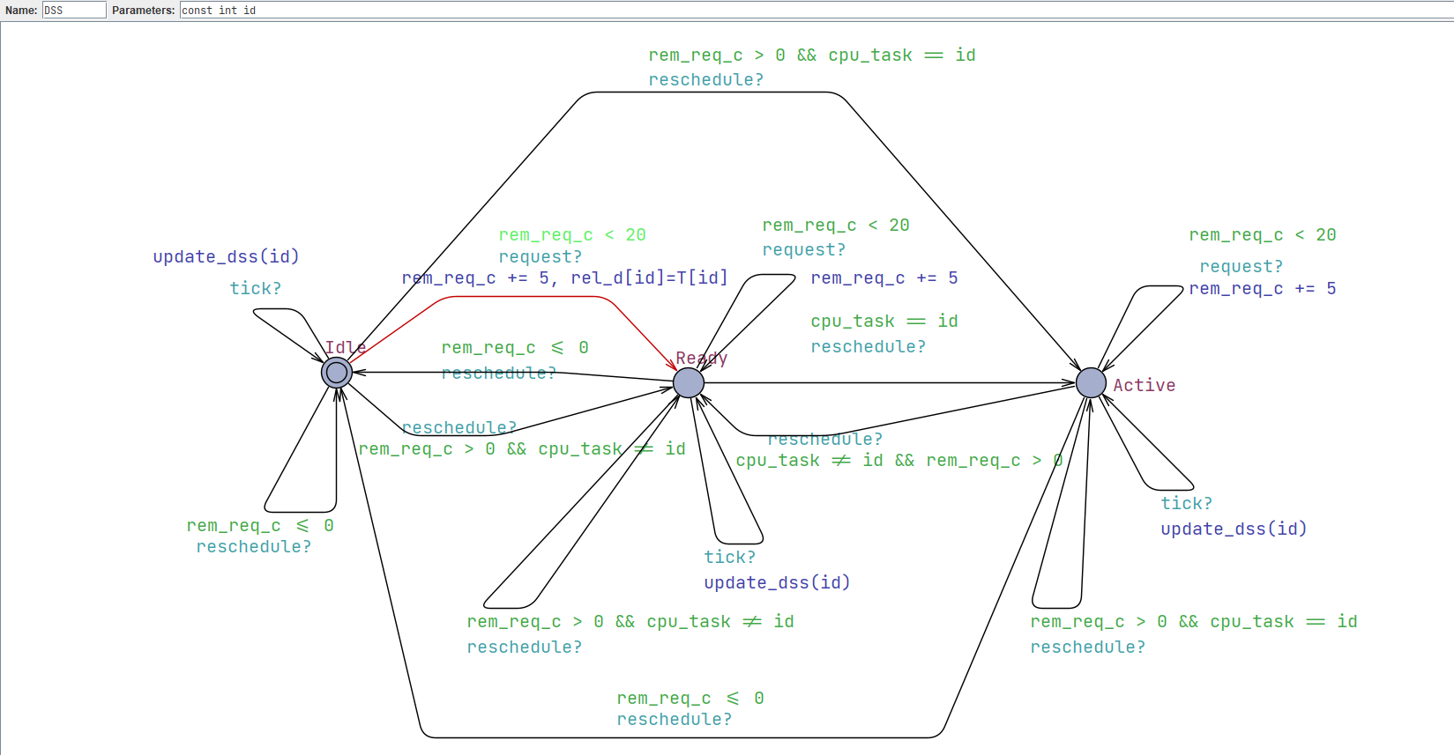
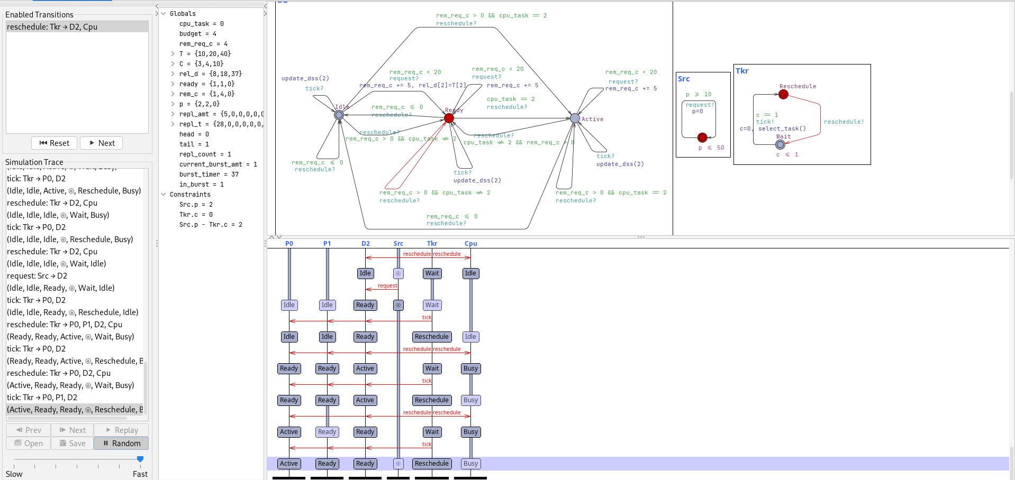
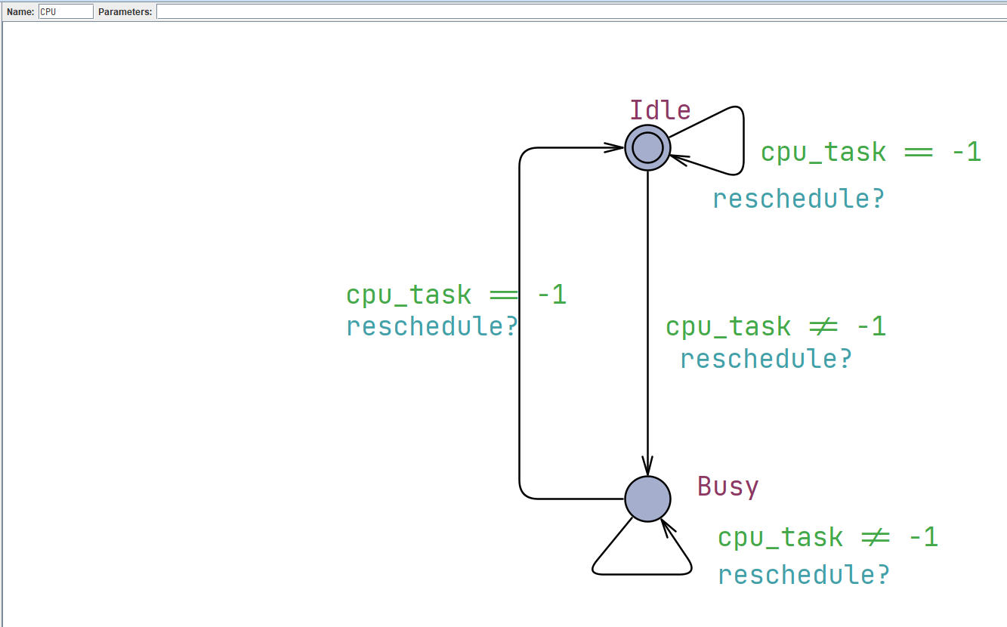
UPPAAL model

Slide 5
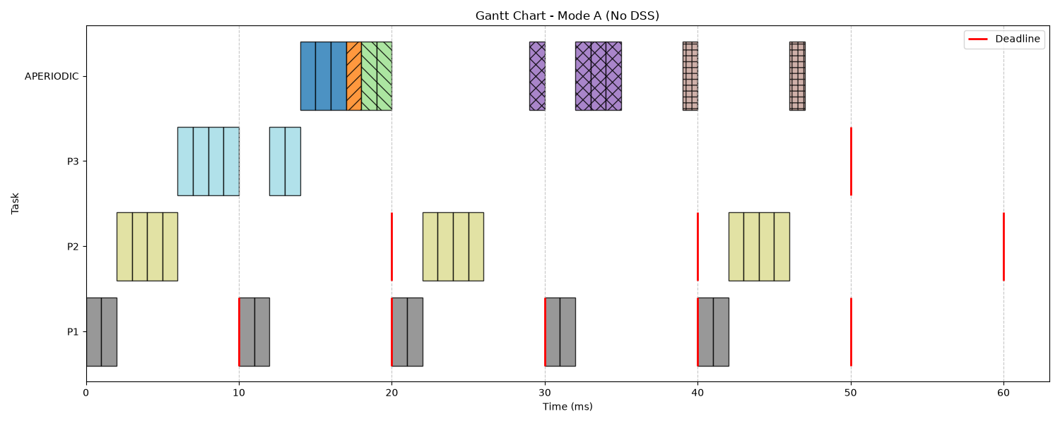
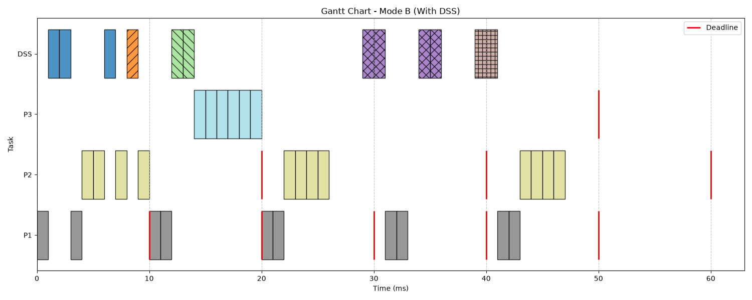

Implementation
$$C_{s}=2ms \\ T_{s}=5ms$$

Slide 6

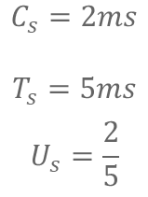
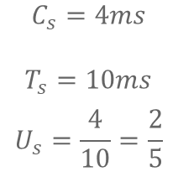
Implementation
$$C_{s}=4ms$$
$$T_{s}=10ms$$
$$U_{s}=\frac{4}{10}=\frac{2}{5}$$
$$C_{s}=2ms$$
$$T_{s}=5ms$$
$$U_{s}=\frac{2}{5}$$

Slide 7
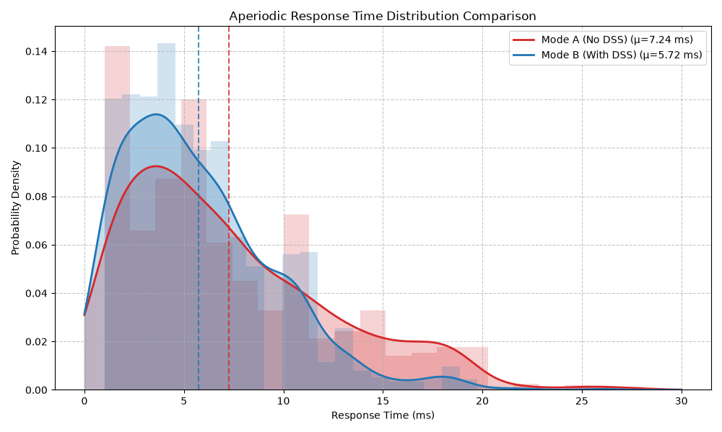
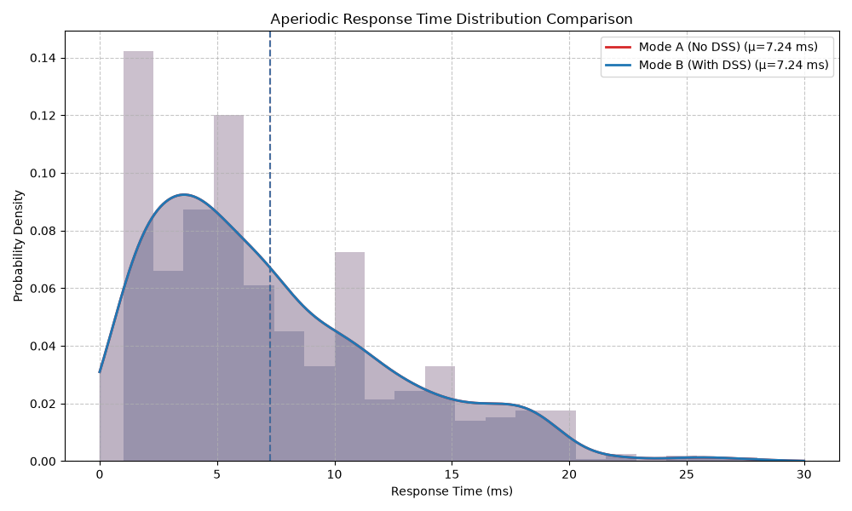
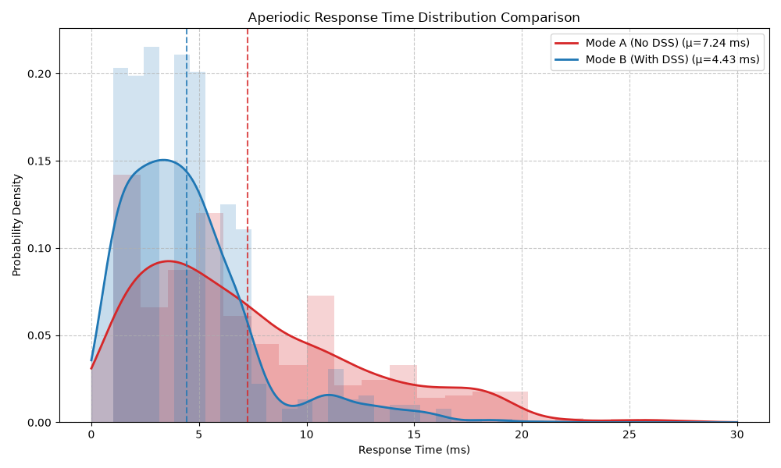
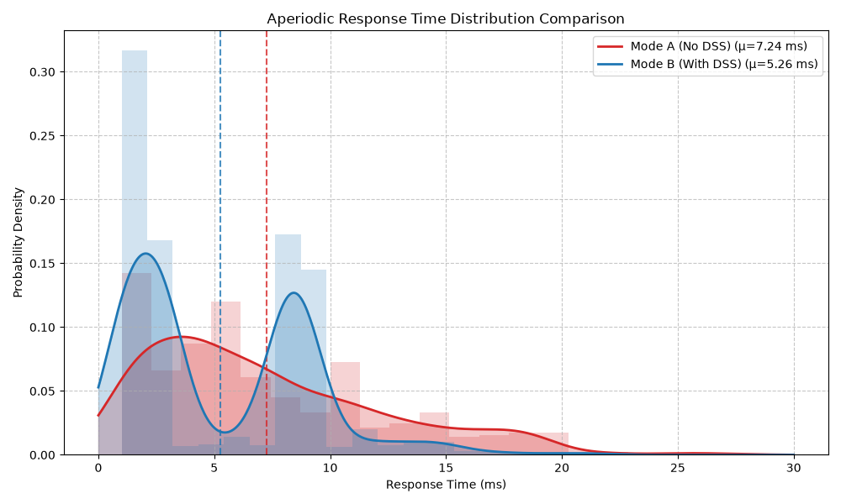




Implementation
$$C_{s}=12ms$$
$$T_{s}=25ms$$
$$U_{s}=\frac{12}{25}$$
$$C_{s}=24ms$$
$$T_{s}=50ms$$
$$U_{s}=\frac{12}{25}$$
$$C_{s}=6ms$$
$$T_{s}=13ms$$
$$U_{s}=\frac{11.54}{25}$$
$$C_{s}=3ms$$
$$T_{s}=7ms$$
$$U_{s}=\frac{10.71}{25}$$

Slide 8
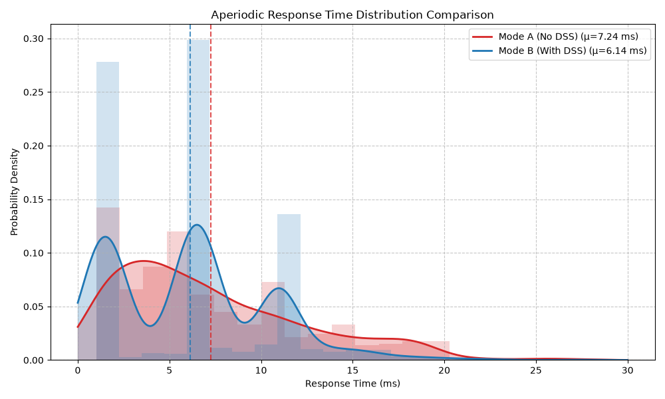
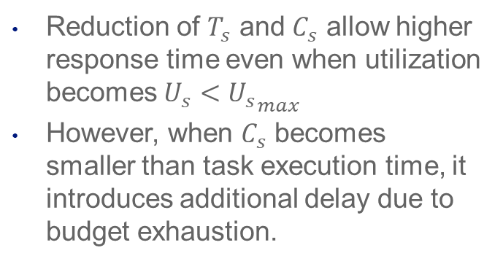
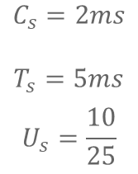


Implementation
$$C_{s}=6ms$$
$$T_{s}=13ms$$
$$U_{s}=\frac{11.54}{25}$$
$$C_{s}=3ms$$
$$T_{s}=7ms$$
$$U_{s}=\frac{10.71}{25}$$
Reduction of $T_{s}$ and $C_{s}$ allow higher response time even when utilization becomes$U_{s}<{U_{s}}_{max}$
However, when $C_{s}$ becomes smaller than task execution time, it introduces additional delay due to budget exhaustion.
$$C_{s}=2ms$$
$$T_{s}=5ms$$
$$U_{s}=\frac{10}{25}$$

Slide 9
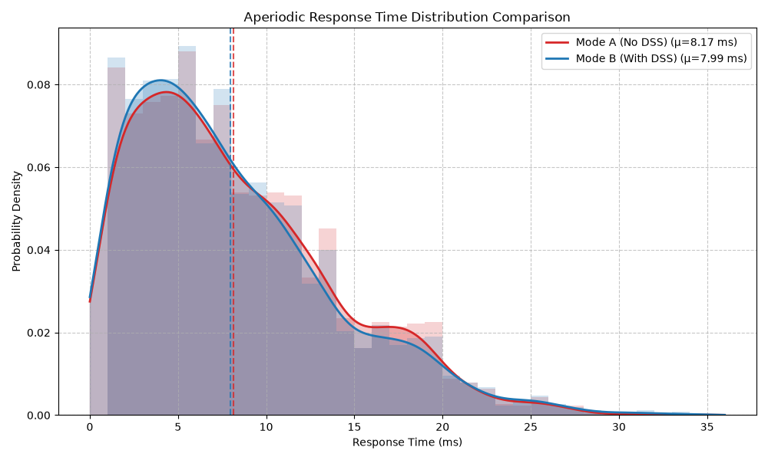
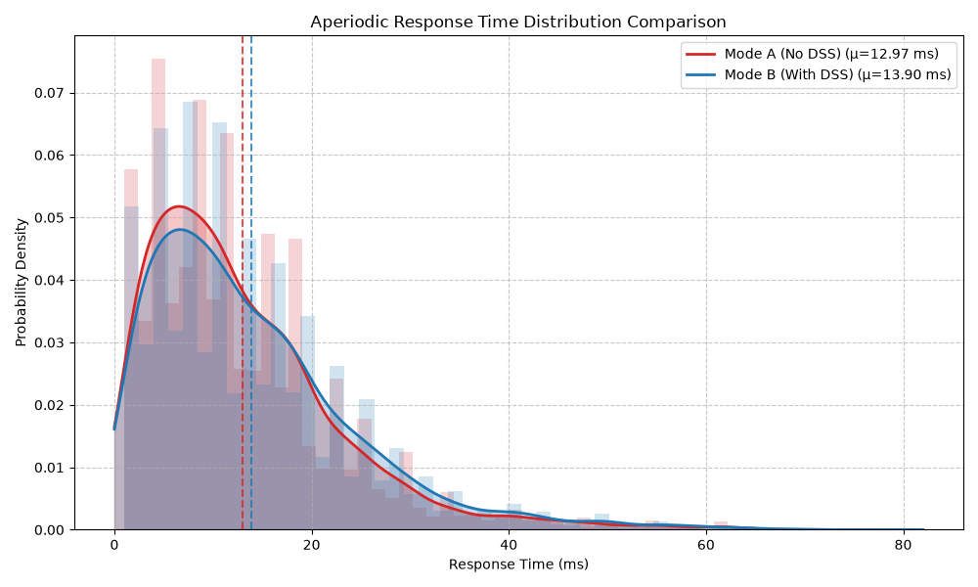




Implementation
$$F_{s}=0.025$$
$$F_{s}=0.05$$
$$C_{s}=12ms$$
$$T_{s}=25ms$$
For the increased frequency of aperiodic task generation, it is clear, that at some point the performance of DSS decreases.
Sometimes even worse than Background Scheduler
$$F_{s}=0.1$$

Slide 10
Conclusion
Achieves low response times with proper configuration
Although the calibration is highly fiddly
Behaves great with low aperiodic task frequency

Slide 11
References
L. Abeni and G. Buttazzo, ‘Integrating multimedia applications in hard real-time systems’, Proceedings - Real-Time Systems Symposium, pp. 4–13, 1998, doi: 10.1109/REAL.1998.739726.
B. Sprunt, L. Sha, and J. Lehoczky, ‘Aperiodic task scheduling for Hard-Real-Time systems’, Real-Time Systems 1989 1:1, vol. 1, no. 1, pp. 27–60, 1989, doi: 10.1007/BF02341920.
J. K. Strosnider, J. P. Lehoczky, and L. Sha, ‘The Deferrable Server Algorithm for Enhanced Aperiodic Responsiveness in Hard Real-Time Environments’, IEEE Transactions on Computers, vol. 44, no. 1, pp. 73–91, 1995, doi: 10.1109/12.368008.
M. Spuri and G. Buttazzo, ‘Scheduling aperiodic tasks in dynamic priority systems’, Real-Time Systems, vol. 10, no. 2, pp. 179–210, Mar. 1996, doi: 10.1007/BF00360340.
ChatGPT (OpenAI, GPT-5.5) was used to assist in the development of the simulation code, literature analysis, and drafting of non-technical text. All generated content was reviewed and validated by the authors.

Slide 12


