Slide 1
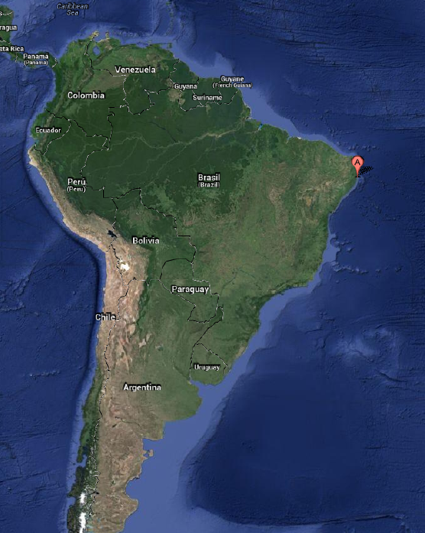


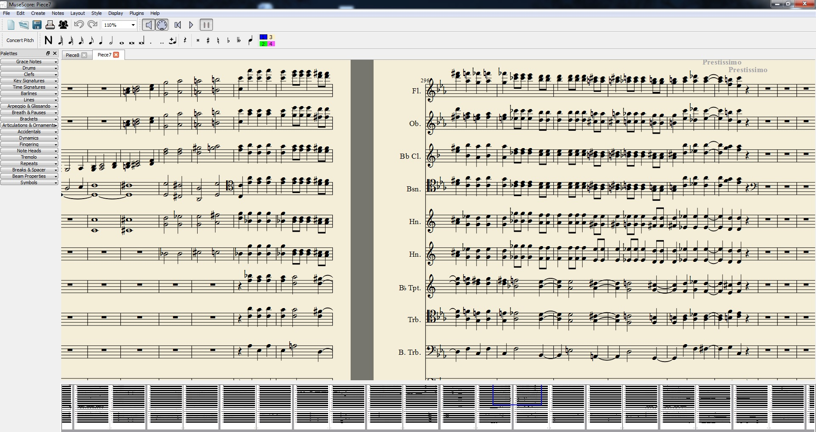
Eduardo Gade Gusmão
Supervisor: Ivan G. Costa
Research Area: Bioinformatics

Slide 2
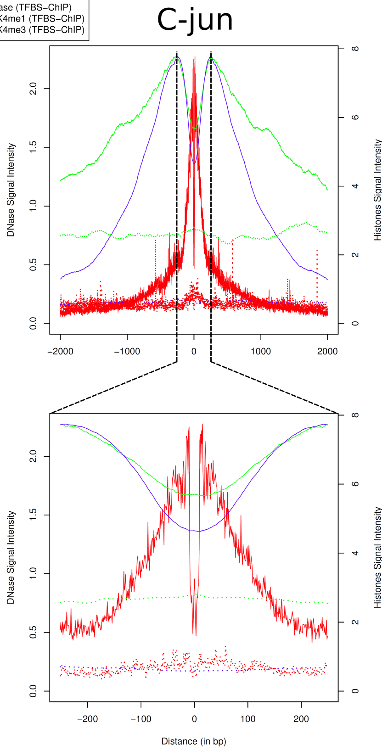
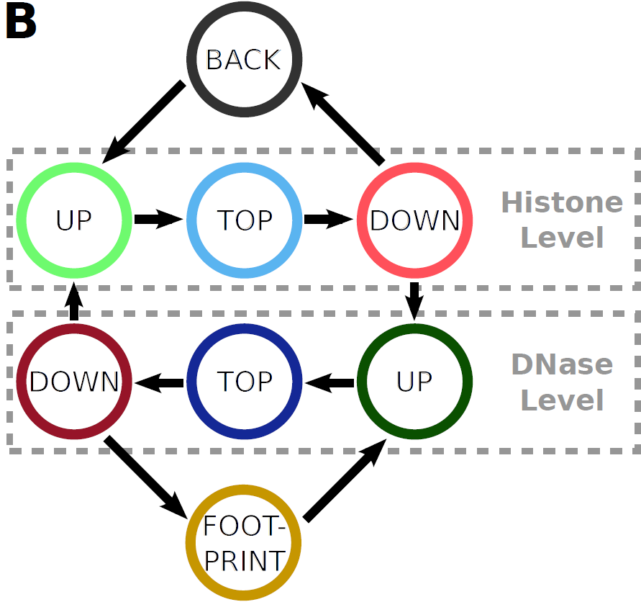
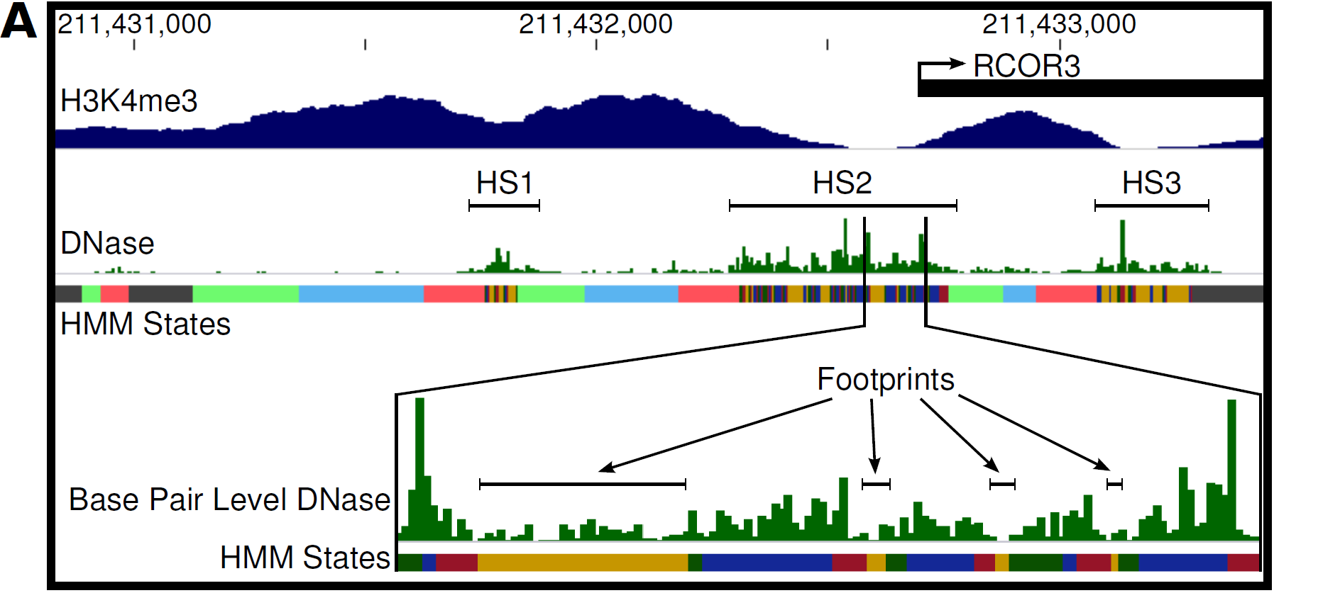
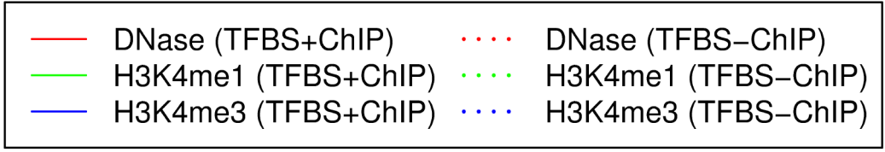

Slide 3
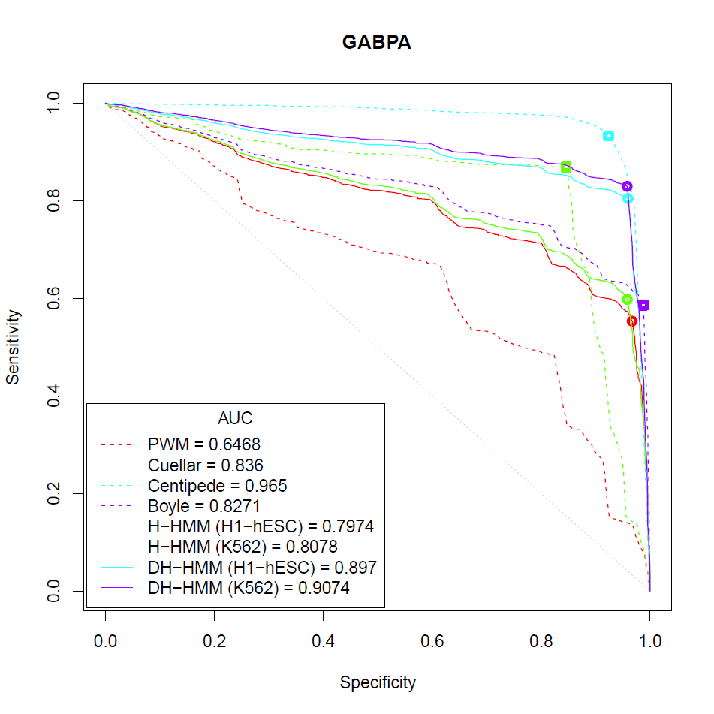
Cell: H1-hESC Factor: GABPA
Improving the Model:
Solve numerical problems
Account for signal variation
Improve training – non-supervised
Develop factor-specific version
Application:
Motif enrichment analysis
De novo motif finding

