Slide 1
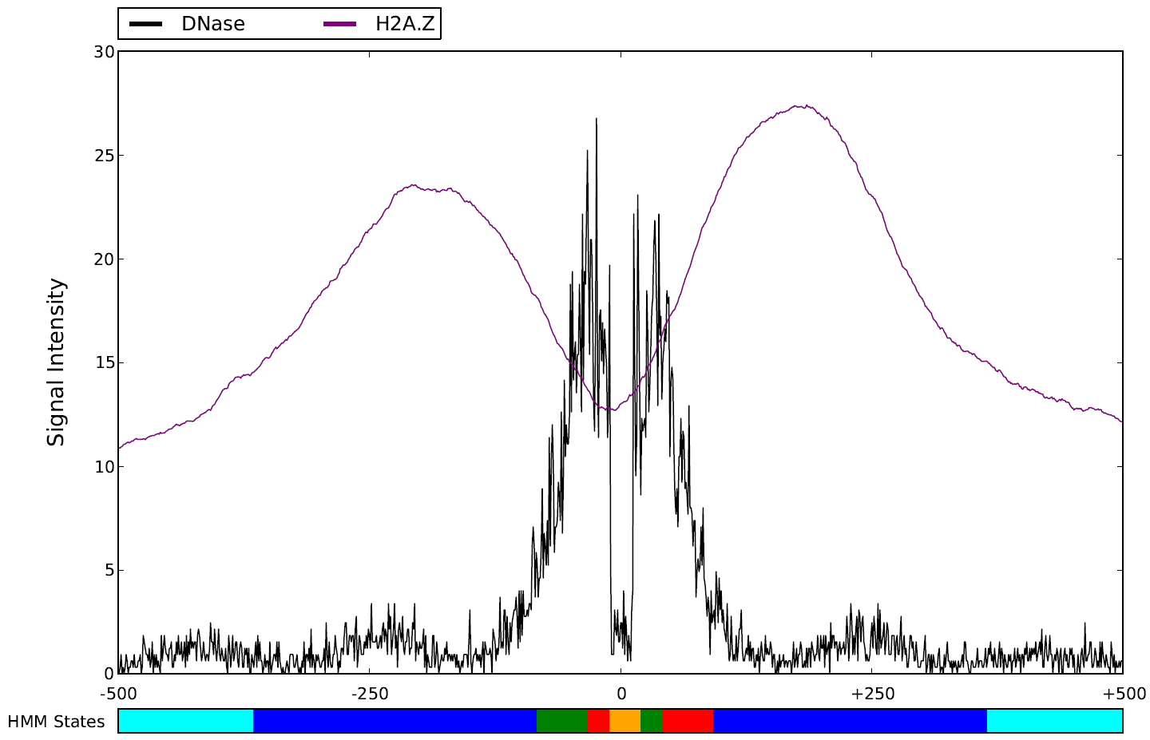
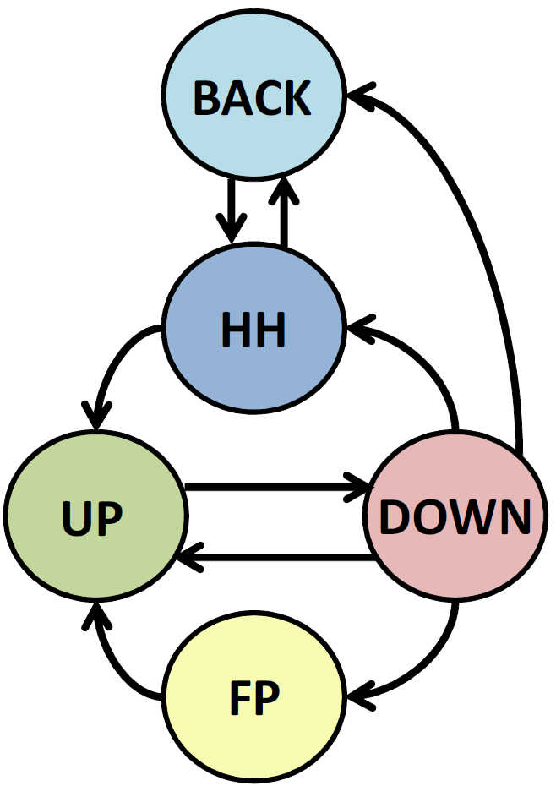
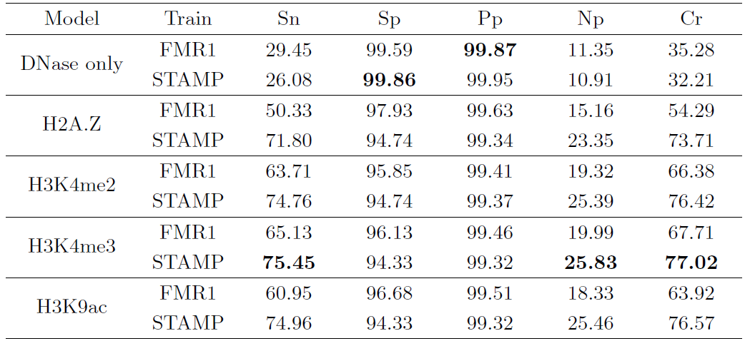
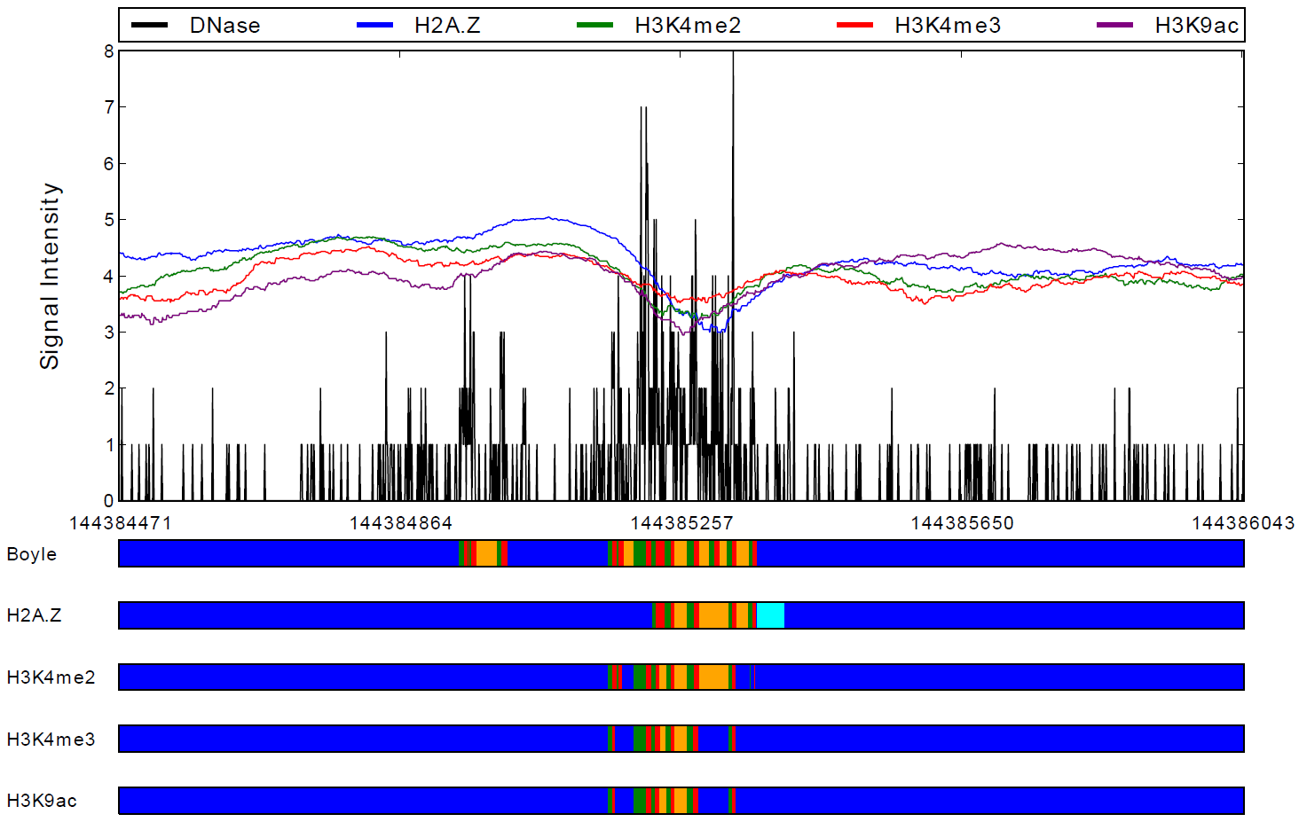
Prediction of TFBS by integrating DNase and histone modification
Eduardo G. Gusmão*, Christoph Dieterich** and Ivan G. Costa*
*Center of Informatics, Federal University of Pernambuco, Recife, Brazil.
**Berlin Institute for Medical Systems Biology, Berlin, Germany.
Introduction
The regulatory mechanism consists of a large number of different components that may play a role in numerous regulatory pathways. It is important to identify these regulatory elements in order to understand their role in each cell's regulatory network and comprehend diseases caused by deregulation¹. The standard computational approach – motif matching – suffers from a very high number of false positives since it cannot predict active TFBSs. Current research has proven that genome wide assays reflecting open chromatin states, such as DNase I digestion or histone modifications, can improve sequence based detection of the binding location of transcription factors that are active in a particular cell type^{2,3,4}. We propose a multivariate HMM that is able to identify TFBSs by integrating DNase I digestion and histone modification data of a particular cell type.
Related Works
Materials and Methods
Boyle et al² proposed an HMM model, which used Dnase I digestion data to predict TFBSs in a genome-wide fashion. This work (DNase only model) is the basis for our comparative study. Cuellar-Partida et al³ et al and Pique-Regi et al⁴ described methods for combining epigenetic data sources using standard Bayesian approaches. However by using a less restrict validation procedure, their approach is not directly comparable to ours.
1. Motif Matching
2. Signal Processing
3. HMM Footprinting
4. Gold Standard
Genome-wide sequence-based search for TFBSs. Produces bit scores that are used to stablish a cutoff value.
DNase I digestion (from DNase-seq) and histone modification (from ChIP-seq) aligned reads are counted, generating a ge-nomic signal that is used as input to the HMM.
The HMM is trained by maximum likelihood based on manual annotations and applied to DNase I Hyper-sensitive regions.
The results from motif matching with ChIP-seq data for each tested TF are used to access the accuracy of the HMM footprinting.
Results
Results on CTCF (Jaspar)
The table on the right shows the results (in percentage) for the CTCF transcription factor obtained on Jaspar. The results are expressed by the Sensitivity (Sn), Specificity (Sp), Positive Predictive Value (Pp), Negative Predictive Value (Np) and Correct Rate (Cr). Two HMM training forms were used: FMR1 (used by Boyle et al) and STAMP (novel approach based on STAMP⁵ algorithm). Figures are shown for Dnase only model as well as our bivariate models (consisting of DNase data and a histone modification – shown on the table row’s labels). The best result for each metric is marked in bold. Below the table there is a graph showing one of the ways our approach performed better than the previous approach. The red square marks a region where the histone signal have masked the prediction of a false-positive CTCF – predicted by DNase only model. We observed, on all factors, a significant increase in sensitivity with a slight drop in specificity. Future works include increasing HMM dimensionality and fixing occasional wider predictions done by our model.
Conclusions
In this work, we proposed a novel multivariate emission HMM method to predict TFBSs based on DNase I digestion patterns and histone modification data. Results favored this integrative approach and we pretend to keep researching epigenetic patterns to create a more generalist and robust model.
Acknowledgments
Bibliography
We would like to thank Marcílio C. P. de Souto and Thaís G. do Rêgo for sharing some valuable information and for making helpful suggestions. This work has been partially supported by Brazilian research agencies: FACEPE, CNPq and CAPES.
1. Maston, G.A., Evans, S.K., Green, M.R. Annu Rev Genomics Hum Genet. 7, 29-59 (2006).
2. Boyle, A.P., Song, L., Lee, B.K., London, D., Keefe, D., Birney, E., et al. Genome Res. Biol. 21(3), 456-464 (2011).
3. Cuellar-Partida, G., Buske, F.A., McLeay, R.C., Whitington, T., et al. Bioinformatics. 28(1), 56-62 (2012).
4. Pique-Regi, R., Degner, J.F., Pai, A.A., Ganey, D.J., Gilad, Y., Pritchard, J.K. Genome Res. 21(3), 447-455 (2011).
5. Mahony, S., Benos, P.V. Nucleic Acids Research. 35(Web Server issue), W253-W258 (2007).

