Slide 1








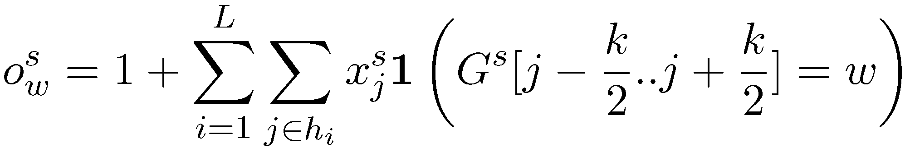
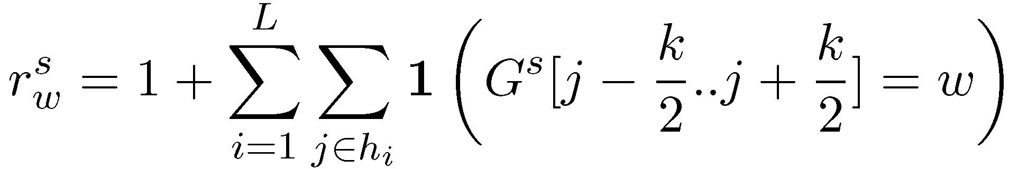

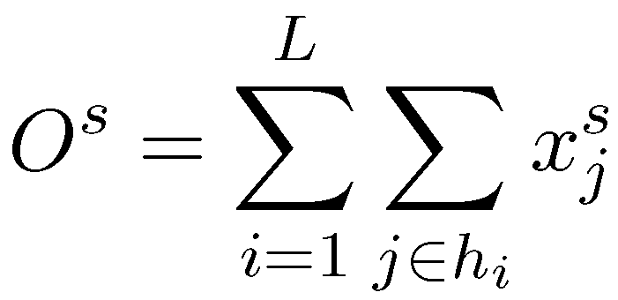
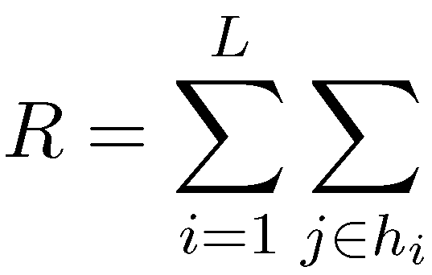
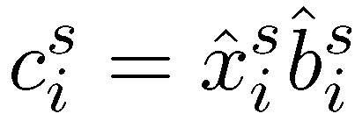
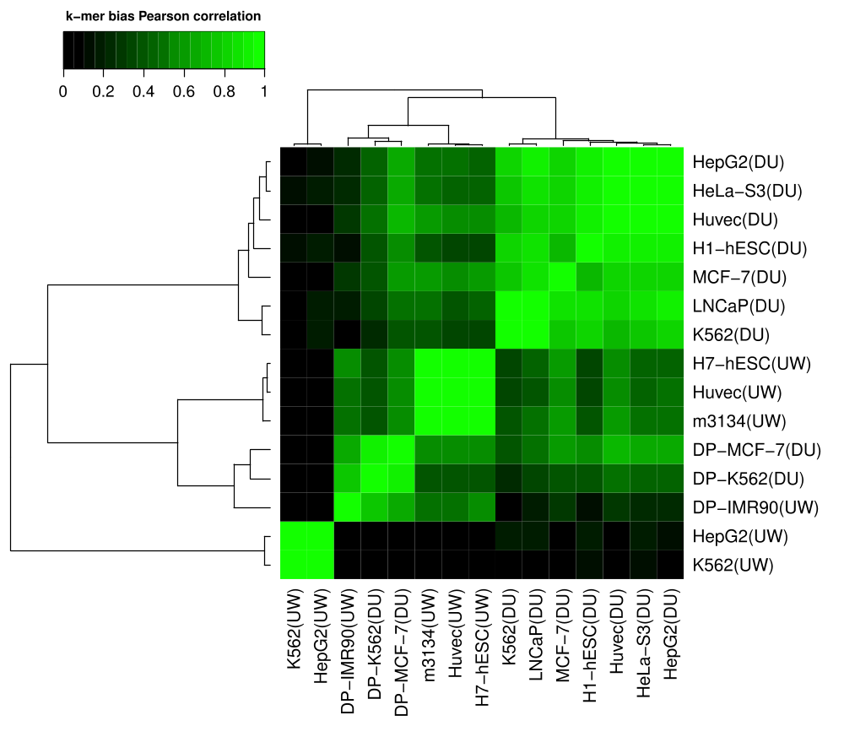
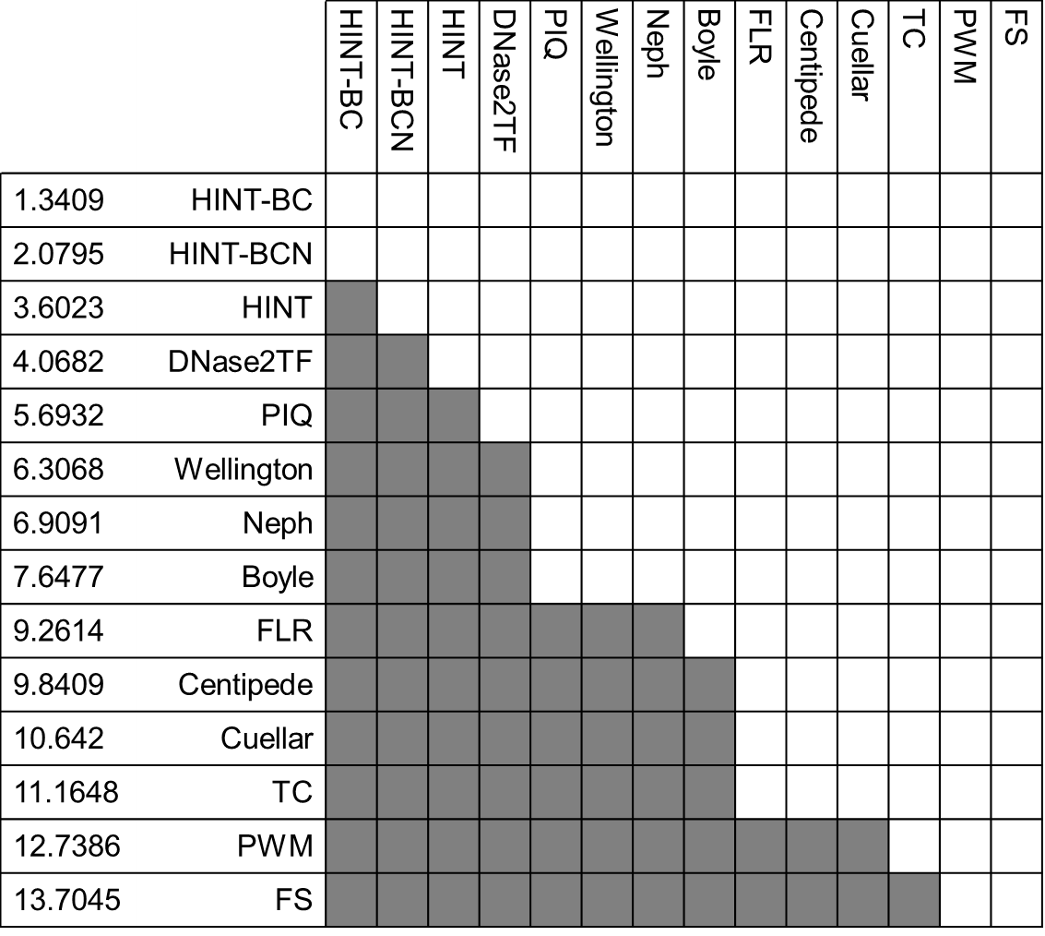
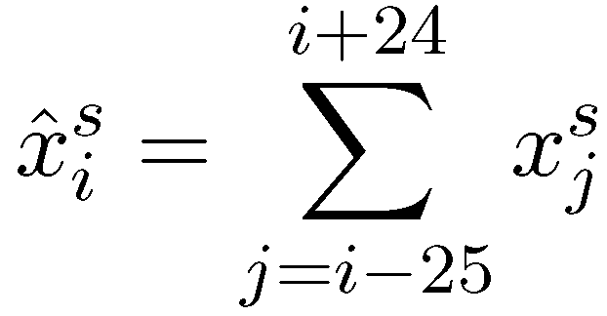
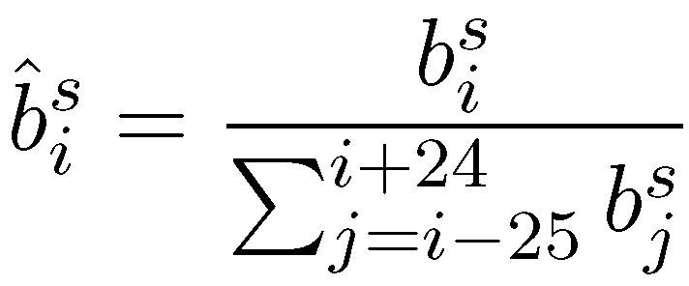
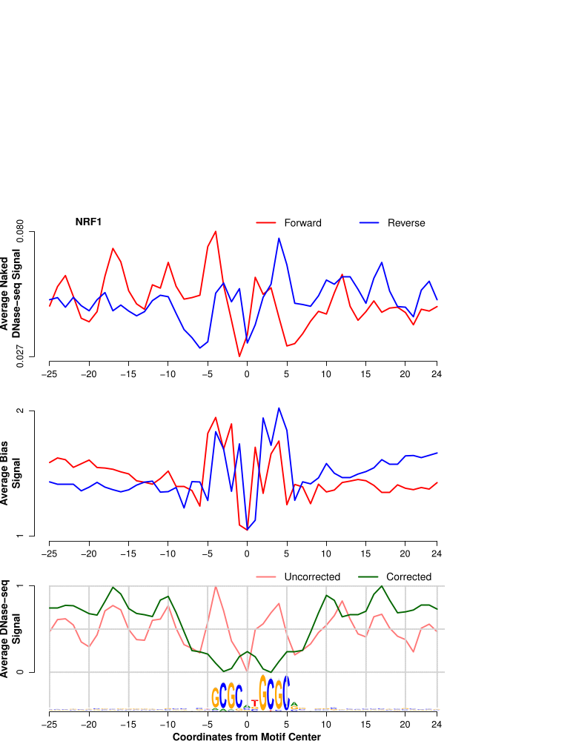
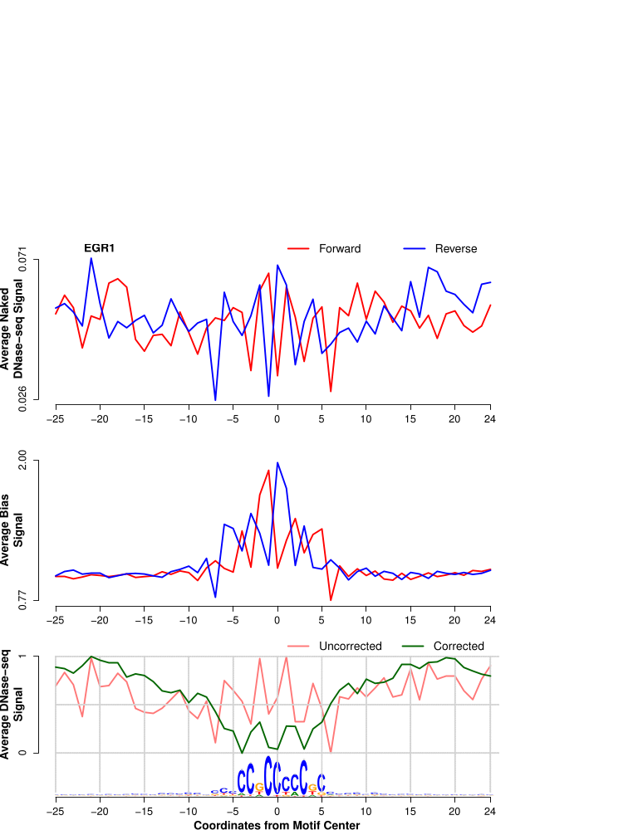
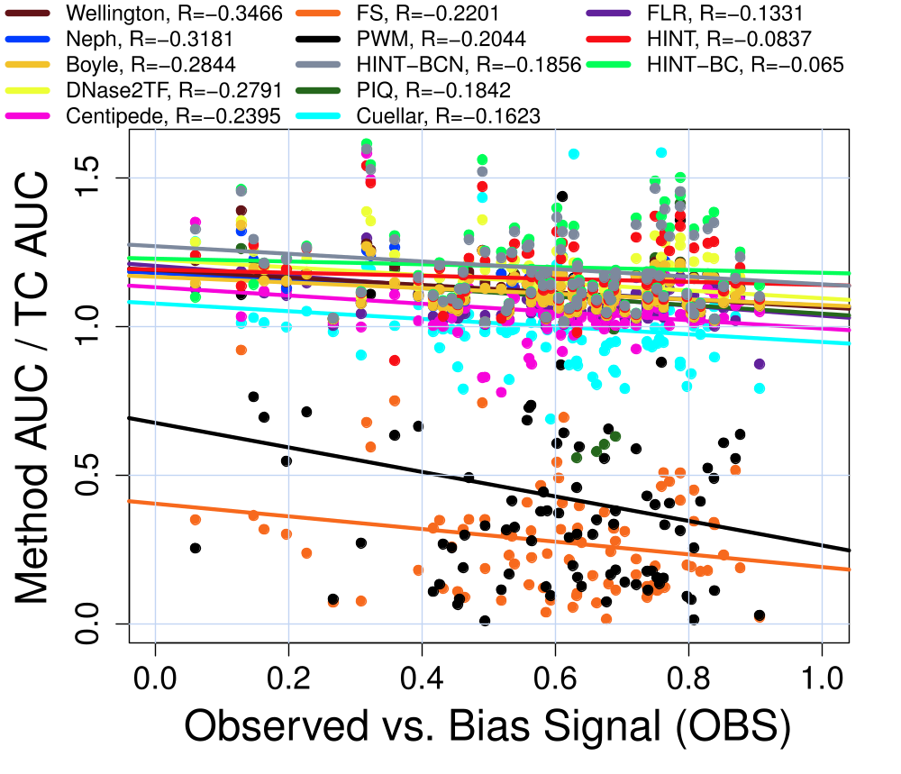
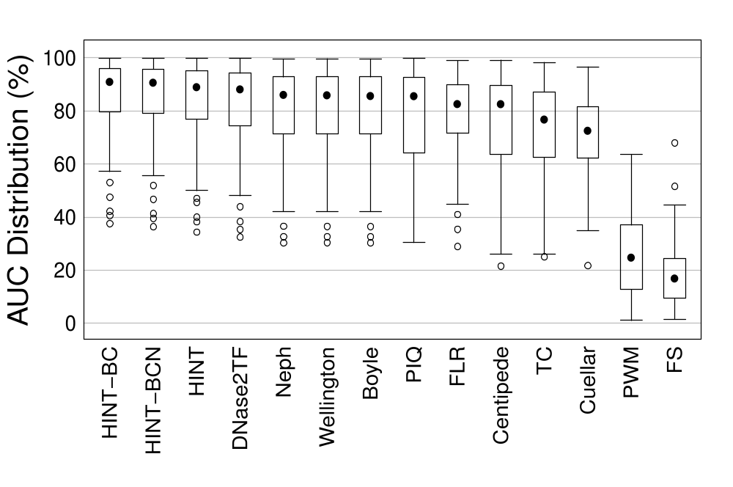
HINT-BC – HMM-based Identification of Transcription Factor Footprints on Bias-Corrected DNase-seq Data
Eduardo G. Gusmão*, Martin Zenke and Ivan G. Costa
Institute for Biomedical Engineering, RWTH Aachen University Medical School, Aachen, Germany
*eduardo.gusmao@rwth-aachen.de
Introduction
Estimation of DNase I Cleavage Bias
DNase I cleavage followed by massive sequencing (DNase-seq) has proven to be a powerful genome-wide technique for identifying active transcription factor (TF) binding sites [1–4]. Several computational approaches have been proposed to find nucleotide-resolution footprints (5-20 bp regions within two DNase-seq peaks) [3–11]. Recently, He et al. (2014) demonstrated that DNase-seq signals have biases towards the preference of DNase I to cleave particular sequences. Moreover, they show that the performance of a digital footprint method (footprint score – FS) [3] correlates with the cleavage bias of the underlying TF motif and that footprints are outperformed by simple DNase-seq tag count scoring (TC). Here, we propose the integration of a bias-correction strategy into our previous method HINT [4], which will be termed HINT-BC [12]. We investigate whether the bias-correction strategy has a significant impact on TF binding site prediction performance and perform a comprehensive evaluation including 13 footprinting methods.
DHS
W = CACGTG
DNase-seq
Aligned Reads
DNase-seq read mapped to reverse
strand
Genome
Genome
Cleavage
site at 5’
k-mer W hits centered
at cleavage sites
GGATTACACGTGTTACG
k-mer W hits inside DHSs
W hit centered at the cleavage site
Given:
DNA sequence from i to j for strand s ϵ {+,-}
DNase-seq signal vector
Set of DNase hypersensitivity regions
Data
Indicator function
Single-hit protocol (DU) | # Reads
H1-hESC | 110303078
HeLa-S3 | 54267867
HepG2 | 50838536
Huvec | 31848532
K562 | 365820647
LNCaP | 163625945
MCF-7 | 89113893
K562-DP* | 202001412
MCF-7-DP* | 210715393
Double-hit protocol (UW) | # Reads
H7-hESC | 302050785
HepG2 | 168883956
Huvec | 429088276
IMR90-DP* | 138604440
K562 | 179970820
m3134 | 127594903
We are able to evaluate:
Observed cleavage frequency
for k-mer w
Background cleavage frequency
for k-mer w
* Deproteinized DNA
Cleavage bias signal
where:
and
DNase I Cleavage Bias Correction
Results
Corrected DNase-seq signal ( ) is evaluated based on a correction signal ( ), which is calculated based on smoothed versions of the DNase-seq signal ( ) and the bias signal ( ).
A
B
NRF1
EGR1
C
D
Bibliography
(A) Correlation of bias scores between different DNase-seq datasets given all possible DNA 6-mers. Deproteinized experiments are marked with “DP”. (B) Friedman-Nemenyi hypothesis test. The rows are sorted by the Friedman ranking. A shadowed cell means that the method in the column outperformed the method in the row (95% confidence). (C) Correlation between the performance of each method (in relation to the DNase-seq tag count; TC) and the OBS (correlation between observed and bias signal). (D) Distribution of the area under the ROC curve (AUC) at 10% specificity for all footprinting methods using a validation set with 88 ChIP-seq experiments.
1. ENCODE Project. Nature. 489(7414):57-74 (2012).
2. He HH et al. Nat Meth. 11(1):73-78 (2014).
3. Neph S et al. Nature. 489(7414):83-90 (2012).
4. Gusmao EG et al. Bioinf. 30(22):3143-51 (2014).
5. Boyle AP et al. Gen. Res. 21(3):456-64 (2011).
6. Cuellar-Partida G et al. Bioinf. 28(1):56-62 (2012).
7. Pique-Regi R et al. Gen. Res. 21(3):447-55 (2011).
8. Sung MH et al. Mol Cell. 56(2):275-85 (2014).
9. Yardimci GG et al. NAR. 42(19):11865-78 (2014).
10. Sherwood RI et al. Nat. Biotech. 32(3):171-8 (2014).
11. Piper J et al. NAR. 41(21):e201 (2013).
12. Gusmao EG et al. Nat. Meth. (in revision).

