Slide 1
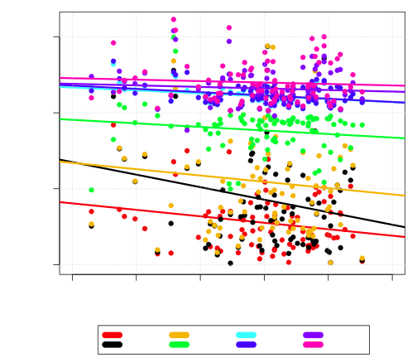
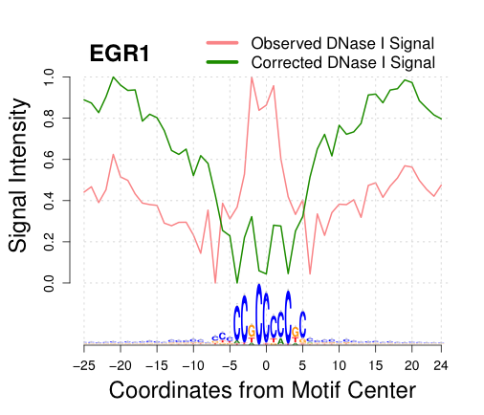
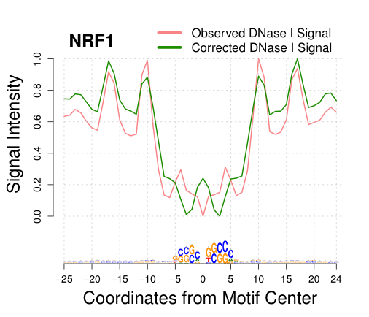
Method AUC/ Tag count AUC
0.0
0.5
1.0
1.5
0.0
0.2
0.4
0.6
0.8
1.0
Observed vs. Bias Signal

