Slide 1
Prediction of Transcription Factor Binding Sites by Integrating DNase digestion and Histone Modification
Eduardo G. Gusmão, Christoph Dieterich and Ivan G. Costa
*
**
*
* Federal University of Pernambuco - Center of Informatics. Recife, Brasil.
** Berlin Institute for Medical Systems Biology. Berlin, Germany.

Slide 2
Outline
Gene Regulation Overview
Measuring Chromatin Structure:
DNase and Histone Modification
Previous Approach: DNase based Method
Our Approach: DNase + Histone Method
Experiments and Results
Discussion
Notes:
First, I am going to present an overview on gene regulation, discuss the problem we are addressing and describe how the data we used, DNase digestion and histone modification, are measured.
Then, I will talk about the previous approach and describe our approach.
Finally, I will present the experiments and results and give a brief discussion.

Slide 3
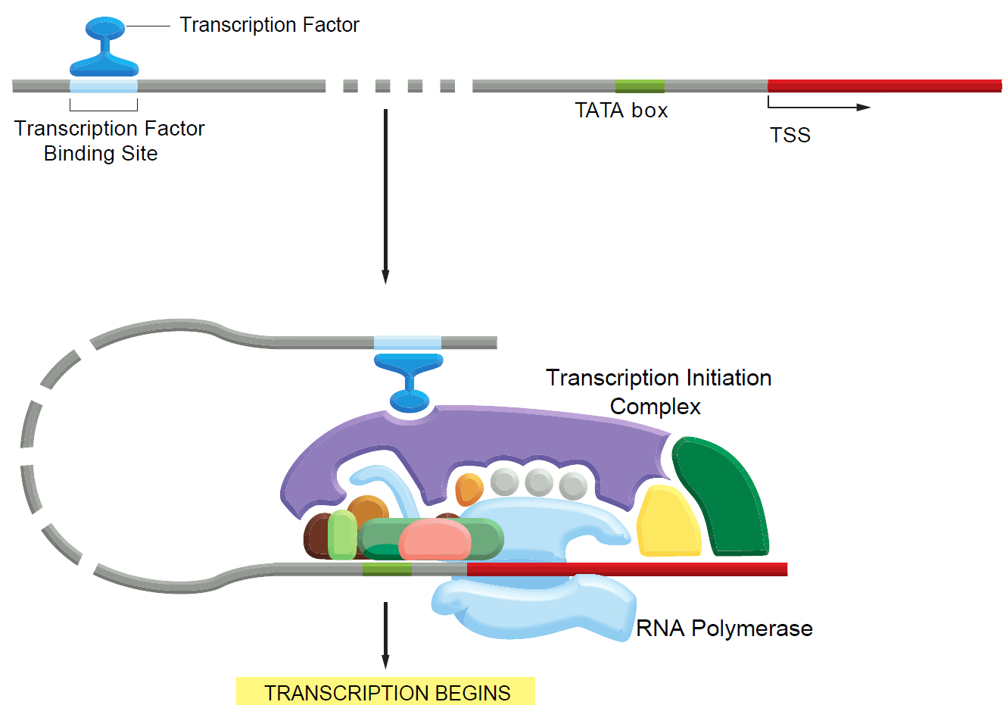
Gene Regulation Overview
Sources: Alberts, B. et al. (2008) Garland Science, 5th ed.
Notes:
It is known that most part of gene regulation occurs at the level of transcription initiation. Typical eukaryotic regulation contains both proximal (near the promoter) and distal (several thousand nucleotide pairs distant) TFs that help or prevent the transcriptional machinery to assemble at the promoter.
These TFs bind to specific short DNA sequences (DNA elements) called TFBSs. Although only one TF is shown here, a typical eukaryotic gene has many TFs of different kinds that dictates the rate and pattern of transcription.

Slide 4
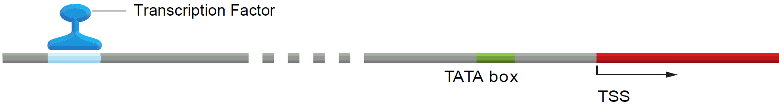
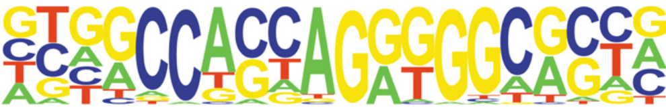
Transcription Factor Binding Sites (TFBSs)
Problem: Identification of TFBSs that are active in a certain cell type.
Traditional approach: Sequence-based search (motif matching)
Disadvantages:
High number of false positive hits – cannot predict active sites.
Motifs are small and degenerate – Size: 6 - 12 bp. Binding specificity: 4 - 6 bp.
PWMs are only available for a fraction of transcription factors.
Sources: Alberts, B. et al. (2008) Garland Science, 5th ed.
Notes:
We can analyze a specific TFBS sequence by collecting many fragments and calculating the frequency that each nucleotide occur in each position. This motif preference information is visually depicted in this graph and numerically represented by a PWM. For example, any of the four nucleotides may occur in the first position but the 6th position is certainly a C.
The problem we are addressing is the identification of TFBSs that are active in a certain cell type, condition, etc.
The traditional computational approach would consist of performing a sequence-based search, or motif matching using these previously known motifs.
However, this approach has many disadvantages. First, there is a high number of false positives, since it cannot predict active sites. Second, motifs are, in most cases, small and degenerate, with sizes ranging from 6 to 12 bp and specificity dictated by no more than 6 bp. And finally, PWMs are only available for a fraction of TFs.

Slide 5
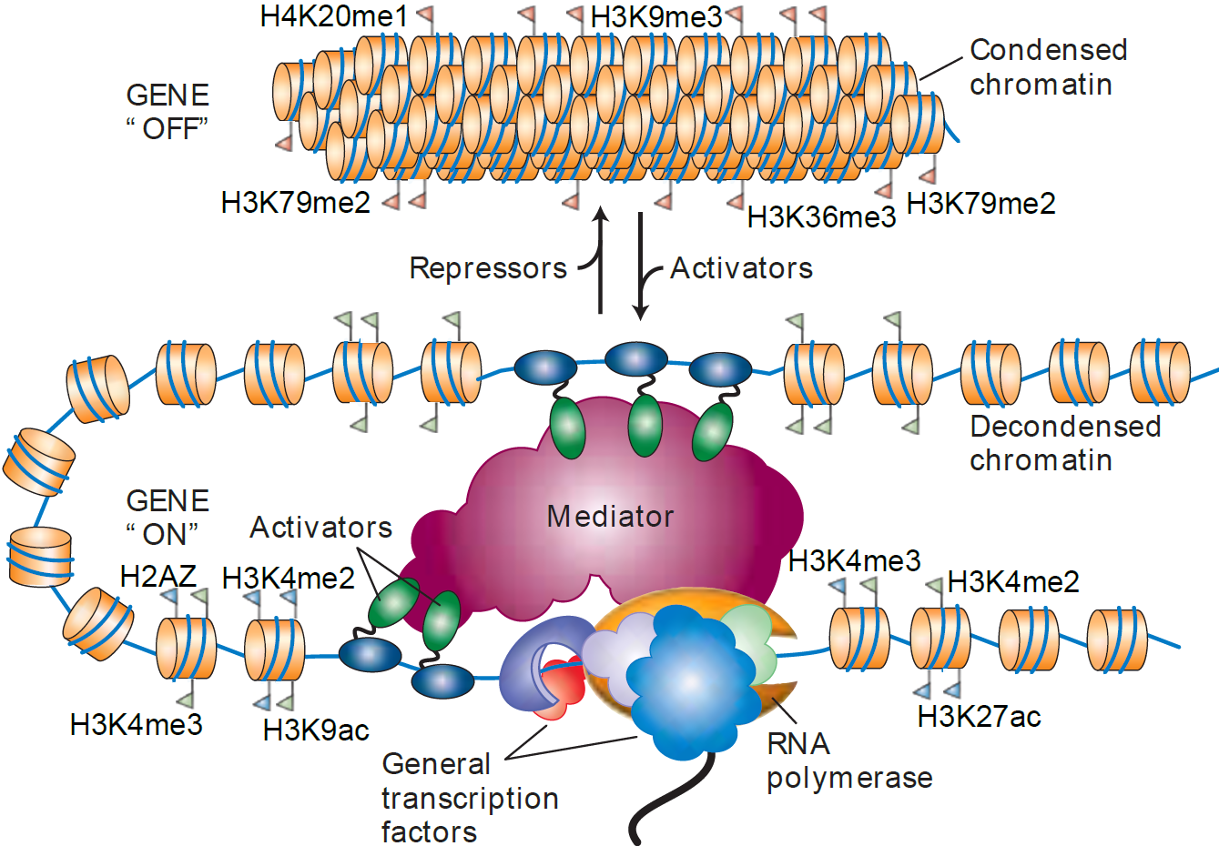
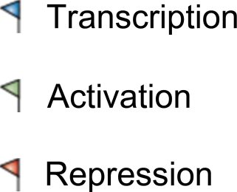
Epigenetic Solution
Sources: Lodish, H. et al. (2004) WHFreeman, 5th ed.
Notes:
Many of these motif matching’s problems have been assuaged with the use of epigenetic data. In this picture, each barrel represents a histone complex.
The main idea is that certain parts of the genome, called heterochromatin, are tightly packed into closed structures and certain parts, called euchromatin, are more lightly packed (it is the so-called “open chromatin”).
As active TFBSs are more likely to occur in open chromatin regions, detecting these regions or the specific features that mark these regions would provide more accurate predictions.
Studies have shown that histone tail modifications can differentiate open from closed regions. For instance, closed regions are rich in H3K79me2 while open regions are rich in H3K4me2.
For simplicity, I will use the term “histone modification” to both histone modifications and histone variants (such as H2A.Z).

Slide 6
How to measure epigenetic features
Next-Generation Sequencing
DNase-seq
DNase I Footprinting followed by next-generation sequencing methods
Identify open chromatin regions
Not protein-specific
High resolution
ChIP-seq
Chromatin Immunoprecipitation followed by next-generation sequencing methods
Identify specific protein-DNA binding locations
Protein-specific
Low resolution
Notes:
But how do we measure these epigenetic features?
Next-Generation sequencing techniques have provided multiple means of performing traditional methods in a genome-wide fashion.
The DNase-seq method consists of traditional DNase I footprinting followed by next-generation methods. It is able to identify open chromatin regions with high resolution. However, it is not TF-specific.
The ChIP-seq method consists of performing chromatin immunoprecipitation followed by next-generation methods. It is able to identify specific proteins or modified proteins bound to DNA. However it is a low-resolution method.
We could use ChIP-seq only to directly identify TFBSs. However, such approach is suited only for studies that requires the identification of a very small set of TFBSs and our intention is to create a genome-wide map of TFBSs.

Slide 7
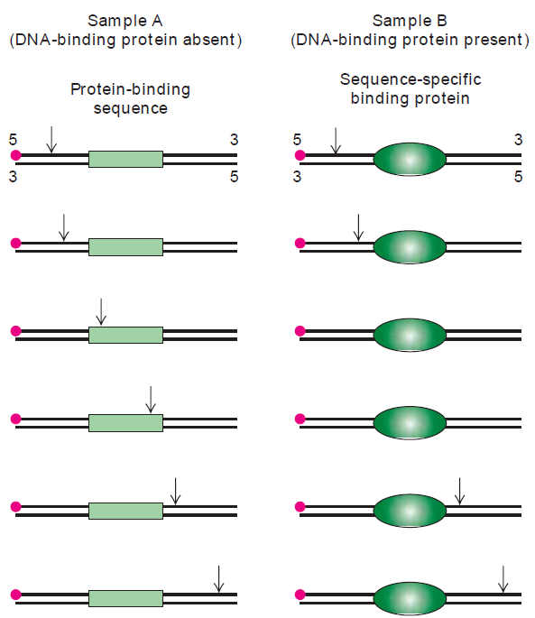
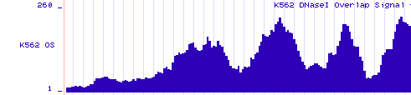
DNase-seq
DNase-seq:
DNase I digestion
Fragment extraction and treatment
Next-Gen sequencing
Regions likely to be TFBSs
Sources: Lodish, H. et al. (2004) WHFreeman, 5th ed.
Notes:
The basic idea of DNase I footprinting is to nick the DNA in a specified position (with a restriction enzyme, for instance) and use DNase I to nick the DNA at many different parts. If no protein is present the digestion will encompass the whole fragment. However, if a protein is bound to DNA, that specific region will not be nicked.
In the traditional DNase footprinting, proteins bound on the DNA would be seen as a gap in the results of a gel electrophoresis experiment.
In the DNase-seq , however, after the DNase I digestion and a few fragment treatment steps, a high-throughput sequencing method is performed.
After that, we can create a signal by aligning the sequenced fragments on the genome and counting how many aligned fragments overlapped at each bp. In this process, regions that contained proteins bound to are represented by a dip between two peaks.
A wider region containing a collection of peaks is the open chromatin region or DNase I Hypersensitivity region.

Slide 8
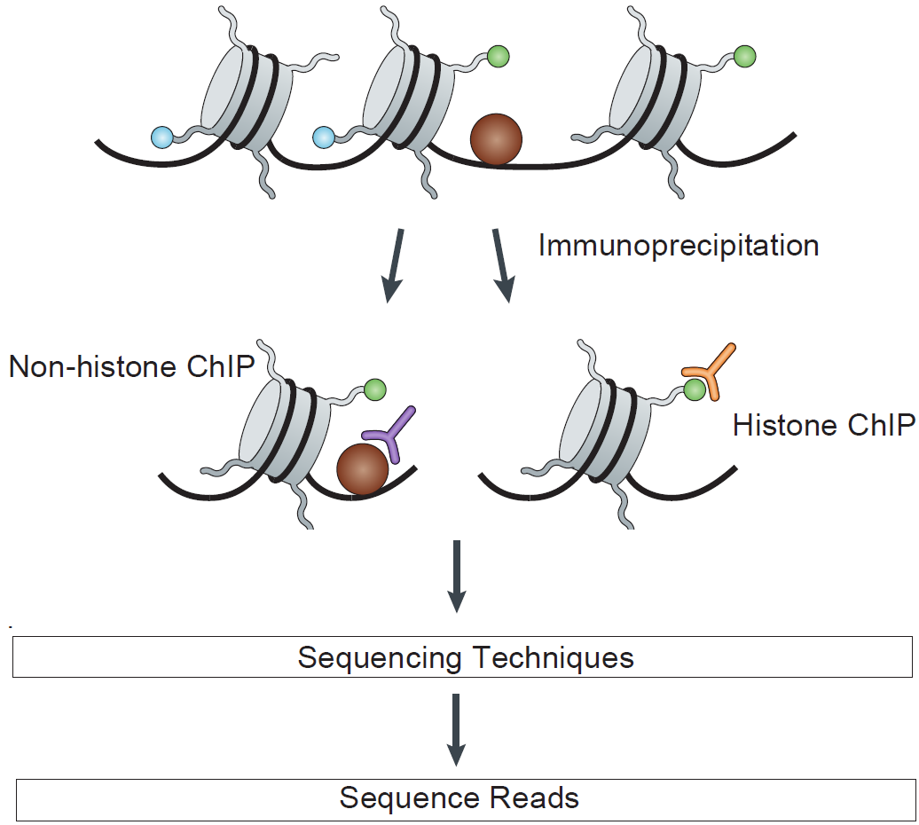
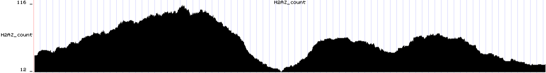
ChIP-seq
ChIP-seq:
Immunoprecipitation
Fragment extraction and treatment
Next-Gen sequencing
Protein-Enriched Regions
Sources: Park, P.J. (2009) Nature Review Genetics, 10:669-680.
Notes:
The ChIP-seq technology follows a similar idea, but it is done targeting a specific protein (or modified protein – such as a methylated or acetylated histone).
First, we use ChIP procedure to fetch the target protein using that target’s antibody. The fragments extracted are then purified and treated with similar procedures as in DNase-seq and sequenced with any high-throughput method.
In contrast to DNase-seq the protein enriched regions are represented as peaks in the genomic signal. This procedure has a lower resolution than DNase-seq because the protein can be approximately at any position of extracted fragments.

Slide 9
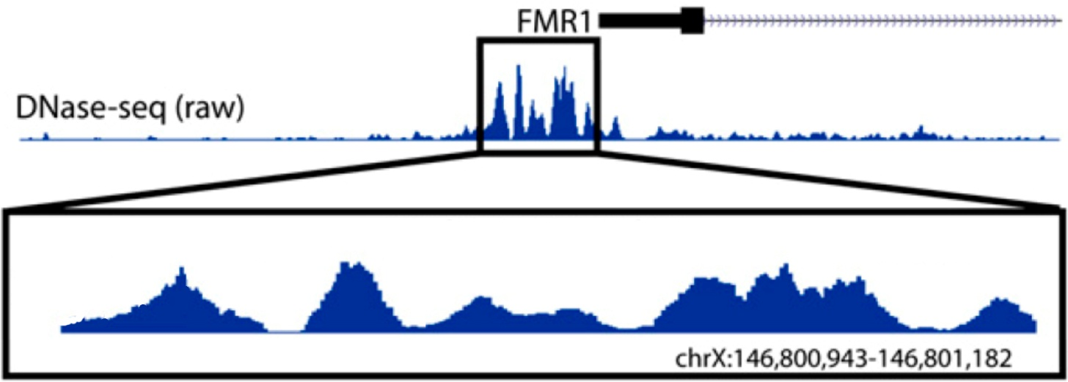
Previous Work
DNase only HMM Model (Boyle et al)
HS1
HS2
UP
DOWN
FP
Sources: Boyle, A.P. et al. (2011), Genome Research, 21:456-464.
Notes:
A successful study of TFBS prediction based on epigenetic data, published in 2011, was based on DNase-seq data only. The main idea is to build a Hidden Markov Model (or HMM) that is able to capture the peak-dip-peak trend.
The created model has five states. HS1 and HS2 states recognizes the low levels of DNase hypersensitivity (or background) before and after peak-rich regions. Up and Down states recognize regions where the signal is increasing and decreasing. And FP (or Footprint) state recognizes the TFBS regions. Let me show an example. The first state we enter into is the HS1 state and proceed to the UP state when the first rise appears. Then the signal drops and enters the footprint state. Then it may rise and drop again entering at another footprint state or leaving through the HS2 state.

Slide 10
Our Approach
Open chromatin (DNase-seq) allows specific TFBS prediction but…
There are other interesting epigenetic features
Our approach is to integrate
Open chromatin
Histone modifications
Bivariate model
Notes:
Open chromatin, or DNase data, allows specific TFBS prediction, but there are other interesting epigenetic features.
We hypothesize that a proper integration of epigenetic features would generate more accurate results.
Our approach is to integrate DNase-seq data with ChIP-seq data from histone modifications. At this first study, as our goal is to verify if this approach is interesting, we have created bivariate models only, always composed of DNase-seq + a histone modification.

Slide 11
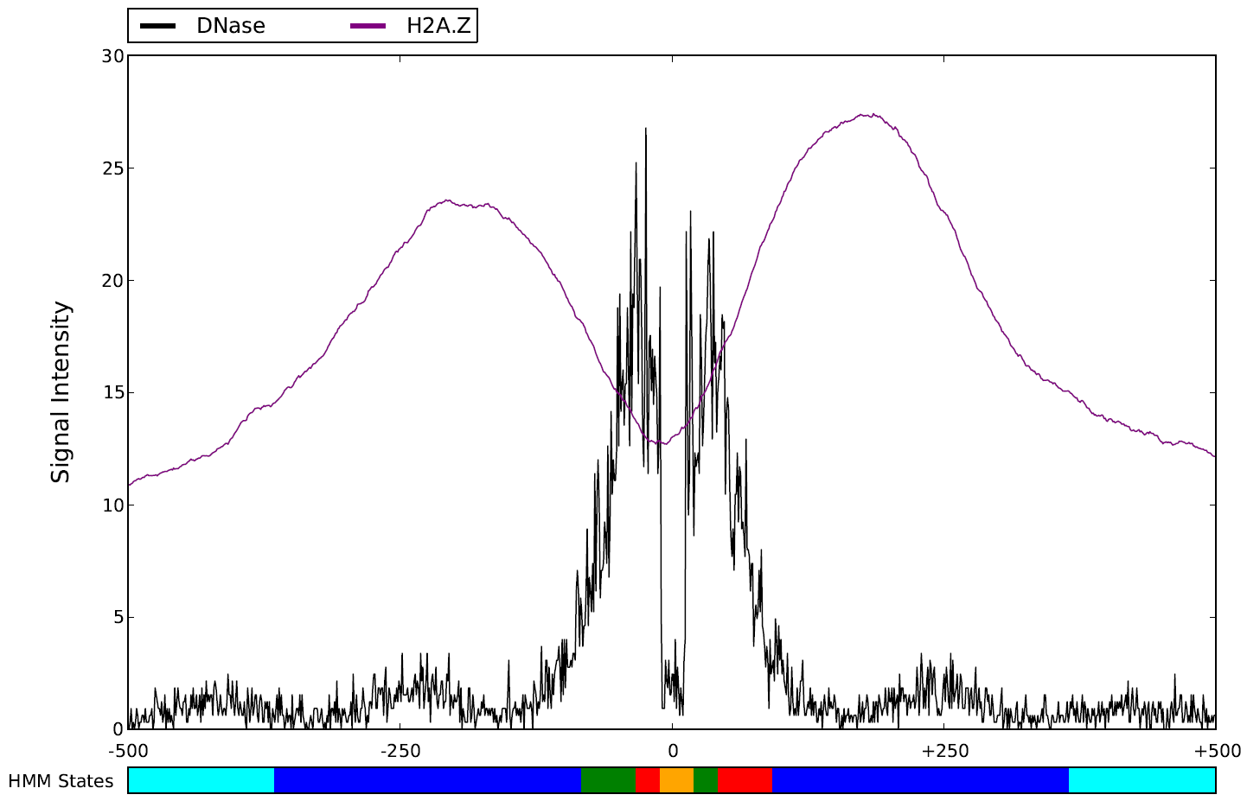
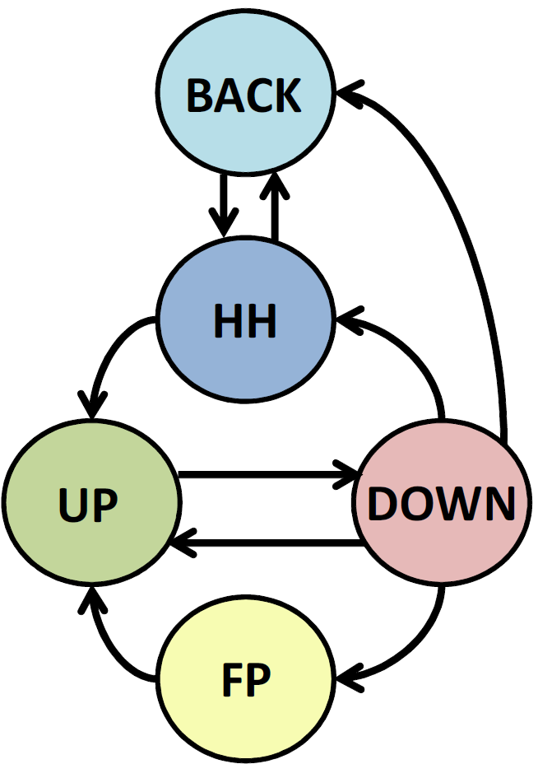
Our approach
DNase + Histone HMM Model
Notes:
On the left there is our model. On the right, there is a graph representing the mean curve for 100 CTCF-enriched regions, where the CTCF motif lies in the middle of the 1000bp window.
For clarity, only DNase and H2A.Z signals are shown.
We are able to notice that DNase peak-dip-peak trend occurs inside a histone modification peak-dip-peak trend.
Our model consisted of a single Background state that does the same as the two background states in the previous model. A High Histone state that captures the histone peaks and UP/DOWN/FP states similar to the previous model. The idea is that the model would be able to capture a trend like this one.

Slide 12
Model Training
FMR1 training (Boyle et al. approach)
Manual Annotation based on FMR1
Pre-model generated by maximum likelihood
Footprint top 1000 HS sites
Final model generated by maximum likelihood
STAMP training (our approach)
STAMP: Algorithm that performs statistically corrected motif matches against whole PWMs datasets.
Sample 10 random HS regions (top scored)
Apply STAMP with as many PWMs as possible
Annotate the regions based on STAMP output
Final model generated by maximum likelihood
Sources: Mahony, S. and Benos, P.V. (2007), NAR, 35:253-258.
Notes:
The HMM models were trained in two different ways.
First, the methodology used in the previous model, consists of manually annotating the state sequence based on the results of traditional DNase I footprinting of the FMR1 promoter region; creating a pre-model by maximum likelihood training; applying the model to the 1000 top-scored HS sites and, based on this new annotation, creating the final model by maximum likelihood again.
Our methodology makes use of the STAMP tool. STAMP is an algorithm that performs motif matches against whole PWMSs datasets.
The idea is to take 10 random HS regions (preferably top-scored) and apply STAMP with as many PWMs as available. This generates reliable footprint predictions without having to perform traditional footprinting methods. Then these regions are manually annotated and the final model is generated by maximum-likelihood.

Slide 13
Experiment – Data
Cell Line: K562 (myelogenous leukemia)
Open Chromatin (DNase-seq)
Histone Modifications (ChIP-seq)
H2A.Z, H3K4me2, H3K4me3, H3K9ac
TFBSs for validation (ChIP-seq)
ATF3, CTCF, GABP, REST
PWMs for validation:
CTCF, GABP, REST
CTCF
ATF3, REST
ENCODE
JASPAR
RENLAB
TRANSFAC
Notes:
All experiments were performed on the myelogenous leukemia cell line K562.
We obtained the DNase-seq data and ChIP-seq for histone modifications and TFBSs for validation, from ENCODE repository.
The PWMs (for validation) were obtained from JASPAR, RENLAB and TRANSFAC.

Slide 14





Experiment – Gold Standard
T
T
F
F
T
F
Motif Matching
TFBS ChIP-seq
Footprint
TP
FN
TN
TN
TP
FP
Notes:
Our gold standard is composed of the Motif Matching results plus the TFBS ChIP-seq evidence. Motif matching hits with ChIP-seq evidence are considered true TFBSs and motif matching hits without ChIP-seq evidence are considered false TFBSs.
By adding our predictions we can evaluate a traditional confusion matrix. TPs are true TFBSs that overlapped a footprint, FNs are true TFBSs that did not overlap a footprint, FPs are false TFBSs that overlapped a footprint and TNs are false TFBSs that did not overlap a footprint.
Based on the confusion matrix we can evaluate the Correct Rate, Sensitivity, Specificity, PPV and NPV.

Slide 15
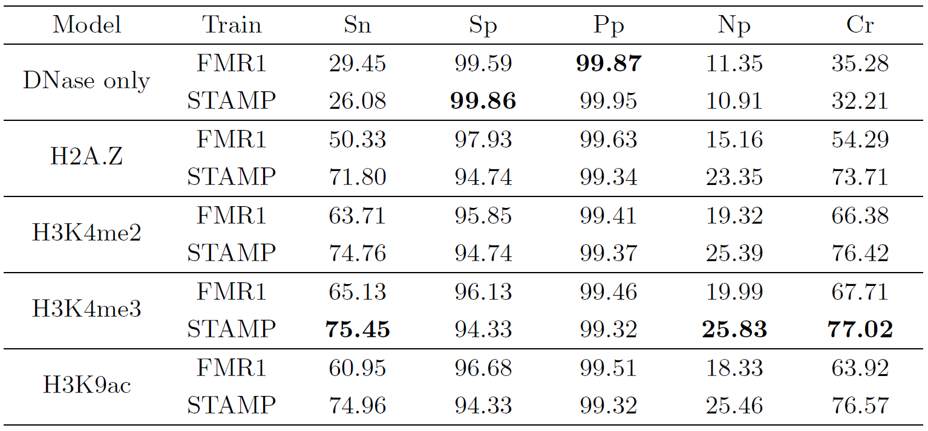
Results
Results (in percentage) on CTCF (Jaspar) for all models - trained with either FMR1 or STAMP
Notes:
This table shows the results for all models with all training possibilities for the CTCF obtained in JASPAR. The best results per metric are marked in bold.
We can see that DNase only approach has the greatest specificity and interestingly it was achieved with our STAMP procedure.
However, by adding these activating histone marks the sensitivity has always increased, to a maximum of 45% higher than the best DNase only result; while the specificity hasn’t decreased much (at most, just over 5%).

Slide 16
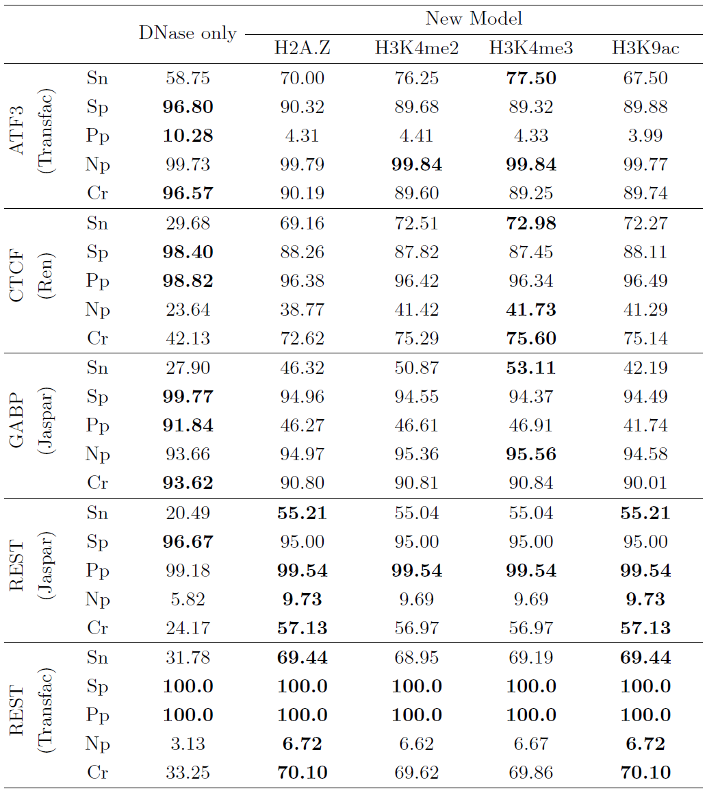
Results
Results (in percentage) on all tested factors, trained with either FMR1 or STAMP
Notes:
Results on other factors have shown the same trend of sensitivity increase and specificity drop.
In ATF3 from TRANSFAC and GABP from JASPAR we must notice that the correct rate dropped in our models. We attribute that mostly to the fact that these factors contains a high number of negative instances, so the specificity has a greater impact on the overall correct rate than the sensitivity.
It is also interesting to notice that while the methylations of the fourth lysine of histone H3 have provided the best results for activators such as ATF3 and GABP, the histone variant H2A.Z and the acetylation of the ninth lysine of histone 3 have provided the best results for the repressor REST.

Slide 17
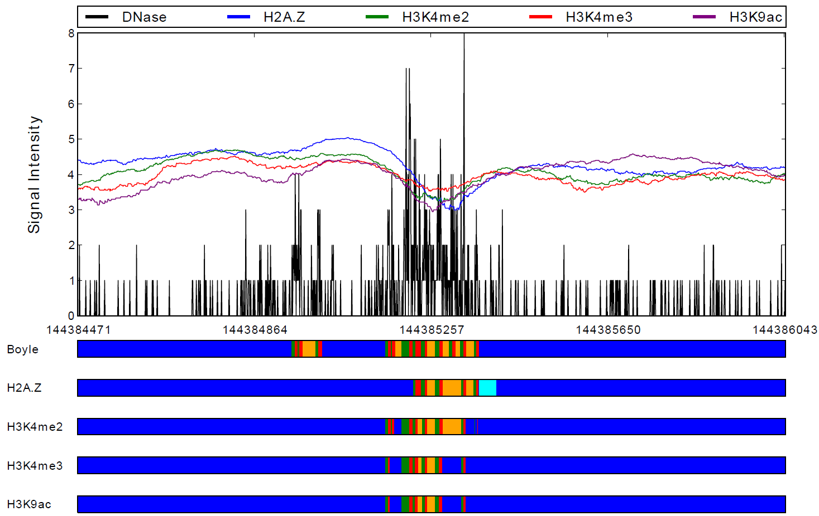
Results
BACK
HH
UP
DOWN
Sample Footprint Graph
FP
CTCF
REST
Notes:
This graph shows one of the forms our method has enhanced the results.
It shows Dnase signal (in black) and histone signal (in color) in a sample HS region on chromosome 6. The color bars show the HMM states at each bp based on this legend.
Here we can see that histone signals have masked two known FPs, predicted by the Boyle et al model.

Slide 18
Discussion
Preliminary work based on Boyle et al’s method
Increase in sensitivity with little decrease in specificity.
Activating histone marks:
Mask DNase-only FPs.
Find TPs in DNase-poor regions.
Simple bivariate model have shown that it is possible to integrate epigenetic data
Problem: Occasional wider predictions
Notes:
We have done a preliminary work based on Boyle et al’s method to verify if the integration of different epigenetic signals improves TFBS prediction.
Our method has increased sensitivity with little decrease in specificity.
It was observed that the addition of activating histone marks have both masked some false DNase-only predictions and found many TPs in DNase-poor regions.
This integrative approach generated interesting results, however we observed that some predicted regions were wider than intended.

Slide 19
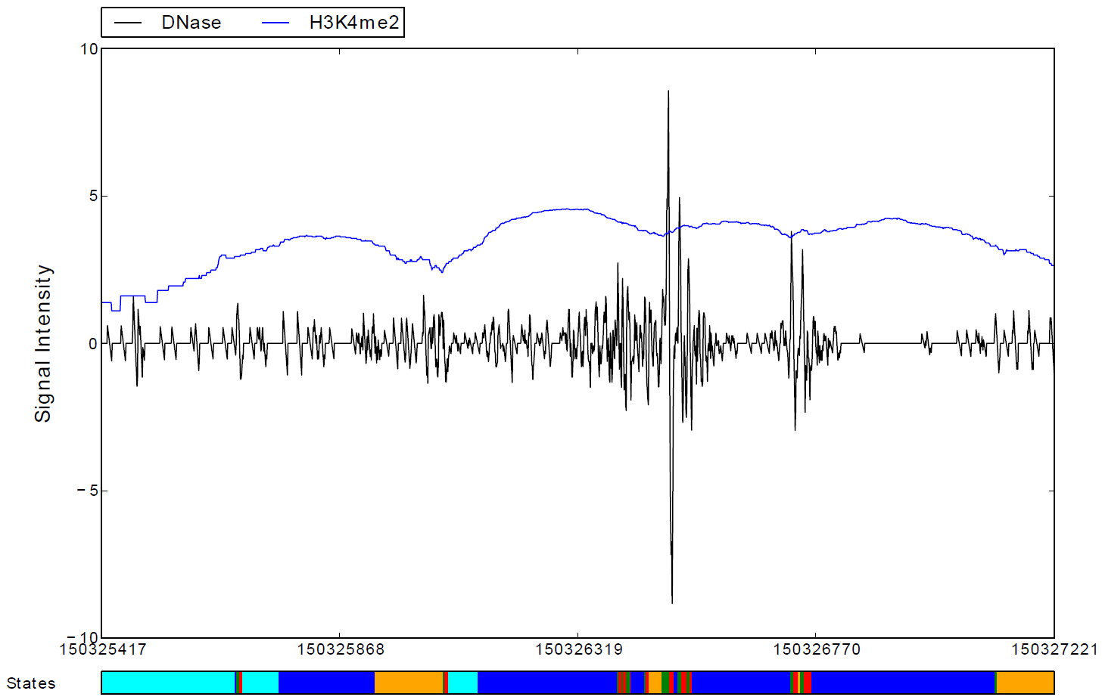
Discussion
BACK
HH
UP
DOWN
FP
Notes:
This graph, containing the DNase and dimethylation of the fourth lysine of histone 3, shows an example of these wider predictions.
The goal was to identify specific TFBS locations such as these, however the histone dips plus a low Dnase signal has allowed some wider regions, such as this and this, to occur.

Slide 20
Future Works
Improve signal processing and training
Perform the analysis on a greater number of:
Cell Lines
Histone Modifications
Transcription Factors
Increase dimensionality / add other data sources
Histone modifications
FAIRE (Formaldehyde-Assisted Isolation of Regulatory Elements)
Motif matching scores
Notes:
Finally, we plan to continue this study, specially on the following topics.
Improve signal processing (normalization and corrections) and model training.
Perform the analysis on a greater number of cell lines, histone modifications and TFs.
And our main goal at this time is to increase the model’s dimensionality by adding more than one histone modifications and possibly adding other epigenetic data sources such as FAIRE (Formaldehyde-Assisted Isolation of Regulatory Elements) or genomic data such as the motif matching scores.

Slide 21
Prediction of Transcription Factor Binding Sites by Integrating DNase digestion and Histone Modification
Brazilian research agencies:
CNPq – CAPES - FACEPE
Thank you!
Eduardo G. Gusmão, Christoph Dieterich and Ivan G. Costa
Notes:
Thank you. I would like to thank the brazilian research agencies CNPq, CAPES and FACEPE.

