Slide 1
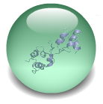
HNF6
Binds
+/- 20kbs
TSS
HNF6 Targets
5123
780 ES genes
Clusters - I,II,V
1437 PP Genes
Clusters - III,VIII,IX

