Slide 1
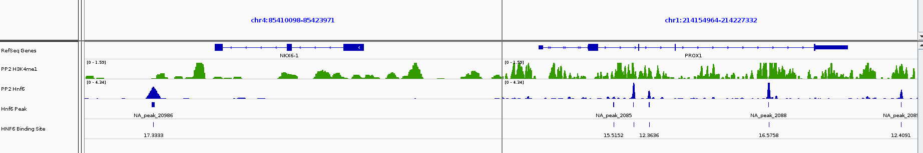
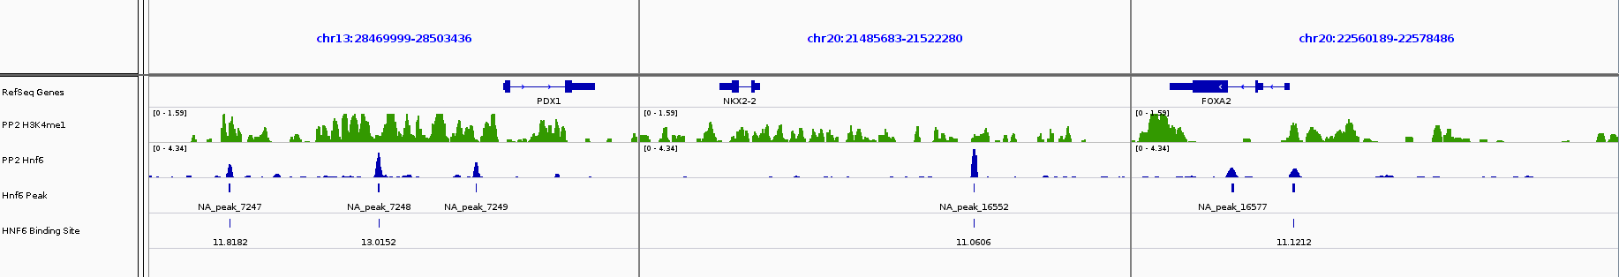
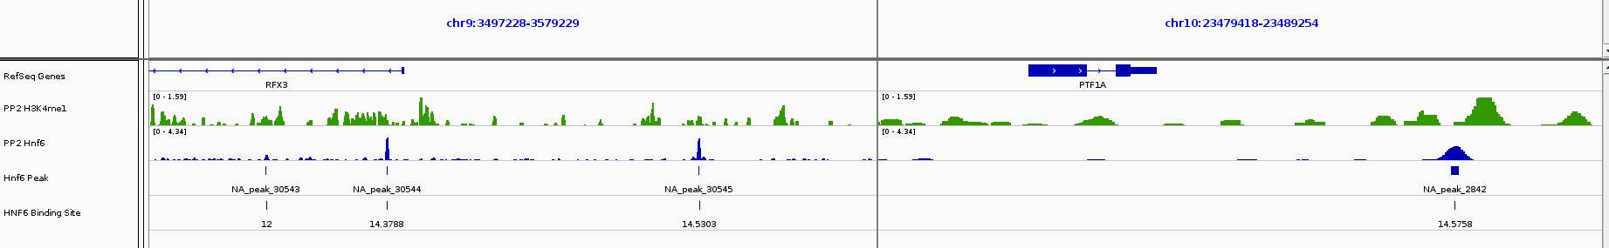
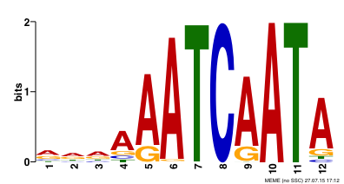
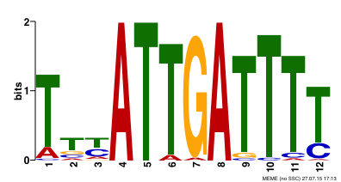
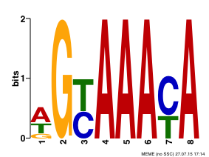
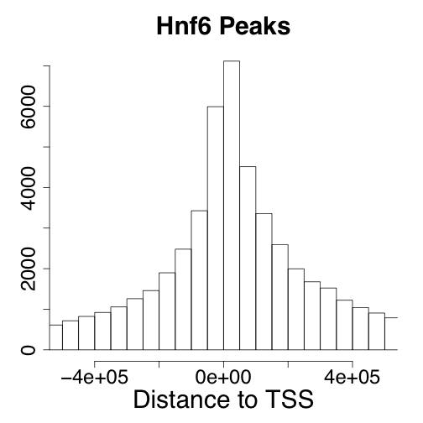
1 a
1 b
Hnf6 (494)
Pbx1(37)
Foxa1, Foxa2 (109)
1 c
Improve fig. quality final candidates are selected

Slide 2
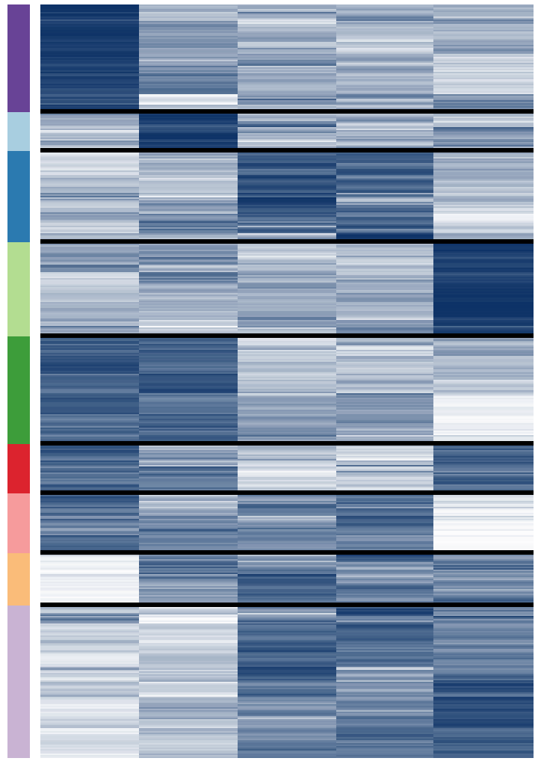
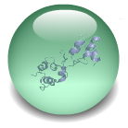
2 a
I - ES
II - DE
III - PP
NKX6-1
PTF1A
IV- BC
NKX2-2
V - ES/DE
VI - ES/DE/BC
VII - ES/DE/PP
VIII - DE/PP/BC
FOXA2
IX- PP/BC
PROX1
PDX1
RFX3
ES
DE
PP1
PP2
BC
2 b
2 c
**
HNF6
Binds
+/- 20kbs
**
TSS
Z-score
*
HNF6 Targets
5123
**
V - ES/DE
I-ES
VI - ES/DE/BC
VII - ES/DE/PP
II – DE
IV - BC
III - PP
VIII - DE/PP/BC
IX - PP/BC
**
780 ES genes
Clusters - I,II,V
1437 PP Genes
Clusters - III,VIII,IX

Slide 3
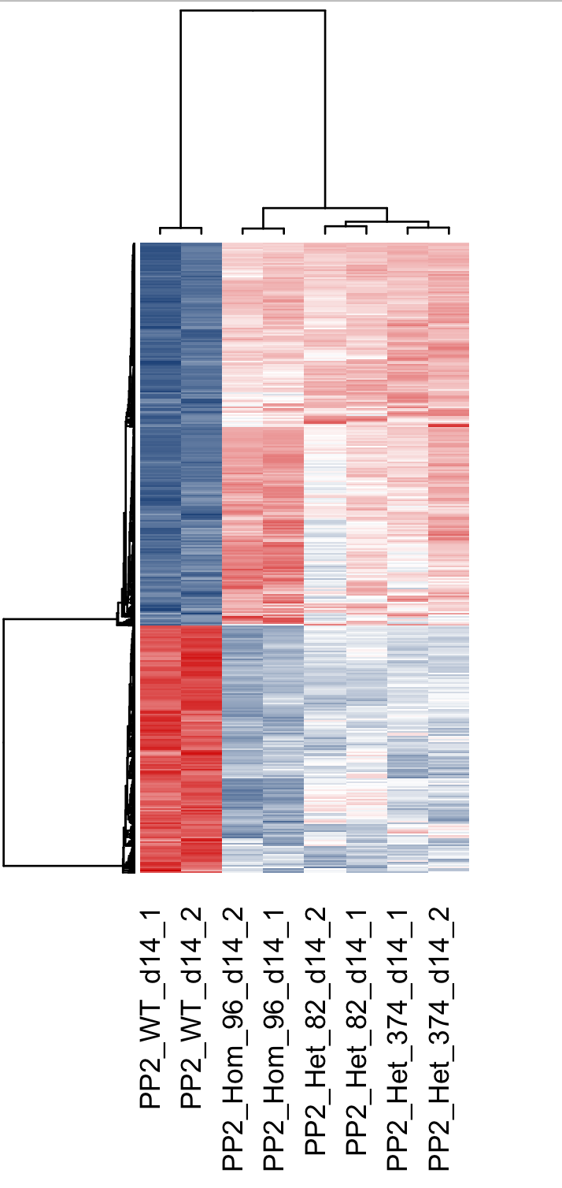
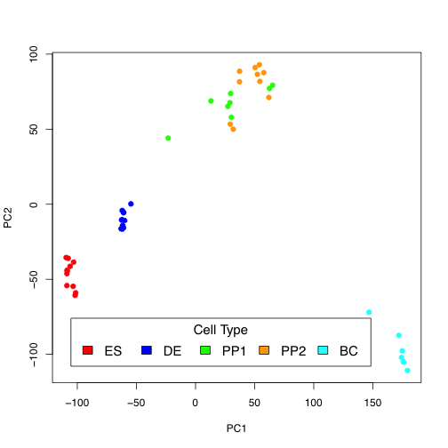
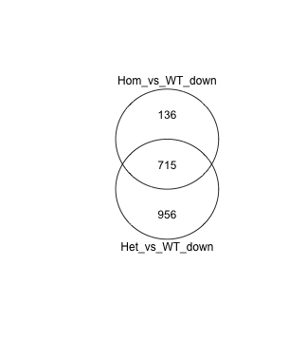
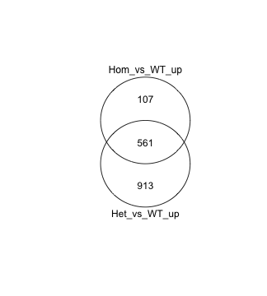
3 a
Hom.
Het
WT
Hom.
Het
3b
Qiong will improve fig. quality and labels
PP2
GO:0001501~skeletal system development
GO:0048598~embryonic morphogenesis
GO:0048568~embryonic organ development
GO:0048562~embryonic organ morphogenesis
GO:0048706~embryonic skeletal system development
GO:0031018~endocrine pancreas development
GO:0031016~pancreas development
GO:0045165~cell fate commitment
GO:0035270~endocrine system development
GO:0034728~nucleosome organization
GO:0006334~nucleosome assembly
GO:0031497~chromatin assembly
3c

